Slide 1
Genetics and Genome Evolution (GGE)
Bioinformatics for Genomics
Lecture 2:
Clustering
Sven Bergmann
Department of Computational Biology
(Sven.Bergmann@unil.ch)

Slide 2
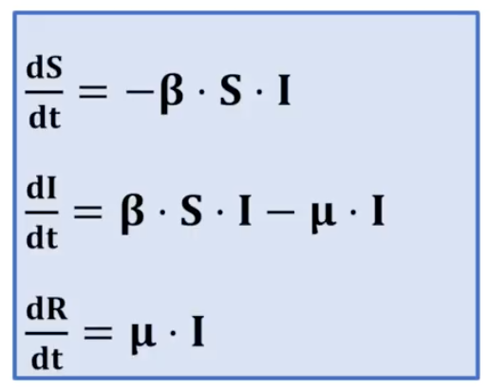

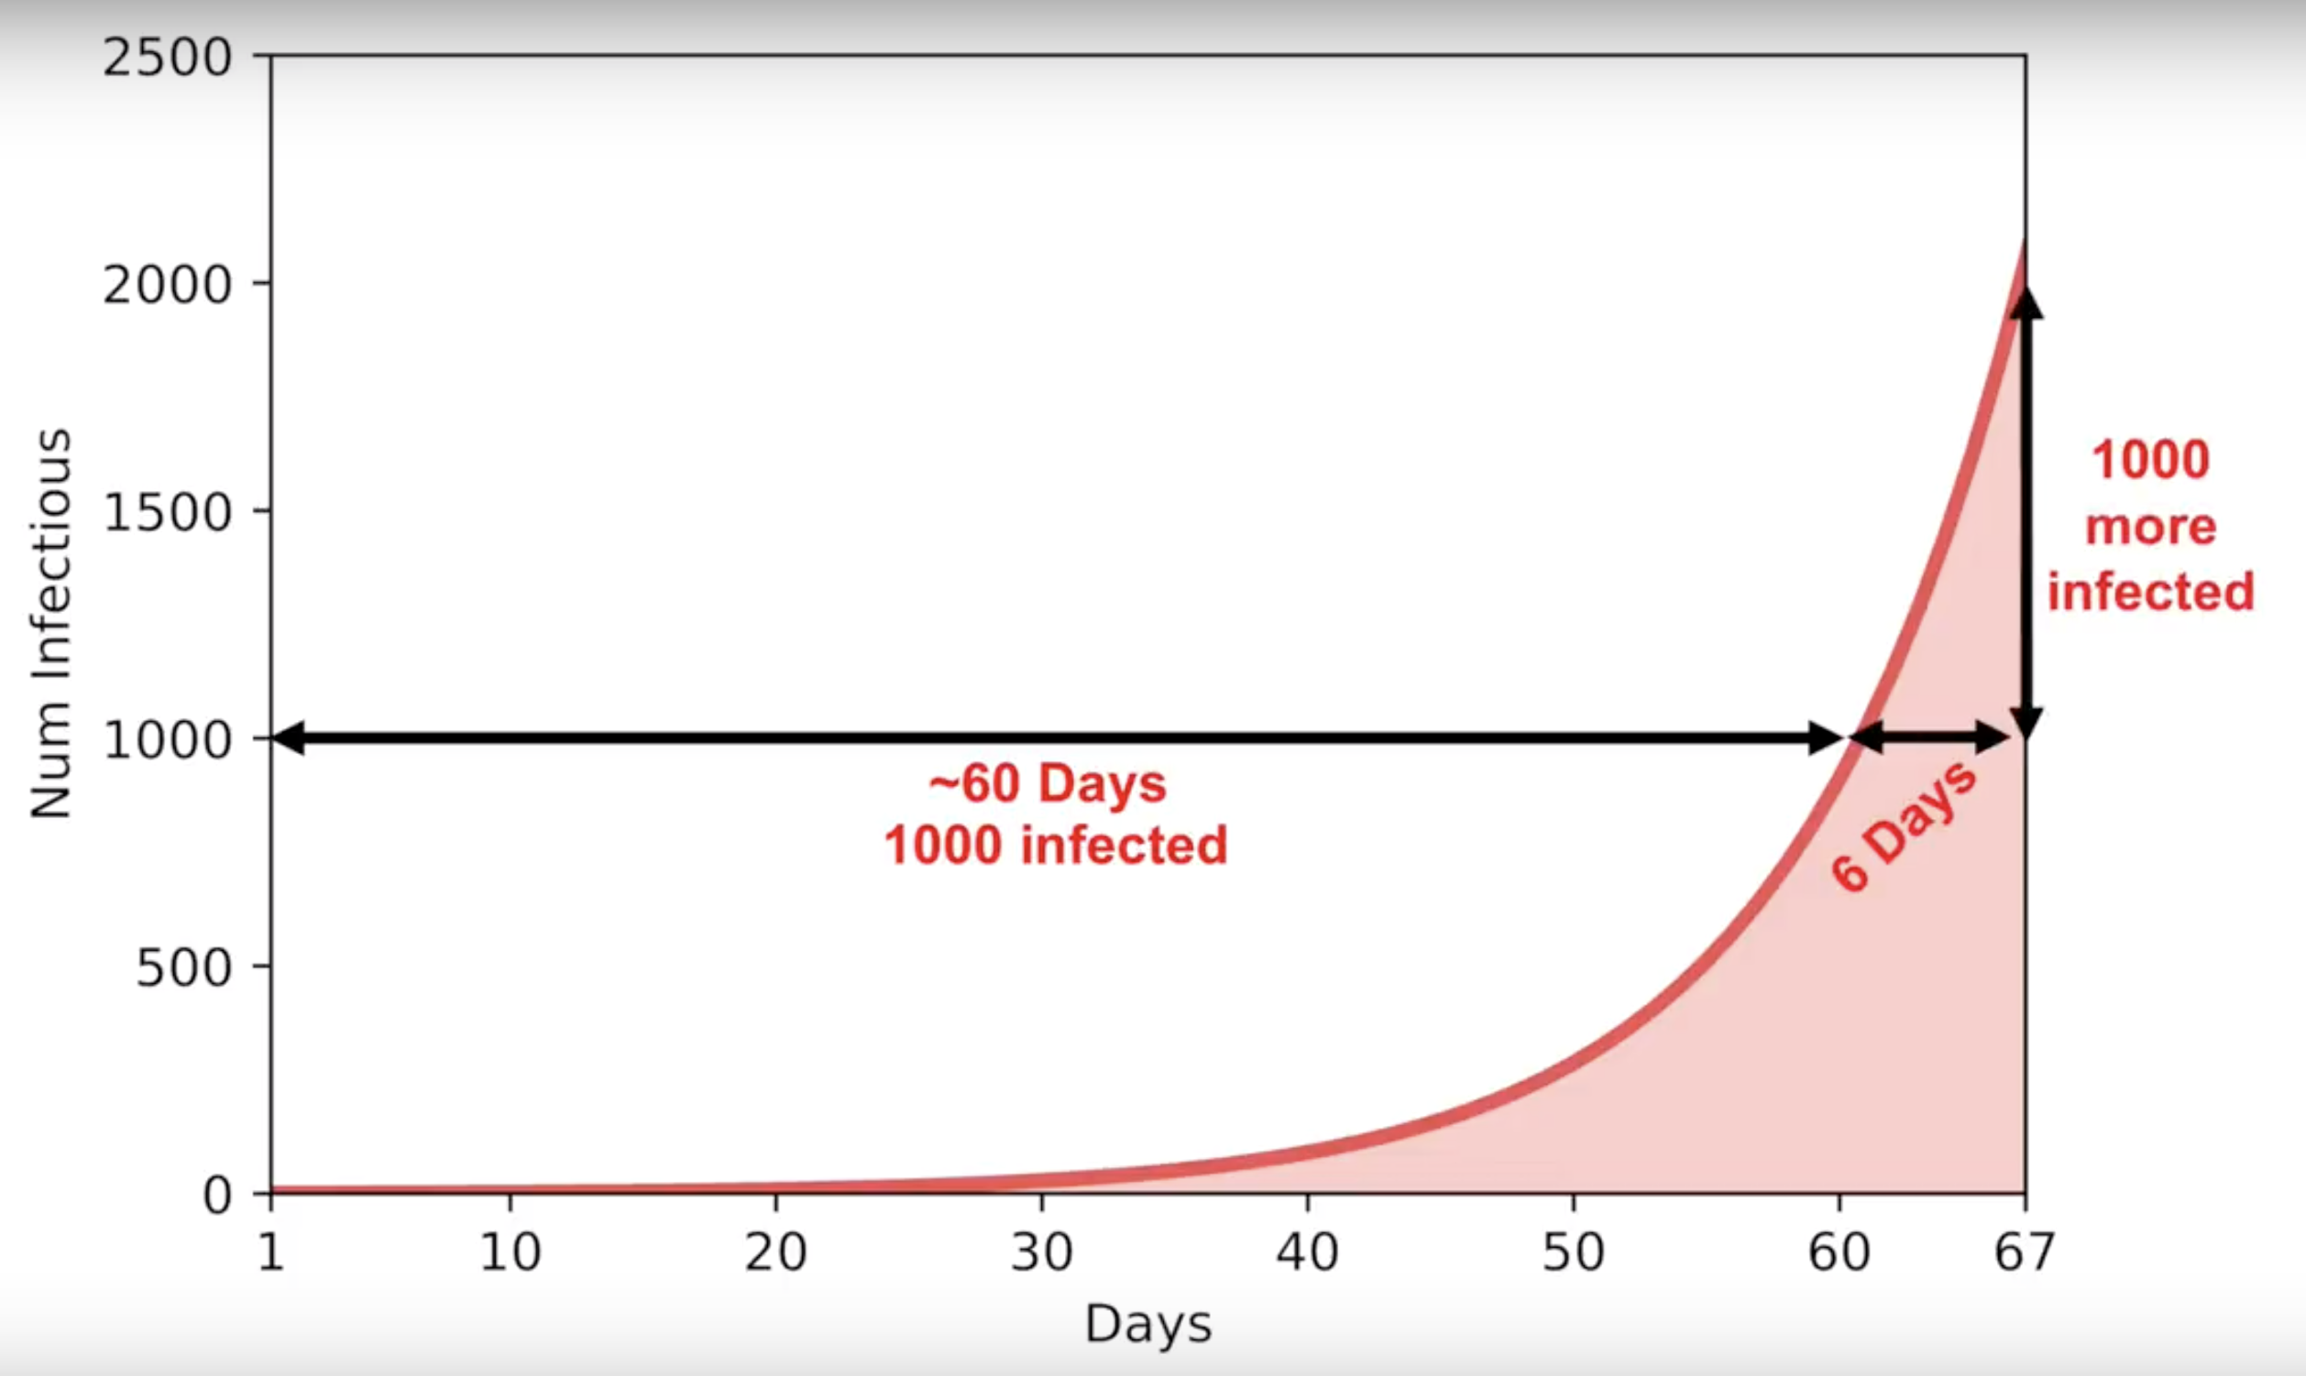
Covid-19
https://www.youtube.com/watch?v=_dXygGFCplk

Slide 3
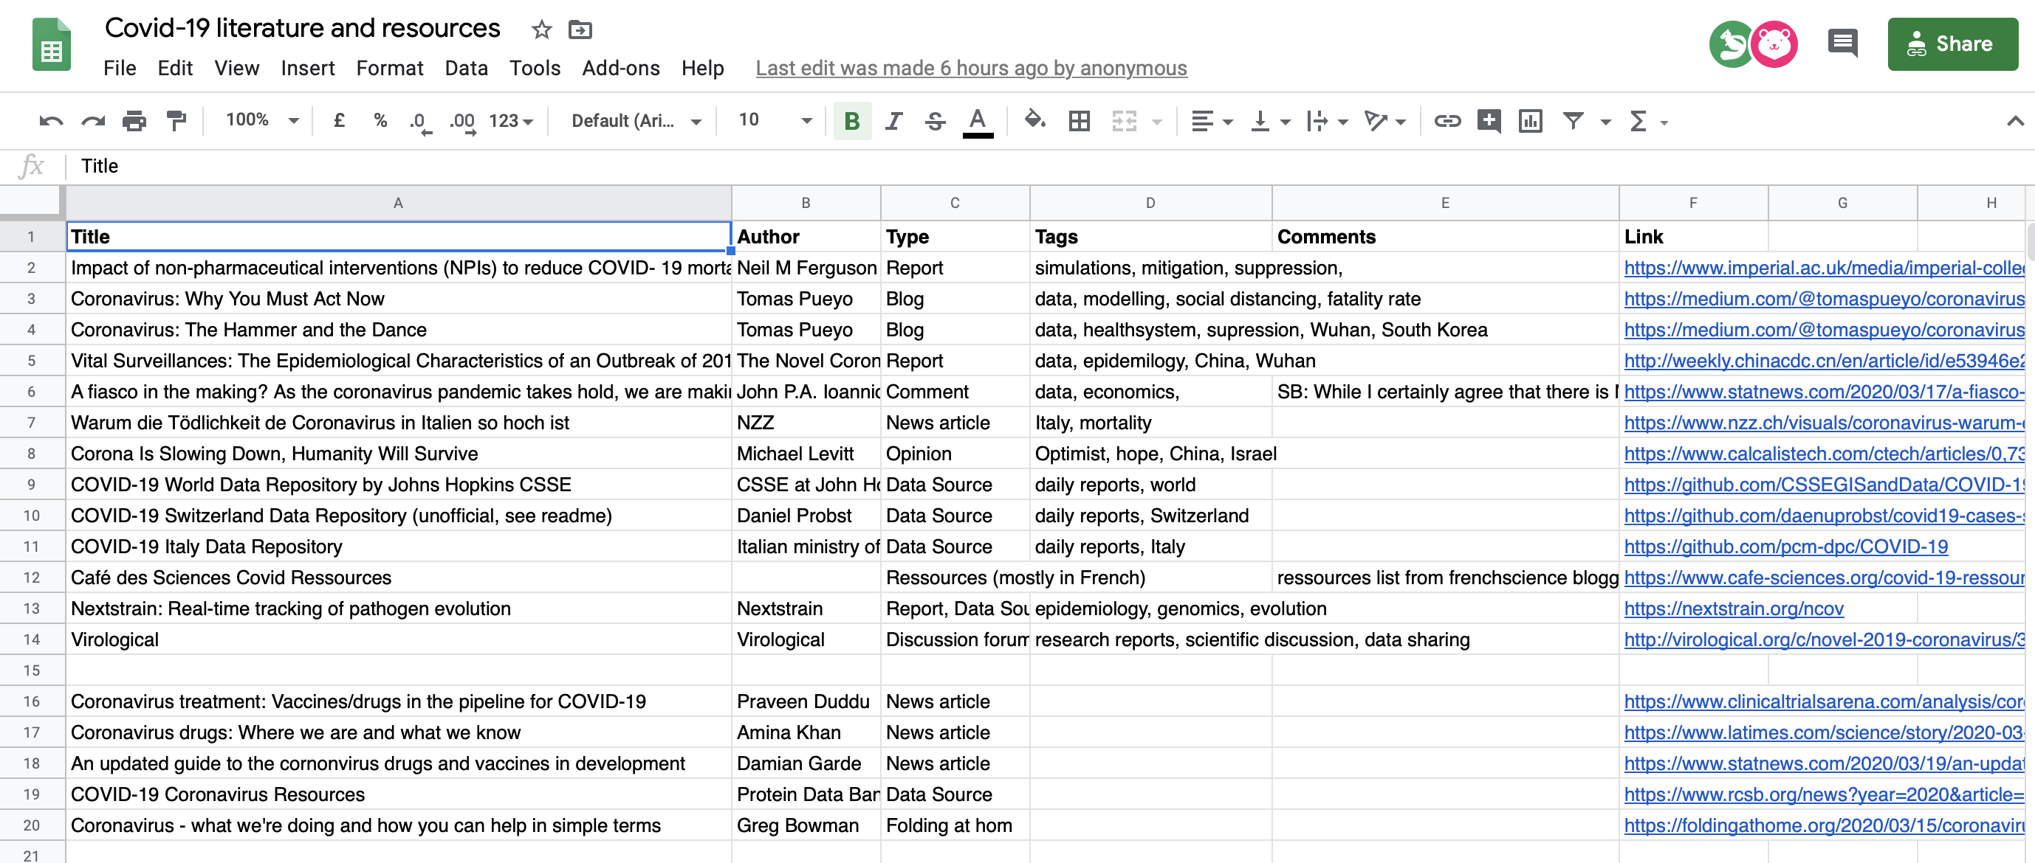
Covid-19
Very hard to find reliable information ...
https://docs.google.com/spreadsheets/d/1IQ9ASLLhvfRYv_k82nnUc65dMqhyLMUiMSBC-HpM8cA/edit?usp=sharing

Slide 4
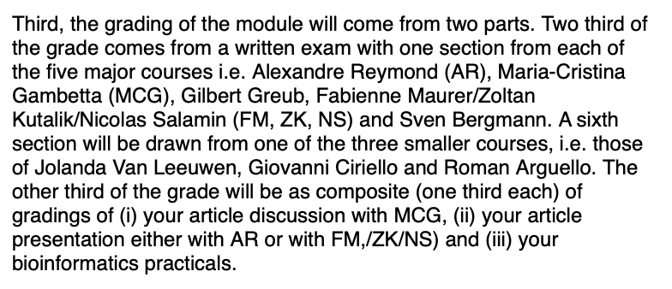
GGE Grading

Slide 5
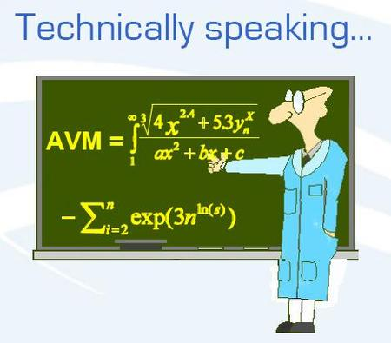
Analysis tools for large datasets
Standard tools
k-means, PCA, SVD
Modular analysis tools
CTWC, ISA, PPA

Slide 6
Motivations
Why to study a large heterogeneous set of expression data?
  Large: Better signals from noisy data!
  Heterogeneous: Global view at transcription program!
Supervised vs. unsupervised approaches
  Large genome-wide data may contain answers to questions we do not ask! Need for both hypothesis-driven and exploratory analyses!

Slide 7
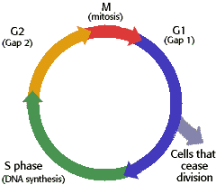
How to get large-scale expression data?
Pool genome-wide expression measurements from many experiments!
cell-
cycle
large-scale
expression data
stress
genes
sets of specific conditions
diverse conditions

Slide 8

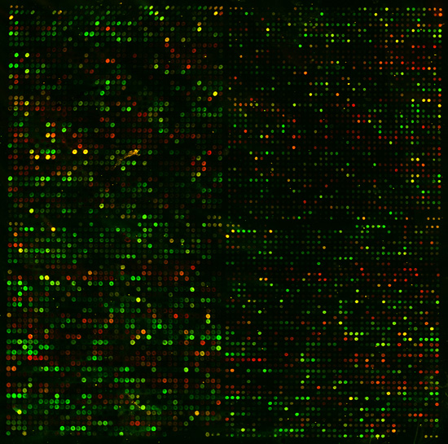
How to make sense of millions of numbers?
Hundreds of samples
Thousands
of genes
New Analysis and Visualization Tools are needed!

Slide 9
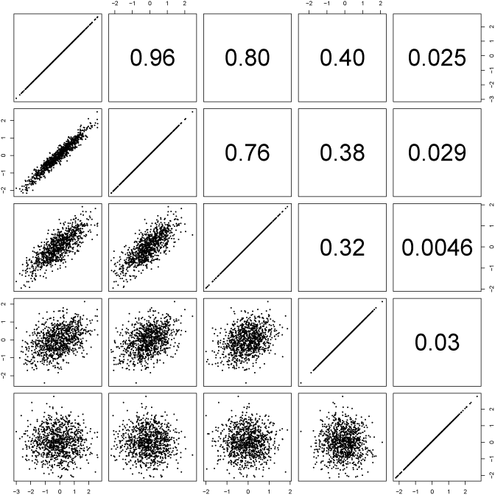
Pearson correlations (Graphic)
Each box is plotting
the values in x_{i} against those in y_{j}
Y = (y_{i})
X = (x_{j})
Comparing profiles X and Y (not distributions!):
What is the tendency that high/low values in X match high/low values in Y?
http://davidmlane.com/hyperstat/A34739.html

Slide 10


Pearson correlations: Formulae
r
(complicated version)
(simple version using z-scores)

Slide 11



Pearson correlations: Intuition
Similarity according to all conditions
(“Democratic vote”)
conditions
gene
1
r₁₂ ~ 1
2
1
2
3
4
5
Clustering-coefficient
gene
1
r₁₂ ~ 0
2
1
2
3
4
5
gene
1
r₁₂ ~ -1
2
1
2
3
4
5

Slide 12
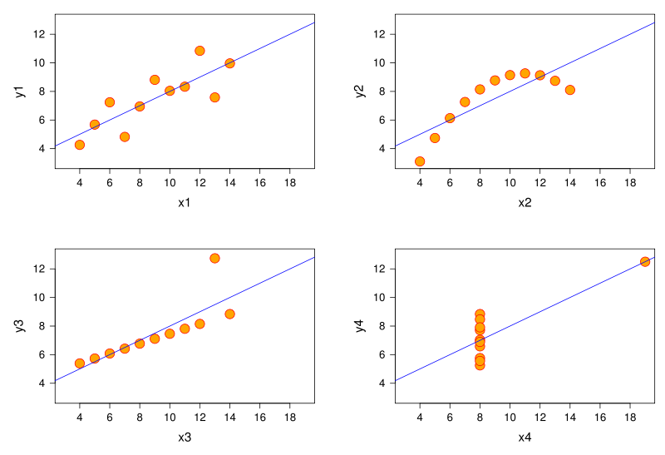
Pearson correlations: Caution!
r=0.8
r=0.8
r=0.8
r=0.8
High correlation does not necessarily mean co-linearity!

Slide 13
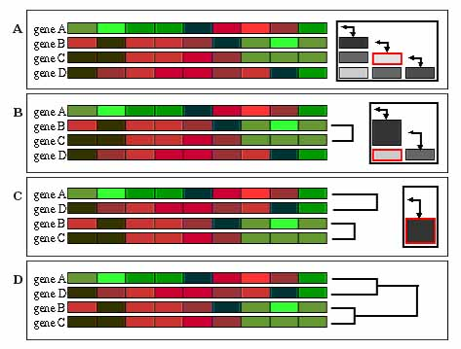
(Hierarchical Agglomerative) Clustering
Join most correlated samples and replace correlations
to remaining samples by average, then iterate …
http://gepas.bioinfo.cipf.es/cgi-bin/tutoX?c=clustering/clustering.config

Slide 14
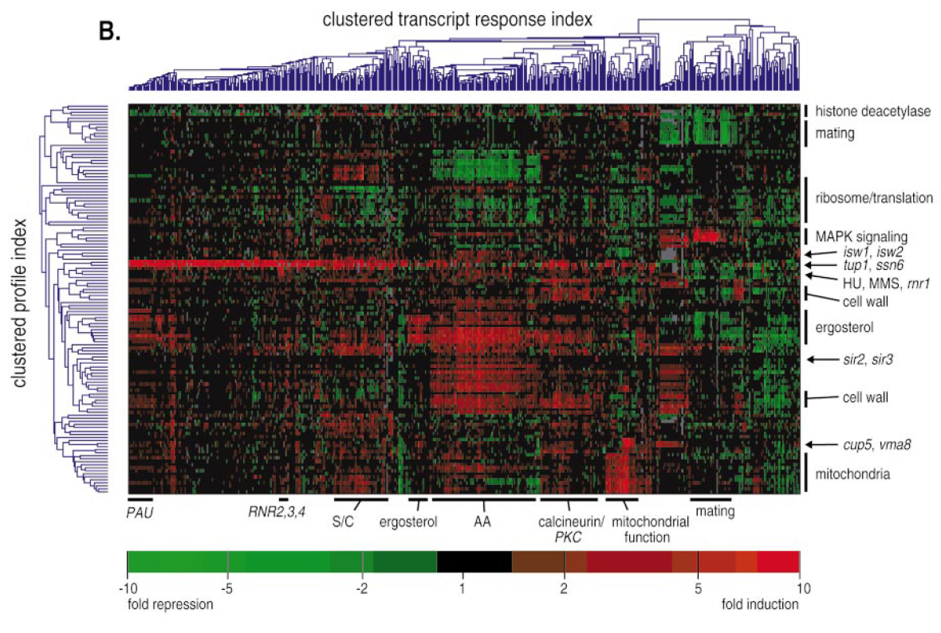
Clustering of the real expression data

Slide 15
K-means Clustering
“guess” k=3 (# of clusters)
http://en.wikipedia.org/wiki/K-means_algorithm

Slide 16
K-means Clustering
“guess” k=3 (# of clusters)
1. Start with random positions of centroids ( )
http://en.wikipedia.org/wiki/K-means_algorithm

Slide 17
K-means Clustering
“guess” k=3 (# of clusters)
1. Start with random positions of centroids ( )
2. Assign each data point to closest centroid
http://en.wikipedia.org/wiki/K-means_algorithm

Slide 18
K-means Clustering
“guess” k=3 (# of clusters)
1. Start with random positions of centroids ( )
2. Assign each data point to closest centroid
3. Move centroids to center of assigned points
http://en.wikipedia.org/wiki/K-means_algorithm

Slide 19

K-means Clustering
“guess” k=3 (# of clusters)
1. Start with random positions of centroids ( )
2. Assign each data point to closest centroid
3. Move centroids to center of assigned points
Iterate 1-3 until minimal cost
with k clusters S_{i}, i = 1,2,...,k and centroids μ_{i} (the mean point of all the points )

Slide 20
K-means Clustering
Plus:
visual
intuitive
relatively fast
Minus:
have to “guess” number of clusters
can give different results for distinct
“starting seeds”
distances computed over all features
one cluster only per element
no cluster hierarchy

Slide 21
Hierachical Clustering
Plus:
Shows (re-orderd) data
Gives hierarchy
Minus:
Does not work well for many genes
(usually apply cut-off on fold-change)
Similarity over all genes/conditions
Clusters do not overlap

Slide 22
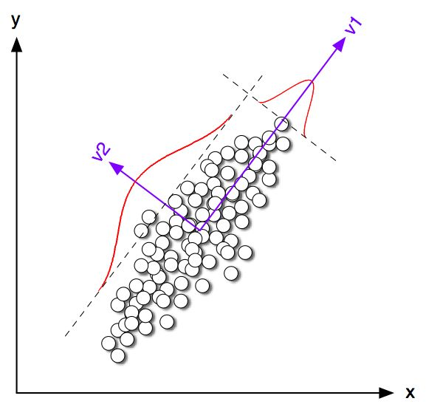
Principle Component Analysis
Principle components (PCs) are projections onto
subspace with the largest variation in the data
http://csnet.otago.ac.nz/cosc453/student_tutorials/principal_components.pdf

Slide 23
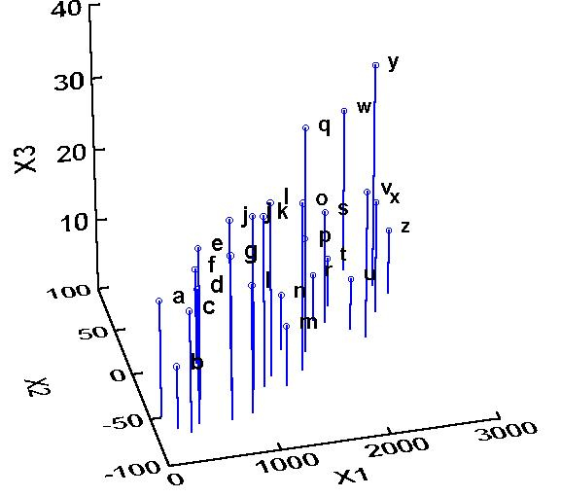
Example: 2PCs for 3d-data
Raw data points: {a, …, z}
http://ordination.okstate.edu/PCA.htm

Slide 24
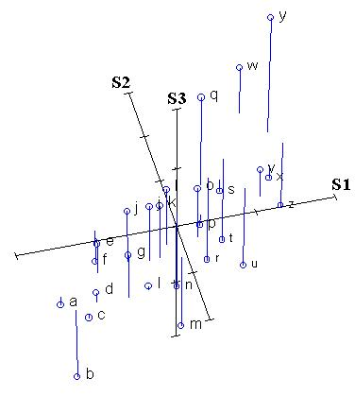
Example: 2PCs for 3d-data
Normalized data points: zero mean (& unit std)!
http://ordination.okstate.edu/PCA.htm

Slide 25
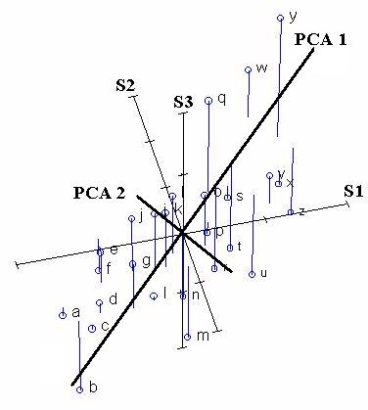
Example: 2PCs for 3d-data
The direction of most variance perpendicular to PCA1 defines PCA2
Most variance is along PCA1
Identification of axes with the most variance
http://ordination.okstate.edu/PCA.htm

Slide 26
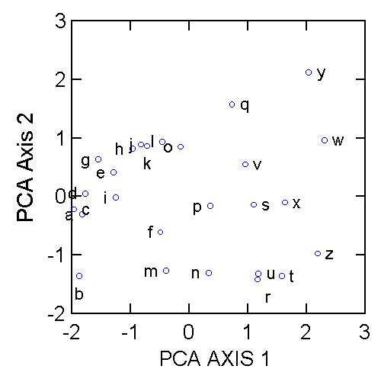
Example: 2PCs for 3d-data
Cluster?
http://ordination.okstate.edu/PCA.htm

Slide 27

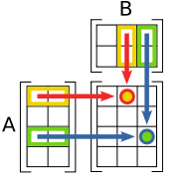


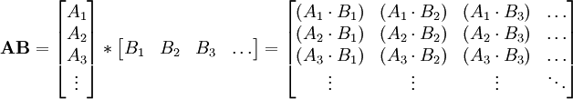

Reminder: Matrix multiplications
Definition:
Scheme:
Vectorized:
Example:
http://en.wikipedia.org/wiki/Matrix_multiplication

Slide 28
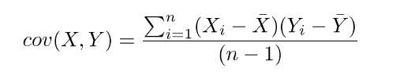
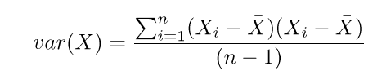
How do we get the PCs?
The PCs are the eigenvectors of the covariance matrix C computed from the (mean-centered) data matrix E:
C = E^{T}·E /(n-1)
C·pc = λ·pc

Slide 29
PCA: Example expression data
1
160
1
30k
1
160
C
=
E^{T}
·
E
C = E^{T}·E /(n-1)
160
160
/(n-1)
30k
1
160
1
λ
1
C·pc = λ·pc
C
·
=
·
160
160
pc
160

Slide 30
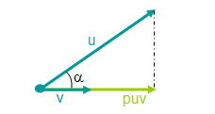
And how to project?
The projected data is just the product of the original data with the PCs:
E’ = E · PC
Principle Component or Transformation Matrix:
PC = [pc₁, pc₂, …, pc_{n}]
(where n is the number of PCs used)

Slide 31
PCA: Example expression data
1
n
1
160
1
E’
E
…
E’ = E · PC
=
·
1
2
n
160
30k
30k
The original gene expression profiles are for 30k genes over 160 samples.
The transformed data contain projections on n “eigen-genes”
(linear combinations of the 160 samples shown in red)

Slide 32
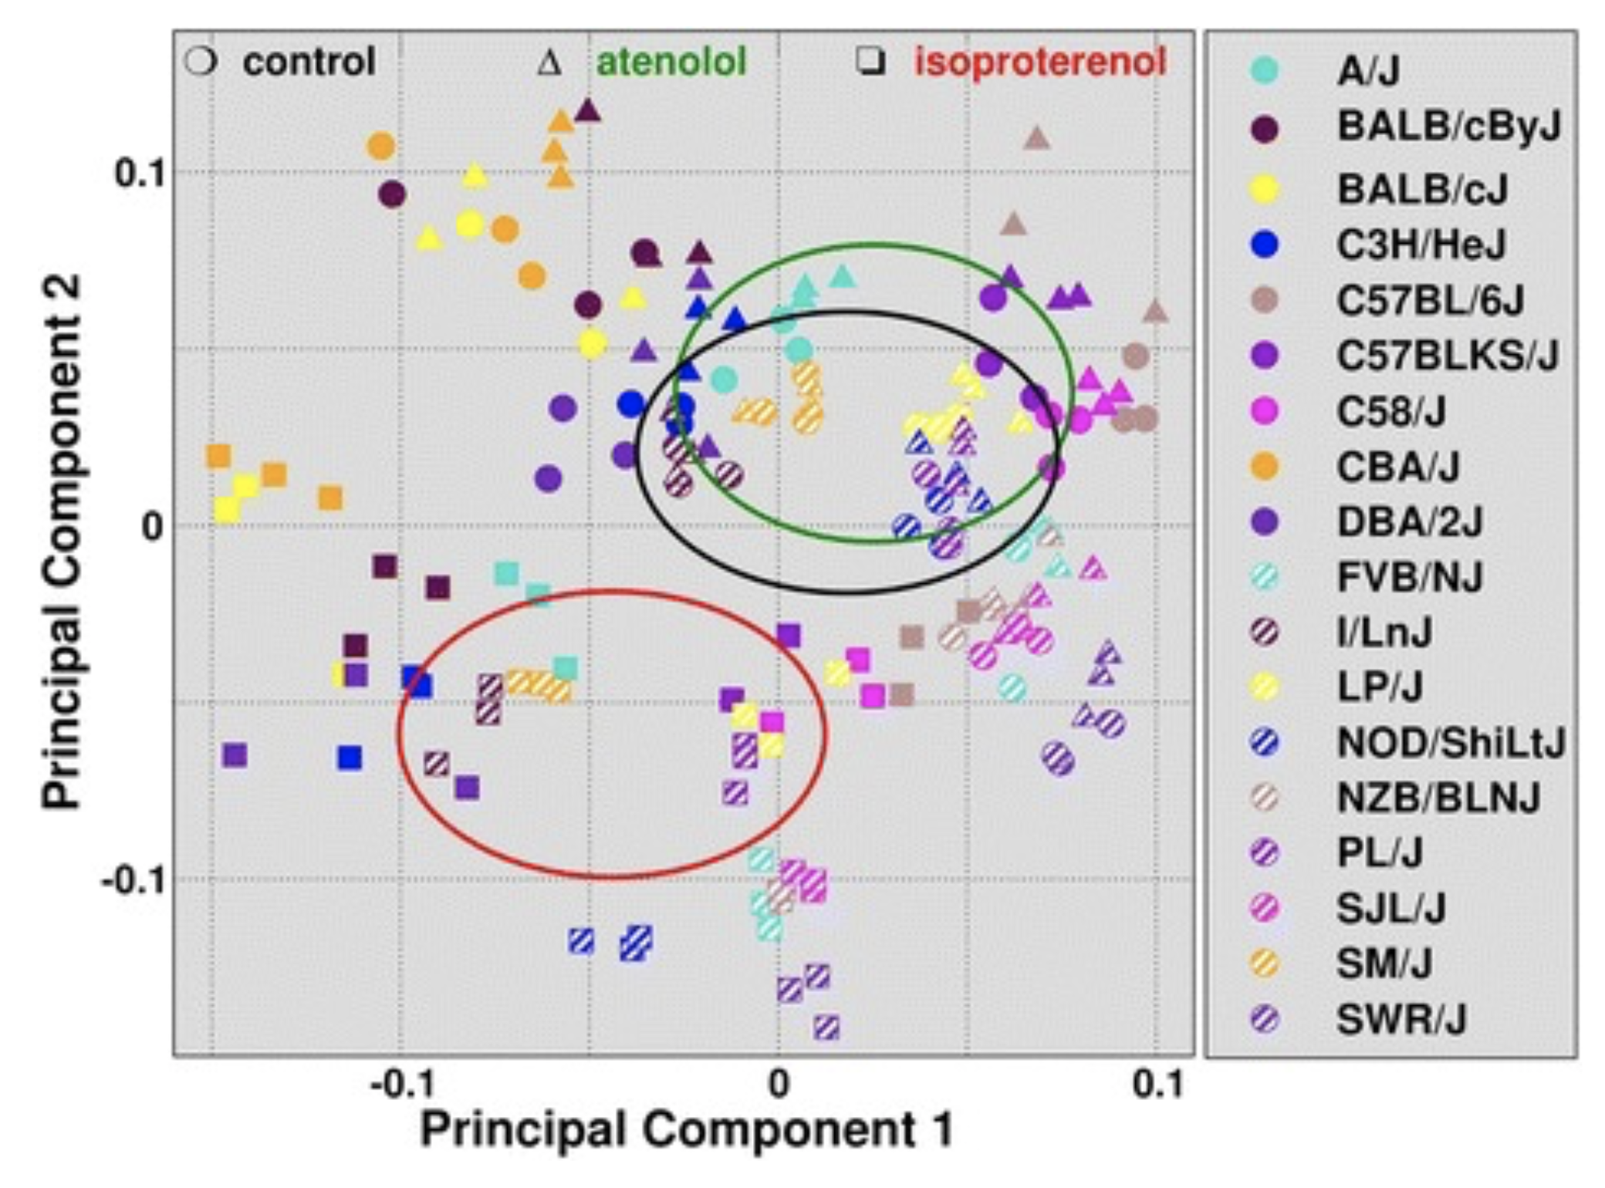
PCA: Example expression data
The first 2 “eigen-genes” separate iso treated mice

