Slide 1
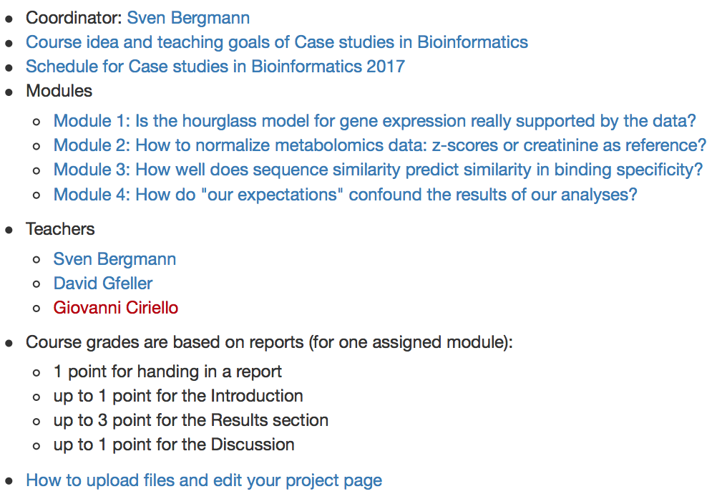
www.unil.ch/cbg
(http://www2.unil.ch/cbg/index.php?title=UNIL_MSc_course:_%22Case_studies_in_bioinformatics_2017%22)

Slide 2
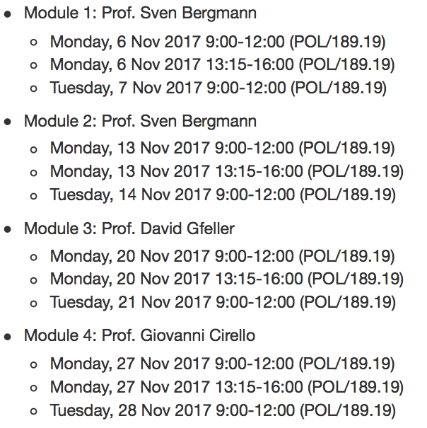
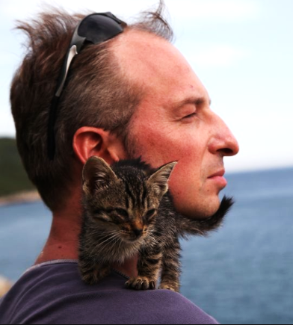
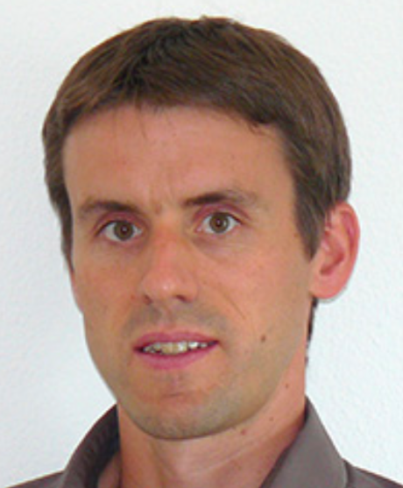
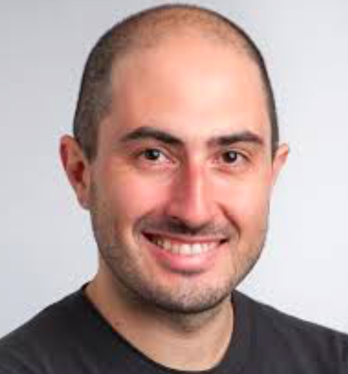
Sven
David
Giovanni

Slide 3
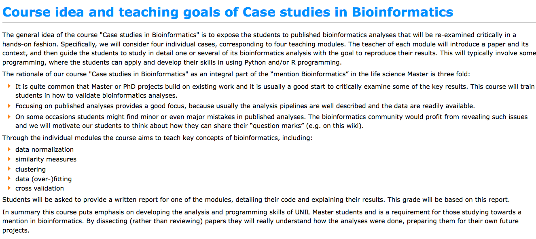
“… published bioinformatics analyses will be reexamined critically in a hands-on fashion.”
“… quite common that Master or PhD projects build on exiting work.”
“… provide written report on one of the modules”
“ this course puts emphasis on developing the analysis and programming skills”

Slide 4
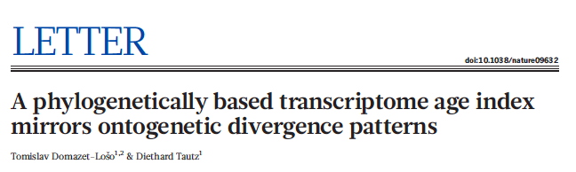
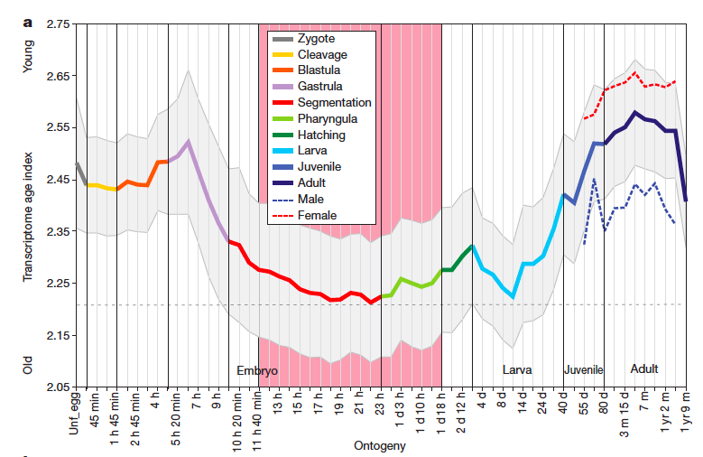
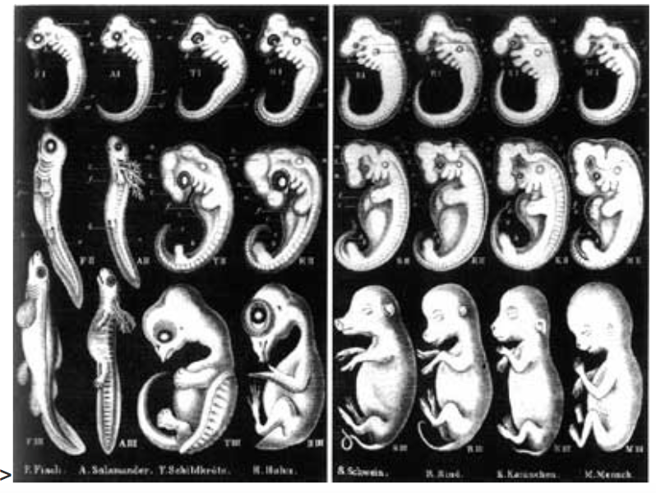
Module 1:
Is the hourglass model for gene expression
really supported by the experimental data?
?

Slide 5
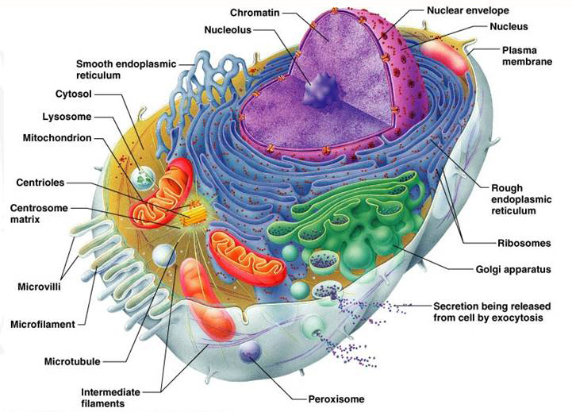
Module 3:
Binding specificity in protein interactions
proteins
Lipids
RNA
ions
DNA
Metabolites
Notes:
Biological systems are extremely complex with thousands of proteins and other molecules in every cell. A key property of these proteins is their ability to bind to their cognate partners with high specificity, despite the sea of other molecules that are surrounding them. Understanding how different proteins recognize their partners is therefore fundamental to have a complete view of cellular mechanisms.

Slide 6
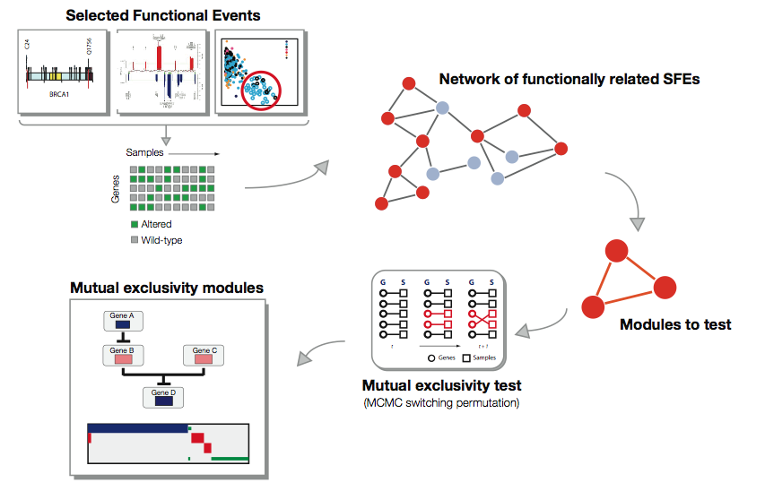
What will you learn:
The problem
Why certain alterations in cancer are mutually exclusive? And why it is interesting to identify them?
The approach
How do we identify mutually exclusive alterations?
The computational challenge
How our assumptions on “what is expected” (null model design) affect our results?

Slide 7
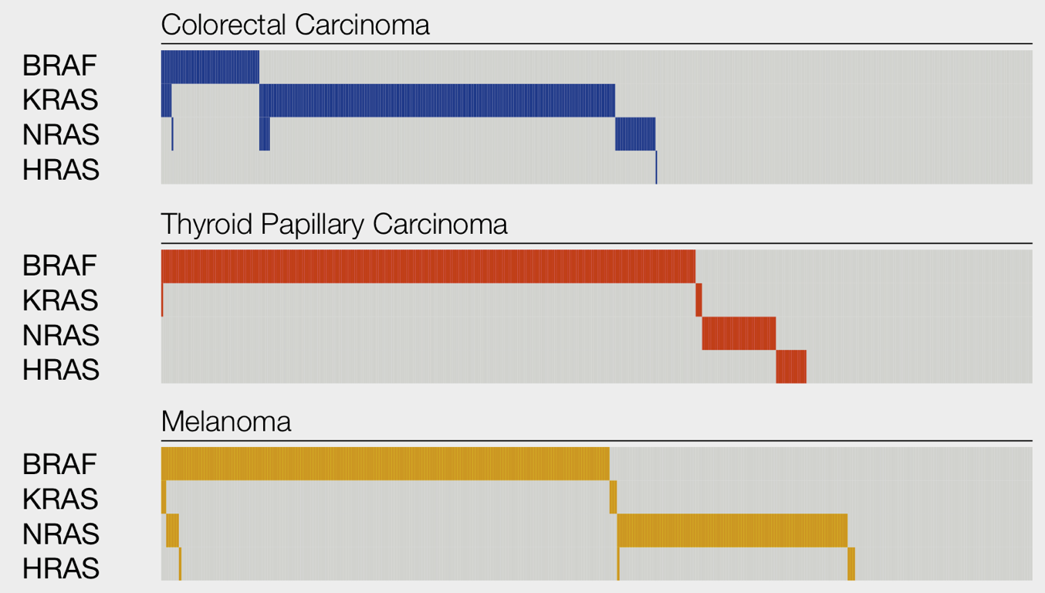
Module 4:
Significant mutual exclusivity between alterations in cancer
KRAS
HRAS
NRAS
BRAF
CANCER

Slide 8
What you will learn
How to model protein-protein interactions and binding specificity (probabilistic model).
How to cluster proteins based on different properties (sequence similarity / binding specificity).
How to predict new protein interactions using the sequence of proteins.
ESFLTWL
Notes:
Here we will see how one can model the binding specificity of some proteins using only sequence information. We will also see how we can use these models to classify proteins, not only based on their sequence but also based on their functional properties. Finally we will briefly discuss how we can use this information to predict new protein-protein interactions.

Slide 9
Module 1:
Is the hourglass model for gene expression
really supported by the experimental data?
?

Slide 11
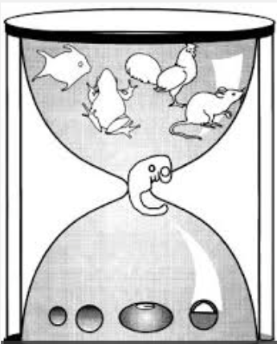

Slide 13
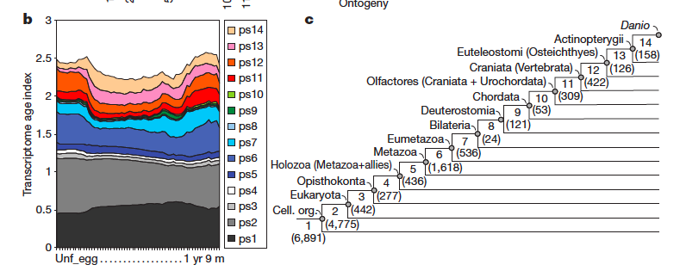

Slide 14
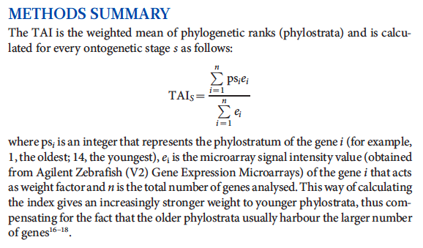

Slide 15
Let’s get going!
Task 1: Get the relevant data
  Gene expression data (GSE24616)
  Age index (aka ps=phylostrata)
Task 2: Compute TAI
  Convert expression data from probe to genes
  Match genes IDs across the 2 datasets
  Compute weighted sum
Task 3: Reproduce Figure 1a
Task 4: Critical re-analysis

Slide 16
Module 1: Is the hourglass model for gene expression really supported by the data?

Slide 17
Find data on the web
Look for python package for Gene Expression Omnibus Database (GEO)
Age index??

Slide 18
Import data and extract relevant information
Steps:
  Install and import python packages
  Download experiments data used in the paper
  Save them with a variable name (for example gse)
An example can be find on: https://geoparse.readthedocs.io/en/latest/Analyse_hsa-miR-124a-3p_transfection_time-course.html

Slide 19
Look to the gse data
  PLATFORM (gpls) and SAMPLE (gsms) of GEOparse object:
    Type of data
    Information inside
      Metadata?
      Columns?
      Table?
            Useful command: head()

Slide 20
>>> gse.gsms['GSM607008'].head()
SAMPLE GSM607008
- Metadata:
!Sample_title = adult_1y2m_male_rep2
!Sample_geo_accession = GSM607008
!Sample_characteristics_ch1 = strain: wild type
!Sample_characteristics_ch1 = developmental stage: adult
!Sample_characteristics_ch1 = developmental timing: 1y2m
- Columns:
description
ID_REF
VALUE processed Cy3 signal intensity
- Table:
Index ID_REF VALUE
0 1 20457.390000
1 2 2.546218
2 3 2.938484
3 4 9.200152
4 5 2.611924

Slide 21
Sample information extraction
Info needed for reproduce figure:
  Sample name
  Stage
  Time
  Gender (only female and mixed are used)
        Hint: Look into the metadata
          characteristics_ch1
          name

Slide 22
Steps
Create an empty dictionary
Using a for loop, fill the dictionary with the information for each sample
        Useful command:
          append()
          split()
          strip()

Slide 23
Expression data
Extract information for only one sample
  Example:
    gsm = gse.gsms['GSM607008']
Extract information for all samples
  Hint:
    GEOparse documentation
    GEOparse example

Slide 24
expression_data = gse.pivot_samples('VALUE')

Slide 25
Match age index and expression data
Look at the data and find the information allowing the match between the two dataset
  Hint: rename rows in both dataset
Match dataset:
  Useful command
    join()
    groupby()
    last()

Slide 26
Select data
One gene can have multiple probes
  For multiple probes take the mean
    Useful command:
      groupby()
      mean()
Only use mixed and female sample
    Hint: create a data frame of the characteristics and select mixed and female sample
Create a new column classifying the time line of the development

Slide 27
Need to give code (probably)
#### sort time
char_df_mixed['timing_number'] = 0
time_stamps = char_df_mixed.time.unique()
for i in range(len(time_stamps)):
char_df_mixed.loc[char_df_mixed.time==time_stamps[i],'timing_number'] =i+1

Slide 28
Select sample with similar time point and average them
Useful command to select sample ID
  reset.index()
  groupeby()
  apply(lambda x: np.array(x))
Useful command to calculate the mean
  for loop

Slide 29
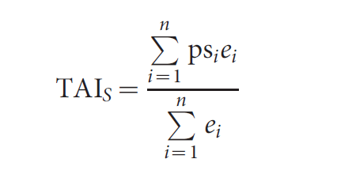
Calculate the TAI index

