Slide 1
Sven’s 10 Golden Rules for a good presentation available at: http://goo.gl/TXTvrz (or google title) Sven.Bergmann@unil.ch

Slide 2
1. Never underestimate the ignorance of your audience!
Always assume that your audience has less background than what you’d hope for, talk to the outsider rather than the expert, and avoid jargon!

Slide 3
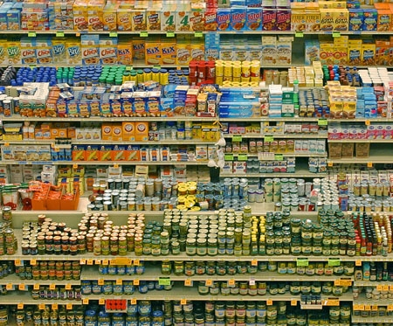
2. Introduce your topic quite general
Don’t try to impress your audience with petty details, concentrate on the big picture!

Slide 4
3. One message per slide!

Slide 5
4. Give an outline only for a longer talk
But always summarize your “take-home messages” even in a short presentation (<20 minutes).

Slide 6
5. Always have your name, e-mail (and web-site if you have one) on your first and last slide!

Slide 7
6. Never say what you will not talk about, rather use your time to say what you want to convey!

Slide 8
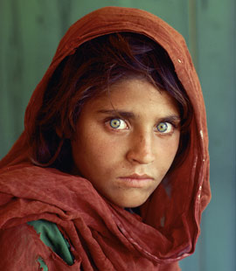
7. Use as little text as possible!
Pictures speak more than thousand words and are processed by most brains much faster!
If you really need some text to remind you what to say, don’t put it on the slide, use the comment function of Powerpoint! But do not read out a ready text, always speak freely!

Slide 9
8. For the little text you need use a big sans-serif font!
Arial, not Times, is easy to read.
Use high contrast colors!
A white background has the advantage that you'll have more light in the room such that less people fall asleep.
Always make sure that your slides can be easily viewed by the half-blind in the last row!

Slide 10
9. Look at your audience frequently, try to make eye-contact, and do not talk to your slides!

Slide 11
10. Avoid hiding behind a reading stand, be visible and stand in the spot light if there is any!

Slide 12
Sven’s 10 Golden Rules for a good presentation available at: http://goo.gl/TXTvrz (or google title) Sven.Bergmann@unil.ch

