Slide 1
Solving Biological Problems that require Math 2016
Identification of cell cycle-relevant gene modules in single-cell RNA-seq data
Adam Alexander T. SMITH
post-doc in ACM lab, UNIL

Slide 2
Biological Background:
lincRNAs & cell cycle

Slide 3
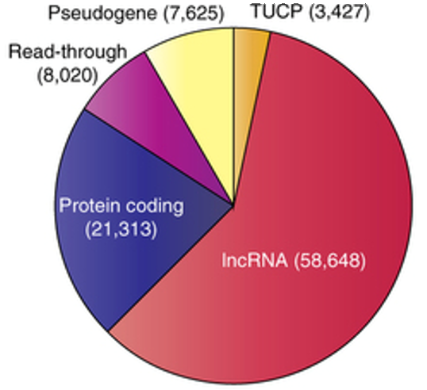
Long intergenic non-coding RNAs: the new guys in town
Bulk RNA-seq revealed extensive, non-protein-coding transcription of genomes
ncRNAs are diverse micro RNAs, piRNAs, pseudogenes... and lncRNAs
lncRNAs: ~60% of known Hu transcripts, functions discovered for a few 100’s
lincRNAs: most abundant of lncRNAs, easier to study
A whole new layer of gene expression regulation!!!
Number of transcripts in the human genome: a large fraction of transcriptional information is in non-coding regions Lyer et al., 2015

Slide 4
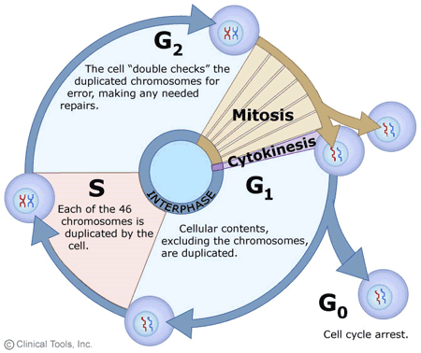
Cell cycle
Extensively studied:
gene & protein expression
phenotypes
yeast, bacteria, mammalian cells
BUT: Not so well-studied from a lncRNA viewpoint!

Slide 5
Working Hypothesis: lincRNAs are involved in the cell cycle
Why would it make sense for lincRNAs to be involved in cell cycle?
High tissue & time specificity => role in tightly-controlled regulatory processes
low expression => responsive processes
RNA-based mechanisms faster than protein-based ones => responsive processes
Some annotated lncRNAs shown to be involved in the cell cycle

Slide 6
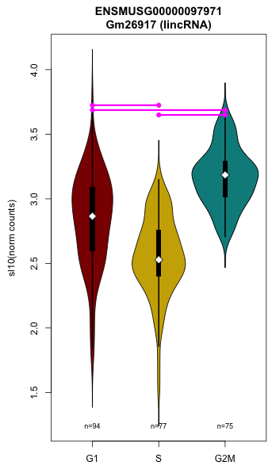
Working Hypothesis: lincRNAs are involved in the cell cycle
Recent work @ACM lab:
lncRNAs regulating mRNA via miRNAs: enrichment in cell cycle genes (Jen)
lincRNAs found to be differentially expressed between cell cycle stages (Alex)
=> need to figure out what these candidates could do

Slide 7
The data

Slide 8
Dataset
Mouse Embryonic Stem Cell samples, staged for G1, S, G2/M (based on Hoechst 33342 staining using flow cytometry), >70 cells per stage.
Gene expression data generated using single-cell RNA sequencing!
Gene expression quantified using Kallisto & DESeq2, QC performed in R.
=> ~10k expressed genes, including <700 lincRNAs, across 246 cells.
Buettner, F., et al. (2015). Computational analysis of cell-to-cell heterogeneity in single-cell RNA-sequencing data reveals hidden subpopulations of cells. Nat Biotech 33, 155–160.

Slide 9
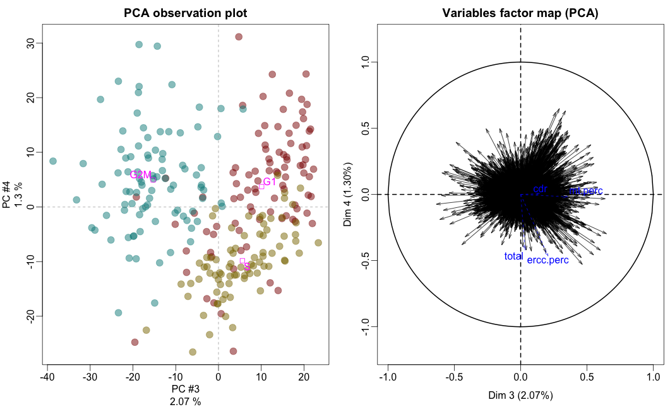
Overall PCA
=> Clear cell cycle signal
Notes:
Here, we performed a Principal Components Analysis on the mRNA & lincRNA expression data. This was to allow us to visualise the main biological & technical signals in the data at a high level. Each dot represents the transcriptome of one cell, they are plotted according to some of the top principal components, and they are coloured by cell cycle stage (G1: red, S: yellow, G2/M: green). As you can see, the transcriptomes belonging to each stage are pretty well clustered amongst themselves, & relatively well separated from the others. The cell cycle signal is thus one of the strongest signals present in the expression data. Reassured by this, we can now push onwards to more complex analyses.

Slide 10
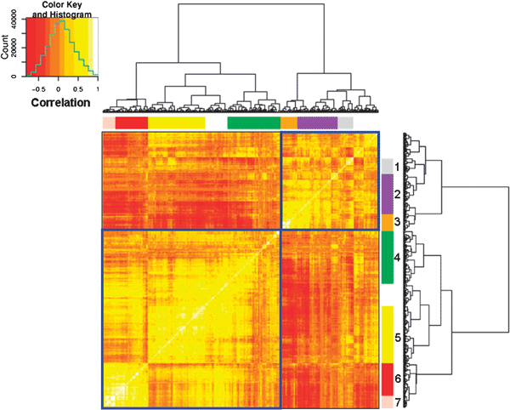
Gene modules
A typical transcriptomics analysis will involve identifying groups of genes that work together, i.e. biological processes relevant to the biological question
Typical approaches: correlation-based clustering, Weighted Gene Correlation Network Analysis… group genes based on the correlation between their expressions.
Gene groups can then be compared to known biological processes’ gene sets.
However, single-cell RNA-seq data is noisy: finding gene modules is challenging, and so far has been unsatisfactory.
Notes:
Why not satisfied?
There are many points to take into consideration when evaluating a clustering: the aspect of the tree (ie are clusters well resolved), the number of clusters obtained after cutting (ie not so many clusters that they can’t all be analysed and not too few to be trivial), the relative sizes of the clusters (eg not dominated by one massive, uninformative cluster), and ultimately the biological relevance and/or usefulness of the clusters (ie can we find functional annotation enrichments in the clusters?). In many of the clustering approaches we tested, one or more of these points failed to deliver. This is most likely due to the high levels of technical and biological noise that are inherent to single-cell transcriptomics.

Slide 11
What will YOU do?

Slide 12
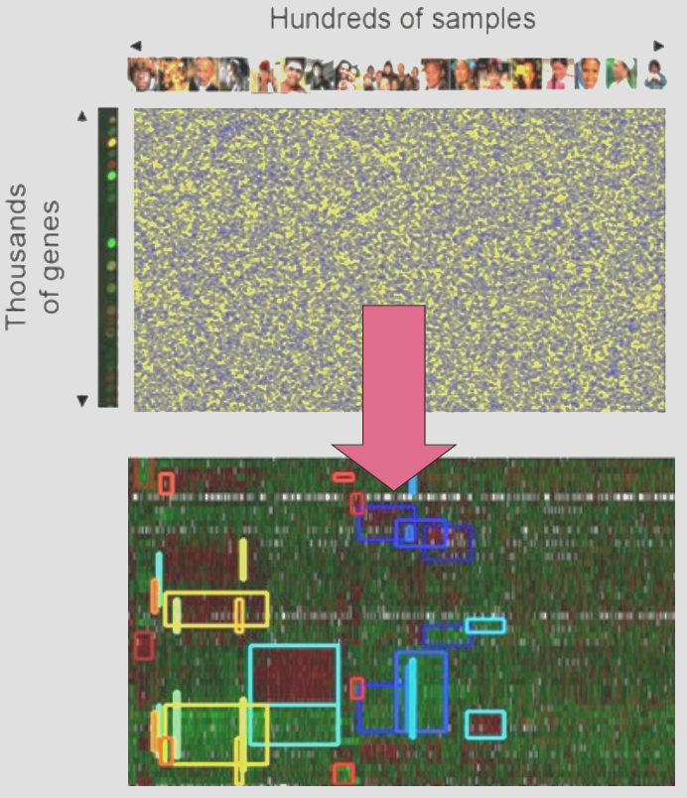
Identify gene “modules” relevant to cell cycle
=> you will test-drive the Iterative Signature Algorithm.
ISA was developed at the DCB to identify “modules” in data matrices: groups of genes that have coherent and distinctive expression levels across groups of samples.
=> you will then evaluate modules’ biological relevance using enrichment analyses (enrichments in annotations eg GO terms, and in cell cycle stages).

Slide 13
ISA & enrichments
The ISA pipeline requires the selection of several parameters, and generates results that may not be straightforward to analyse.
You will:
experiment with ISA parameters => ISA will be run in R
explore the results => ISA results will be visualised & explored in R. Modules will be tested for biological relevance using R & ToppFun.
Notes:
ISA parameters include (honestly at this point you can look to Sven, he knows better than I!):
how the expression matrix is thresholded prior to correlation calculations
the number of “random seeds” the algorithm begins with in each run
the number of runs the algorithm performs
thresholds on how much overlap two modules need to have before being merged into one
etc

Slide 14
Thank you for your attention
Alex
We look forward to seeing you!

Slide 15
That’s all for now!

