Slide 1
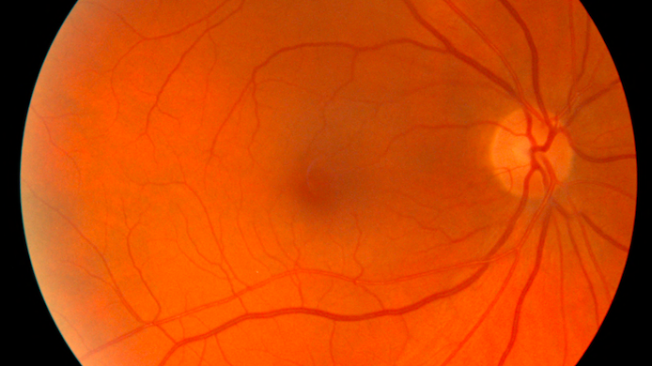
Solving Biological Problems that Require Maths
Retina Project
Emmy Gonzalez, Loïc Perlstain, Mansour Faye
Supervisors : Michael Beyeler, Alexander L. Button

Slide 2
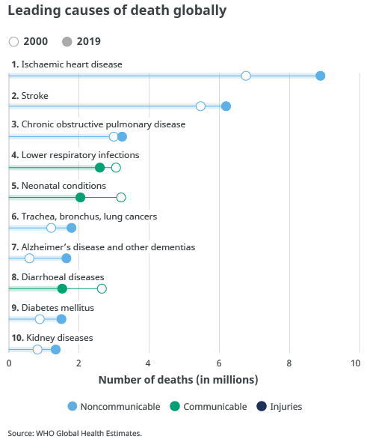
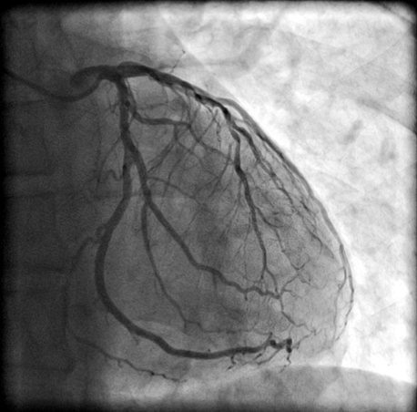
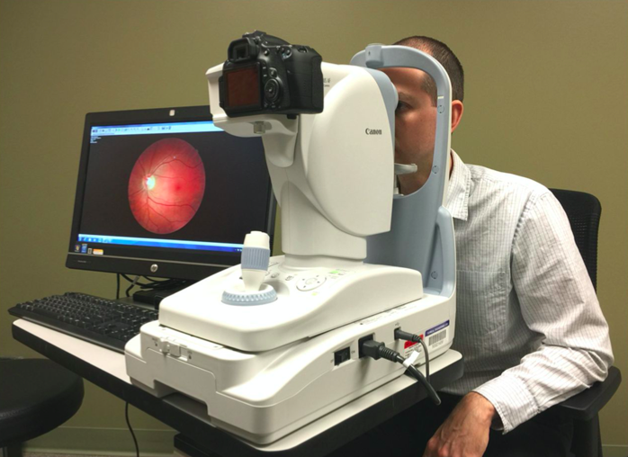
Background : Searching for ways to detect Heart Disease
Need for new diagnostic tools :
Better understanding of the disease
Better detection (prediction) of the disease
X-ray coronary angiogram
Funduscopy

Slide 3
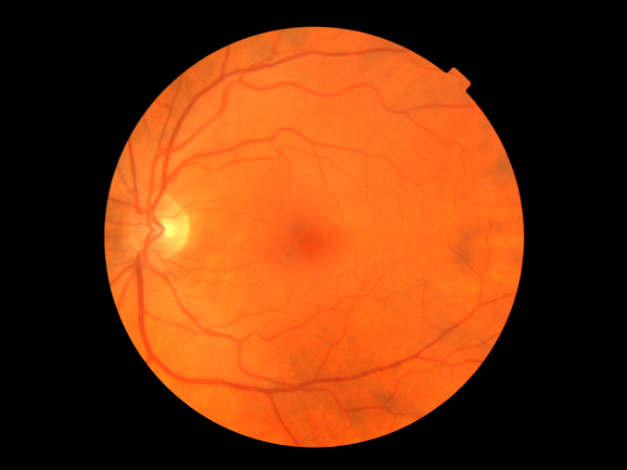
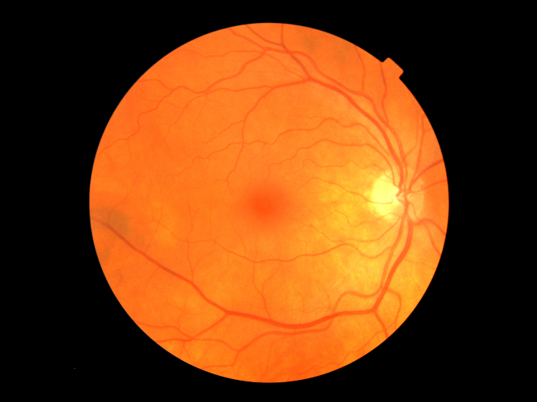
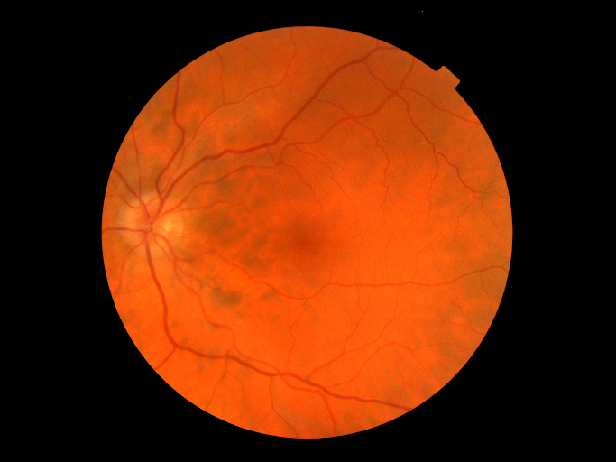
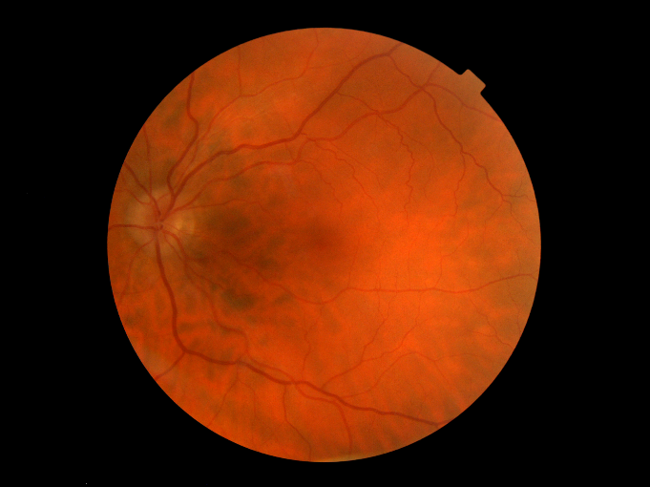

UK biobank retina images
Left and right eyes of the same participant
Left eye of a participant and its technical replica

Slide 4
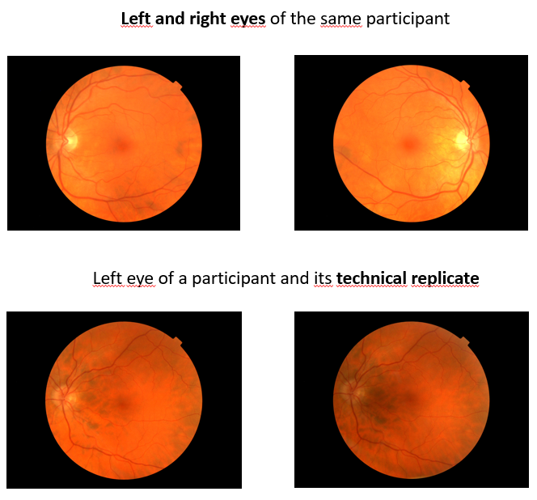
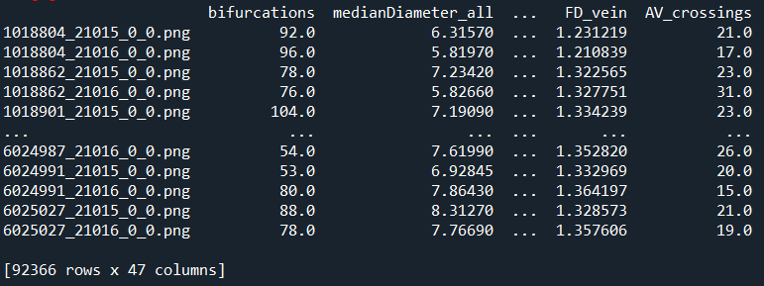
The images and data we worked with

Slide 5
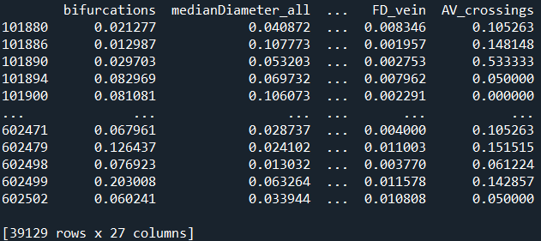


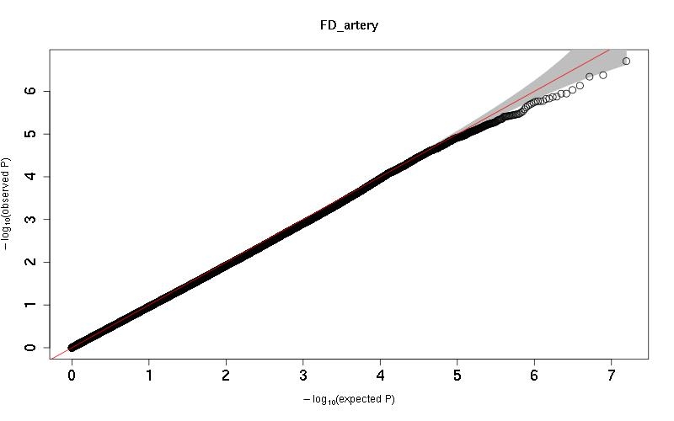
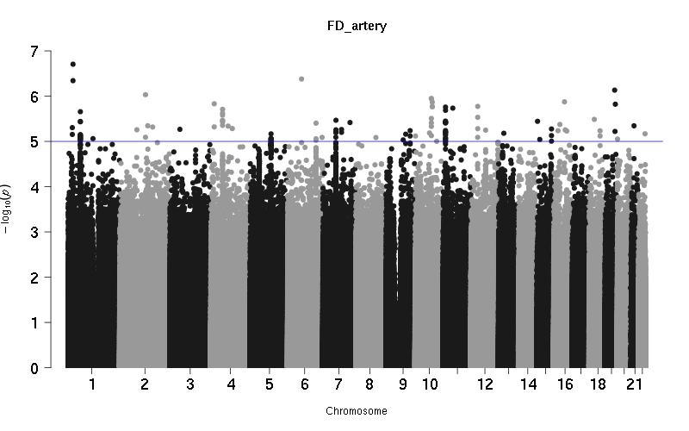
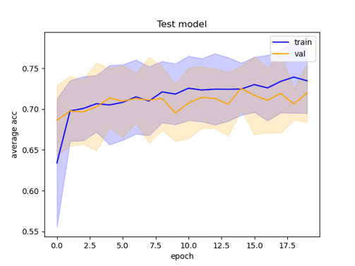
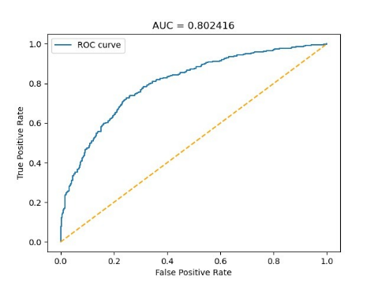
The project makes two different analyses:
1) Looking at the biological relevance of some variables of the transformed dataset by doing a GWAS :
2) Using the transformed dataset as a way to select the best images for a supervised learning classification whose task is to predict hypertension :
GWAS
DenseNet
Accuracy of the prediction of hyper-tension !

Slide 6
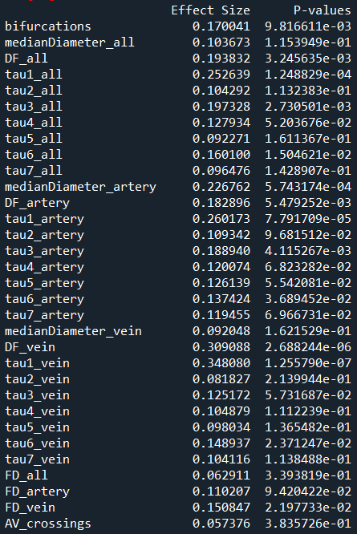
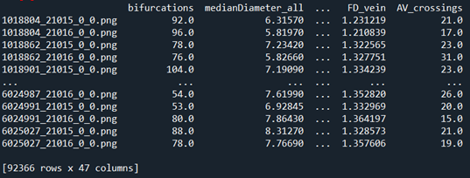
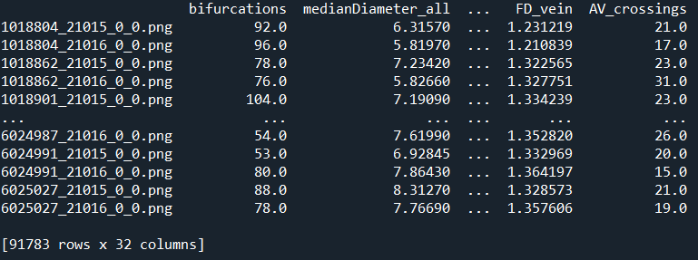
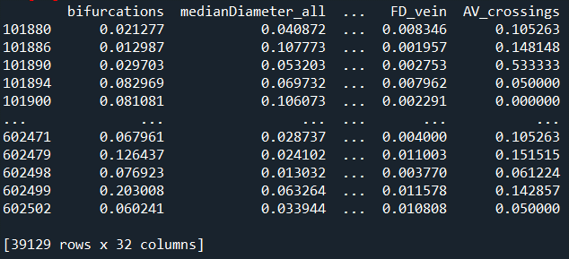
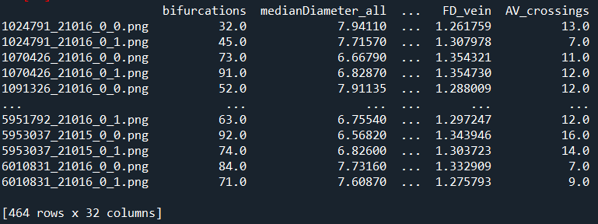
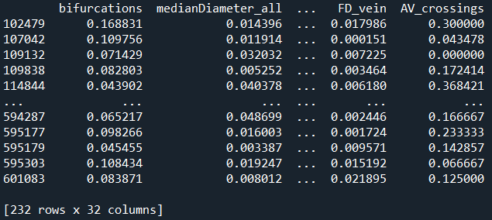
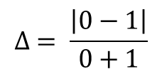
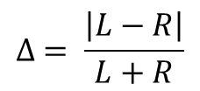
Transforming the dataset and mathematical rationale
Removal of significant variables after Bonferroni correction for 32 tests
Transformed dataset
Cleaning : Removing non relevant variables, keeping only individuals with both left and right eyes/isolating technical replica
T-test, Cohen’s D
Pairs of left (L) and right (R) eyes
$$∆ = \frac{\left|L−R\right|}{L+R}$$
Pairs of originals (0) and their replica (1)
$$∆ = \frac{\left|0−1\right|}{0+1}$$

Slide 7
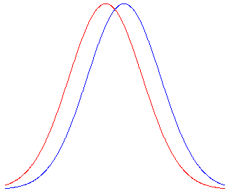
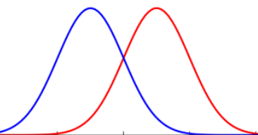
Why making a T-test between left-right and original-replica data ?
For the classification model and to predict hypertension, it is better for input images of left and right eyes to not have striking (biological) difference between them, otherwise the machine could lose in accuracy by accounting for these supplementary data, instead of focusing on the overall structure of the images it analyses.
A given variable
left
right
Left-right :
Non-significant p-values and low effect size
Same variable
Original-replica :
original
replica

Slide 8
The project makes two different analyses:
1) Looking at the biological relevance of some variables of the transformed dataset by doing a GWAS :
2) Using the transformed dataset as a way to select the best images for a supervised learning classification whose task is to predict hypertension
GWAS
Dense Net
Prediction of hyper-tension accuracy !

Slide 9
Supervised Learning : Predicting Hypertension

Slide 10
Image Classifier
The model was built by the CBG to predict hypertension, using retina fundus images
Easily reproducible pipeline
Using a measure of technical error could improve prediction
Convolutional Neural Network overview [1]

Slide 11
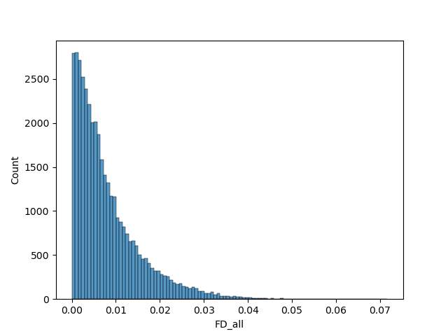
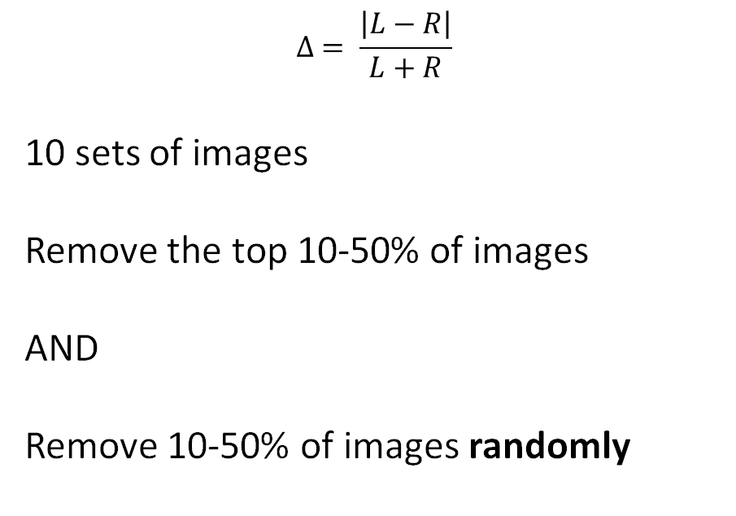
Using the Delta variable to sort images
$$∆ = \frac{\left|L−R\right|}{L+R}$$
10 sets of images
Remove the top 10-50% of images
AND
Remove 10-50% of images randomly

Slide 12
What exactly did we do?
Part 1:
Sort participants according to Delta
Extract the labels of the bottom 50-90%
On the server, use these labels to select images
Part 2:
Modify the config files for the CNN model
Run the preprocessing, training and testing scripts
Download results, ROC Curve, Learning Curve, etc
Repeat Part 2 for each set of images

Slide 13
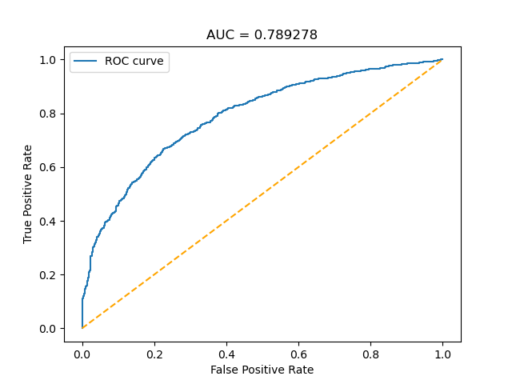

Performance measures
ROC Curves
Area Under the Curve (AUC)
Accuracy Curve

Slide 14
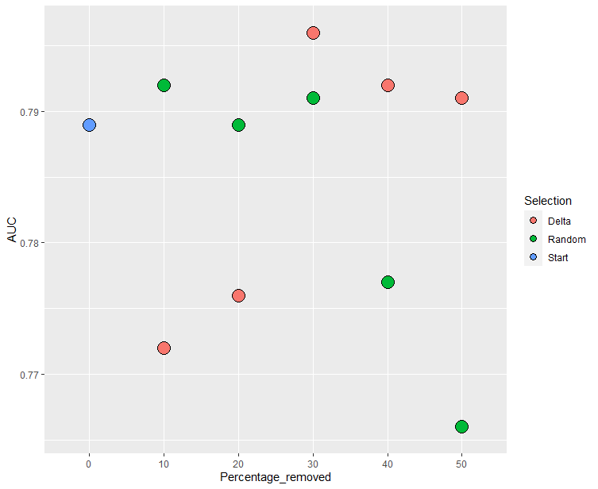
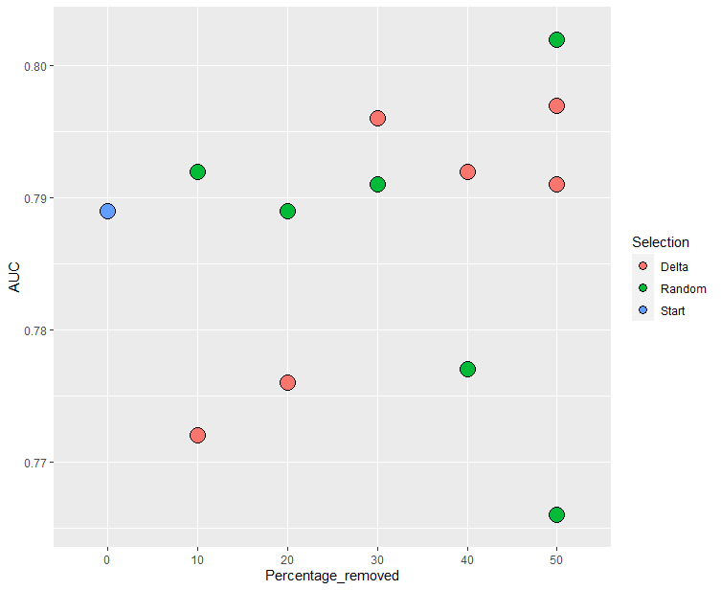
Change in Area Under the ROC Curve

Slide 15
Interpretation
General trend: slight improvement of model performance
But
Inherent variation in AUC from run to run
Statistical tests?
-> More results needed
A <50% reduction of dataset size does not drastically decrease performance

Slide 16
Improvements / Future perspectives
Do at least three runs per set of images
-> Clearer picture + possible tests
Use another variable to set the cutoff
Compute an average Δ for each participant, and use it as the selection criterion
-> take all variables into account

Slide 17
GWAS

Slide 18
What is a GWAS?
Genome wide association study
Goal : discover associations between phenotypic and genetic variation
The human genome contains approx. 4-5 million SNPs (Single Nucleotide Polymorphism)
Regression analysis of SNPs
Manhattan plot to visualize p-values
QQplot to compare with phenotype with random relashionship with SNPs

Slide 19
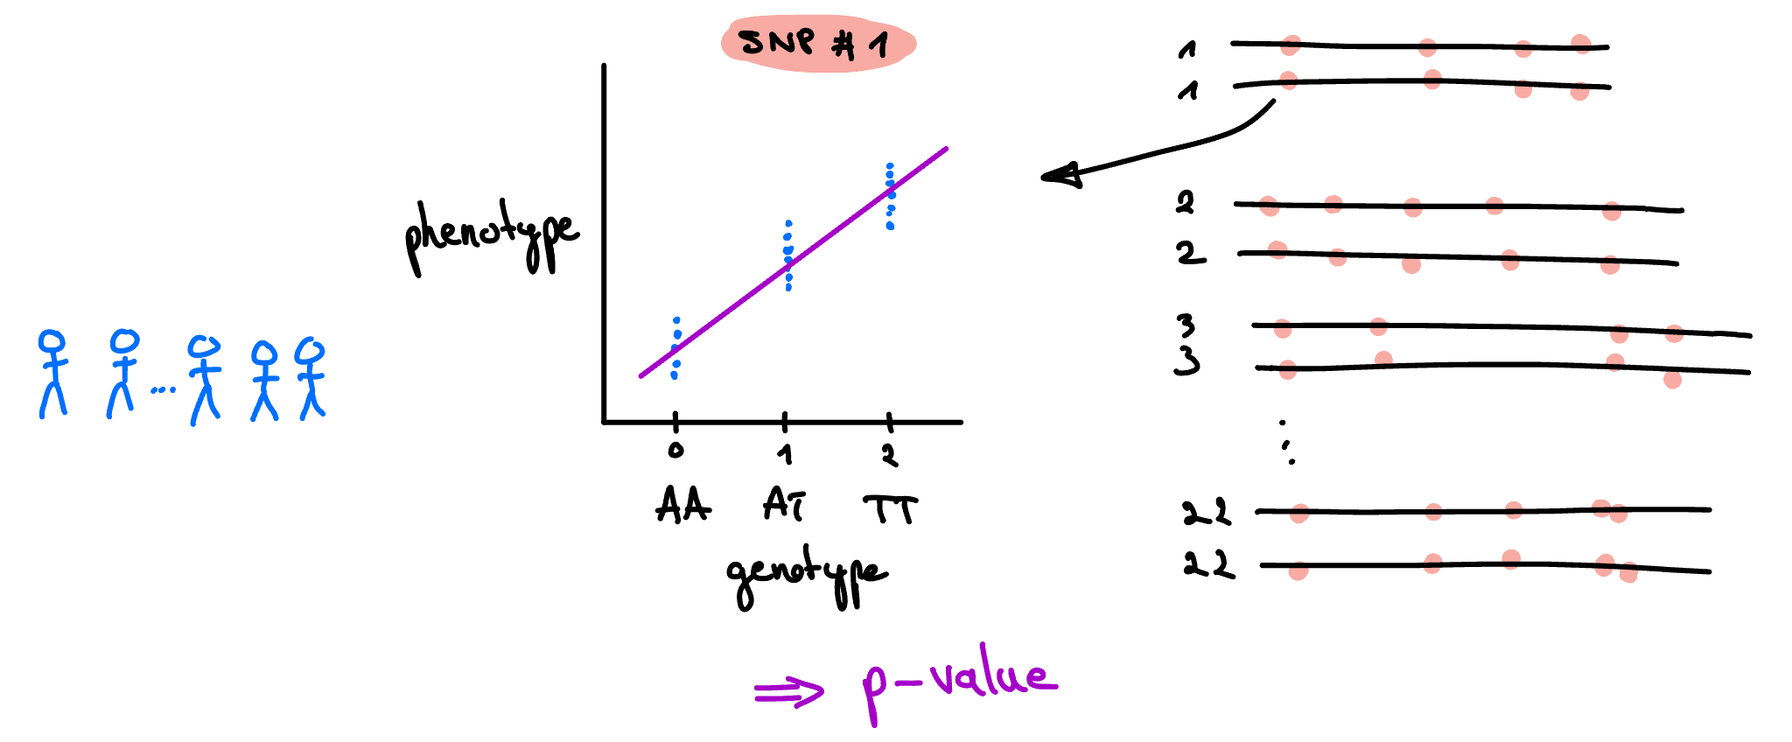
Regression analyses

Slide 20
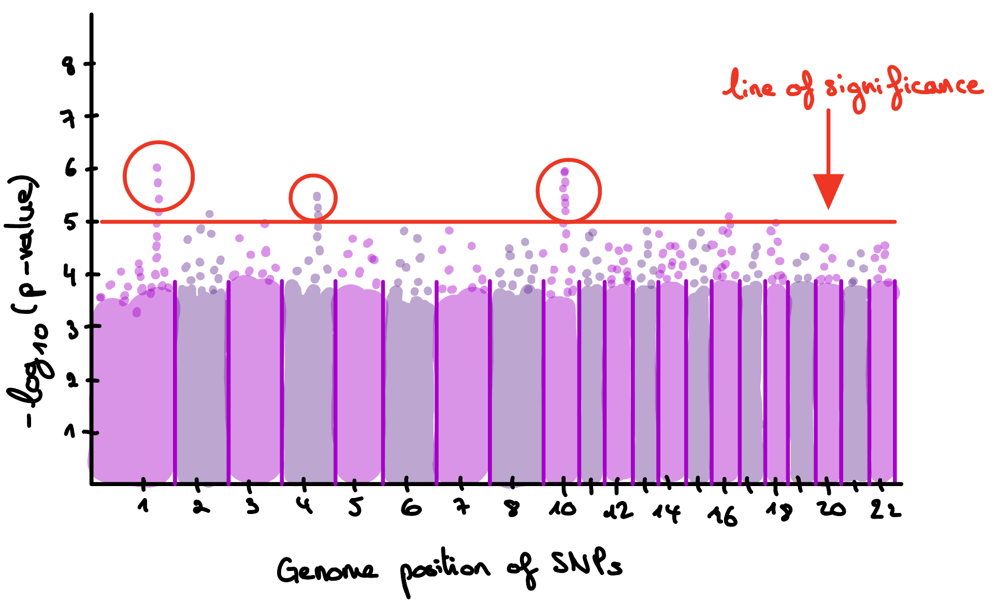
Manhattan plot

Slide 21
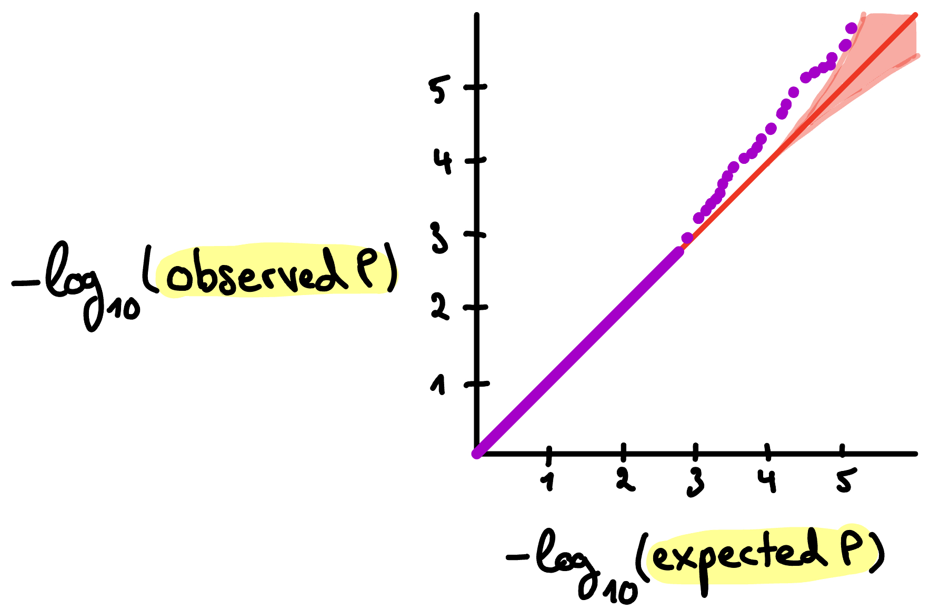
QQ plot

Slide 22
What did we do and why?
Why :
What genes could cause an asymmetry in certain traits of the eyes?
What :
Data set: measurements for multiple traits for each subject
Ex: diameter of vein or artery, tortuosity of vein or artery, fractal density, etc...
We looked at the distribution of those traits for each individual in each eye.
For some traits, we observed a significant difference between left and right eye in most people: Tortuosity and Fractal Density
We quantified the difference : Delta. This Delta is the phenotype we used for the GWAS

Slide 23

Fractal density (FD)
Higher fractal density
Lower fractal density

Slide 24

Tortuosity (tau)
Lower tortuosity
Higher tortuosity

Slide 25
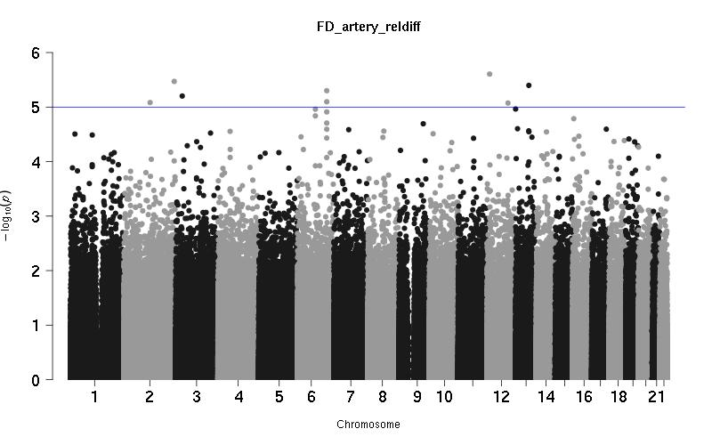
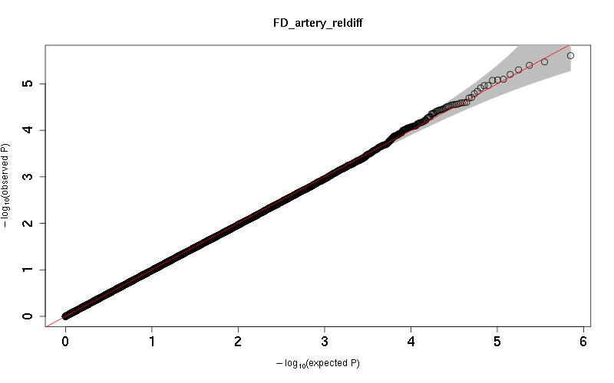
GWAS 1: Fractal Density arteries
N = 37'731

Slide 26
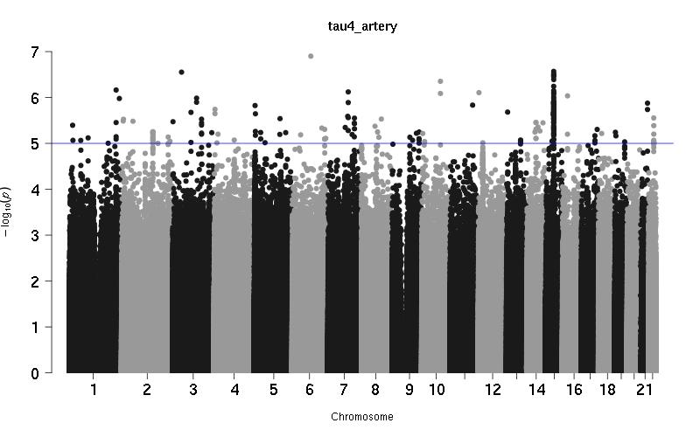
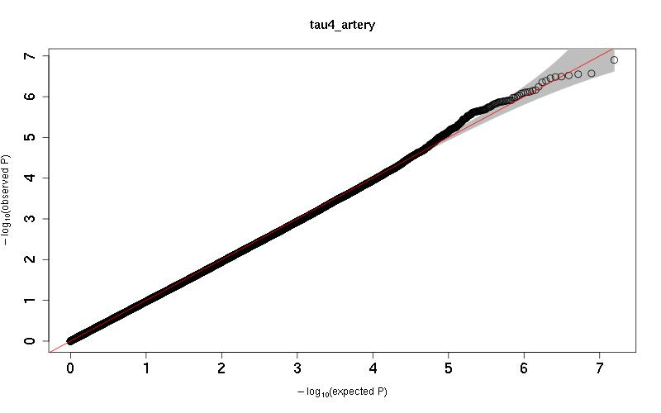
GWAS 1: Tortuosity
N = 37'731

Slide 27
GWAS 2: Fractal Density arteries
N = 48'340

Slide 28
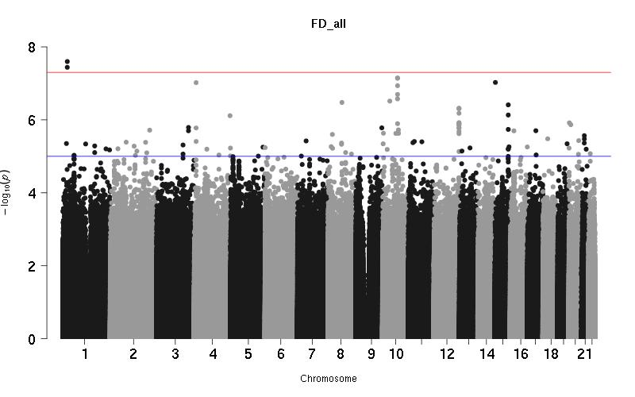
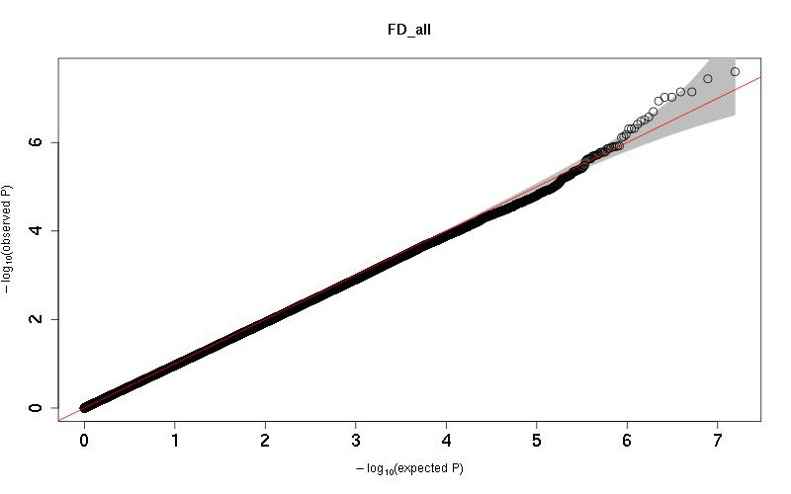
GWAS 2: Fractal Density
N = 48'266

Slide 29
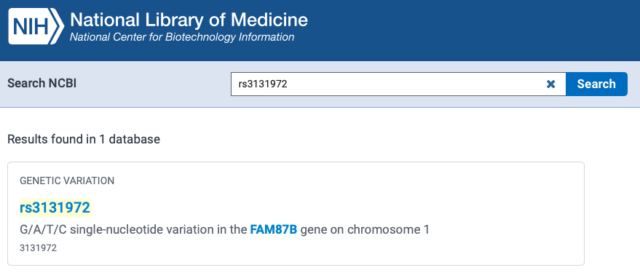
What next?
Assuming our results are more significant than they are..
Each SNP has a "Rsid" (Reference SNP cluster ID)
Identification of gene around a particular SNP
Insights on biological mechanism behind phenotype!

Slide 30
References
[1] Mohammad Farukh Hashmi, Satyarth Katiyar, Avinash G.
Keskar, Neeraj Dhanraj Bokde, and Zong Woo Geem.
Efficient pneumonia detection in chest xray images using deep
transfer learning.
Diagnostics, 10(6):1–23, 2020.

Slide 31
Thank you for your attention!
Questions?

