Slide 1
Genetics and Genome Evolution (GGE)
Bioinformatics for Genomics
Lecture 5:
Networks
Sven Bergmann
Department of Computational Biology
(Sven.Bergmann@unil.ch)

Slide 2
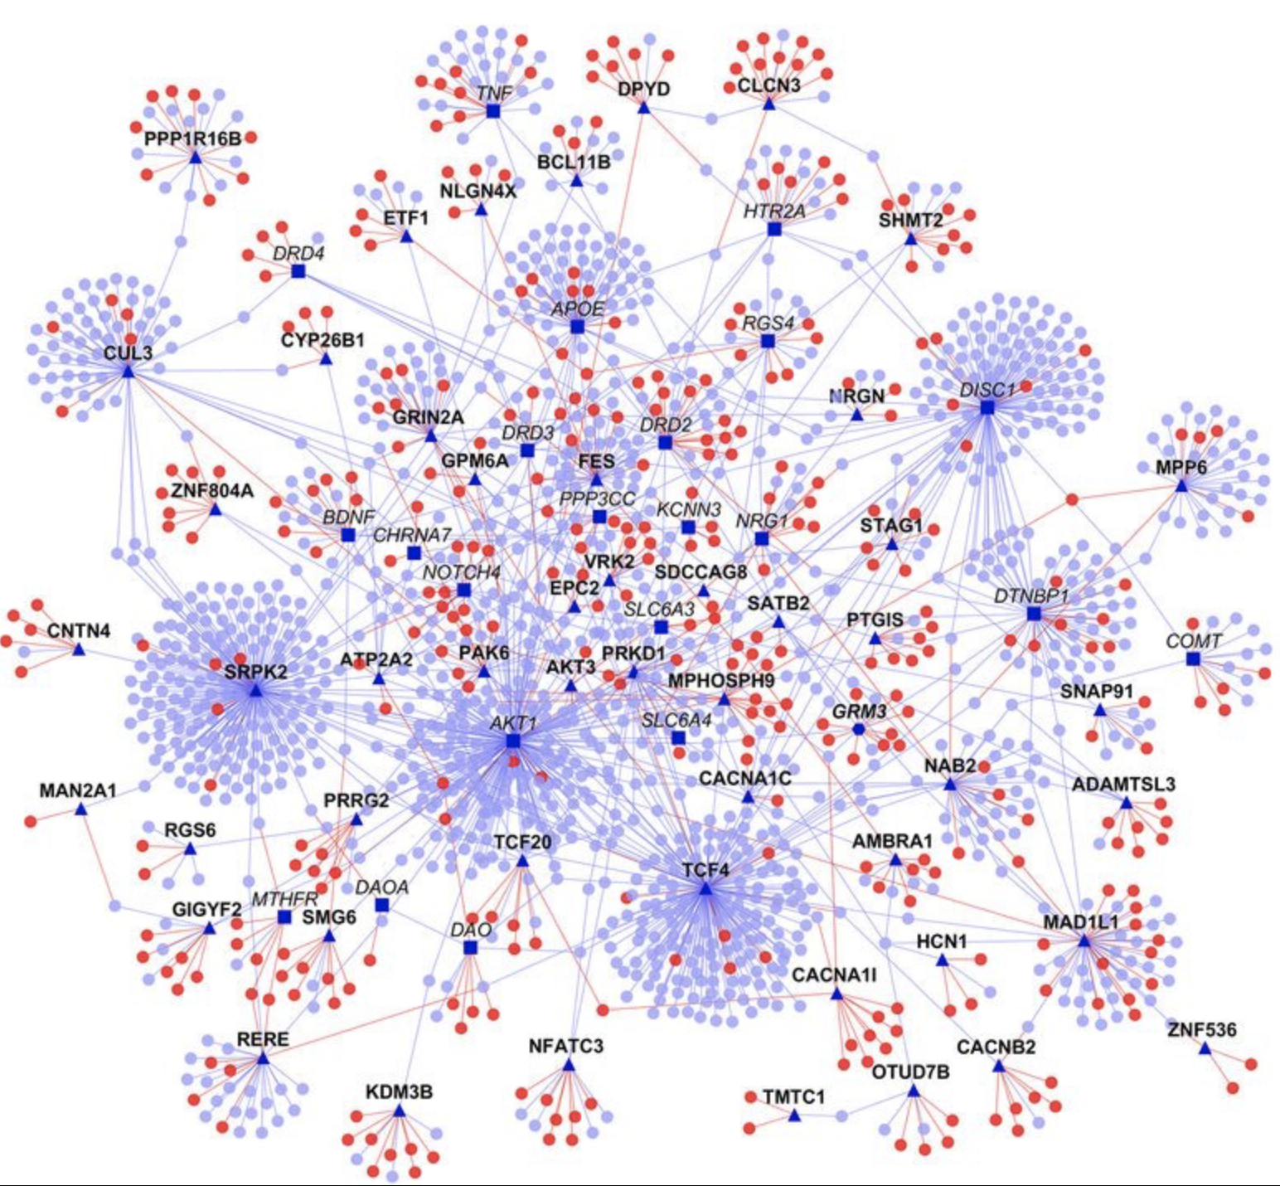
Networks are ubiquitous in biology
Protein interactions
Metabolic networks
Co-expression
Homology
Signaling
Neurons
Species
…

Slide 3
Example: Gene networks
Each gene corresponds to a node ( )
Connect “related” genes by edges ( )
Possible “relations”: physical interaction,
co-expression etc.
Gene A
Gene C
Similar
Expression
profiles
Distinct
Expression
profiles
Gene B
Gene D
Notes:
Let me show you how one can use expression data to construct an expression network.
Here each gene corresponds to a node in the network, represented by circle.
Nodes are connected by an edge if the respective genes are correlated according to the expression data.
For example, these two genes are connected indicating that they have similar expression profiles,
And these two genes are not connected indicating that they have distinct expression profiles.

Slide 4
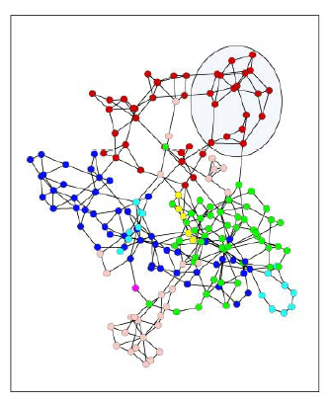
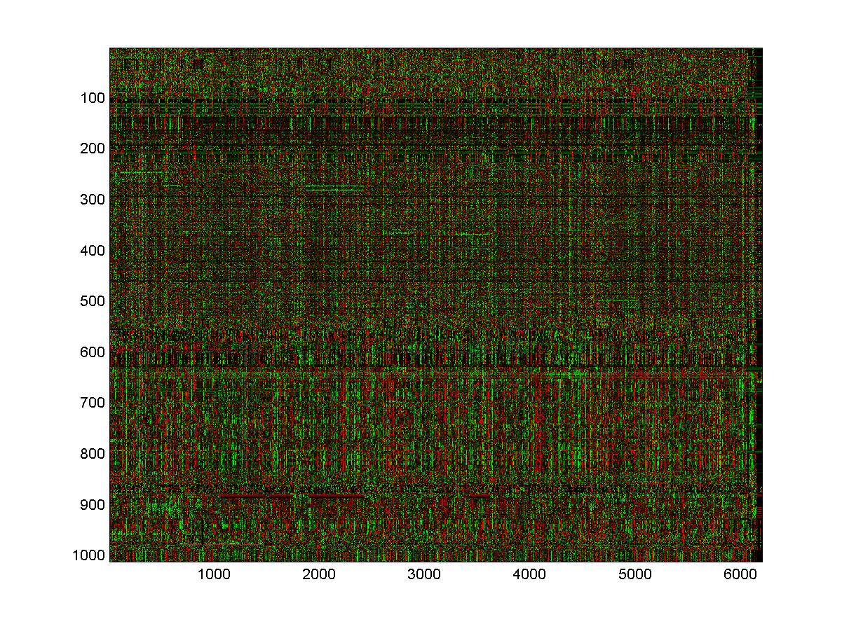
Constructing an “Expression network”:
Notes:
This procedure allows us to map the expression matrix into a complex, undirected network
That reflects the underlying transcriptional network.
Such a network is illustrated here on the right.
So why should one do this?
The answer is that there exists a lot of network theory.
Therefore, we can adapt well established concepts to study our expression network.

Slide 5
Connectivity
k = number of edges per node
2
3
1
5
2
1
0
Notes:
I will try to illustrate this using “connectivity” as an example.
The connectivity k of a given node is nothing more than the number of edges it has.
For example, this node’s connectivity equals to five, and this node’s connectivity is zero.

Slide 6
Connectivity distribution
2
n(k)
3
1
5
2
1
0
k
Notes:
The connectivity of all nodes defines the connectivity distribution.
That is you simply count, how many nodes have a particular number of edges.
The corresponding histogram indicates that one node has connectivity zero, two nodes have connectivity 1, and so on.

Slide 7
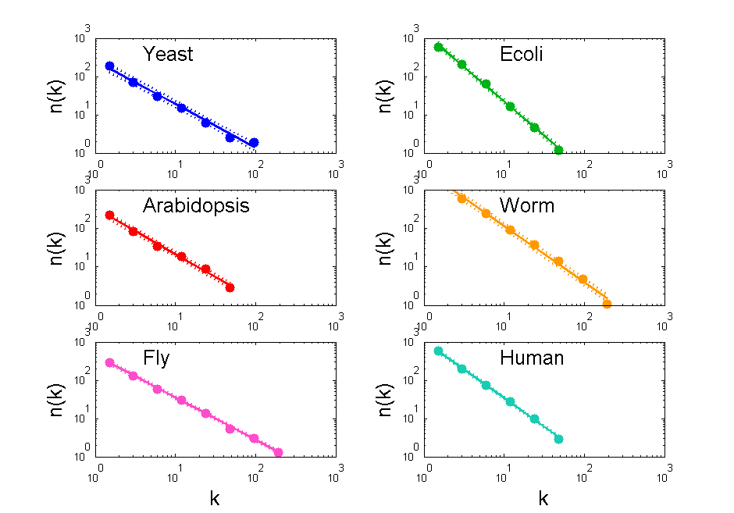
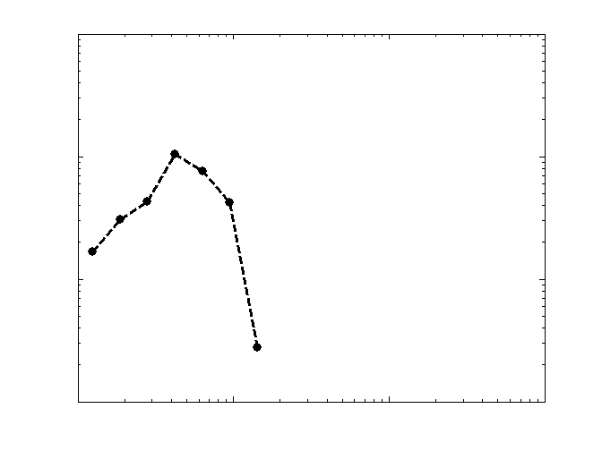
Connectivity distribution
for yeast expression network
n(k)
random network
data
k
Power-law:
centered around mean k
exponential decay for large k
n(k) ~ k^{-γ}
Notes:
The connectivity distribution for the yeast expression networks looks like this.
The number of edges per node is averaged here of seven bins, and the result is
Shown in a log-log plot. The fact that we observe a straight line indicates a power-law distribution.
Why is this interesting?
Well, first of all, a power law is not what you would expect from a random network.
The black line shows the connectivity distribution that one obtains for a network with the same number nodes and the same number of edges that are, however, assigned arbitrarily between those nodes. For this random network the connectivity distribution is centered around the mean connectivity and it decays exponentially for large k.

Slide 8
Connectivity Distributions
for Expression Networks
highly connected yeast genes:
related to protein synthesis
rRNA processing
n(k) ~ k^{-γ}
Notes:
Second, it turns out that the connectivity distributions corresponding to all six organisms behave like a power law.
And the exponent gamma is rather similar ranging between one and 1.5.
So all expression networks share this global property.
We checked what are the highly connected genes, and for yeast it turns out that most of them are related to protein synthesis and ribosomal RNA processing. However we could not find a similar relation for the other organisms.

Slide 9
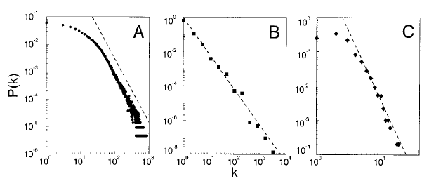
Other networks with power-law distributions
actors
WWW
power-grid
n(k)
k
k
k
Notes:
Third, a power law is interesting because recently such distributions have also been observed for many other, apparently un-related network.
In the actor network each actor represents node, and edges are placed between nodes if the actors appeared in the same movie.
Similarly, the world-wide-web and the American power grid are networks with a power-law connectivity distribution.
So the question is why all these networks this common global property.

Slide 10
Theoretical Approaches
Dynamically evolving networks with preferential attachment (“rich get richer”)
[Barabasi & Albert 1999]
Systems with “Highly Optimized Tolerance” (HOT)
[Carlson & Doyle 2000]
n(k) ~ k^{-γ}
Notes:
Two different theoretical approaches attempt to make such a connection.
Barabasi and Albert showed that models of dynamically evolving networks with preferential attachment exhibit power laws in the connectivity distribution. In these networks new nodes are added sequentially. Each new node is connected to some of the existing nodes, but with a higher probability to those nodes that have already many edges, resembling a “rich get richer” phenomena.
Work by Carlson and Doyle shows that also system which have been highly optimized to tolerate a spectrum of perturbations have power-law distributions.
Both approaches, one emphasizing evolution and the other optimization, appear to be also highly relevant to the expression networks.

Slide 11
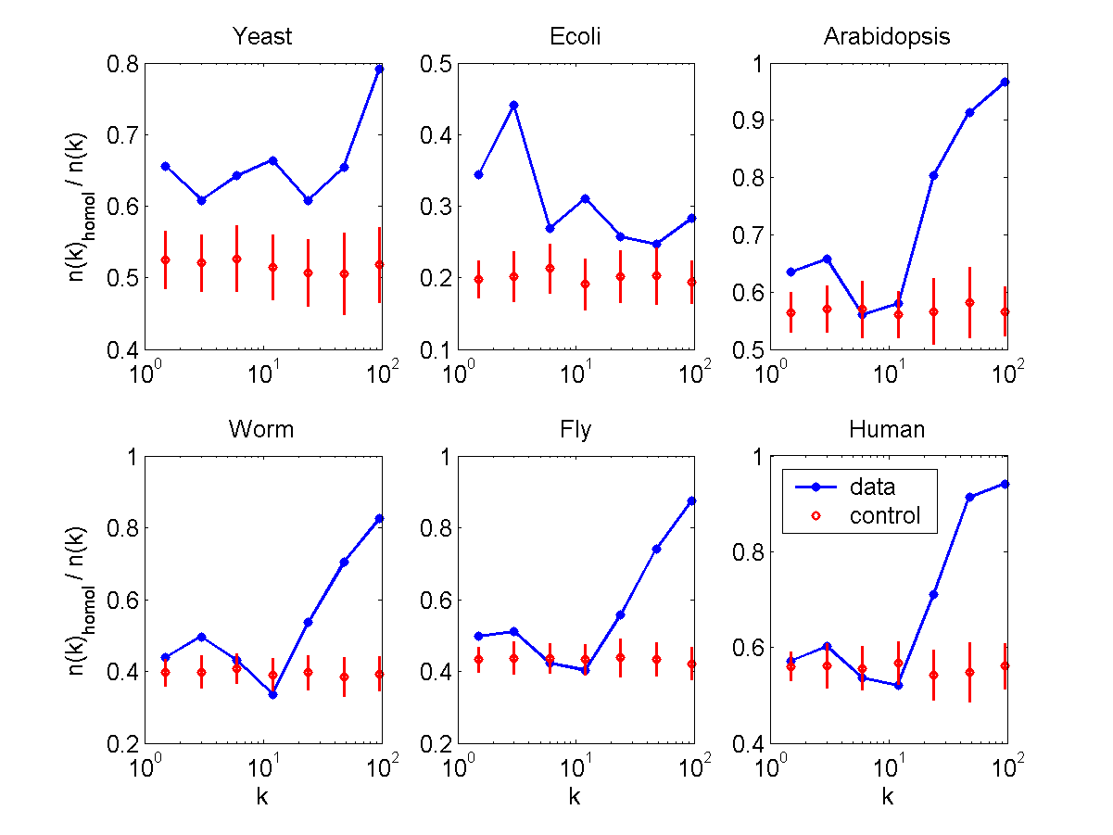
Centrality & Homology
Fraction of yeast genes with human homologue
connectivity
Notes:
The fact that we deal with expression networks has the advantage that we relate the connectivity to biological properties of the genes.
For example, in this graph I plotted the fraction of yeast genes that have human homologue as a function of the connectivity k.
One can see that genes with a low connectivity are less likely to have a human homologue than genes with many edges.
Only the blue line corresponding to the real data has a sharp increase for large k, while this is not seen for the random control shown in red.
This might indicate that evolutionary conserved genes play a more central role in the transcription network.

Slide 12
Centrality & Homology
Notes:
We observed a similar relation for the fraction of yeast genes with a homologue in the higher eukaryotes, arabidopsis, C.elegans and fly.
Interestingly, this effect is not seen for the homologues in E.coli, and it is weak when considering the homologues within yeast itself.

Slide 13
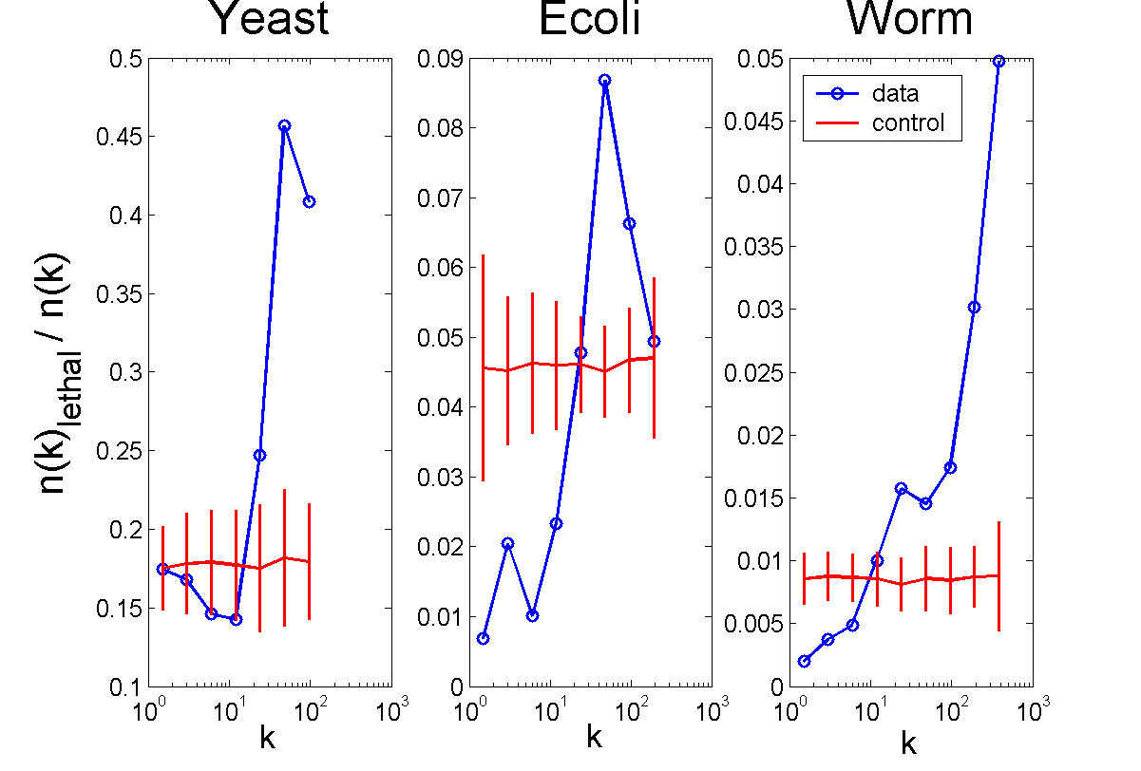
Centrality & Lethality
Notes:
Another interesting observation for the three organisms for which we found information on gene lethality is that genes with large connectivity are more likely to be essential.
So it appears that the removal of genes that are linked to many other genes has a more dramatic effect on the transcription network.

Slide 14
Clustering-coefficient
Friendships between friends
C =
Possible friendships
How many of your friends are also friends amongst each other?
1
1
6/15
1
1
1
1
Notes:
Finally, let me briefly mention a second quantity used to study global network properties.
This properties is best explained in a social network where nodes correspond to people and edges connect people that are friends.
In this network the “clustering-coefficient” of each node would be defined as the number of friendships between the friends of a given person.
For example in this toy network all the nodes except the central one are fully connected among each other such that their clustering coefficient is one. However not all the node the central node is connected to also also connected among each other. In fact only 6 of the 15 possible connections exist.

Slide 15
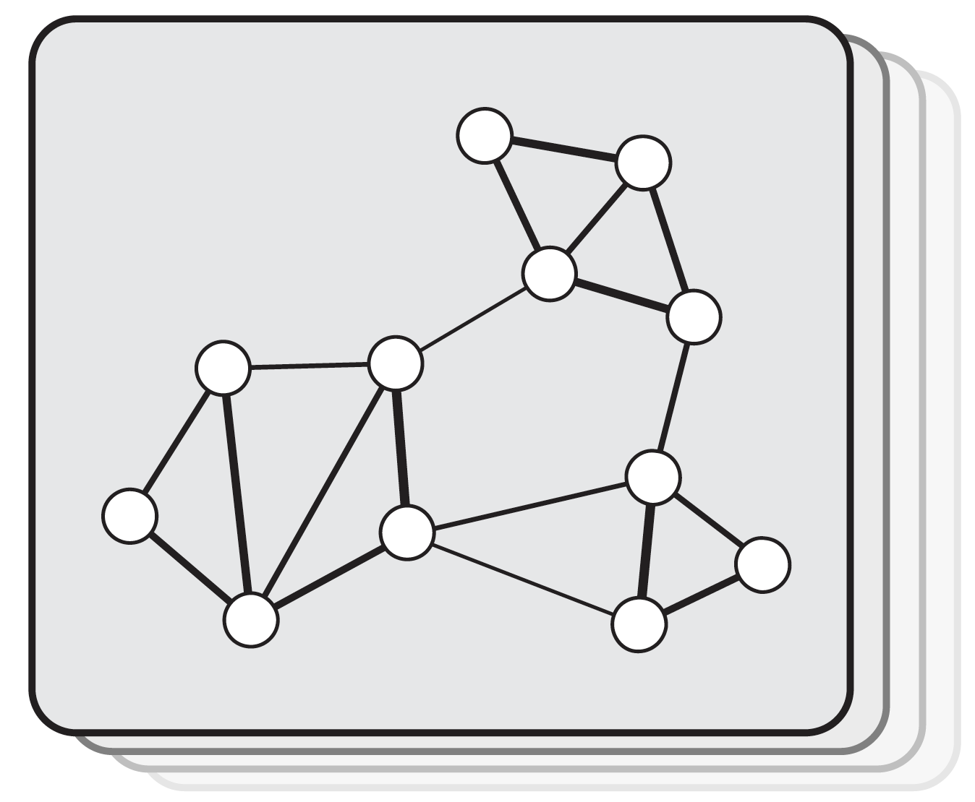
Biological networks tend to be highly modular
But how best to identify modules from these networks?

Slide 16
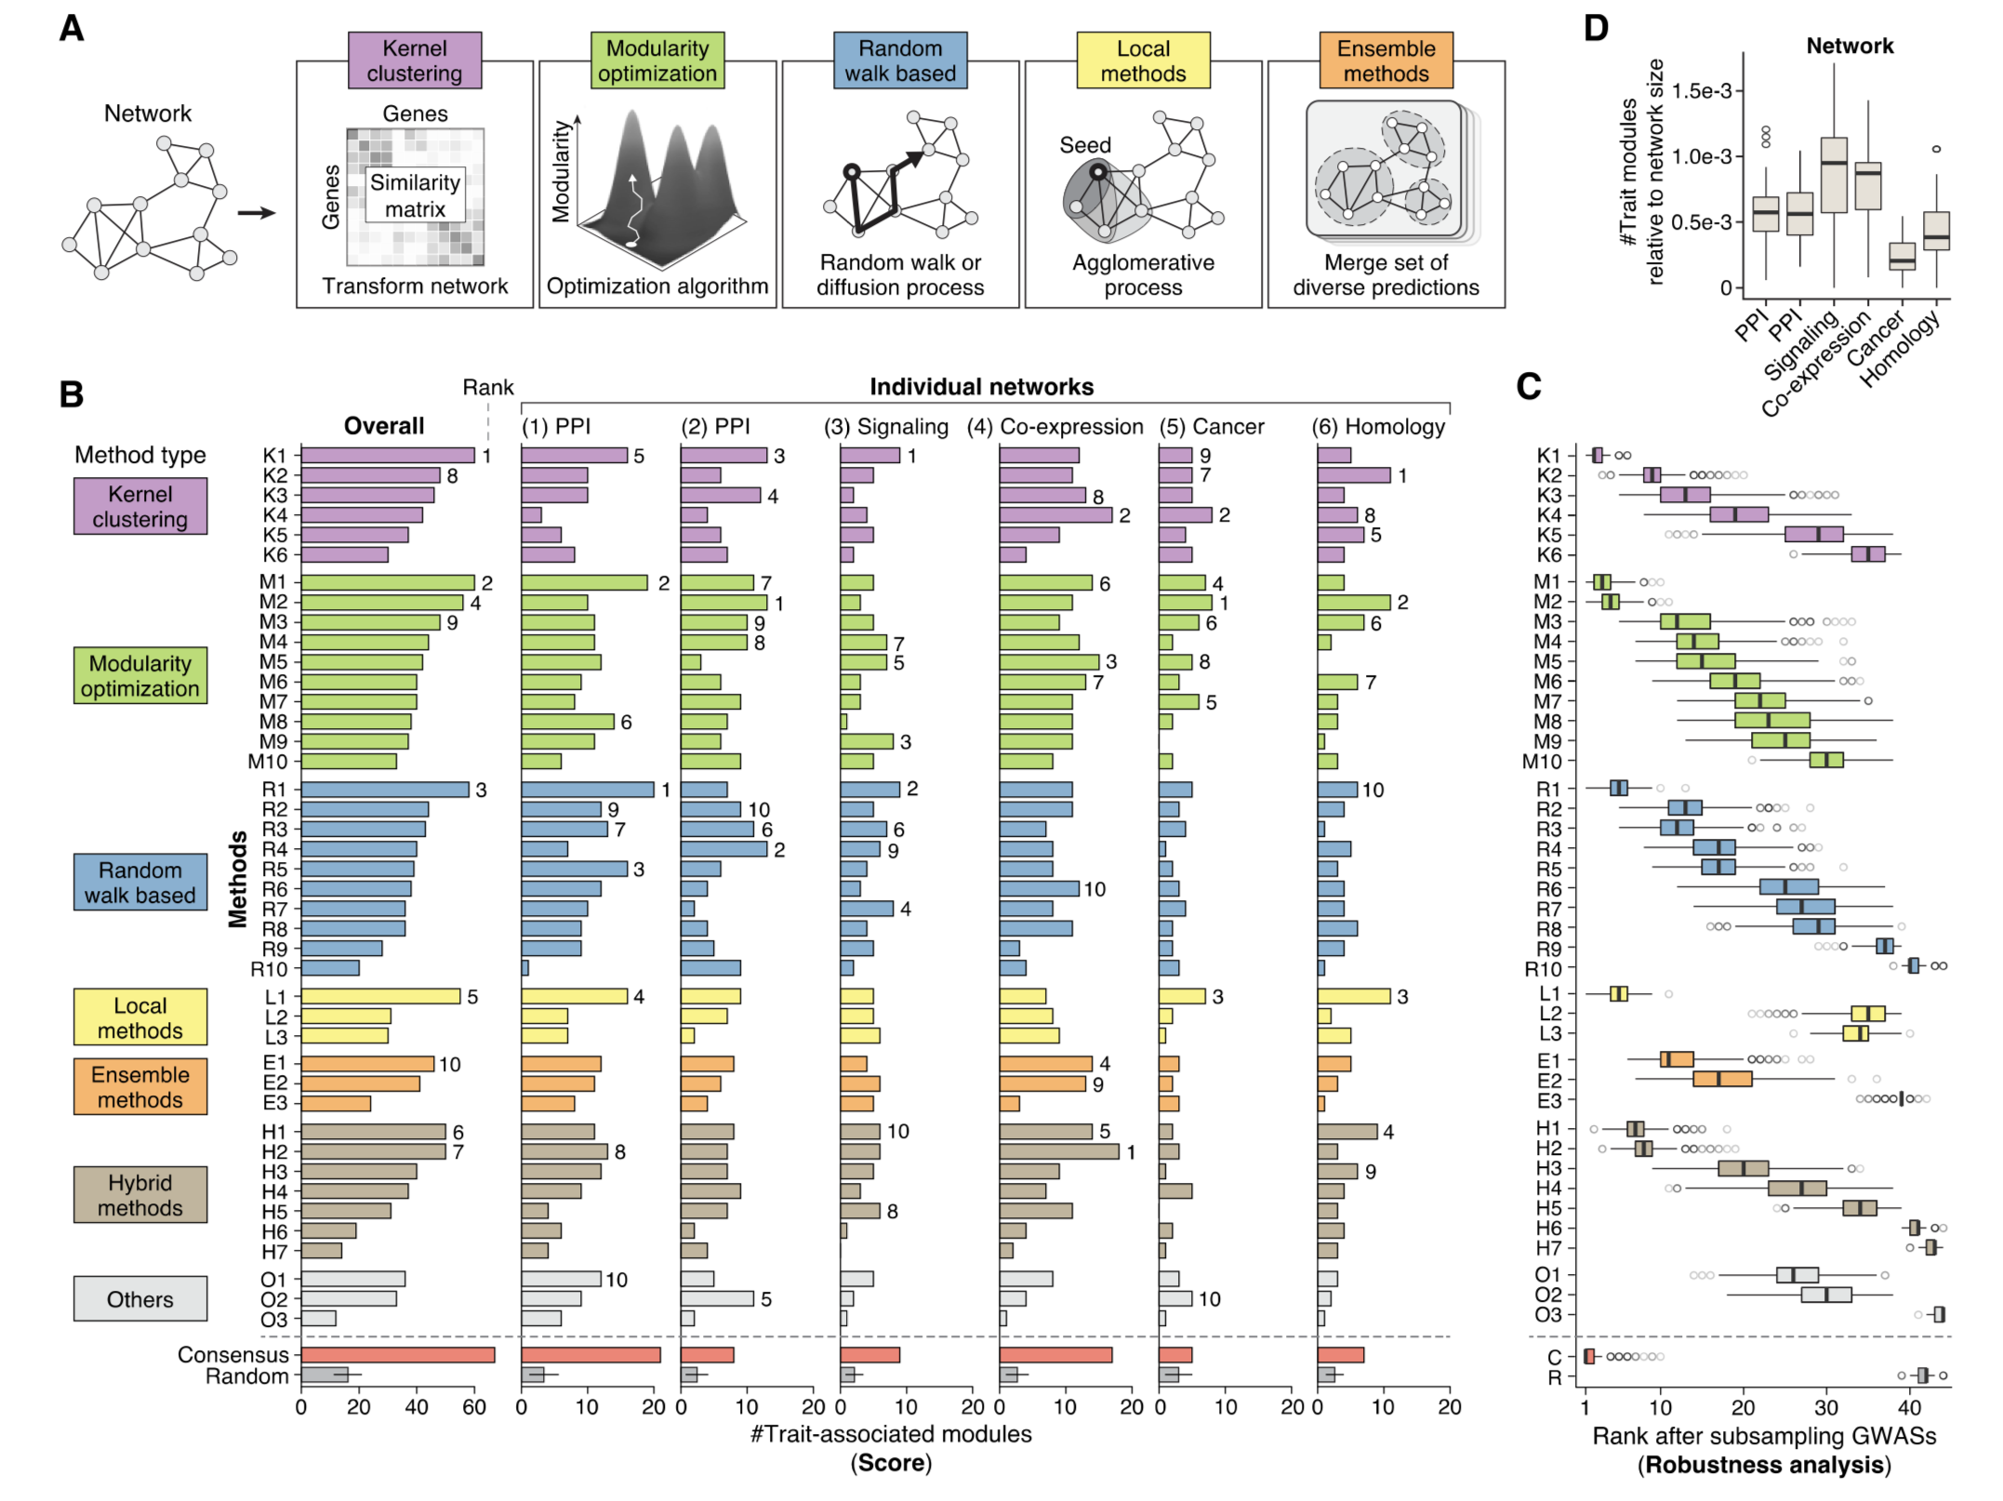
Many methods for module identication using different approaches

Slide 17

Which methods work best?

Slide 18
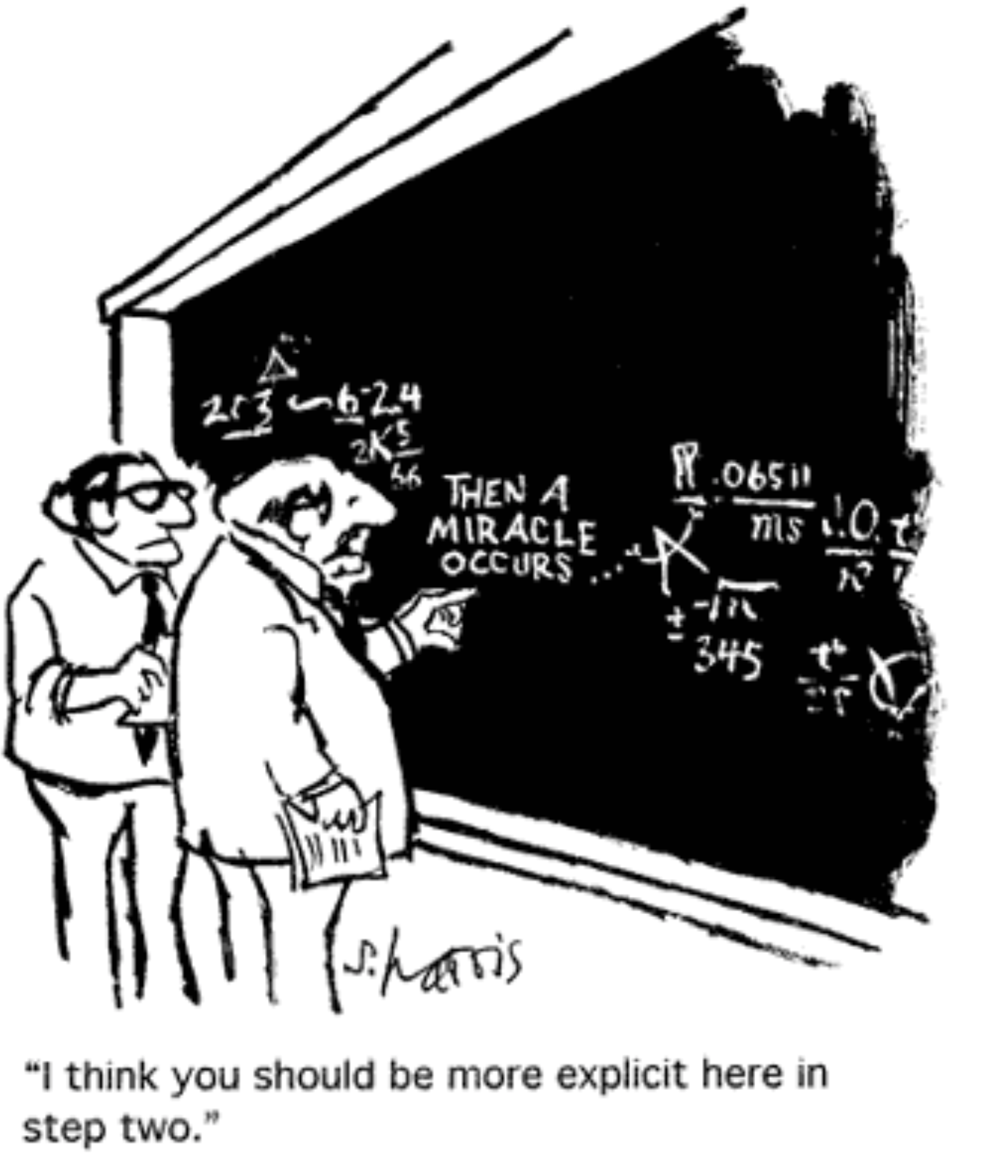
Reproducible Science

Slide 19

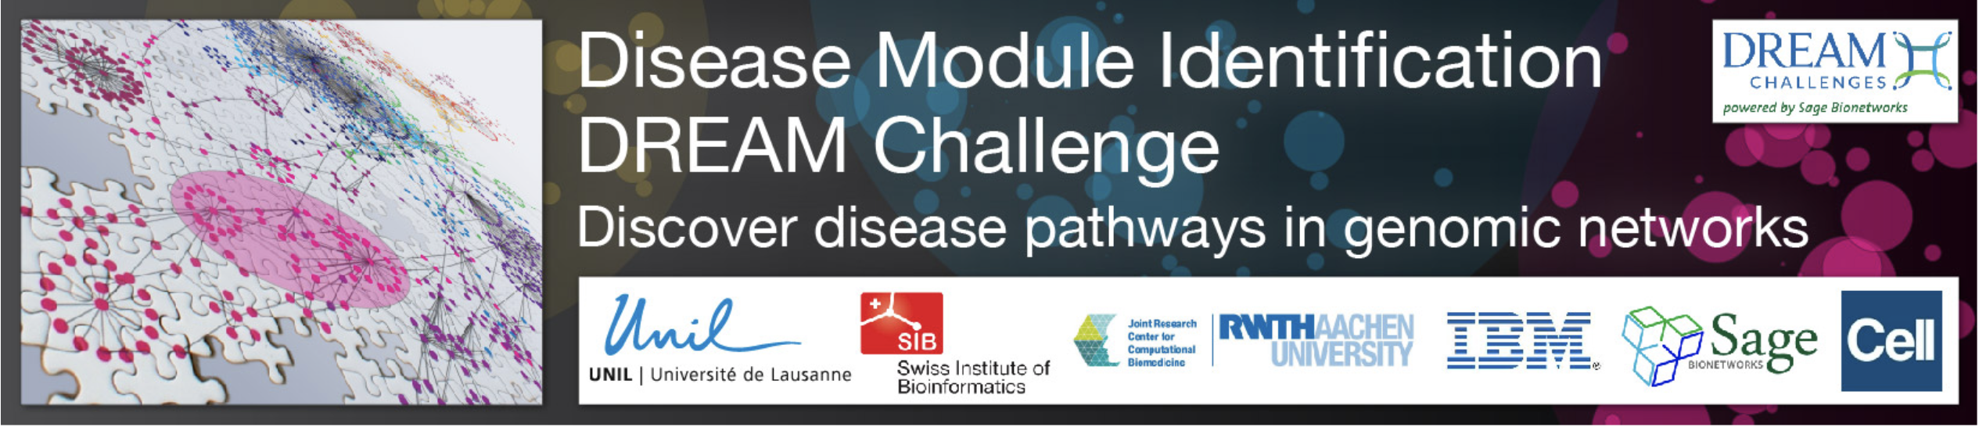
Dialogue on Reverse Engineering and Assessment (DREAM)
Daniel Marbach

Slide 21
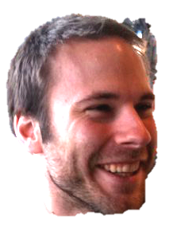



Genetic variation in SNPs
(Single Nucleotide Polymorphisms)
ATTGCAATCCGTGG...ATCGAGCCA…TACGATTGCACGCCG…
ATTGCAATCCGTGG...ATCGAGCCA…TACGATTGCACGCCG…
ATTGCAAGCCGTGG...ATCTAGCCA…TACGATTGCAAGCCG…
ATTGCAAGCCGTGG...ATCTAGCCA…TACGATTGCAAGCCG…
ATTGCAAGCCGTGG...ATCTAGCCA…TACGATTGCAAGCCG…
ATTGCAATCCGTGG...ATCGAGCCA…TACGATTGCACGCCG…
ATTGCAATCCGTGG...ATCTAGCCA…TACGATTGCACGCCG…
ATTGCAATCCGTGG...ATCGAGCCA…TACGATTGCACGCCG…
ATTGCAAGCCGTGG...ATCTAGCCA…TACGATTGCAAGCCG…
ATTGCAAGCCGTGG...ATCGAGCCA…TACGATTGCACGCCG…
Notes:
Une fois ce catalogue génétique établi, nous trouvons des différences entre individus au niveau de l'ADN comme indiqué par les lettres de couleurs différentes
En zoomant sur la séquence d’ADN, on peut voir des différences entre individus.

Slide 22

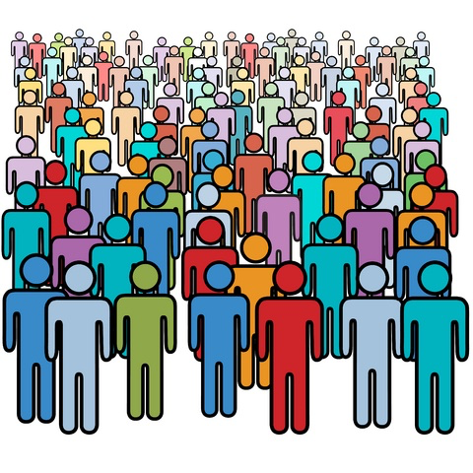

Association with genotype
SNPs
trait variant
chromosome
Population with ‘ ’ allele
Population with ‘ ’ allele
Distributions of “trait”

Slide 23
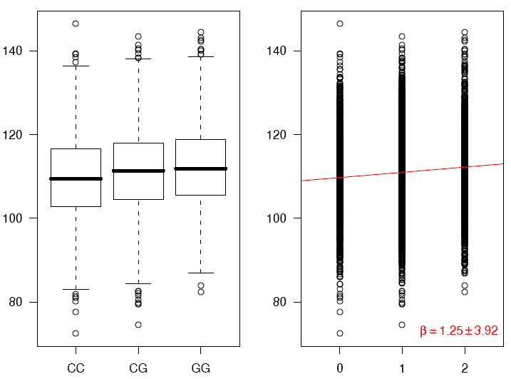
Association using regression
phenotype
genotype
Coded genotype

Slide 24
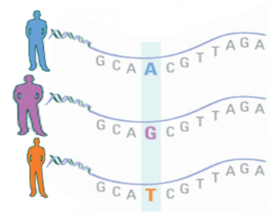

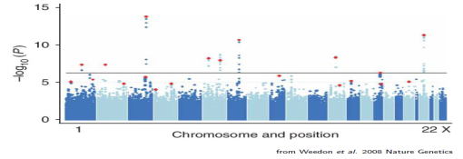
Genome-wide Association Studies link traits to genotypes (SNPs)
G
P
significance
Chromosomal position

Slide 25
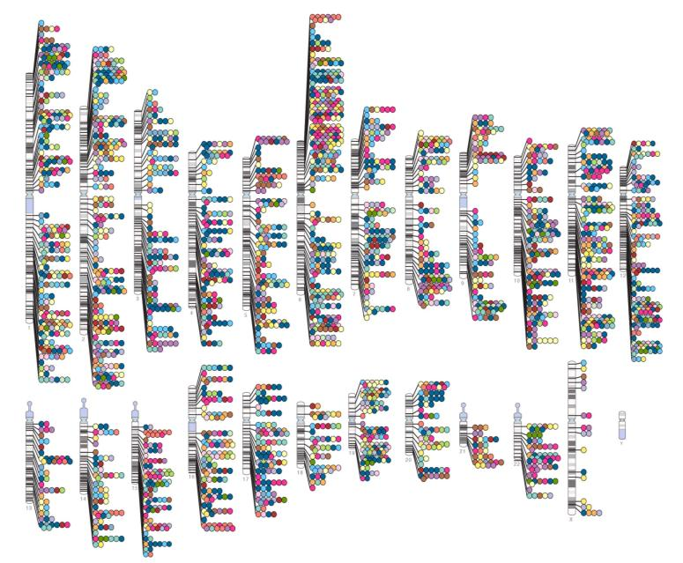
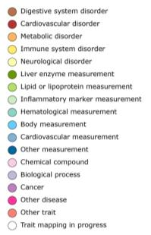


Published Genome-Wide Associations
(at p≤5x10⁻⁸ for 18 trait categories)
NHGRI GWA Catalog
www.genome.gov/GWAStudies
www.ebi.ac.uk/fgpt/gwas/

Slide 26
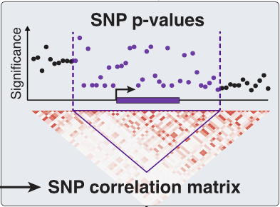
How to compute gene-scores?
Gene
Common approach:
Pick a window around the gene-body and compute the
sum or the maximum
of summary statistics
Notes:
La lèpre est une maladie chronique causée par le bacille Mycobacterium leprae.
Les chiffres officiels montrent que près de 182 000 personnes, résidant principalement en Asie et en Afrique, étaient infectées au début de 2012, et que 219 000 nouveaux cas environ ont été notifiés en 2011.
M. leprae se multiplie très lentement et la période d’incubation de la maladie est d’environ cinq ans. Les symptômes peuvent n’apparaître qu’au bout de 20 ans.
La lèpre n’est pas très contagieuse. Elle est transmise par des gouttelettes d’origine buccale ou nasale, lors de contacts étroits et fréquents avec un sujet infecté et non traité.
Faute de traitement, la lèpre peut entraîner des lésions progressives et permanentes de la peau, des nerfs, des membres et des yeux.
Un diagnostic précoce associé à un traitement par polychimiothérapie (PCT) restent les éléments clés pour éliminer la maladie en tant que problème de santé publique.

Slide 27
How to compute gene-scores?
Gene
Challenge: SNPs are not independent
(due to “linkage disequilibrium”)
Notes:
La lèpre est une maladie chronique causée par le bacille Mycobacterium leprae.
Les chiffres officiels montrent que près de 182 000 personnes, résidant principalement en Asie et en Afrique, étaient infectées au début de 2012, et que 219 000 nouveaux cas environ ont été notifiés en 2011.
M. leprae se multiplie très lentement et la période d’incubation de la maladie est d’environ cinq ans. Les symptômes peuvent n’apparaître qu’au bout de 20 ans.
La lèpre n’est pas très contagieuse. Elle est transmise par des gouttelettes d’origine buccale ou nasale, lors de contacts étroits et fréquents avec un sujet infecté et non traité.
Faute de traitement, la lèpre peut entraîner des lésions progressives et permanentes de la peau, des nerfs, des membres et des yeux.
Un diagnostic précoce associé à un traitement par polychimiothérapie (PCT) restent les éléments clés pour éliminer la maladie en tant que problème de santé publique.

Slide 28
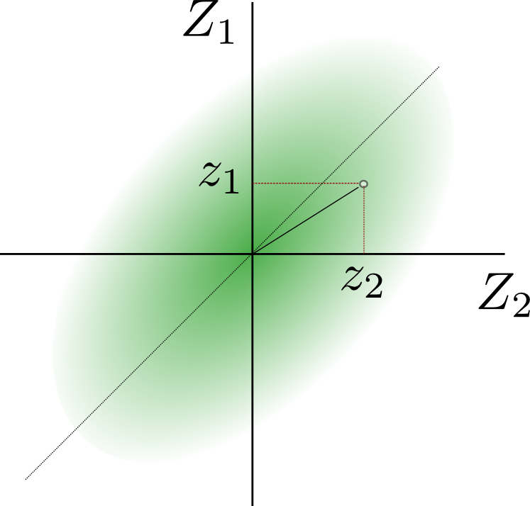
Example: 2 SNPs only
Sum-statistic:
a = z₁² + z₂² from
observed z-scores (i.e. normalized effect sizes)
z₁ and z₂ for two SNPs.
What is the probability to observe a > a₀
when the SNPs are correlated?
Notes:
La lèpre est une maladie chronique causée par le bacille Mycobacterium leprae.
Les chiffres officiels montrent que près de 182 000 personnes, résidant principalement en Asie et en Afrique, étaient infectées au début de 2012, et que 219 000 nouveaux cas environ ont été notifiés en 2011.
M. leprae se multiplie très lentement et la période d’incubation de la maladie est d’environ cinq ans. Les symptômes peuvent n’apparaître qu’au bout de 20 ans.
La lèpre n’est pas très contagieuse. Elle est transmise par des gouttelettes d’origine buccale ou nasale, lors de contacts étroits et fréquents avec un sujet infecté et non traité.
Faute de traitement, la lèpre peut entraîner des lésions progressives et permanentes de la peau, des nerfs, des membres et des yeux.
Un diagnostic précoce associé à un traitement par polychimiothérapie (PCT) restent les éléments clés pour éliminer la maladie en tant que problème de santé publique.

Slide 29

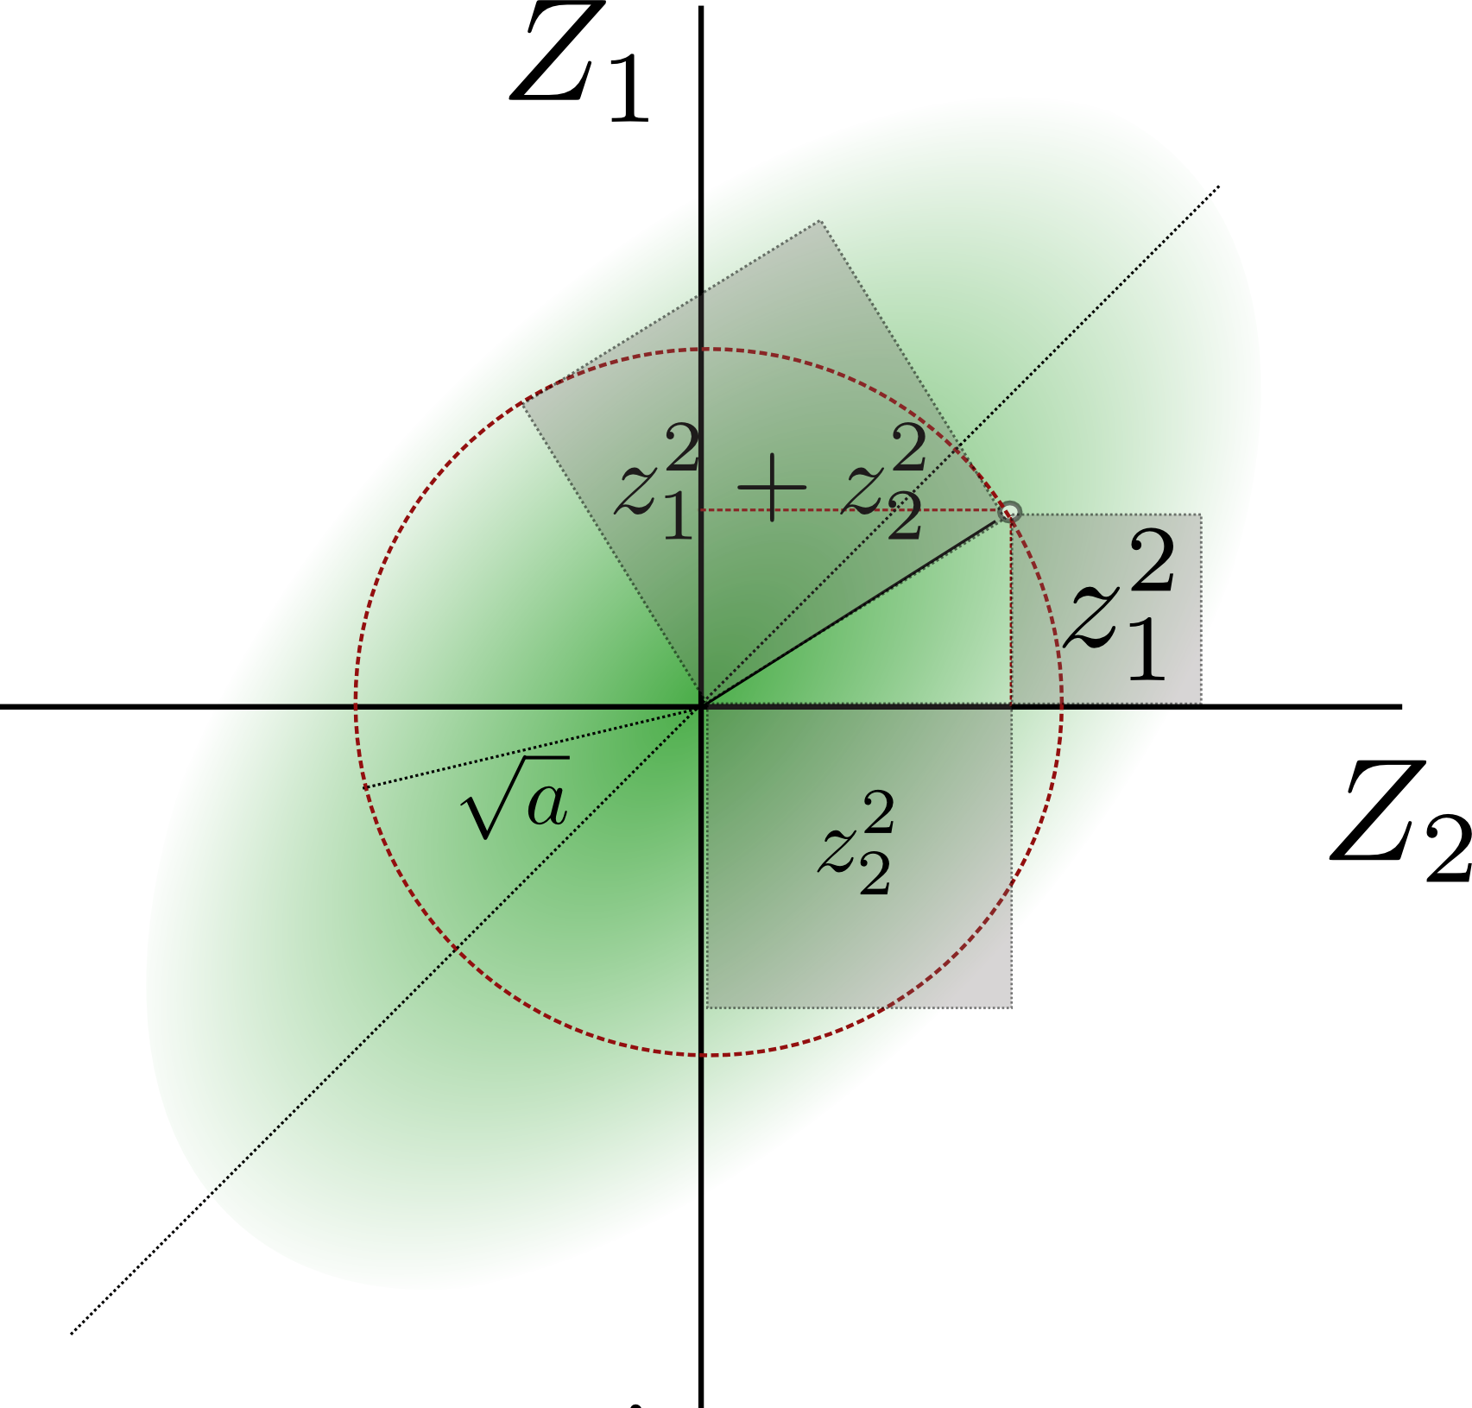
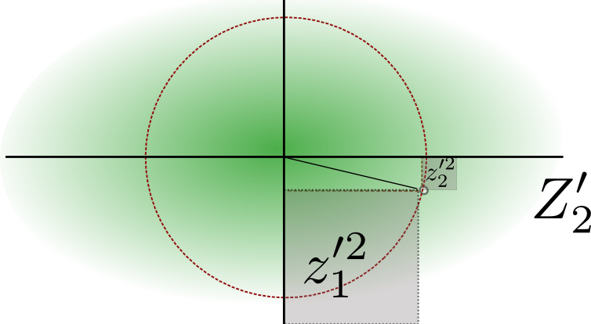
Intuitive answer:
Since a = z₁² + z₂² is rotationally invariant one just needs to find the proper coordinate system of the independent eigen-SNPs Z₁’ and Z₂’
So a ~ λ₁ χ₁² + λ₂ χ₂² follows a weighed χ² distribution
(with eigenvalues λ₁ and λ₂ from the SNP covariance matrix)
Notes:
La lèpre est une maladie chronique causée par le bacille Mycobacterium leprae.
Les chiffres officiels montrent que près de 182 000 personnes, résidant principalement en Asie et en Afrique, étaient infectées au début de 2012, et que 219 000 nouveaux cas environ ont été notifiés en 2011.
M. leprae se multiplie très lentement et la période d’incubation de la maladie est d’environ cinq ans. Les symptômes peuvent n’apparaître qu’au bout de 20 ans.
La lèpre n’est pas très contagieuse. Elle est transmise par des gouttelettes d’origine buccale ou nasale, lors de contacts étroits et fréquents avec un sujet infecté et non traité.
Faute de traitement, la lèpre peut entraîner des lésions progressives et permanentes de la peau, des nerfs, des membres et des yeux.
Un diagnostic précoce associé à un traitement par polychimiothérapie (PCT) restent les éléments clés pour éliminer la maladie en tant que problème de santé publique.

Slide 30
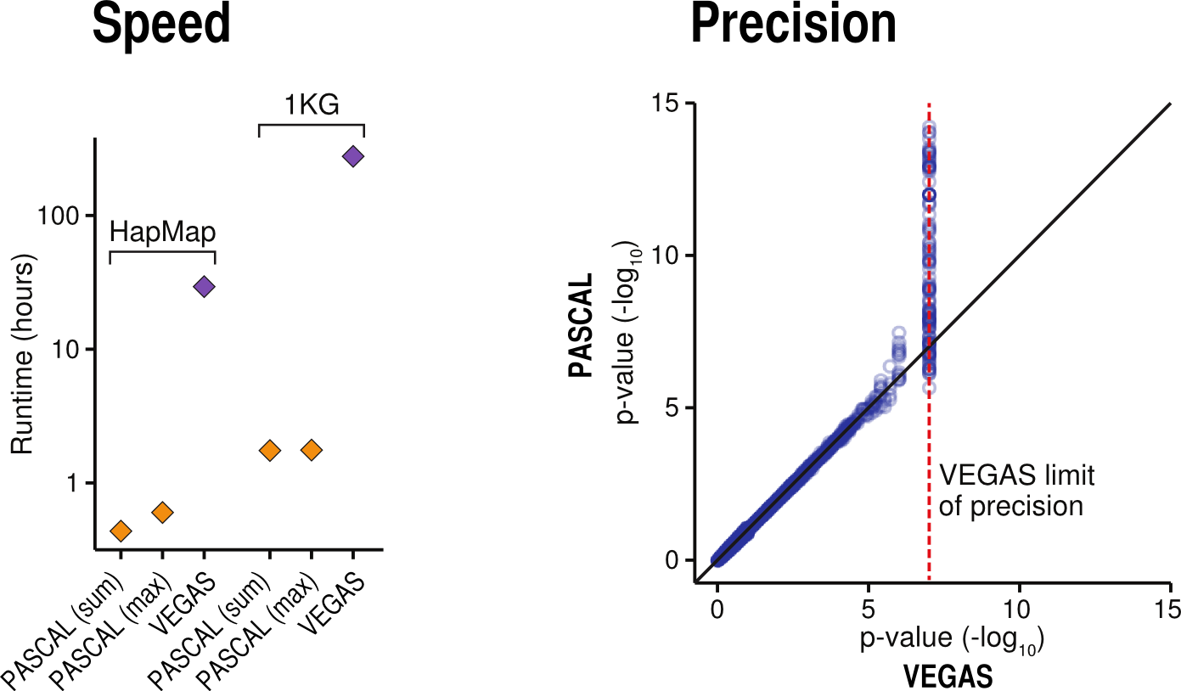
PASCAL vs VEGAS

Slide 31
PASCAL gene scoring overview
Notes:
La lèpre est une maladie chronique causée par le bacille Mycobacterium leprae.
Les chiffres officiels montrent que près de 182 000 personnes, résidant principalement en Asie et en Afrique, étaient infectées au début de 2012, et que 219 000 nouveaux cas environ ont été notifiés en 2011.
M. leprae se multiplie très lentement et la période d’incubation de la maladie est d’environ cinq ans. Les symptômes peuvent n’apparaître qu’au bout de 20 ans.
La lèpre n’est pas très contagieuse. Elle est transmise par des gouttelettes d’origine buccale ou nasale, lors de contacts étroits et fréquents avec un sujet infecté et non traité.
Faute de traitement, la lèpre peut entraîner des lésions progressives et permanentes de la peau, des nerfs, des membres et des yeux.
Un diagnostic précoce associé à un traitement par polychimiothérapie (PCT) restent les éléments clés pour éliminer la maladie en tant que problème de santé publique.

Slide 32
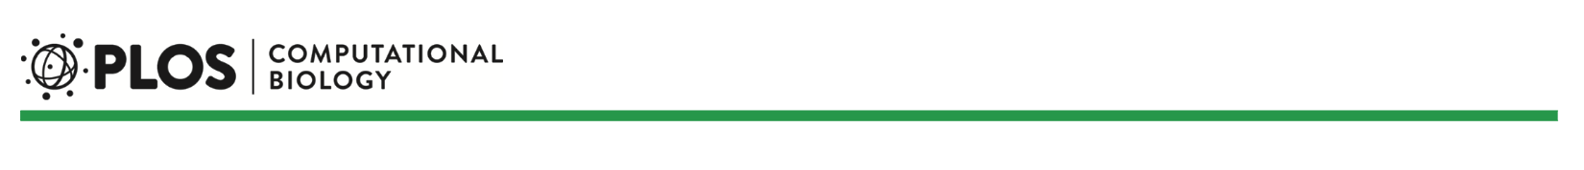
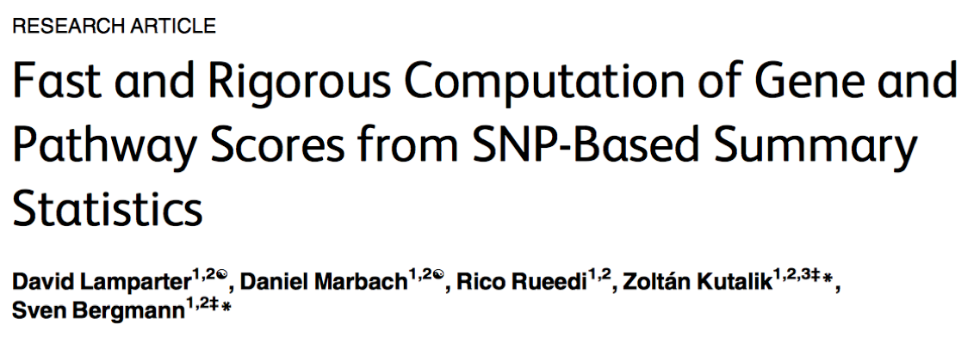
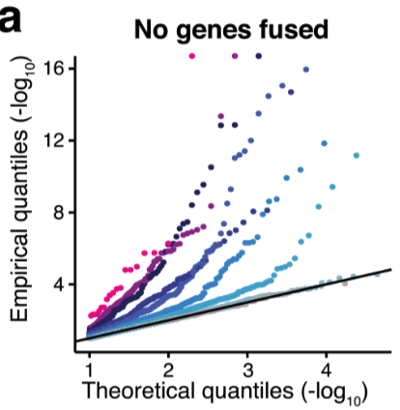
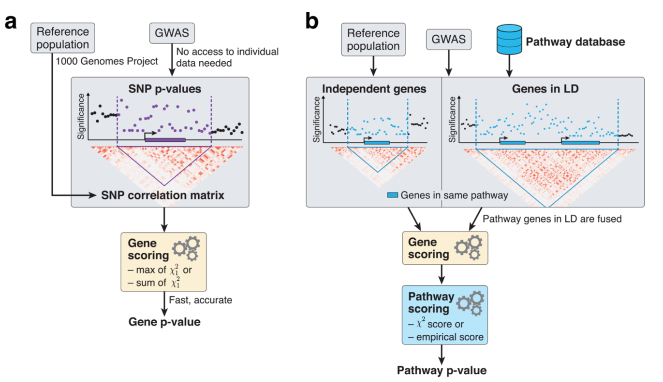
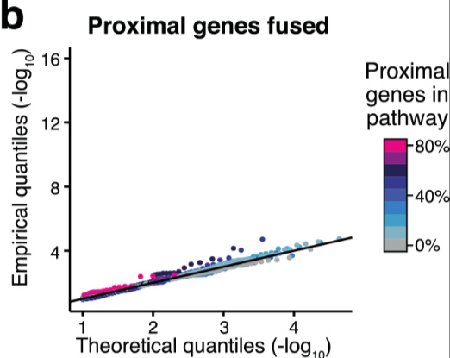
Pascal

Slide 34
Networks are ubiquitous in biology
Protein interactions
Metabolic networks
Co-expression
Homology
Signaling
Neurons
Species
…

Slide 35
Biological networks tend to be highly modular
But how best to identify modules from these networks?

Slide 36
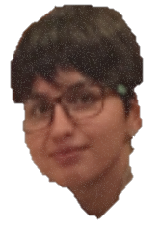
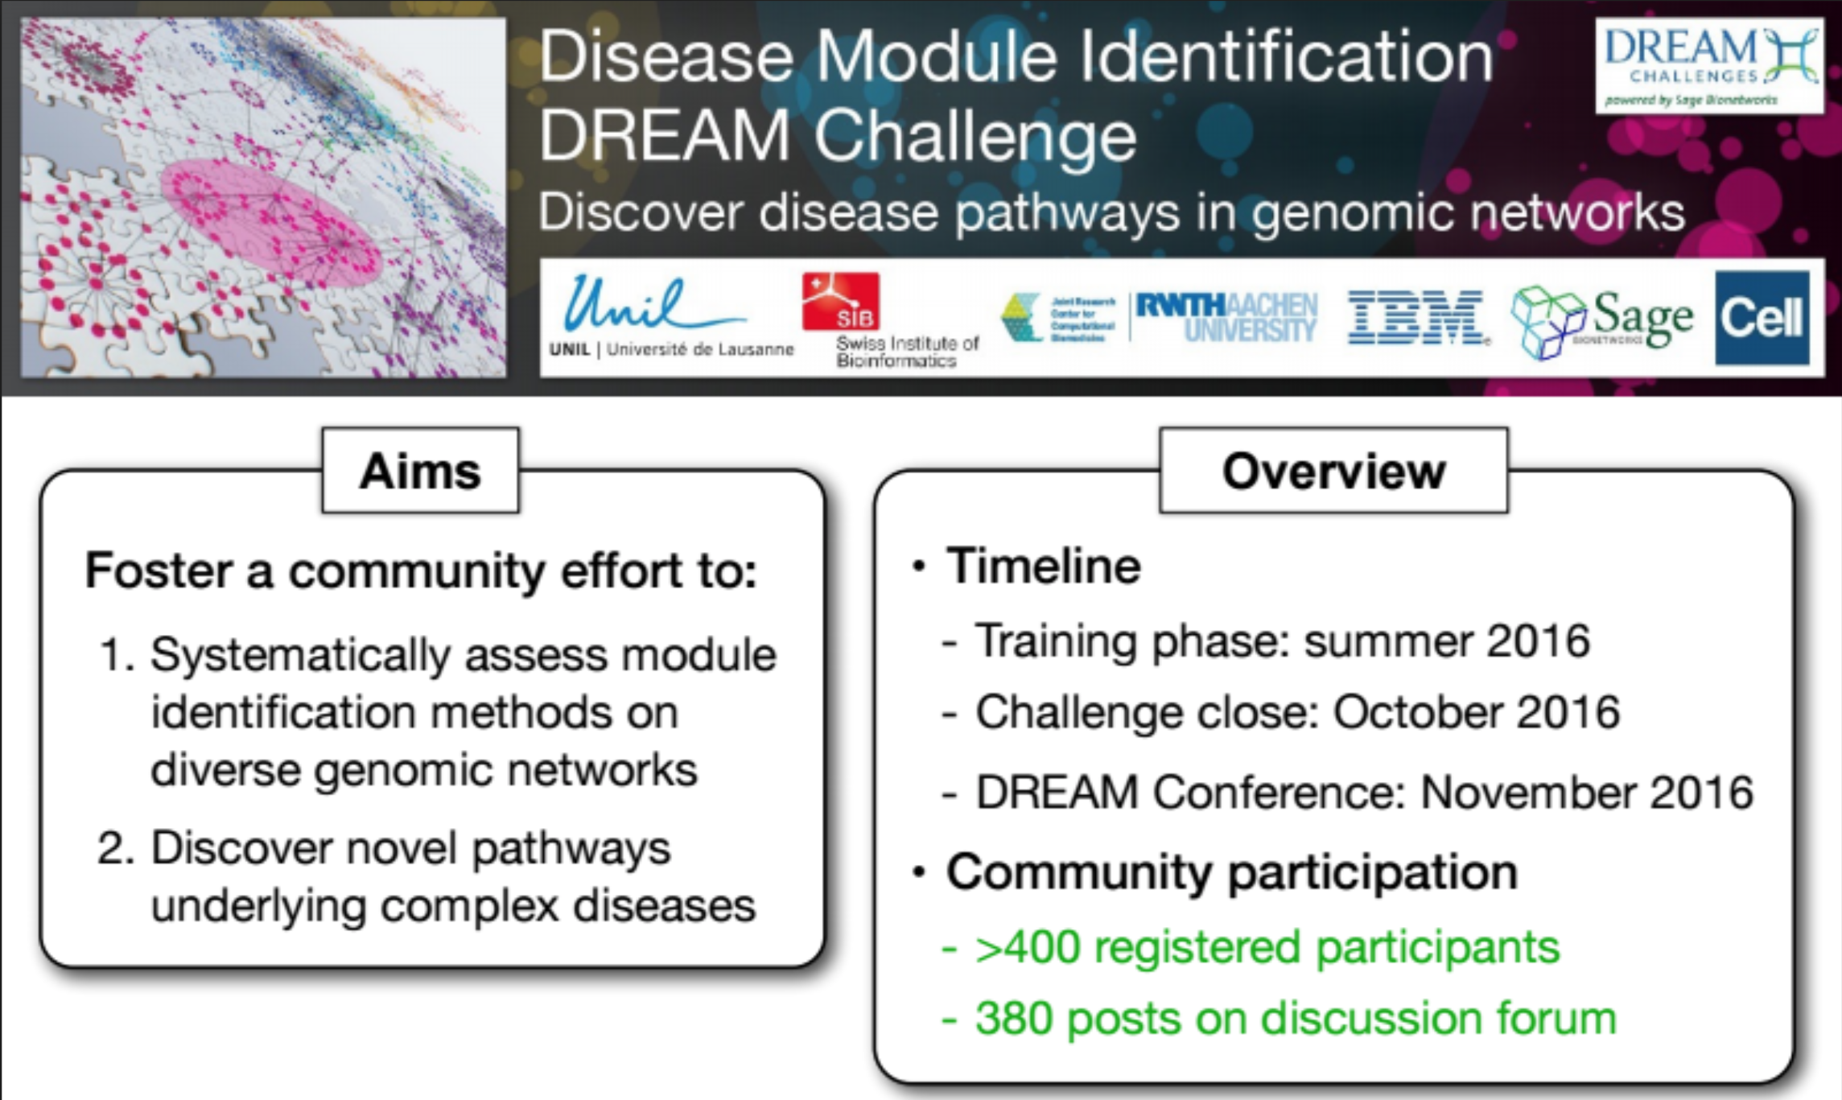
Network modularization as a community challenge

Slide 37
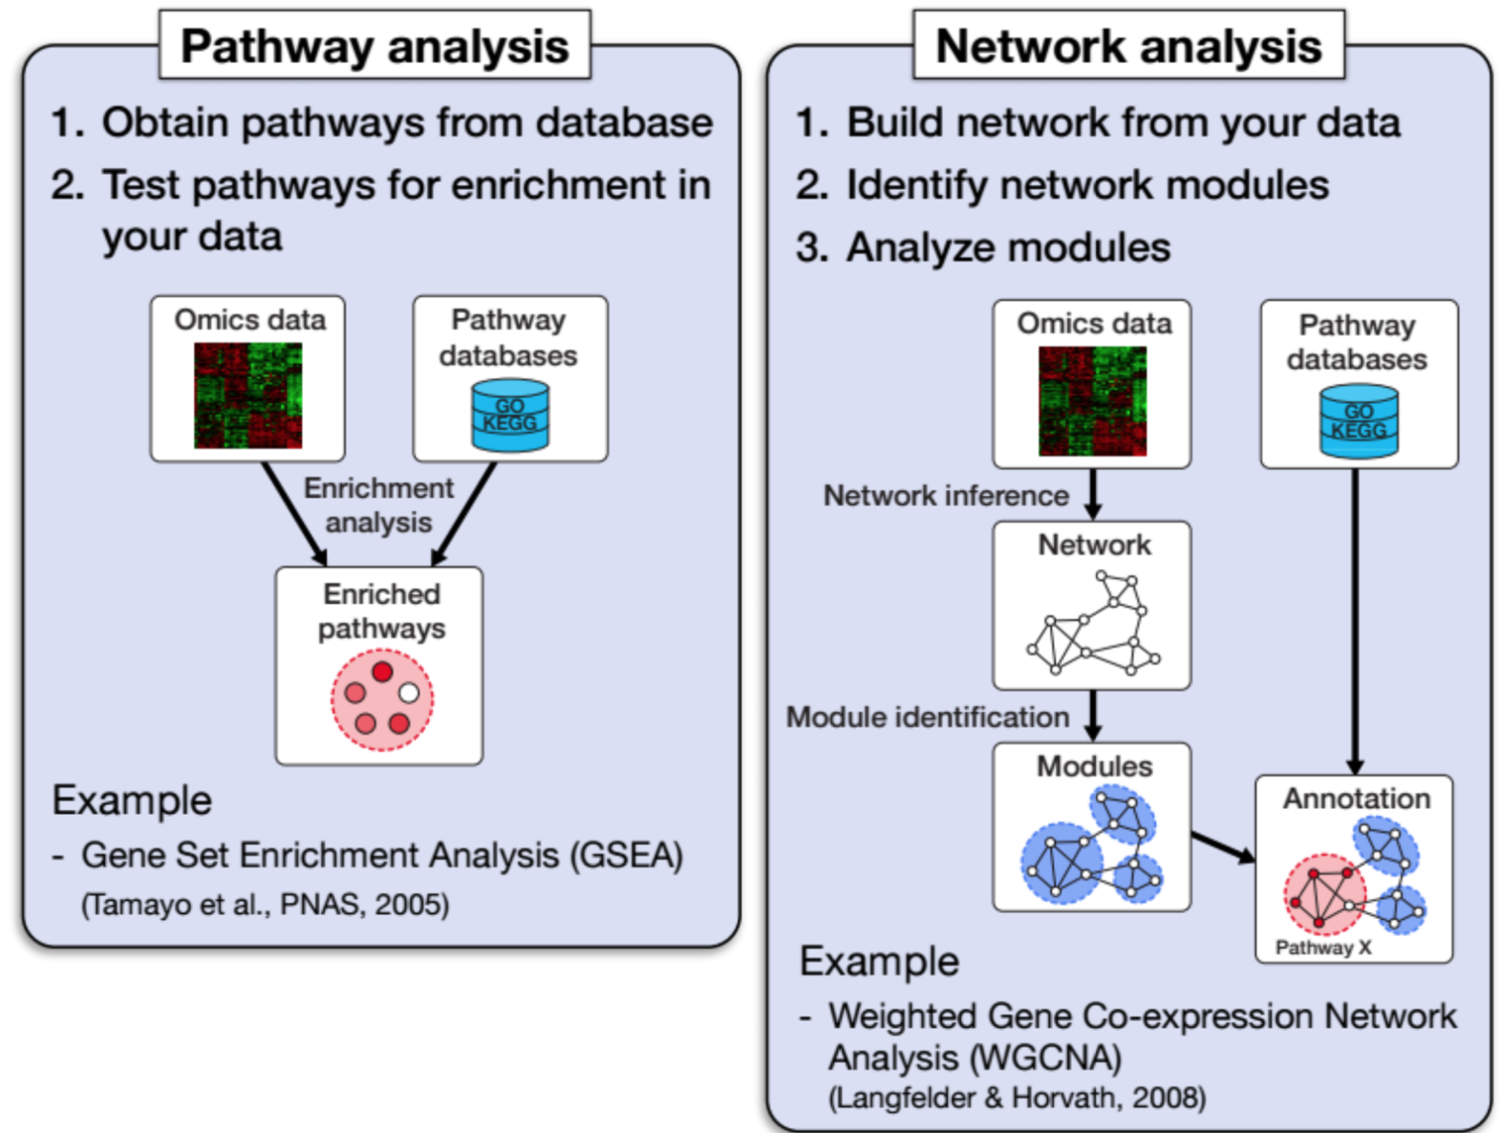
From pathway to network analysis

Slide 38
Our challenge design
Use GWAS data
Challenge task

Slide 39
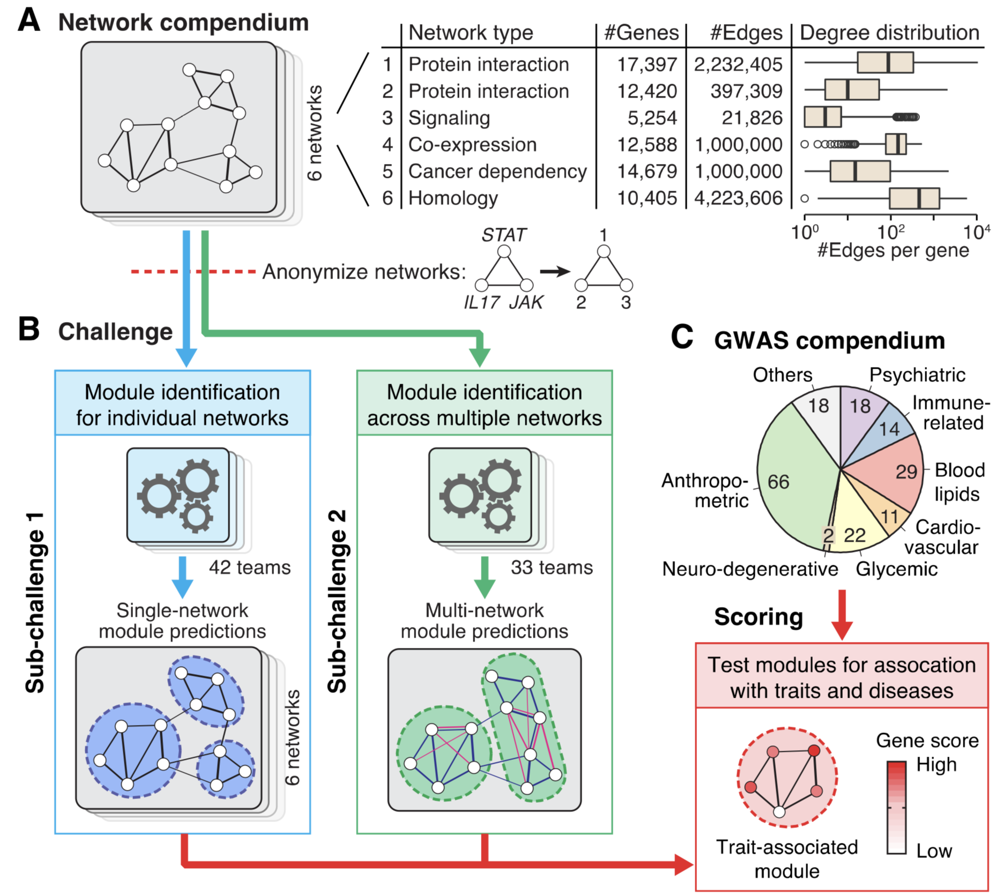
Input networks vary in properties

Slide 40
Analysis Pipeline

Slide 41
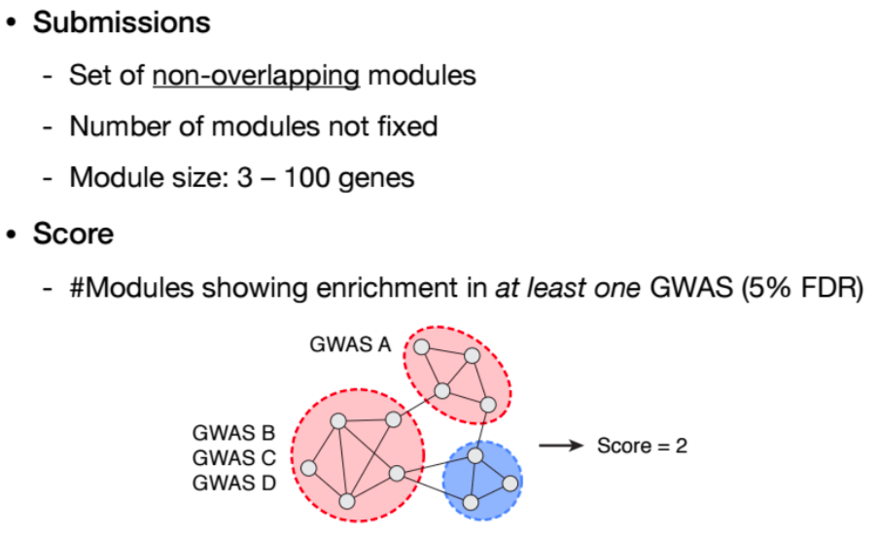
Scoring

Slide 42
Most methods were among the “Big five”

Slide 43
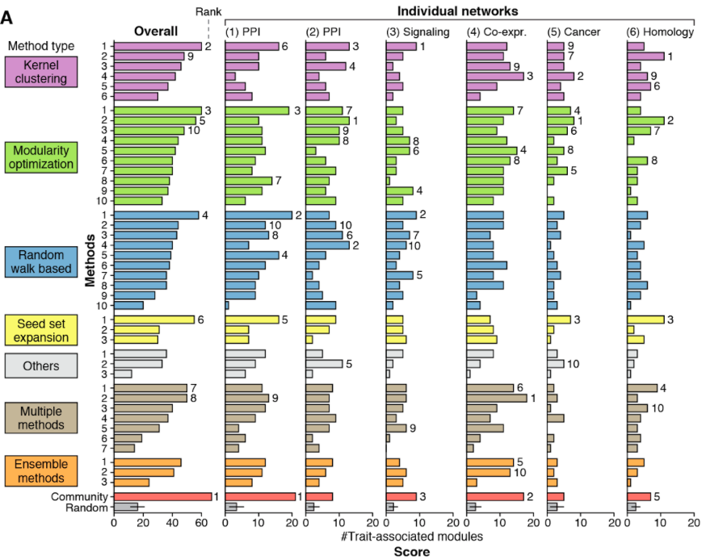
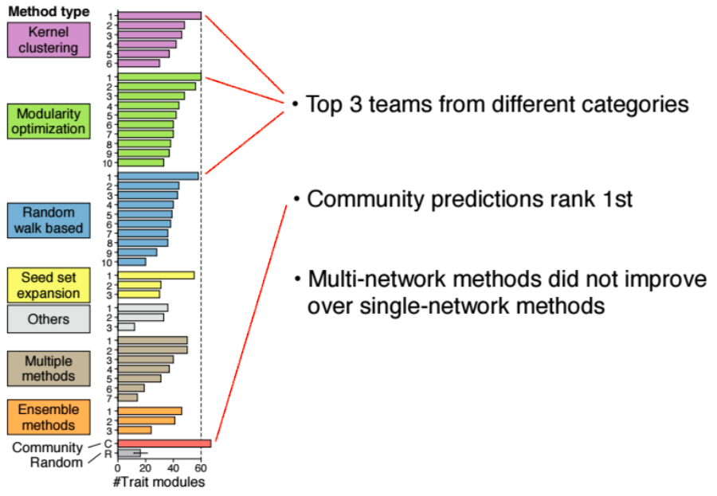
Top methods perform well on all networks

Slide 44
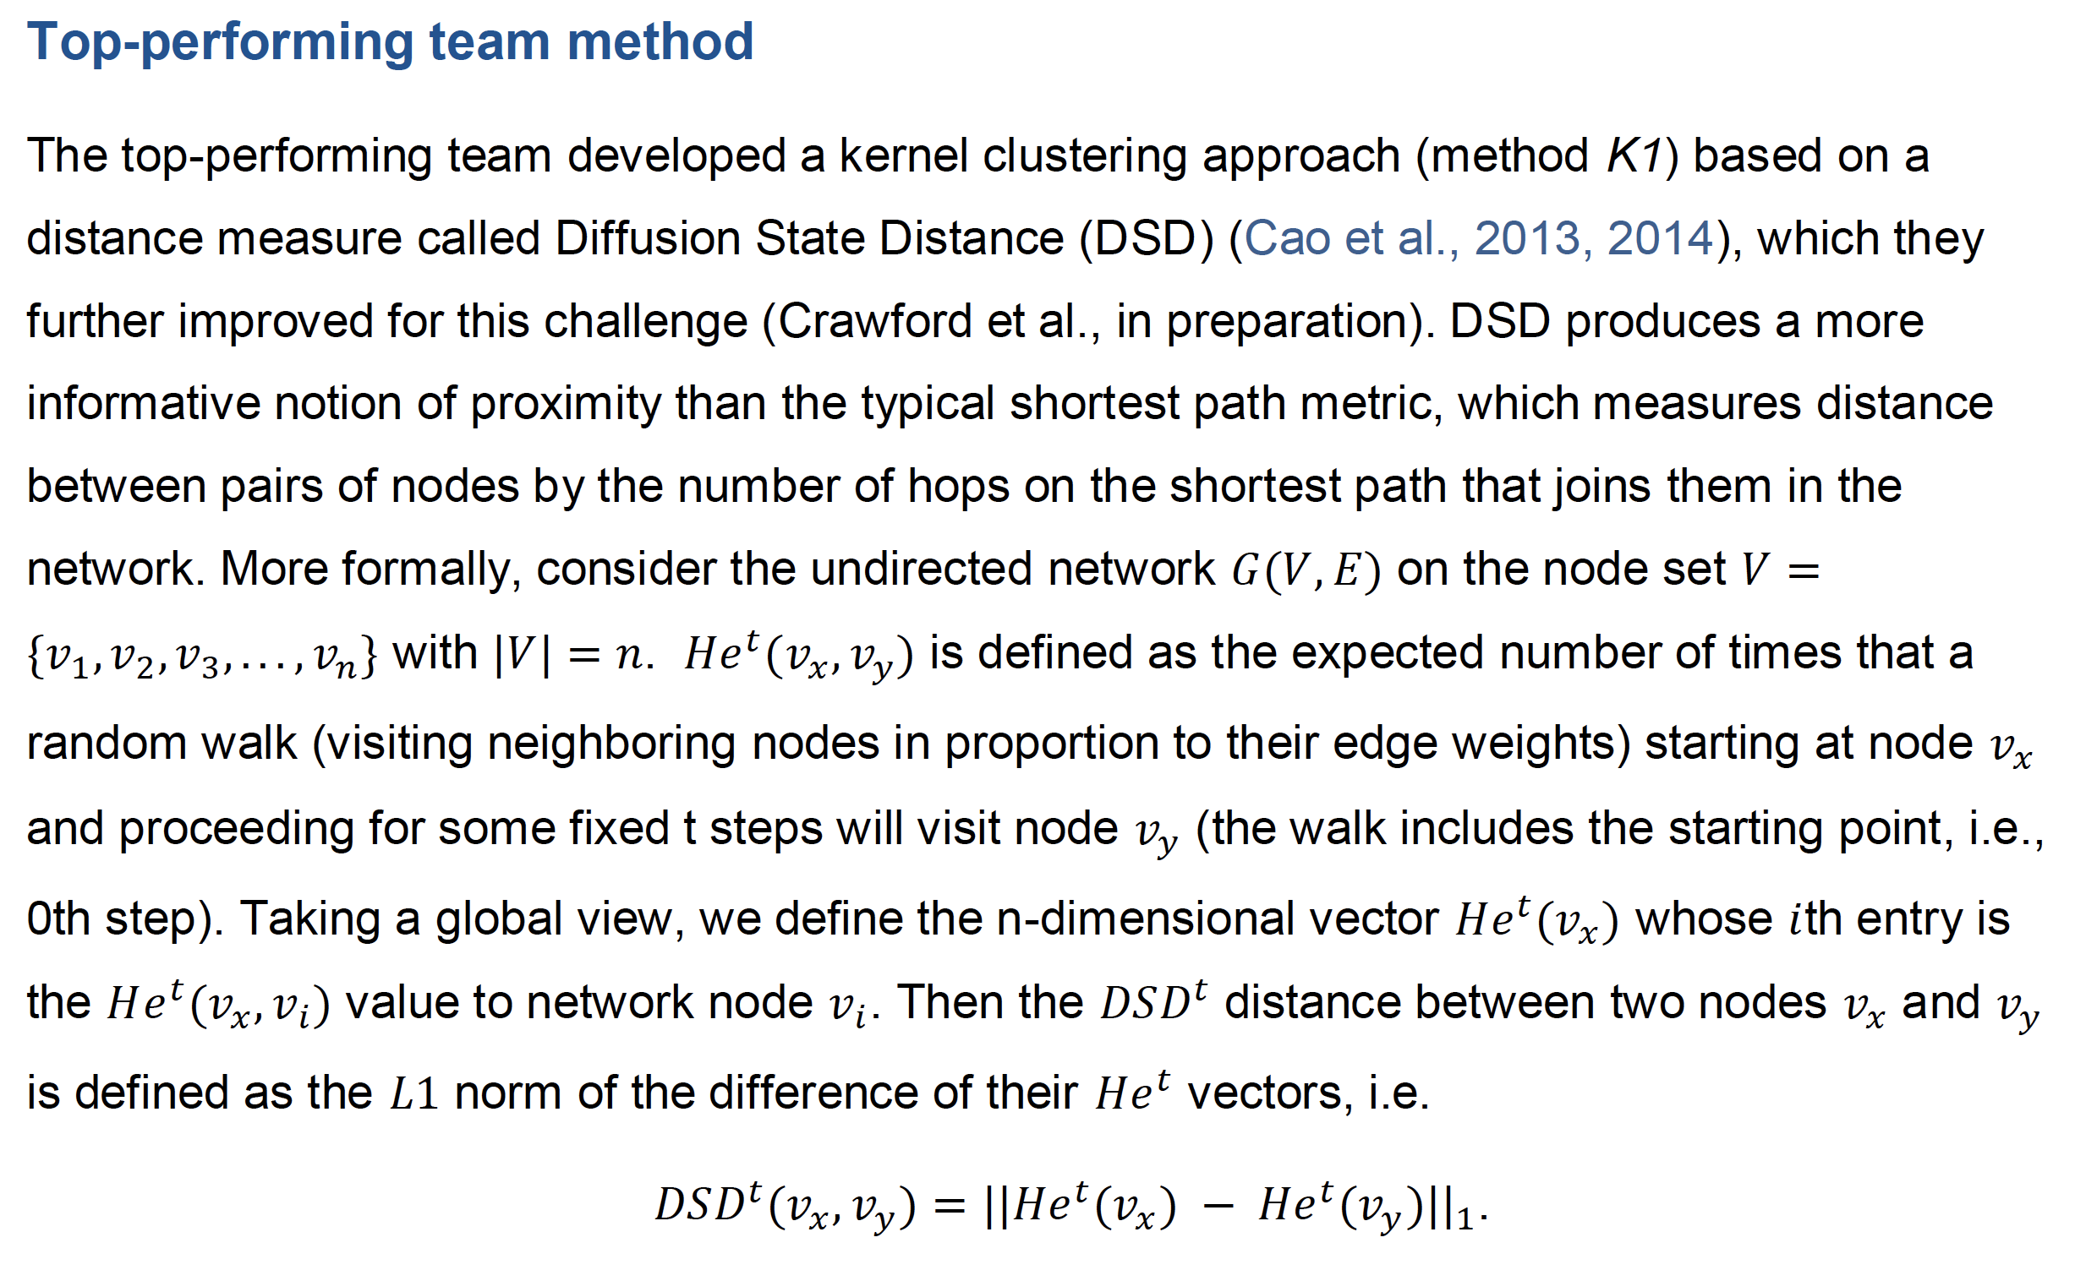
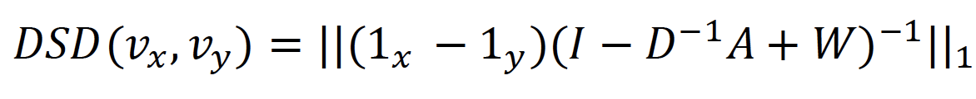
Top method defines a new distance measure Diffusion State Distance (DSD)

Slide 45
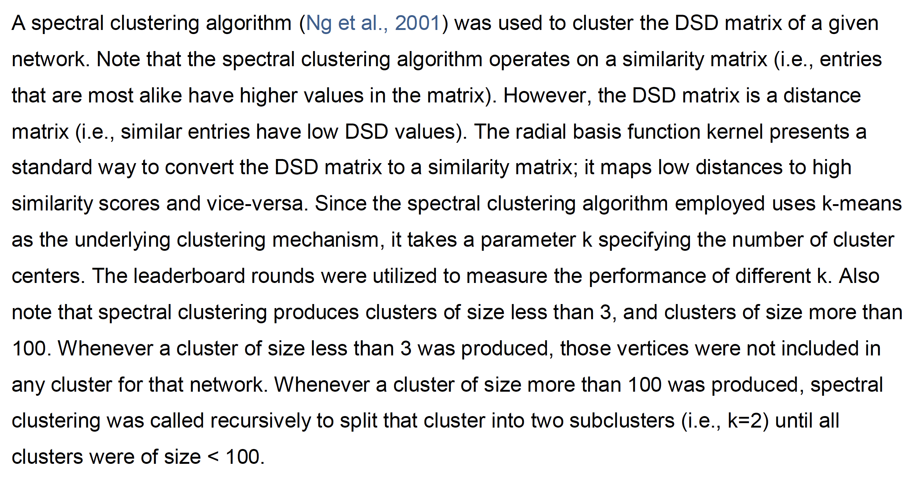
… and uses spectral clustering on the corresponding similarity measure

Slide 46
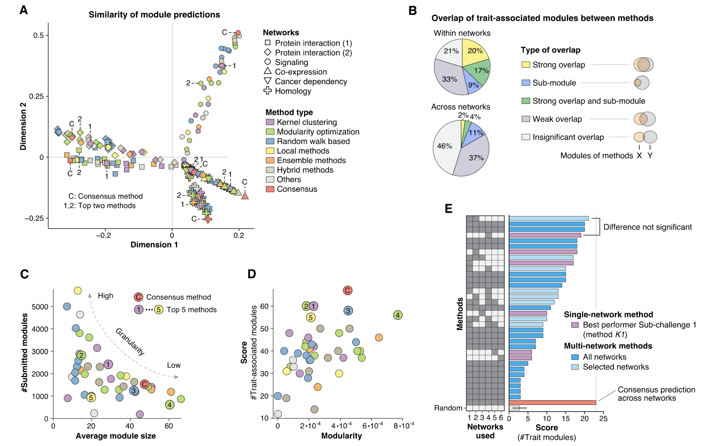
Module predictions depend more on networks than on methods

Slide 48
Average module size varies across top methods

Slide 49
Modularity varies across top methods

Slide 50
None of the methods performed well in Sub-challenge 2 (except consensus)

Slide 51
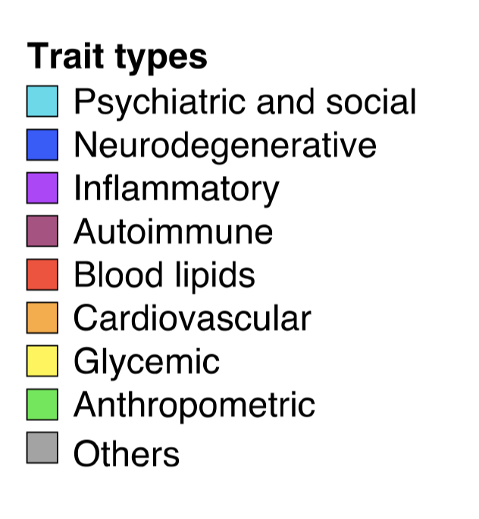
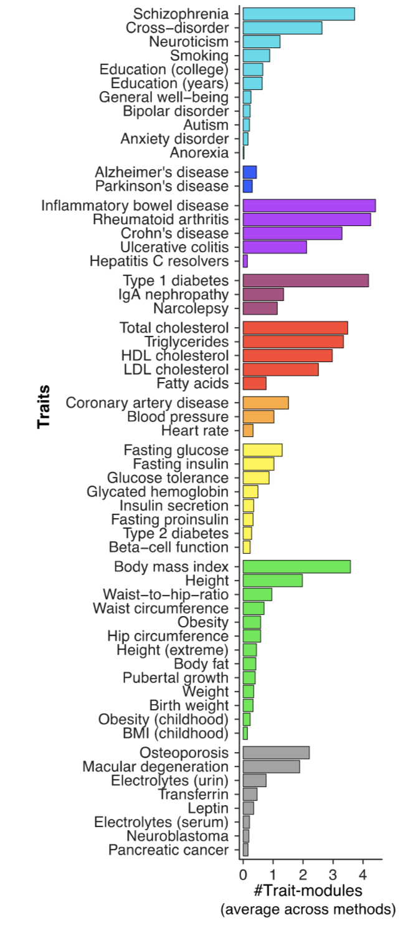
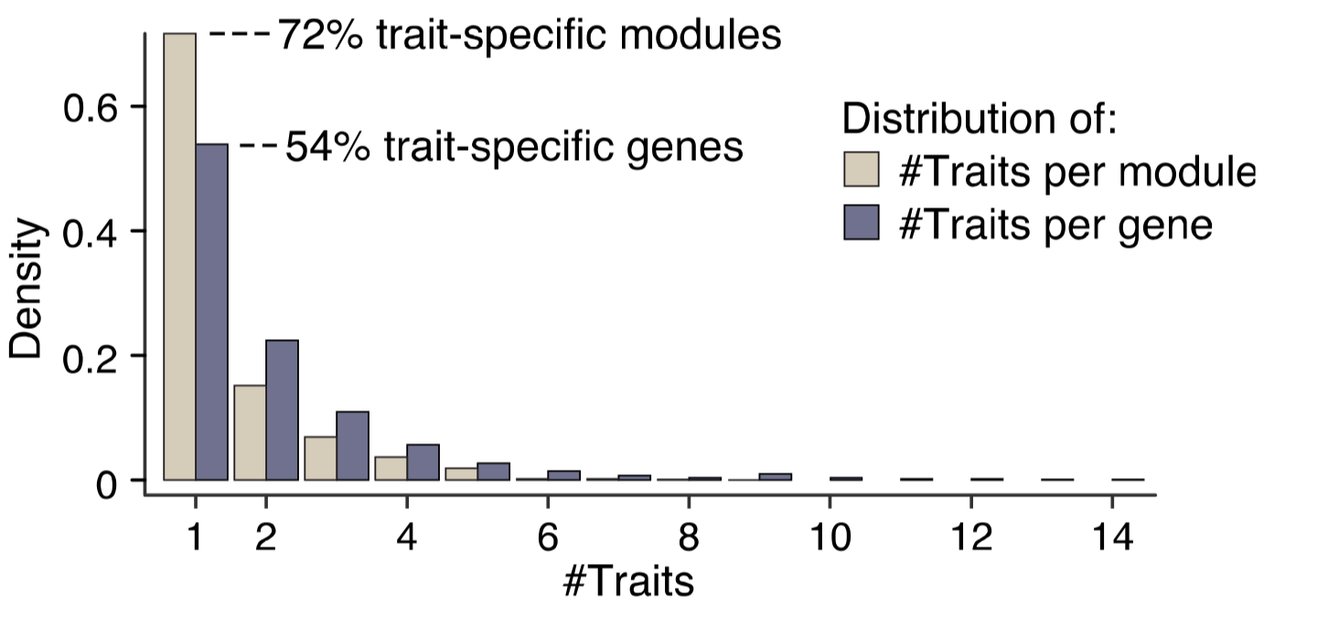
Modules are found across many traits

Slide 52
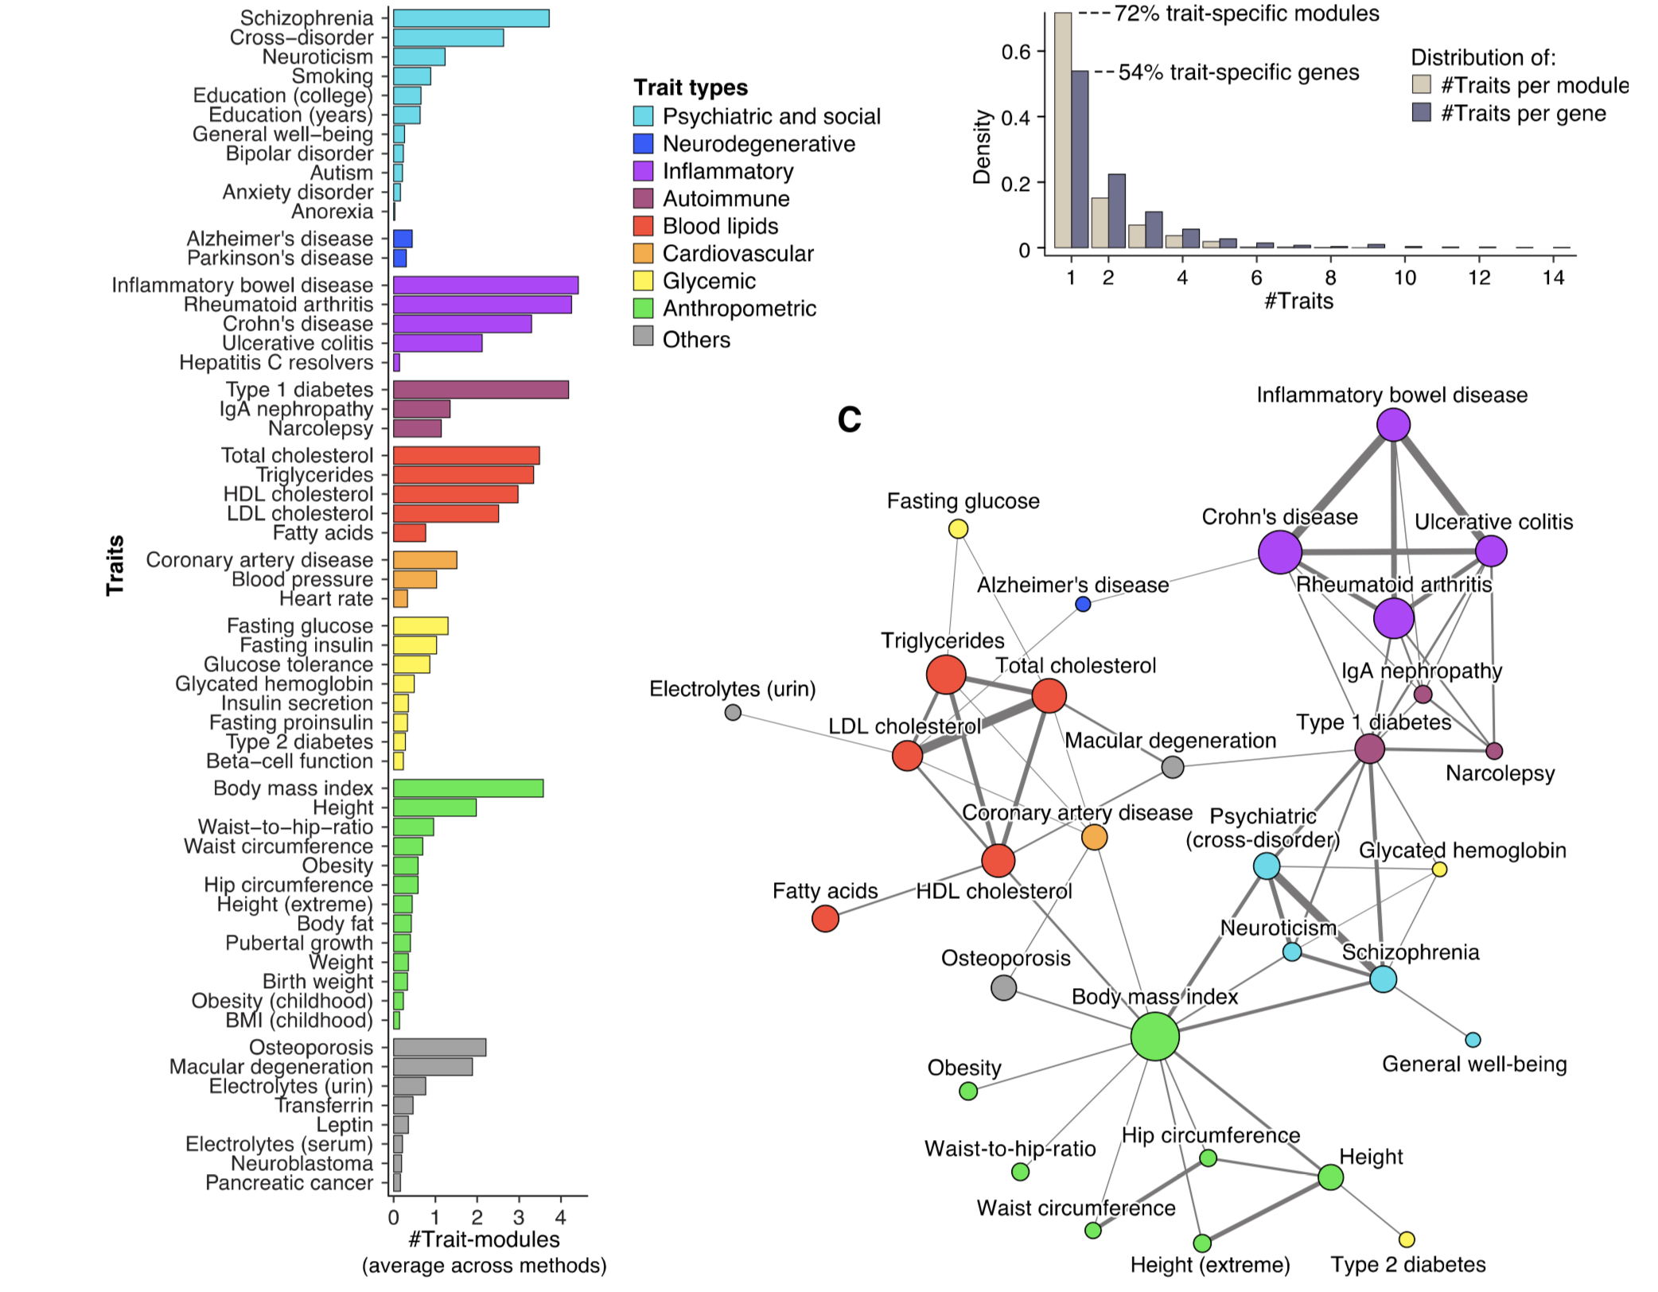
Traits & diseases cluster by joint modules

Slide 53
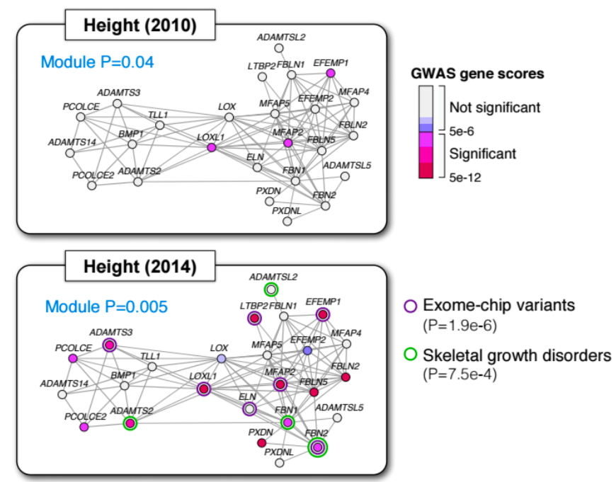
Marginally significant module from early GWAS on adult height

Slide 54
Recent high-powered study confirms many additional predicted players

Slide 55
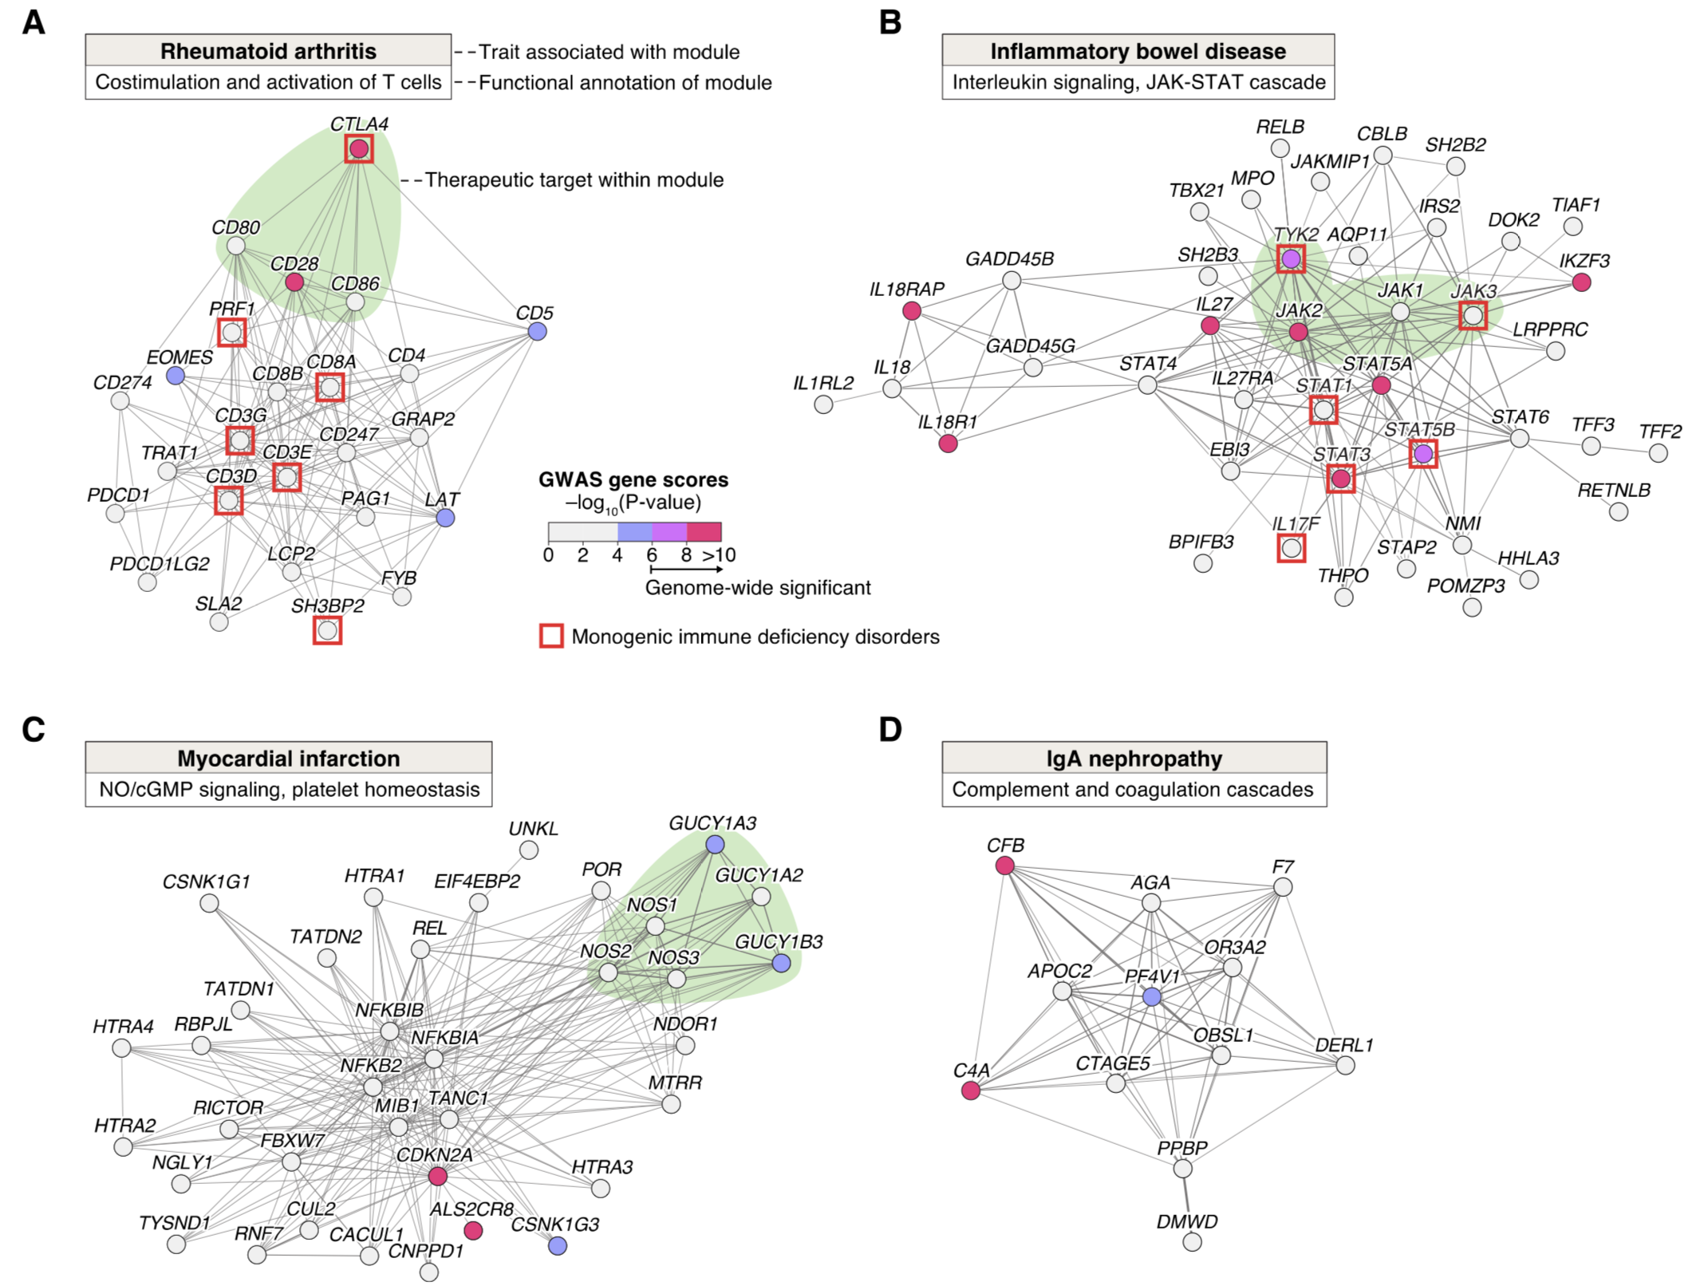

Slide 56
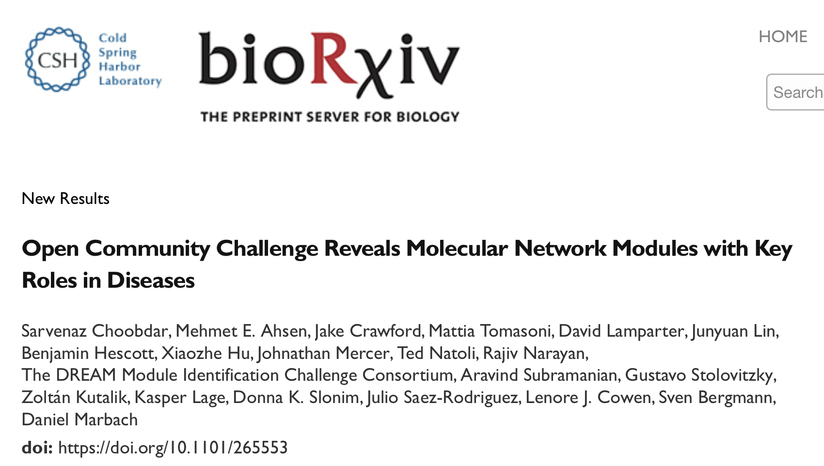
Take-home Messages:
Crowd-sourced challenge enables critical assessment of module identification methods
Top approaches recover complementary disease modules in diverse molecular networks
Molecular network modules reveal core pathways underlying complex traits and diseases
Notes:
Let me conclude by pointing out again my take-home messages:
The accumulation of large scale expression data makes comparative analysis of transcriptomes at all possible.
I have presented to you practical tools that allow for decomposing data into “transcription modules” in order to reduce the complexity of the expression data.
I have shown you how that sequence information can be used for “gene-mapping” in order to provide functional hypotheses.
Finally, I defined expression networks for the six organisms and showed that they share certain global properties,
Namely a power-law connectivity distribution and a high degree of clustering.
I would like to thank Naama for her excellent guidance and support and the whole group for the very nice working atmosphere.

