Slide 1
Retina image analyses
Michael Beyeler: michael.beyeler@unil.ch

Slide 2
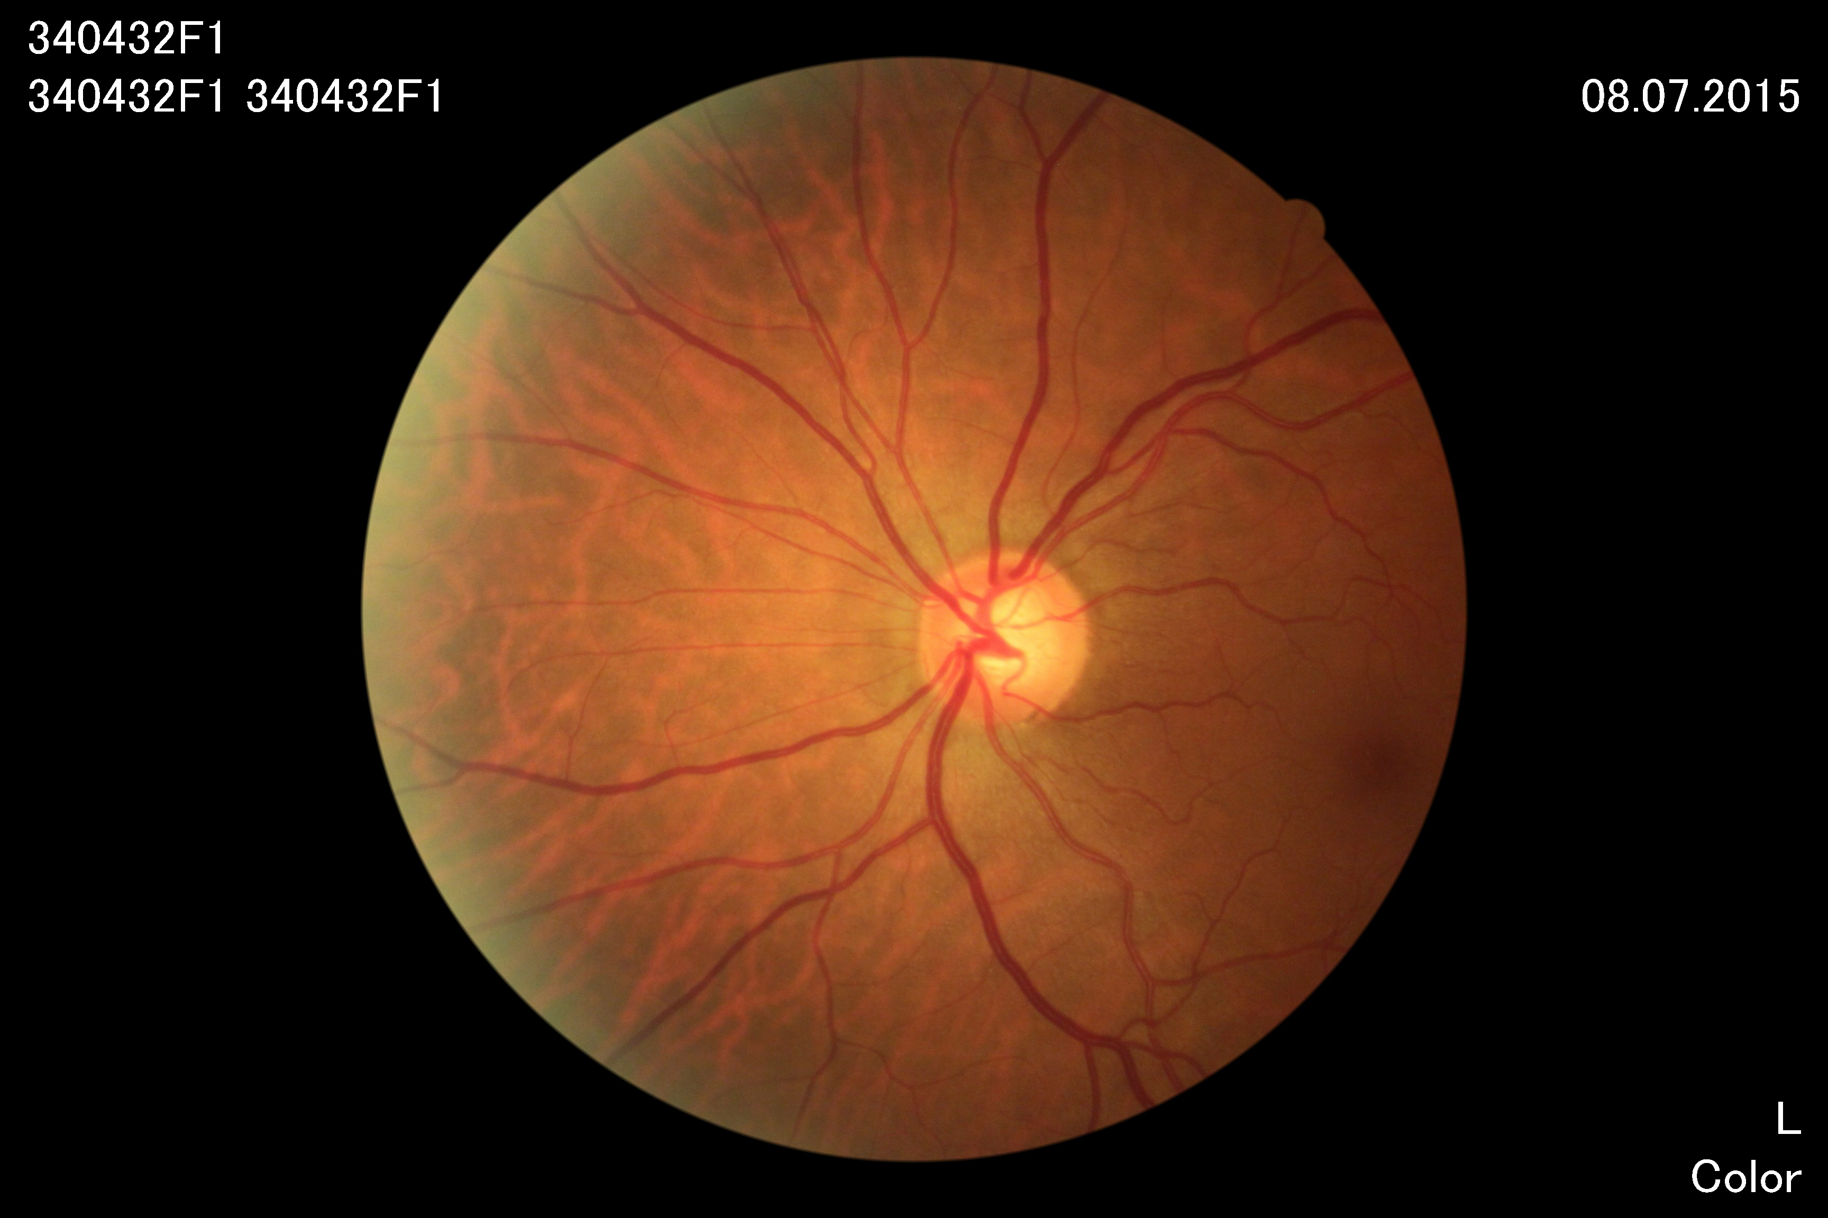
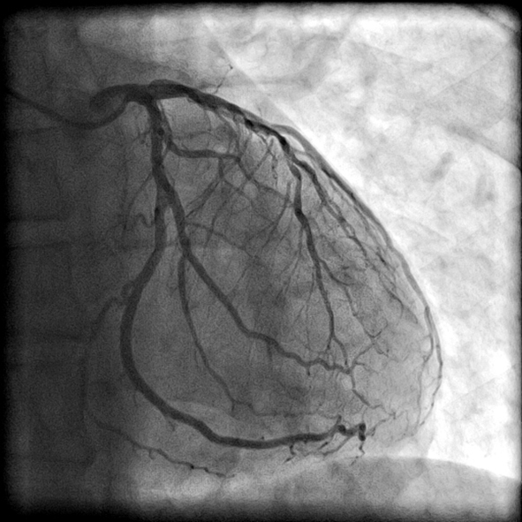
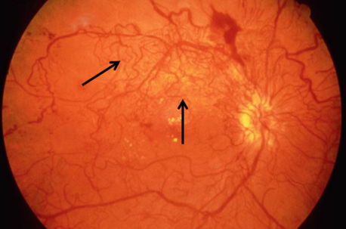
The inner eye varies between people
Fundus images
Depict
Vasculature
Optic nerve
Fovea
Multiple layers of semi-transparent tissue
Can show evidence for diseases
Related to eye
Glaucoma
neovascularization
Systemic to vasculature
cardiovascular disease (CVD)
Hypertension
Body-wide
diabetes
Notes:
FOVEA: best vision, lies in center of macula (dark spot)
Arteriolar tortuosity: less is associated with higher blood pressure, higher BMI
Venular tortuosity: more associated with lower HDL, higher blood pressure

Slide 3
We linked vessel properties to disease and genetic structure
Linked disease outcomes
Angina
Heart attack
Hypertension
Genetic structure
Tomasoni 2021, medRXiv
https://www.medrxiv.org/content/10.1101/2020.06.25.20139725v2.full.pdf

Slide 4
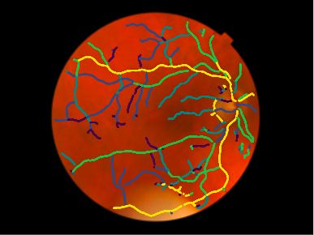
Taking measurements from eyes
1) We extracted vessel segments for thousands of images
2) We then reduced segment measurements to single number:
$tortuosity_{image}=Median\left(\left\{tortuosity_{segment}\right\}\right)$
Measured segment properties:
Thickness
Tortuosity
Likelihood of beeing artery or vein
Notes:
Mention previous software, talk about center image

Slide 5
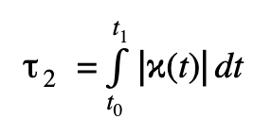
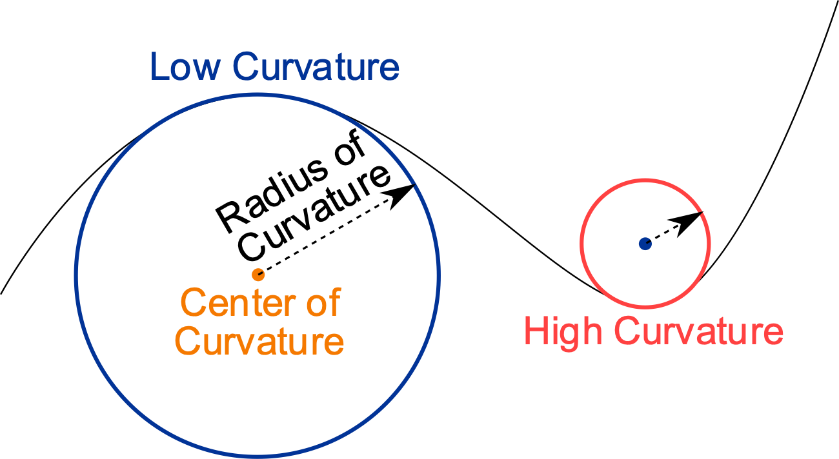
Tortuosity
Distance factor
Curvature-based
where
arc
chord
$$τ_{DF}=\frac{arc}{chord}$$

Slide 6
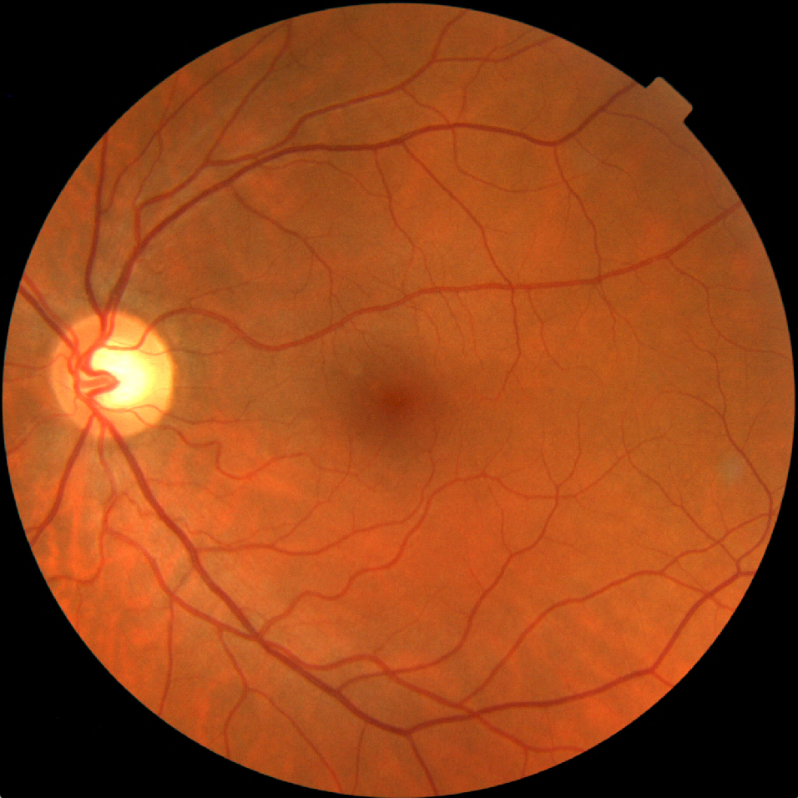
Your project
Implement measurements of tortuosity
Does tortuosity vary as a function of vessel thickness?
Can we narrow down tortuosity to specific locations?
What you will learn
Coding Python or Matlab, maybe Shell scripting
Quality judgements of measurables
Contact: michael.beyeler@unil.ch

