Slide 1
Genetics and Genome Evolution (GGE)
Bioinformatics for Genomics
Lecture 2:
Clustering
Sven Bergmann
Department of Computational Biology
(Sven.Bergmann@unil.ch)

Slide 2
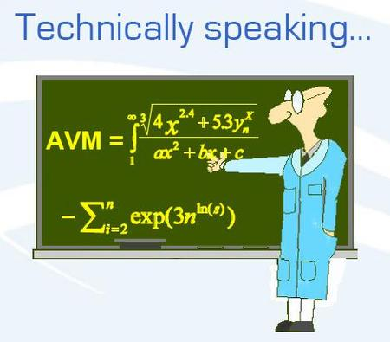
Analysis tools for large datasets
Standard tools
k-means, PCA, SVD
Modular analysis tools
CTWC, ISA, PPA

Slide 3
Motivations
Why to study a large heterogeneous set of expression data?
  Large: Better signals from noisy data!
  Heterogeneous: Global view at transcription program!
Supervised vs. unsupervised approaches
  Large genome-wide data may contain answers to questions we do not ask! Need for both hypothesis-driven and exploratory analyses!

Slide 4
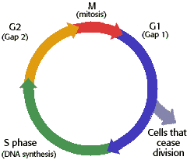
How to get large-scale expression data?
Pool genome-wide expression measurements from many experiments!
cell-
cycle
large-scale
expression data
stress
genes
sets of specific conditions
diverse conditions

Slide 5

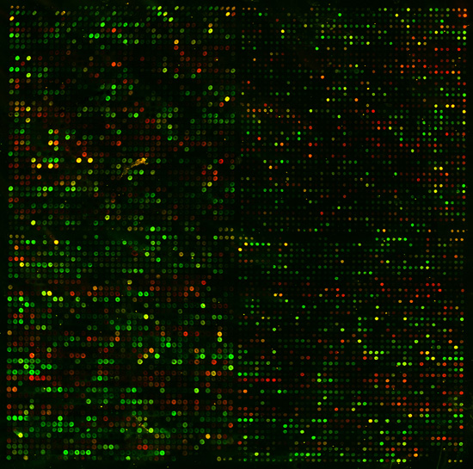
How to make sense of millions of numbers?
Hundreds of samples
Thousands
of genes
New Analysis and Visualization Tools are needed!

Slide 6
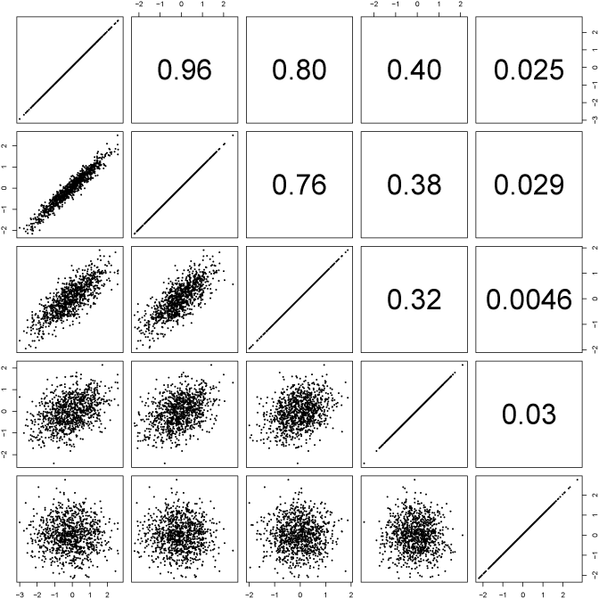
Pearson correlations (Graphic)
Each dot is
a pair (x_{i},y_{i})
Y = (y_{i})
X = (x_{i})
Comparing profiles X and Y (not distributions!):
What is the tendency that high/low values in X match high/low values in Y?
http://davidmlane.com/hyperstat/A34739.html

Slide 7


Pearson correlations: Formulae
r
(complicated version)
(simple version using z-scores)

Slide 8



Pearson correlations: Intuition
Similarity according to all conditions
(“Democratic vote”)
conditions
gene
1
r₁₂ ~ 1
2
1
2
3
4
5
Clustering-coefficient
gene
1
r₁₂ ~ 0
2
1
2
3
4
5
gene
1
r₁₂ ~ -1
2
1
2
3
4
5

Slide 9
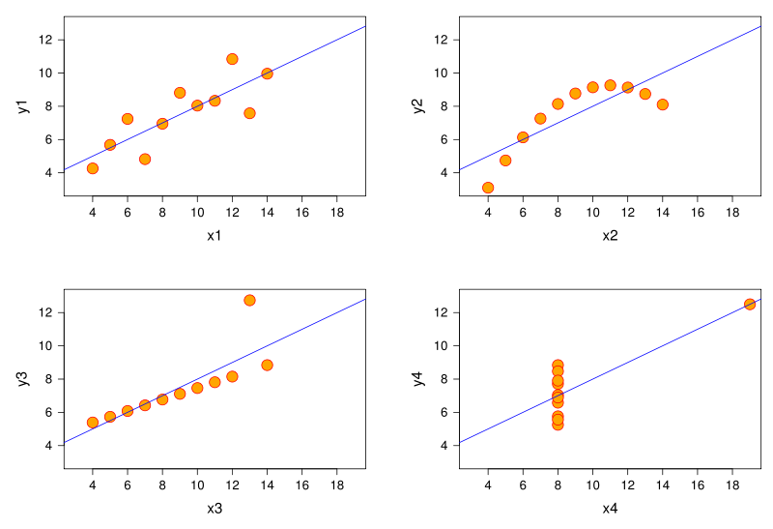
Pearson correlations: Caution!
r=0.8
r=0.8
r=0.8
r=0.8
High correlation does not necessarily mean co-linearity!

Slide 10
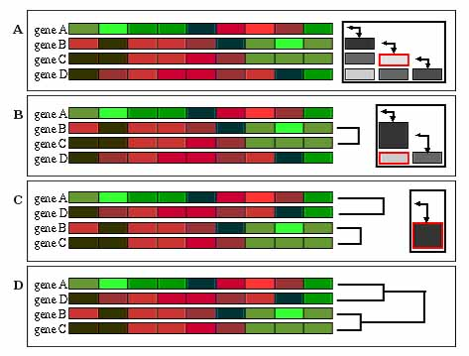
(Hierarchical Agglomerative) Clustering
Join most correlated samples and replace correlations
to remaining samples by average, then iterate …
http://gepas.bioinfo.cipf.es/cgi-bin/tutoX?c=clustering/clustering.config

Slide 11
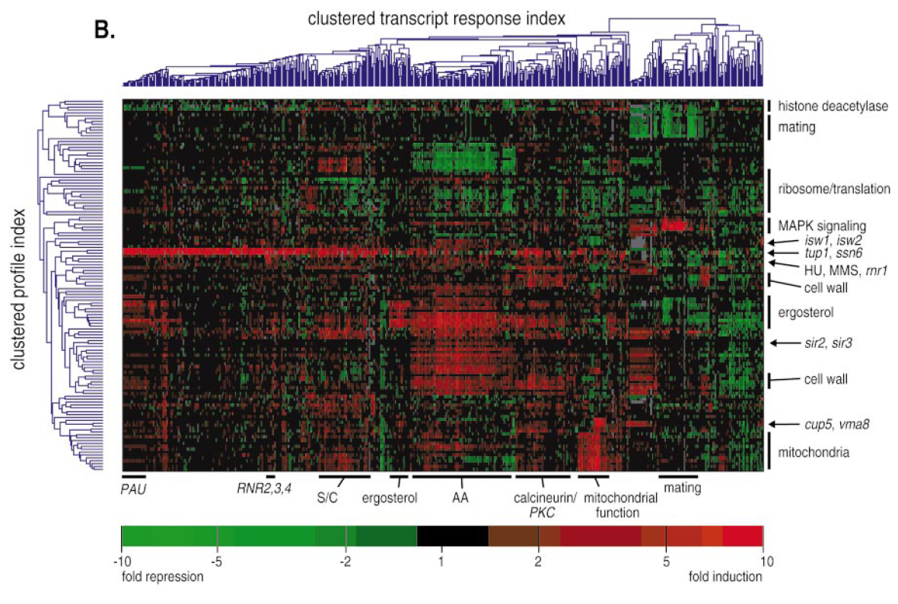
Clustering of the real expression data

Slide 12
K-means Clustering
“guess” k=3 (# of clusters)
http://en.wikipedia.org/wiki/K-means_algorithm

Slide 13
K-means Clustering
“guess” k=3 (# of clusters)
1. Start with random positions of centroids ( )
http://en.wikipedia.org/wiki/K-means_algorithm

Slide 14
K-means Clustering
“guess” k=3 (# of clusters)
1. Start with random positions of centroids ( )
2. Assign each data point to closest centroid
http://en.wikipedia.org/wiki/K-means_algorithm

Slide 15
K-means Clustering
“guess” k=3 (# of clusters)
1. Start with random positions of centroids ( )
2. Assign each data point to closest centroid
3. Move centroids to center of assigned points
http://en.wikipedia.org/wiki/K-means_algorithm

Slide 16

K-means Clustering
“guess” k=3 (# of clusters)
1. Start with random positions of centroids ( )
2. Assign each data point to closest centroid
3. Move centroids to center of assigned points
Iterate 1-3 until minimal cost
with k clusters S_{i}, i = 1,2,...,k and centroids μ_{i} (the mean point of all the points )

Slide 17
K-means Clustering
Plus:
visual
intuitive
relatively fast
Minus:
have to “guess” number of clusters
can give different results for distinct
“starting seeds”
distances computed over all features
one cluster only per element
no cluster hierarchy

Slide 18
Hierachical Clustering
Plus:
Shows (re-orderd) data
Gives hierarchy
Minus:
Does not work well for many genes
(usually apply cut-off on fold-change)
Similarity over all genes/conditions
Clusters do not overlap

Slide 19
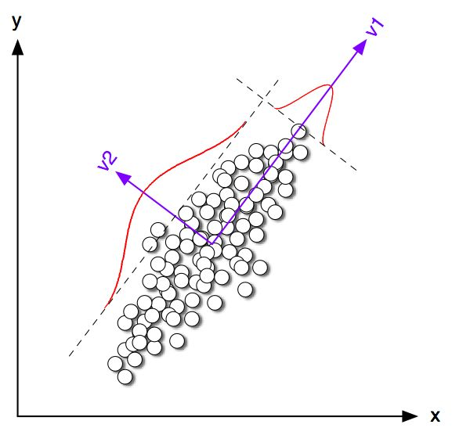
Principle Component Analysis
Principle components (PCs) are projections onto
subspace with the largest variation in the data
http://csnet.otago.ac.nz/cosc453/student_tutorials/principal_components.pdf

Slide 20
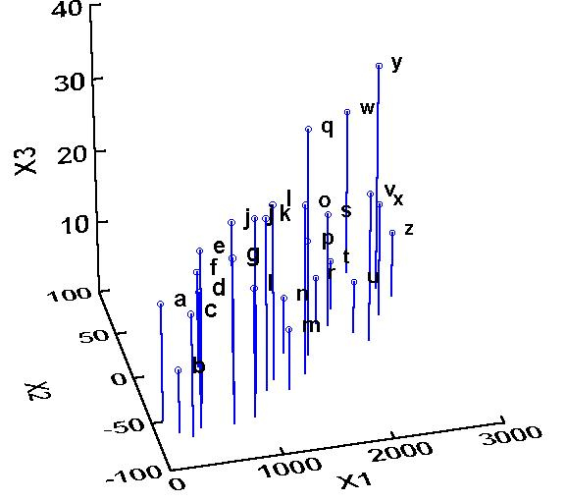
Example: 2PCs for 3d-data
Raw data points: {a, …, z}
http://ordination.okstate.edu/PCA.htm

Slide 21
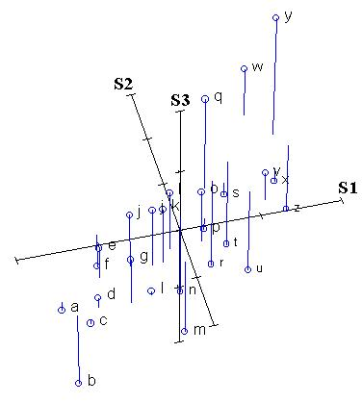
Example: 2PCs for 3d-data
Normalized data points: zero mean (& unit std)!
http://ordination.okstate.edu/PCA.htm

Slide 22
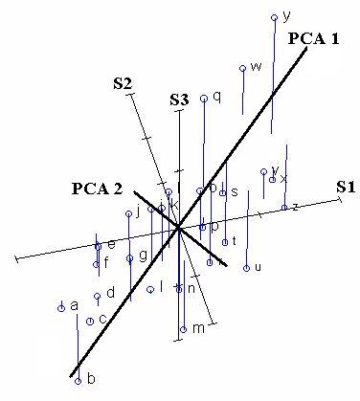
Example: 2PCs for 3d-data
The direction of most variance perpendicular to PCA1 defines PCA2
Most variance is along PCA1
Identification of axes with the most variance
http://ordination.okstate.edu/PCA.htm

Slide 23
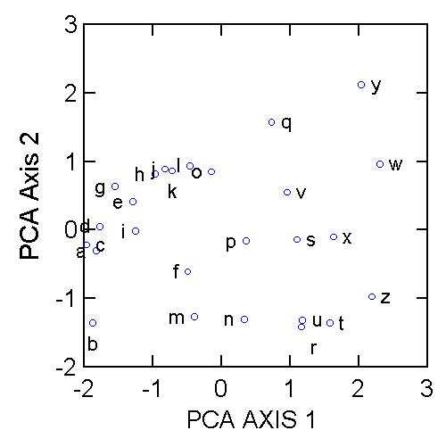
Example: 2PCs for 3d-data
Cluster?
http://ordination.okstate.edu/PCA.htm

Slide 24

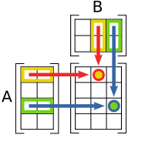


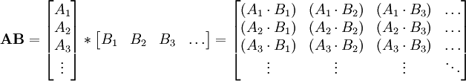

Reminder: Matrix multiplications
Definition:
Scheme:
Vectorized:
Example:
http://en.wikipedia.org/wiki/Matrix_multiplication

Slide 25
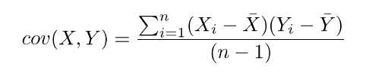
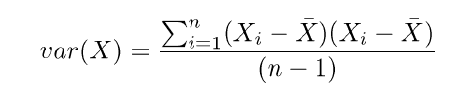
How do we get the PCs?
The PCs are the eigenvectors of the covariance matrix C computed from the (mean-centered) data matrix E:
C = E^{T}·E /(n-1)
C·pc = λ·pc

Slide 26
PCA: Example deletion mutants
1
300
1
30k
1
300
C
=
E^{T}
·
E
C = E^{T}·E /(n-1)
300
300
/(n-1)
30k
1
300
1
λ
1
C·pc = λ·pc
C
·
=
·
300
300
pc
300

Slide 27
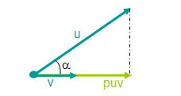
And how to project?
The projected data is just the product of the original data with the PCs:
E’ = E · PC
Principle Component or Transformation Matrix:
PC = [pc₁, pc₂, …, pc_{n}]
(where n is the number of PCs used)

Slide 28
PCA: Example deletion mutants
1
n
1
300
1
E’
E
…
E’ = E · PC
=
·
1
2
n
300
30k
30k
The original gene expression profiles are for 30k genes over 300 samples.
The transformed data contain projections on n “eigen-genes”
(linear combinations of the 300 arrays shown in red)

Slide 29
PCA: Example deletion mutants
The first 2 “eigen-genes” separate data into 3 clusters

Slide 30
PCA: Example deletion mutants
Third “eigen-gene” (PCA3) reveals little structure!

