Slide 1
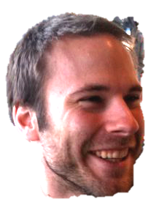


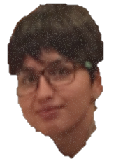
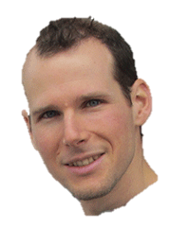
David
Daniel
Rico
Sarvenaz
Zóltan

Slide 2

Genetic variation in SNPs
(Single Nucleotide Polymorphisms)
ATTGCAATCCGTGG...ATCGAGCCA…TACGATTGCACGCCG…
ATTGCAATCCGTGG...ATCGAGCCA…TACGATTGCACGCCG…
ATTGCAAGCCGTGG...ATCTAGCCA…TACGATTGCAAGCCG…
ATTGCAAGCCGTGG...ATCTAGCCA…TACGATTGCAAGCCG…
ATTGCAAGCCGTGG...ATCTAGCCA…TACGATTGCAAGCCG…
ATTGCAATCCGTGG...ATCGAGCCA…TACGATTGCACGCCG…
ATTGCAATCCGTGG...ATCTAGCCA…TACGATTGCACGCCG…
ATTGCAATCCGTGG...ATCGAGCCA…TACGATTGCACGCCG…
ATTGCAAGCCGTGG...ATCTAGCCA…TACGATTGCAAGCCG…
ATTGCAAGCCGTGG...ATCGAGCCA…TACGATTGCACGCCG…
Notes:
Une fois ce catalogue génétique établi, nous trouvons des différences entre individus au niveau de l'ADN comme indiqué par les lettres de couleurs différentes
En zoomant sur la séquence d’ADN, on peut voir des différences entre individus.

Slide 3

Phenotypic variation:

Slide 4


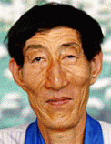
Association with genotype
SNPs
trait variant
chromosome
Population with ‘ ’ allele
Population with ‘ ’ allele
Distributions of “trait”

Slide 5
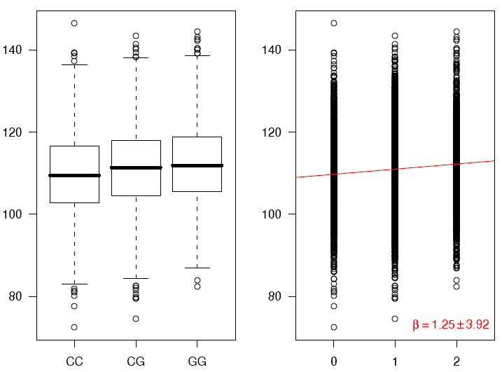
Association using regression
phenotype
genotype
Coded genotype

Slide 6
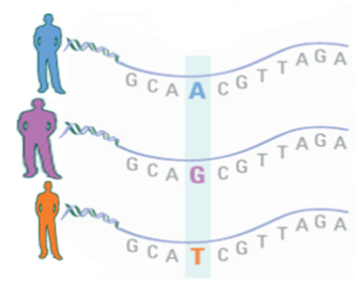


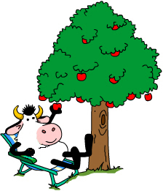
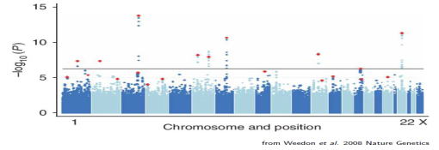
Genome-wide Association Studies
G
P
A
significance
Chromosomal position

Slide 7
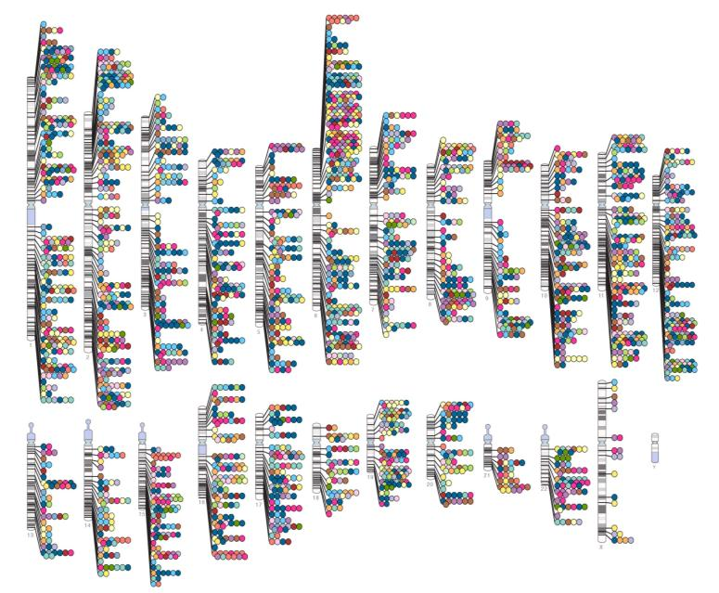
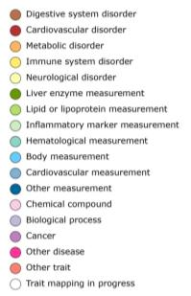


Published Genome-Wide Associations
(at p≤5x10⁻⁸ for 18 trait categories)
NHGRI GWA Catalog
www.genome.gov/GWAStudies
www.ebi.ac.uk/fgpt/gwas/

Slide 8
How can we make use of all the GWAS results to better predict disease risk and learn about disease mechanisms?

Slide 9
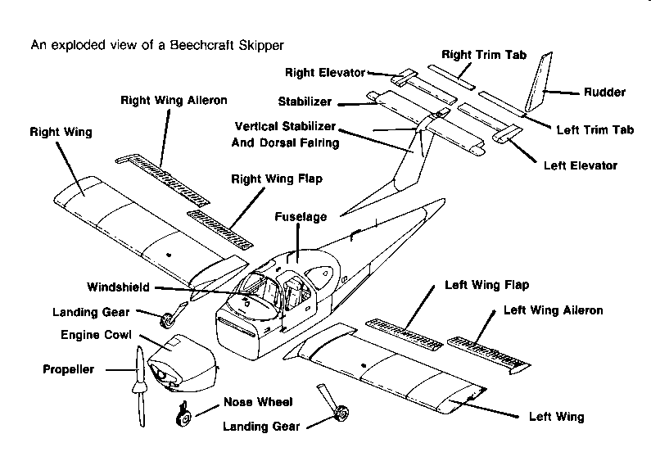

Slide 10


Slide 11
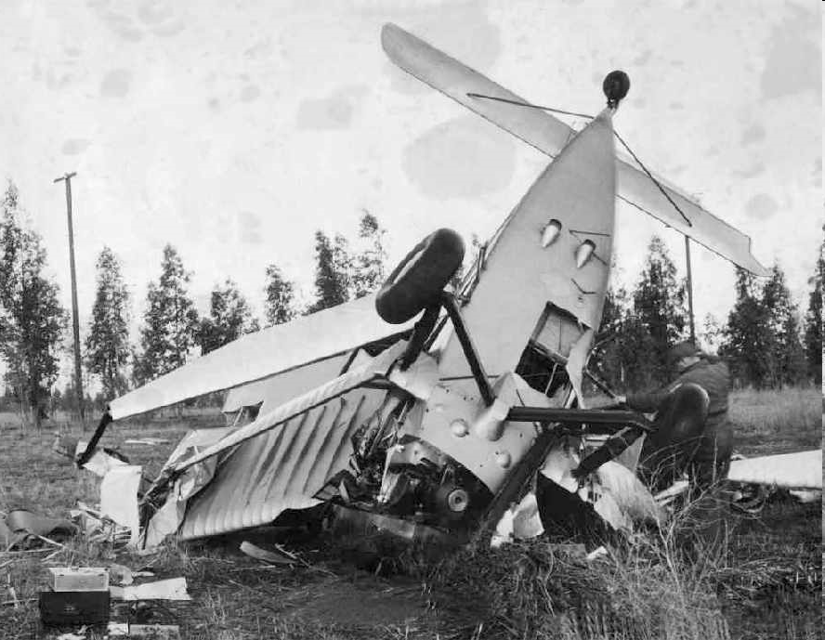

Slide 12
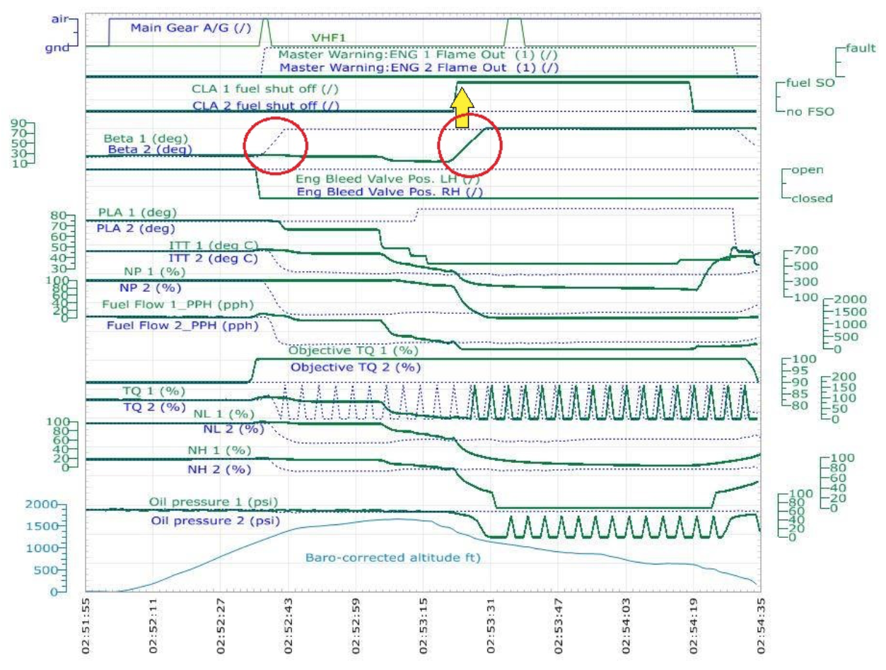

How could our models become more predictive?
Need BLACKBOX!

Slide 13
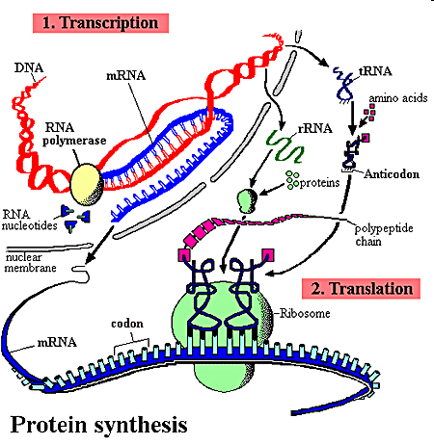
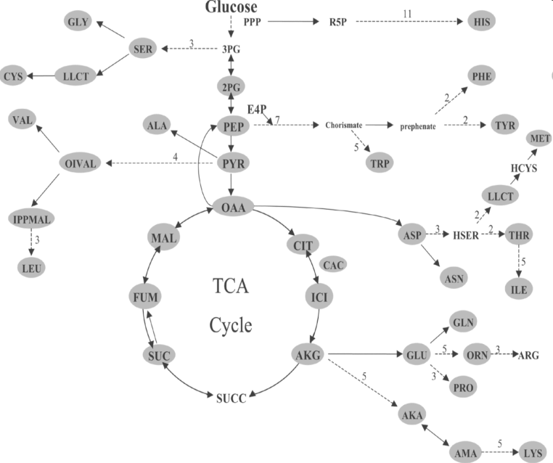
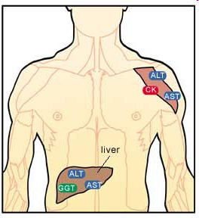
Towards a layered Systems Model
We need intermediate (molecular) phenotypes
to better understand organismal phenotypes

Slide 14
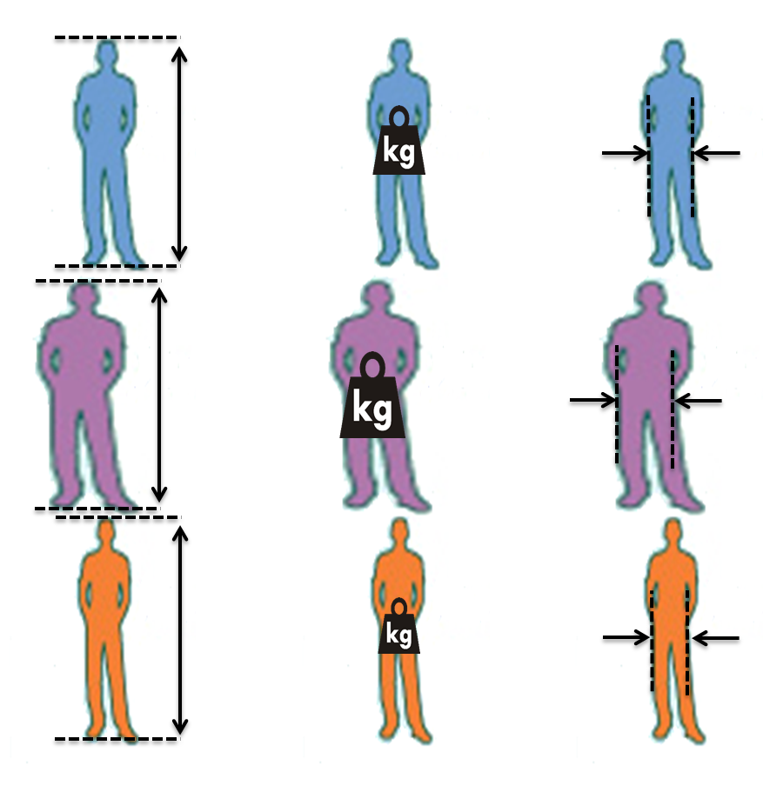


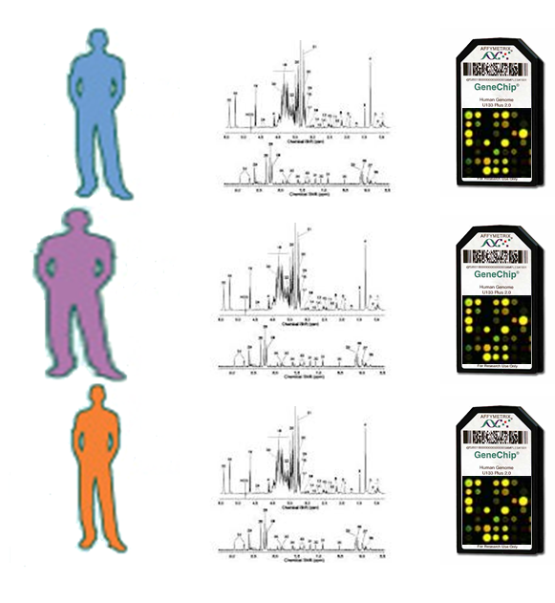
An integrated analysis framework
P
p
G
g
A
m
M

Slide 15
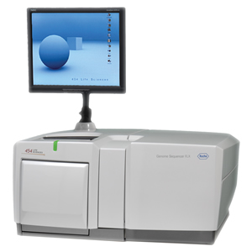
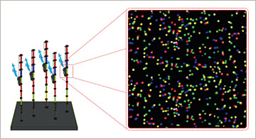
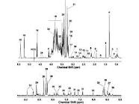
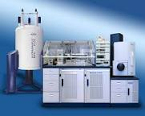
High throughput methods generating molecular phenotypes
Sequence-based:
10000s of genes
100000s of variants
1000000s of elements
Spectroscopy-based:
1000s of features
100s of compounds

Slide 17
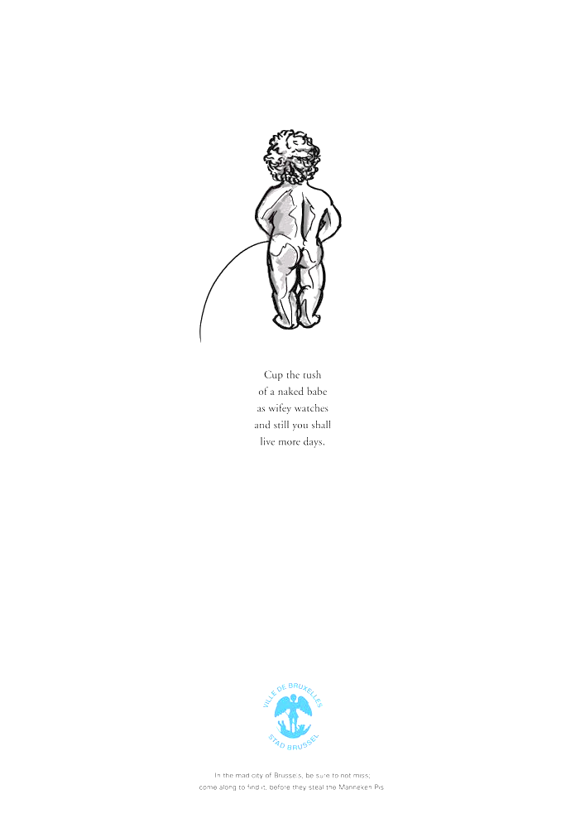
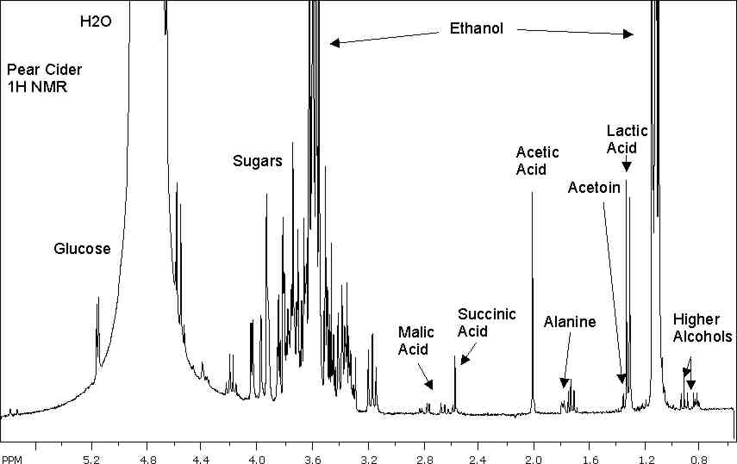
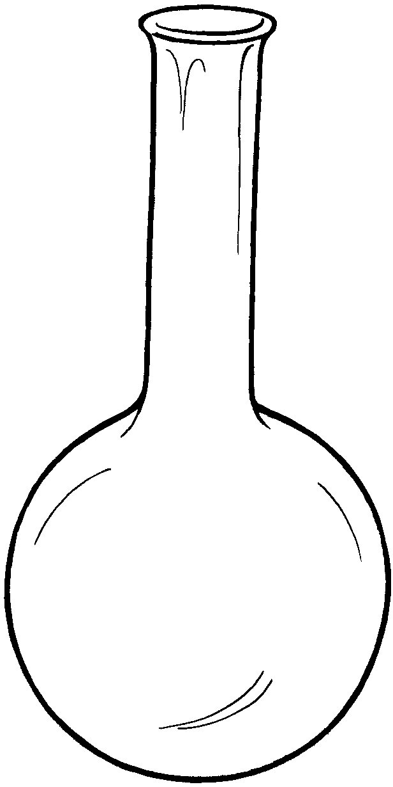
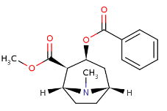
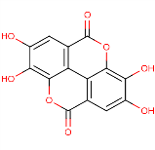
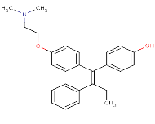
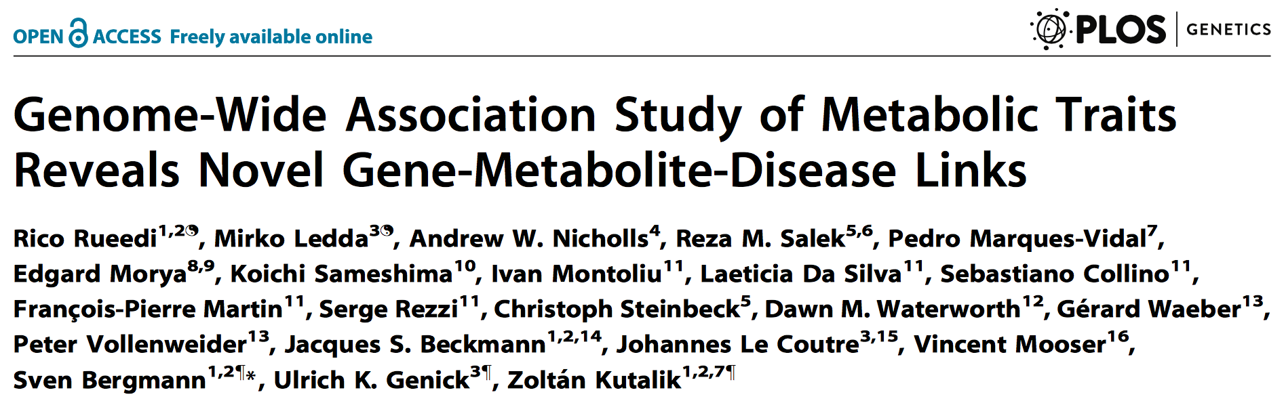
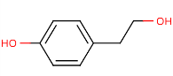
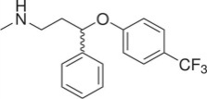
CoLaus Metabolomics Study
~1000 urine samples
(from genotyped individuals)
~2000 NMR shifts
Bruker 16.4T 700MHz

Slide 18
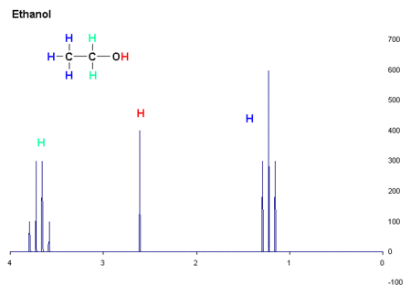
NMR produces a spectral fingerprint for any chemical compound
signal intensity [a.u.]
Chemical shift [in ppm of the resonance frequency]

Slide 19
… and convoluted spectra for chemical substances
signal intensity [a.u.]
Chemical shift [in ppm of the resonance frequency]

Slide 20
Targeted Metabolomics de-convolutes these spectra for a limited number of compounds
Measured spectral intensity
Estimated concentration
Highly non-trivial
mostly proprietary solutions
~2000 NMR shifts
~100 compounds

Slide 21
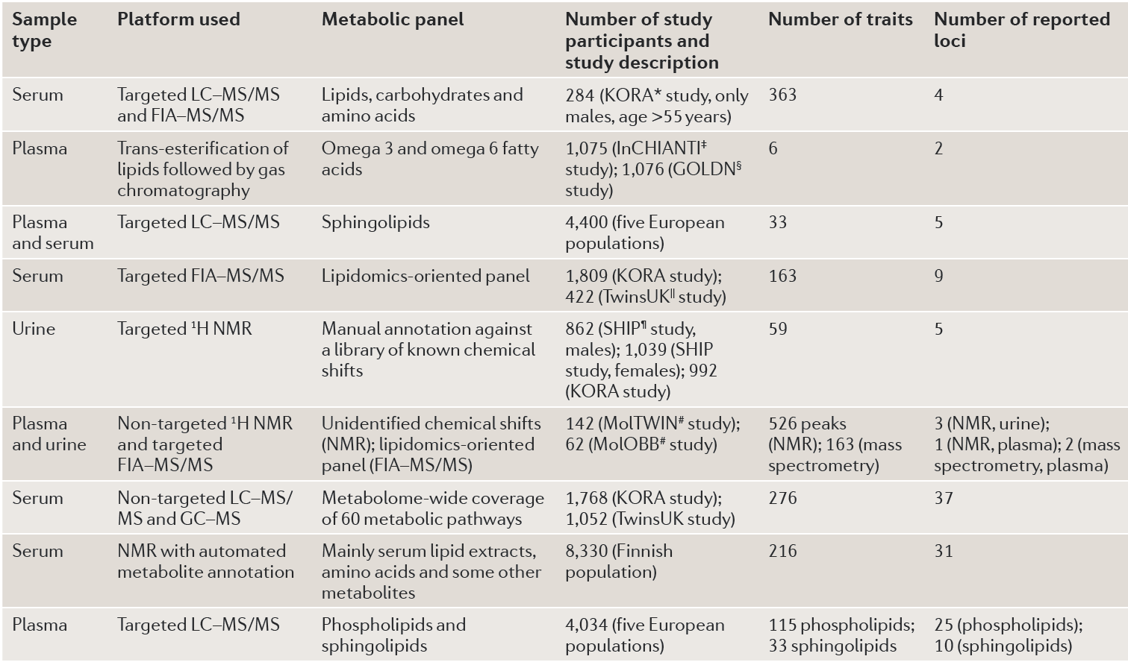
So far, most GWAS on Metabolomics used targeted approach

Slide 22
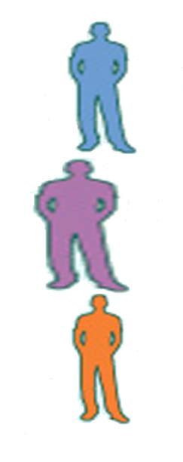

Untargeted approach:
GWAS with all NMR features
G
M
Significant
SNP-feature
Associations
significance
Chromosomal position

Slide 23
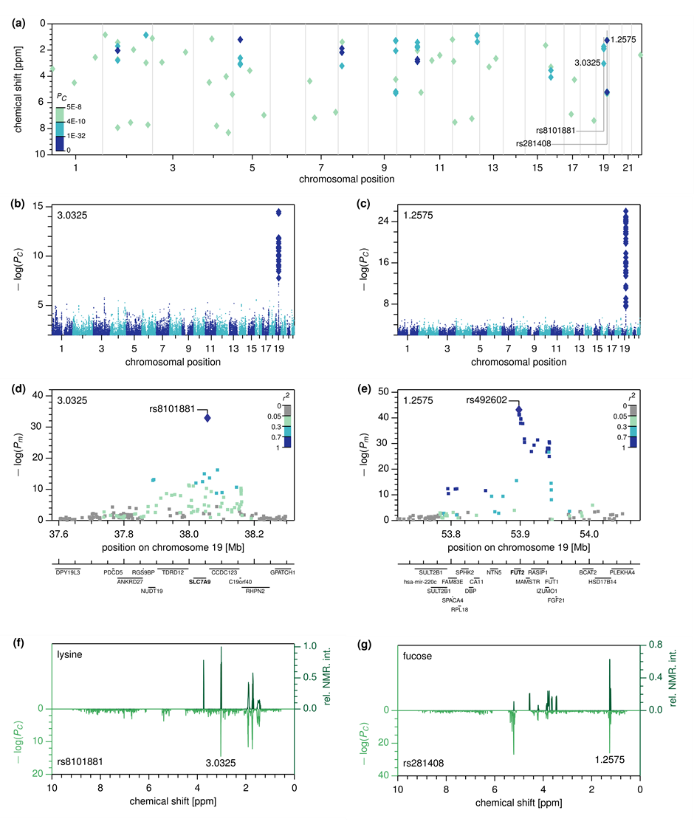
Many NMR features have very significant associations
significance
Chromosomal position

Slide 24
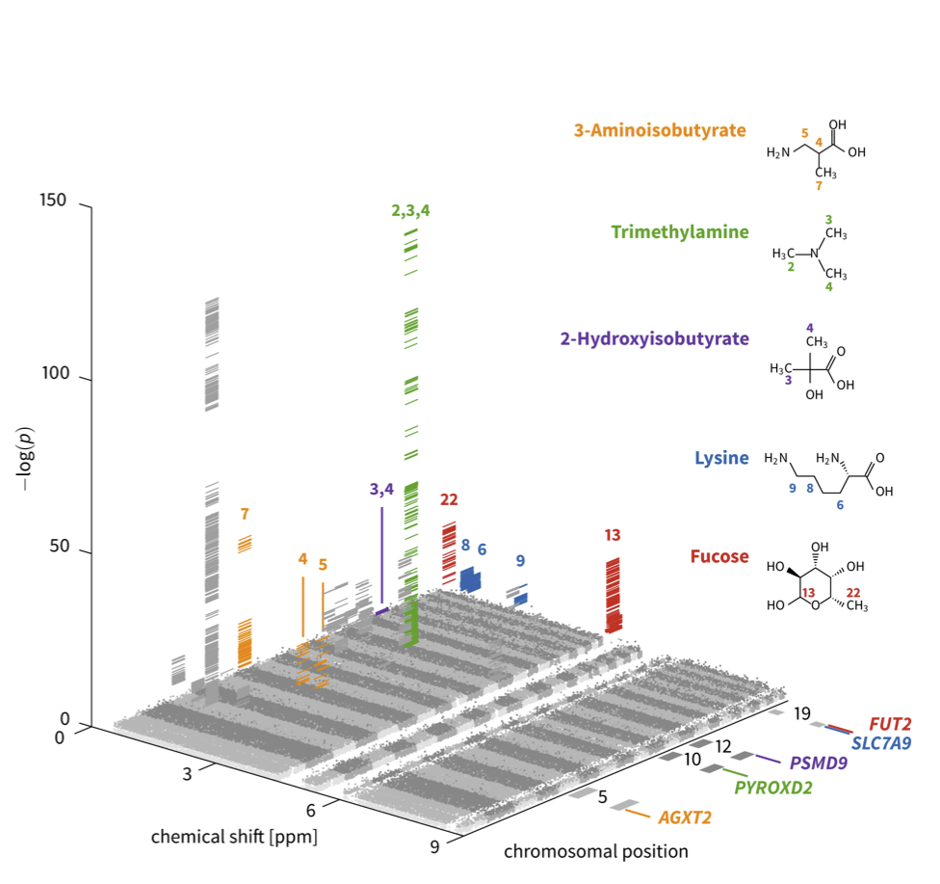
3D Manhattan plot

Slide 25

Two extremely strong associations point to novel loci

Slide 26
Two extremely strong associations point to novel loci

Slide 27
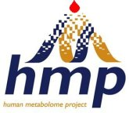
But what compound is linked to a particular SNP?
Compare with NMR spectra of pure compounds
Plot significance for all NMR features for a given SNP
Significance
Metabomatching

Slide 28
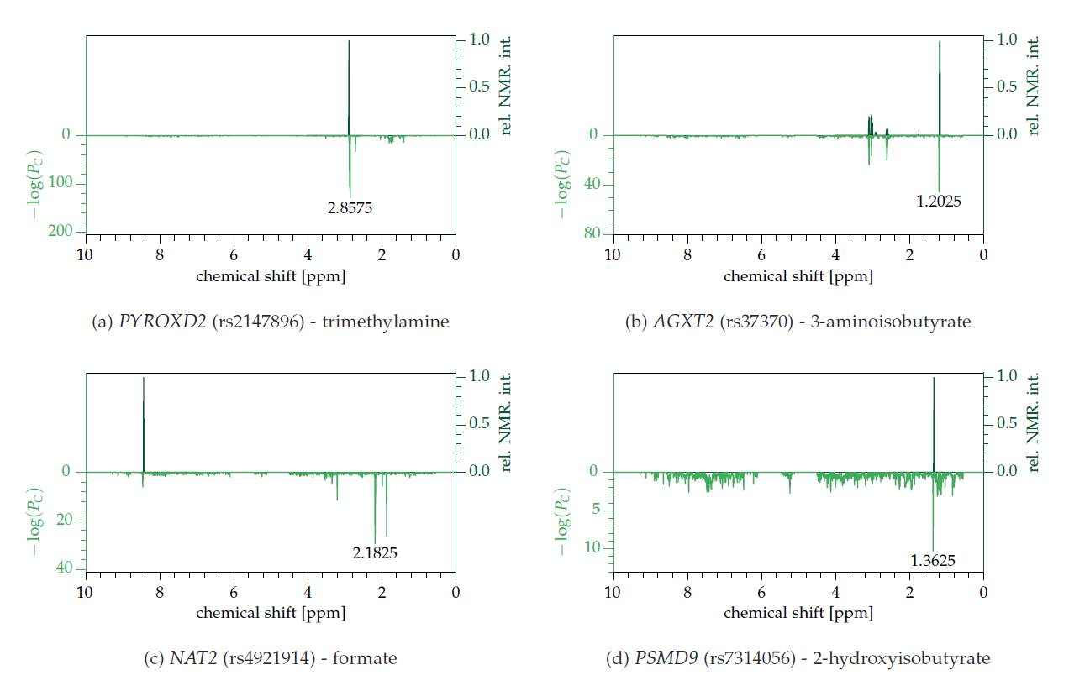
“Metabo-matching” works well for several known associations

Slide 29
Our novel compound-locus associations make biological sense
Solute Carrier Light Chain Family 7, Member 9 (Glycoprotein-Associated Amino Acid Transporter)
Fucosyltransferase 2
Lysine
Fucose

Slide 30
TasteSensomics Cohort Replicates >40% of the CoLaus associations
Cohort | CoLaus | TasteSensomics
Initiator | CHUV / GSK | Nestle Research Center
Sample size | 835 | 601
NMR device | Bruker 16.4T 700MHz | Bruker Avance II 600MHz
Population | Lausanne | São Paulo
Ethnicity | Caucasian | Admixed
Discovery | 139 (P<5x10^{‑8})
Replication |  | 56 (P<0.05/139)

Slide 31

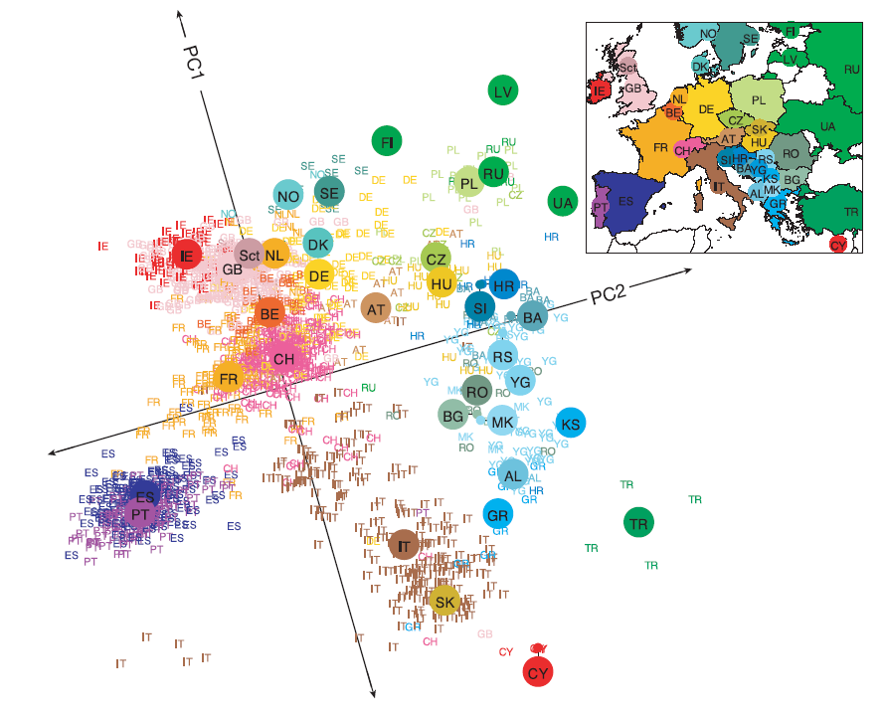
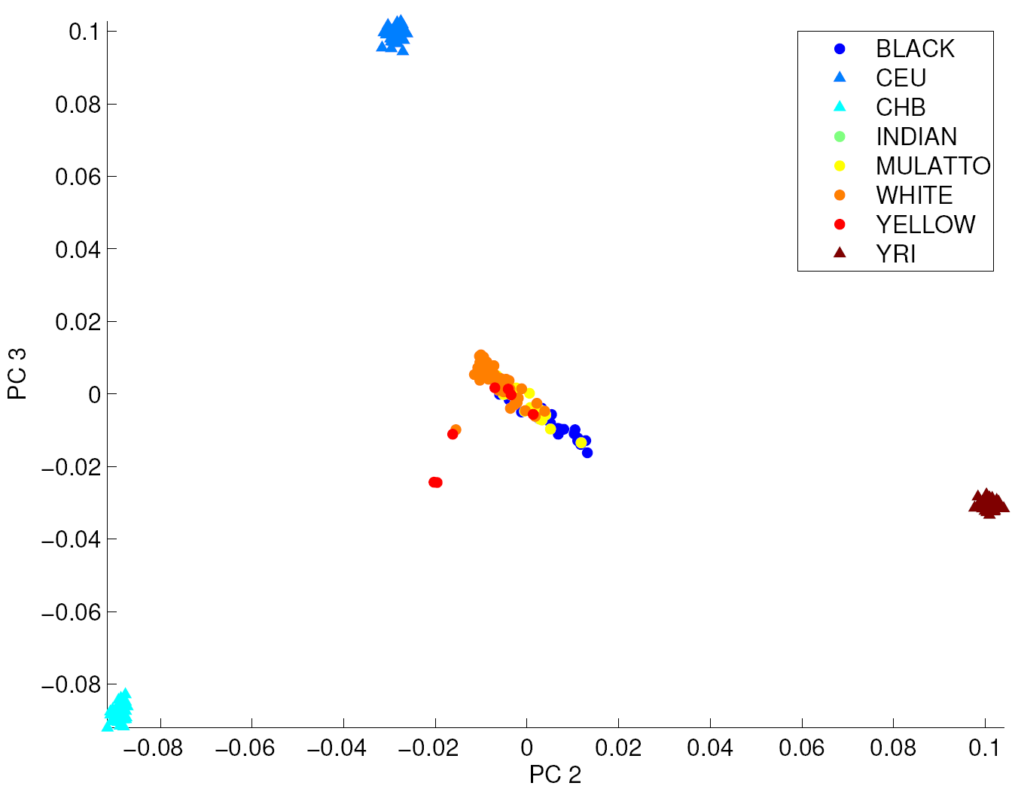
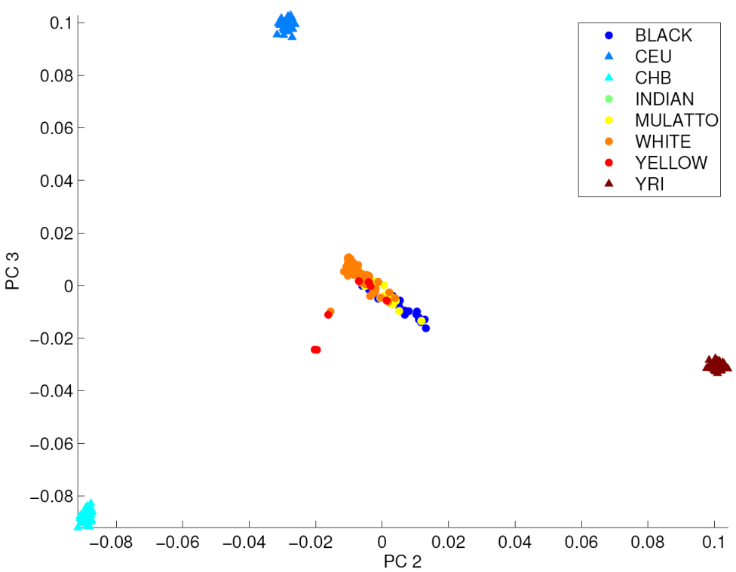

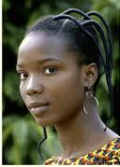
… despite different populations
CoLaus: Caucasian
TasteSensomics: Admixed
Observed effects are likely to be ethnicity-independent, and robust against variations of diet and other environmental factors

Slide 32

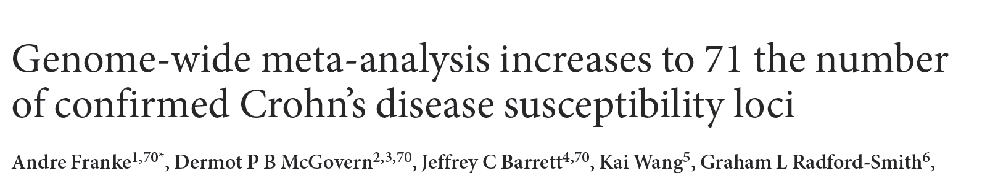
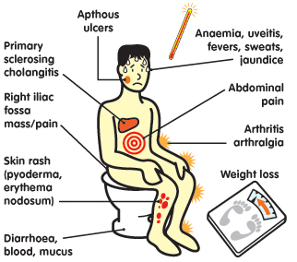
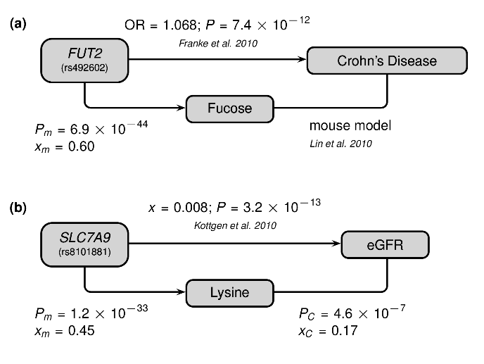
Clinical implications: FUT2
…

Slide 33

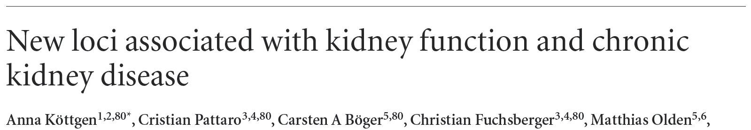
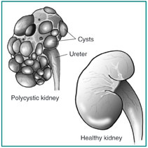
Clinical implications: SLC7A9
…
CoLaus

