Slide 1
Genetics and Genome Evolution (GGE)
Bioinformatics for Genomics
Lecture series 2020
Sven Bergmann
Department of Computational Biology
(Sven.Bergmann@unil.ch)

Slide 2
Genetics and Genome Evolution (GGE)
Bioinformatics for Genomics
Lecture series 2020
Sven Bergmann
Department of Computational Biology
(Sven.Bergmann@unil.ch)

Slide 3

Bioinformatics for Genomics
Overview
March 23 Lecture 1: RNA-seq & DE
March 24 Lecture 2: Clustering
March 30 Lecture 3: Biclustering
March 31 Lecture 4: More data
April 1 Lecture 5: Networks

Slide 4
DNA sequencing assays
ChIP-seq: Which DNA segment bind to proteins?
DNase-seq, Mnase-seq, FAIRE-seq & ATAC-seq: Which chromatin regions are accessible?
RiboProfiling: Which mRNAs bind to ribosomes?
HiC: Which DNA segments make contacts?
and many more ...

Slide 5
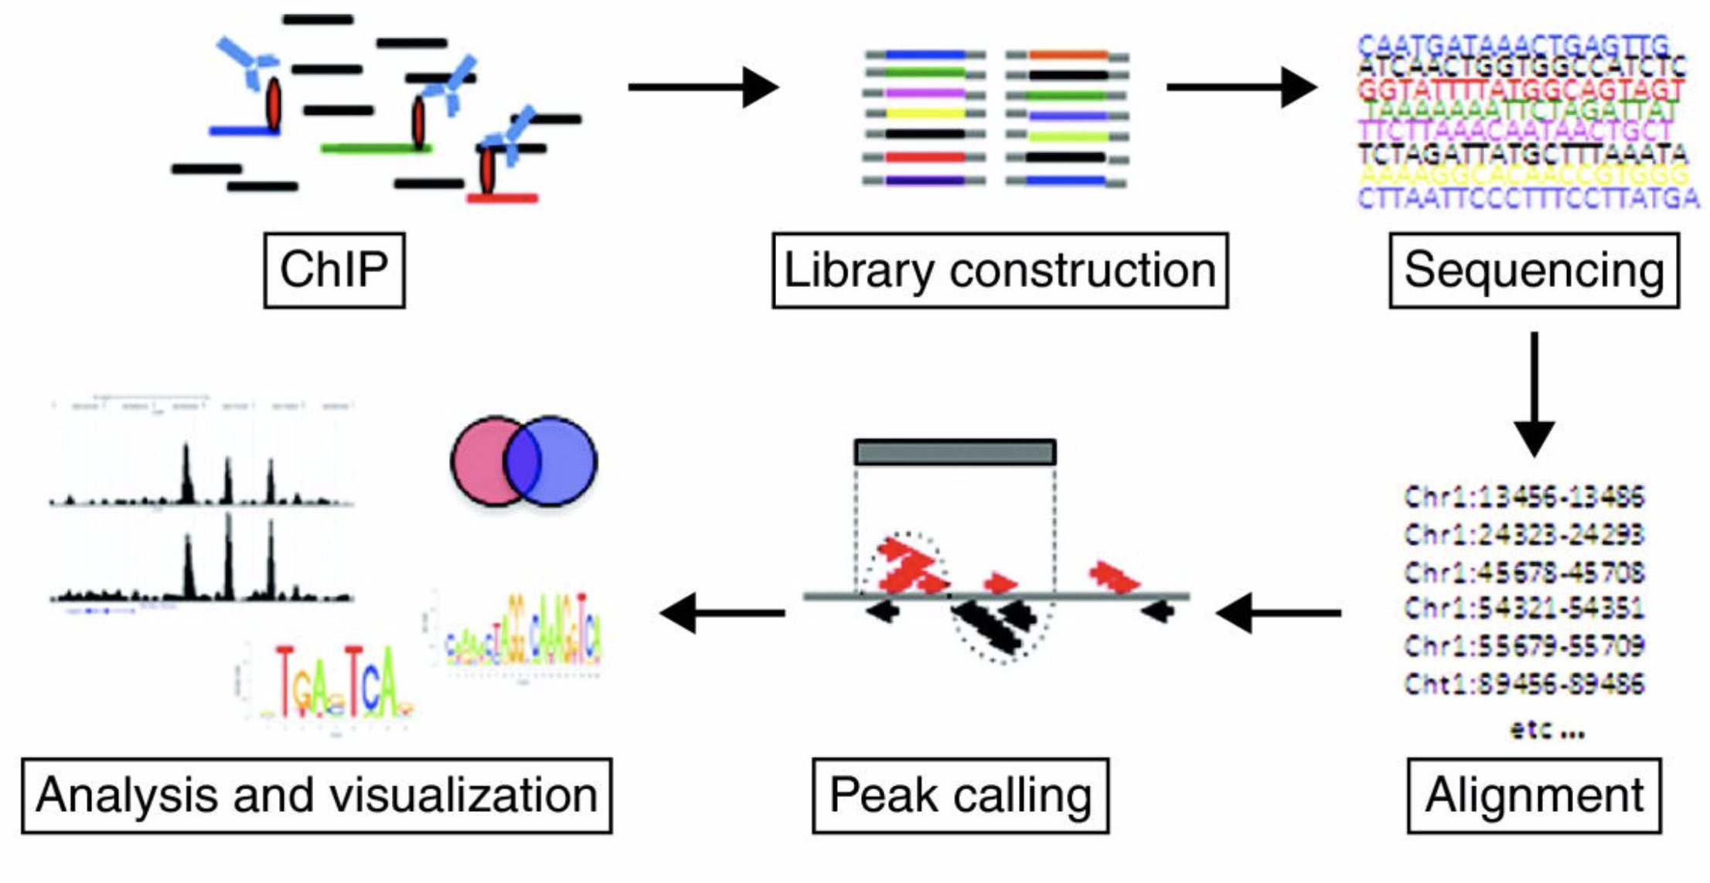
ChIP-seq overview
(Chromatin Immuno-Precipitation)

Slide 6
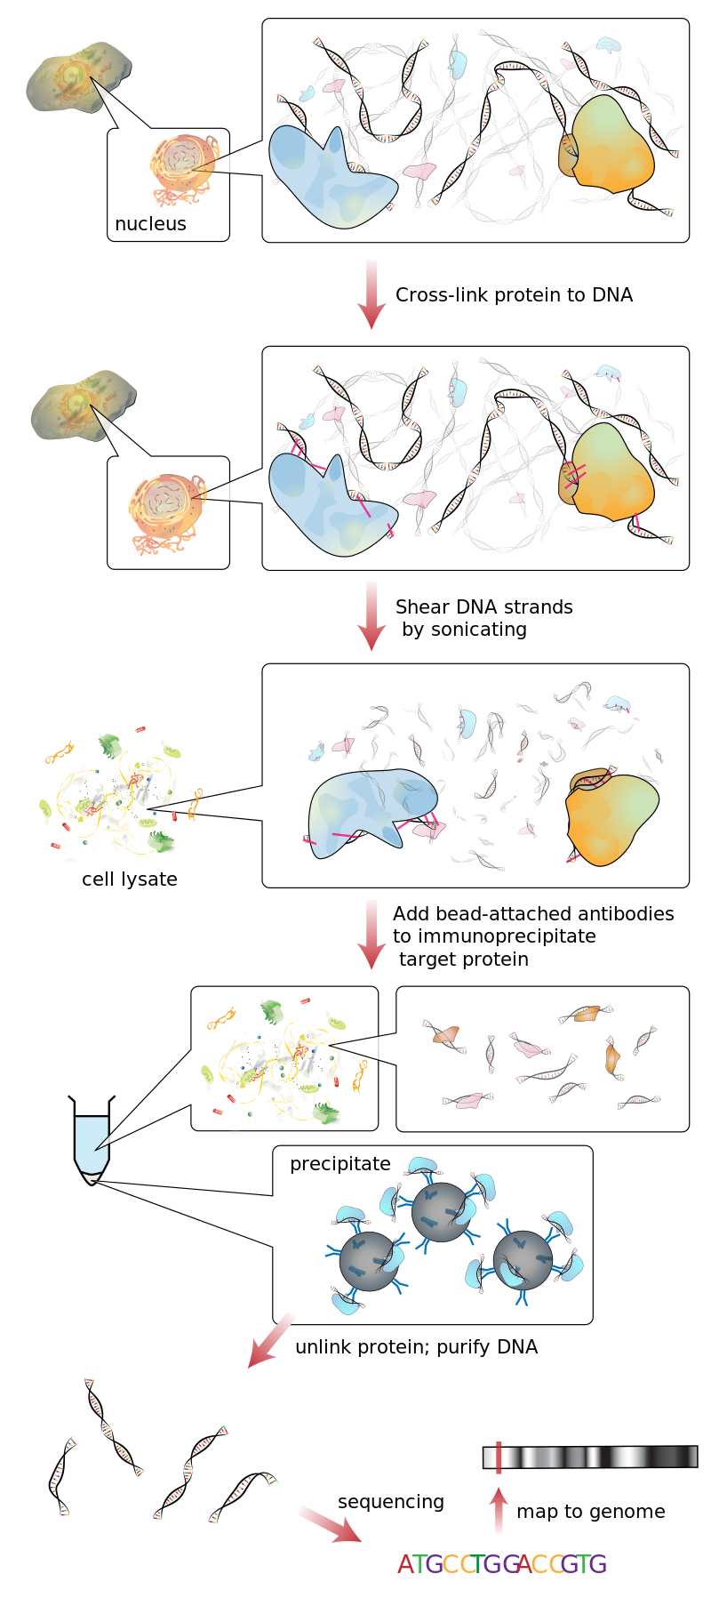
ChIP-seq protocol

Slide 7
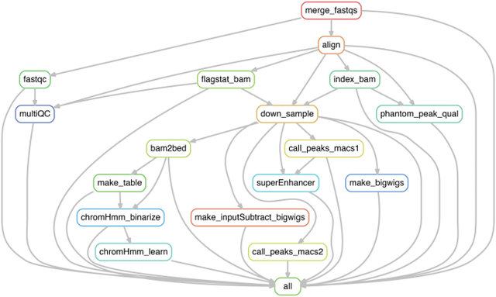
ChIP-seq analysis workflow

Slide 8
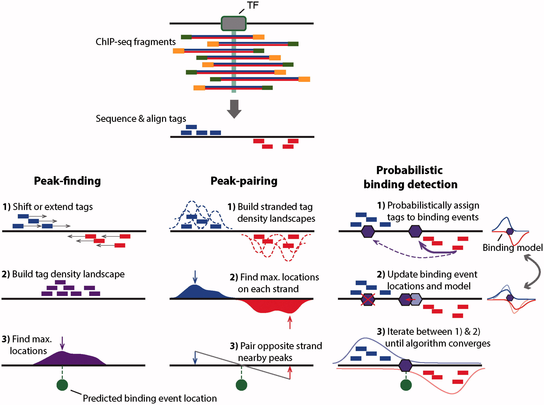
ChIP-seq binding predictions

Slide 9
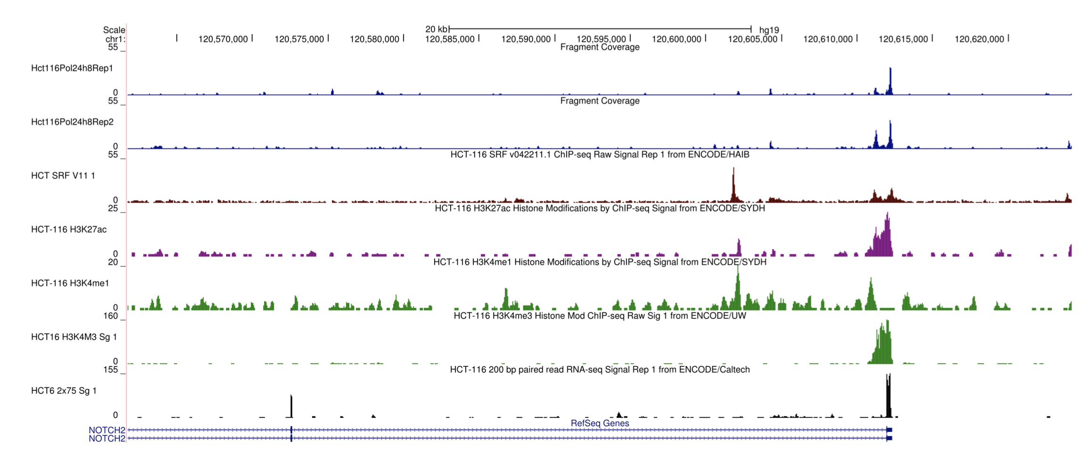
ChIP-seq output visualisation

Slide 10
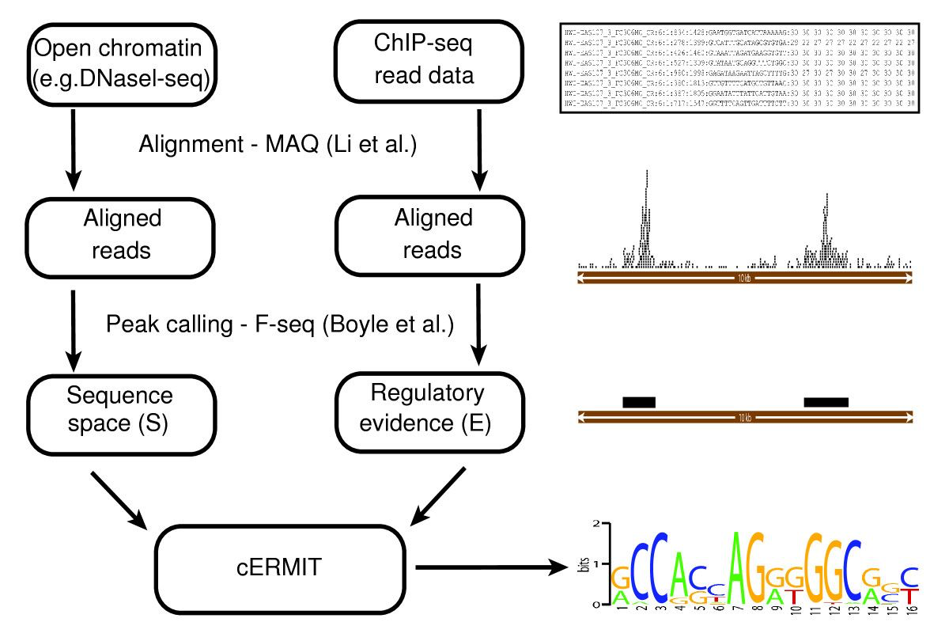
ChIP-seq for binding motif prediction

Slide 11
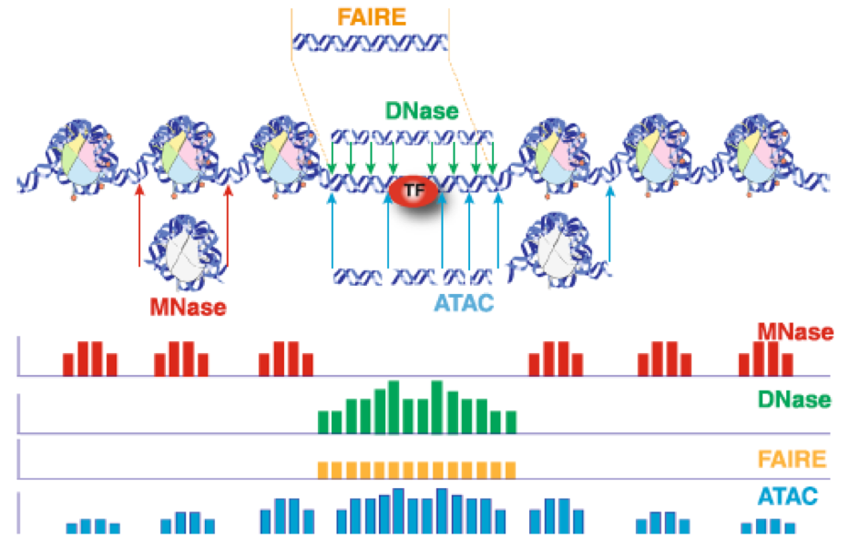
Chromatin structure methods
DOI //dx.doi.org/10.13070/mm.en.9.2797

Slide 12
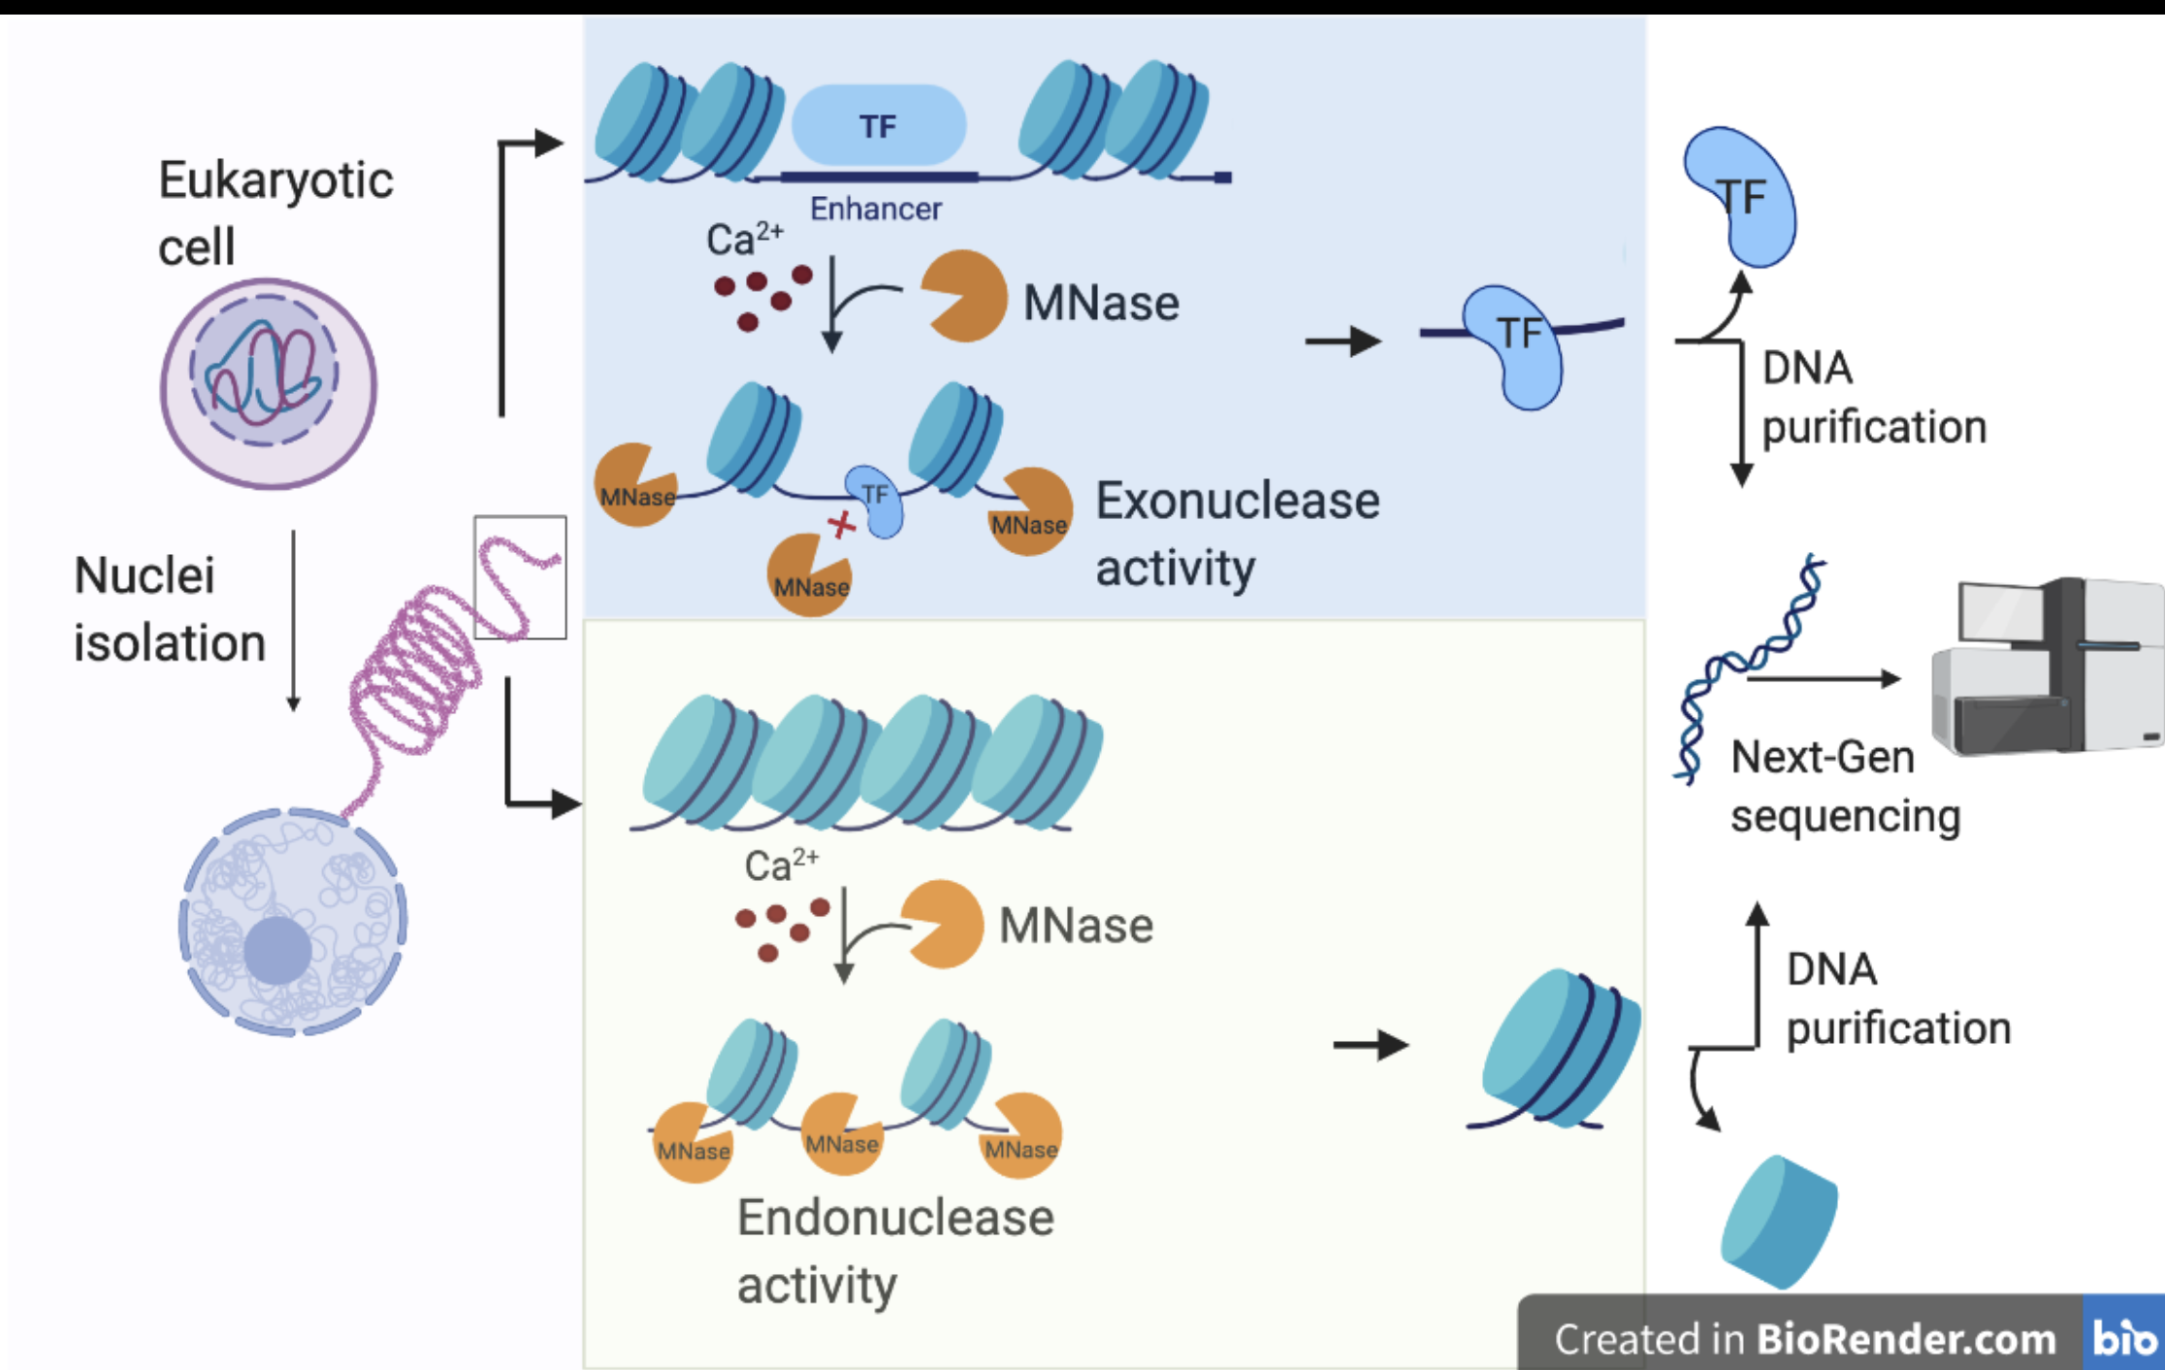
MNAse-seq reveals DNA on nucleosomes
(Micrococcal Nuclease digestion)
https://en.wikipedia.org/wiki/MNase-seq

Slide 13
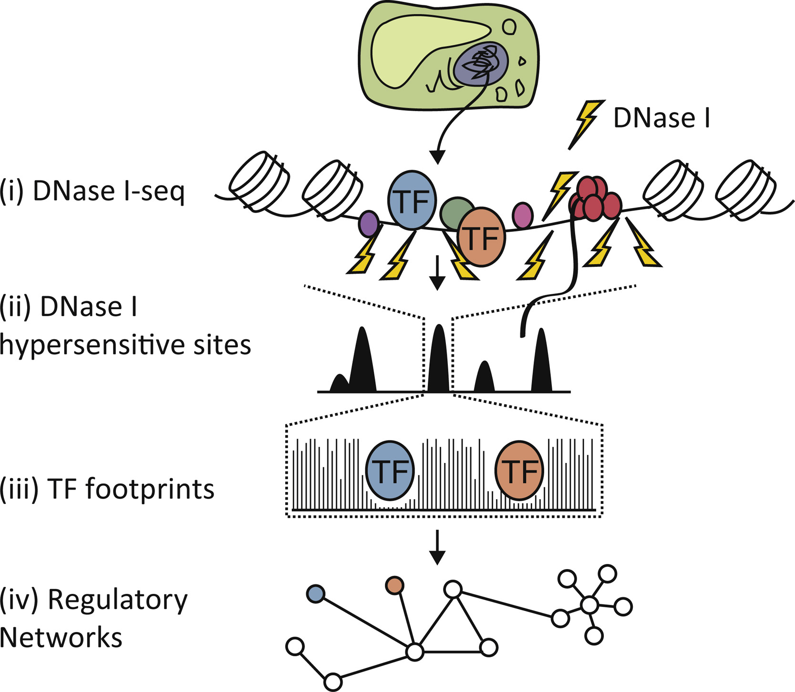
DNAse-seq reveals open, unoccupied DNA

Slide 14
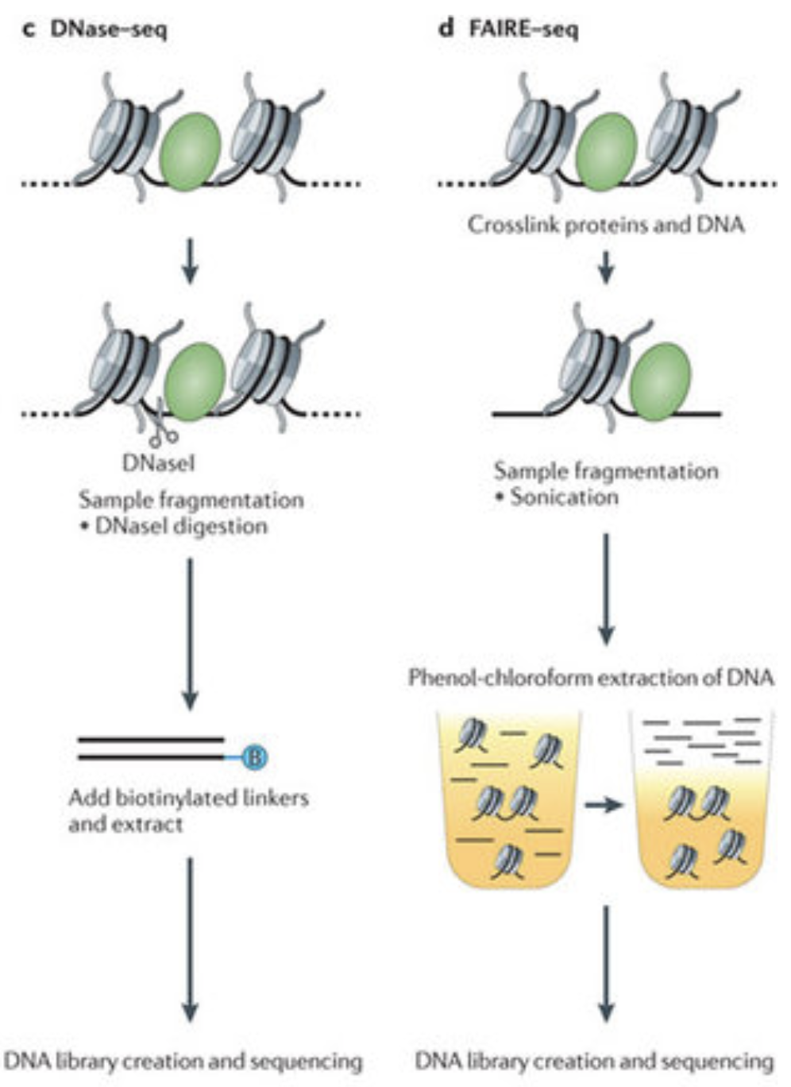
FAIRE-seq reveals open chromatin
(Formaldehyde-Assisted Isolation of Regulatory Elements)

Slide 15
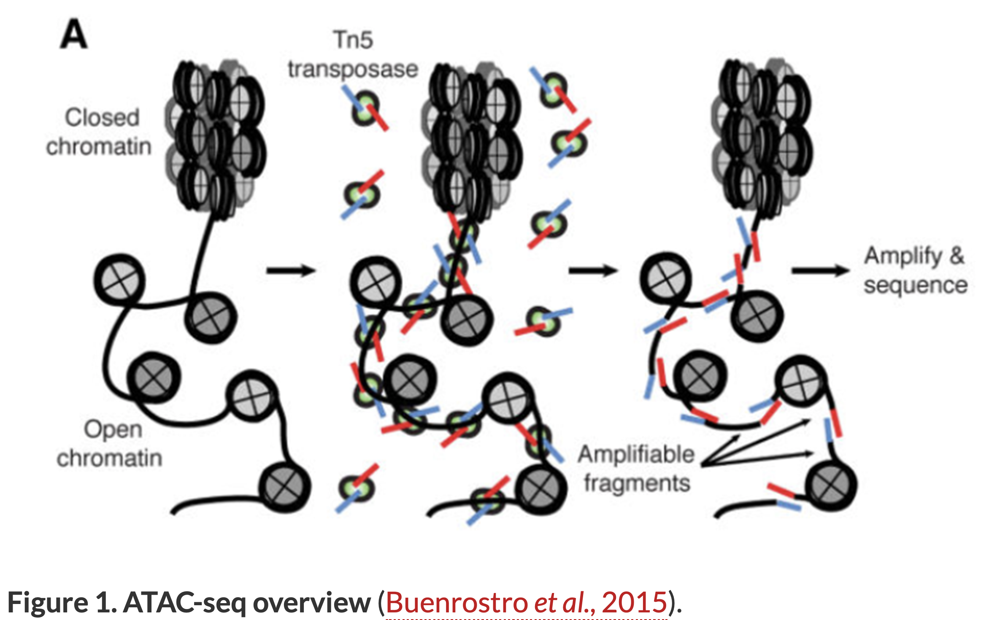
ATAC-seq reveals accessible DNA (including between nucleosomes)

Slide 16
Chromatin structure methods
DOI //dx.doi.org/10.13070/mm.en.9.2797

Slide 17
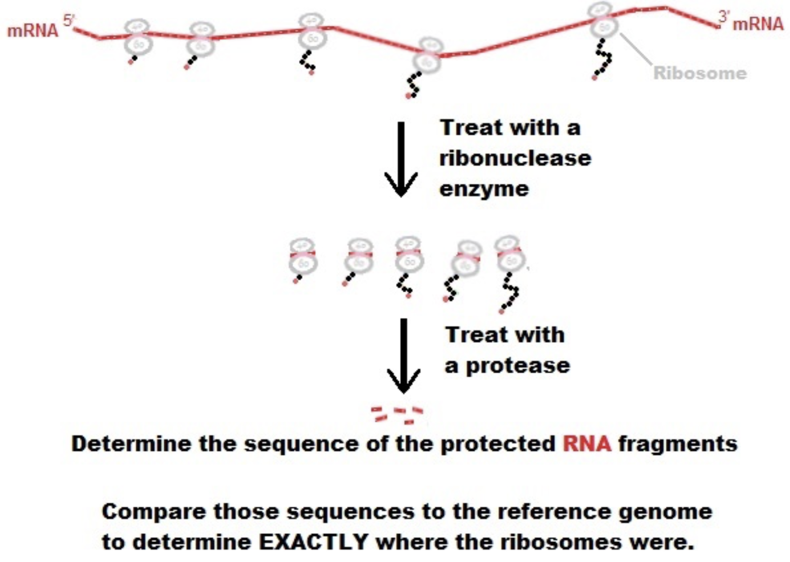
Ribo-seq reveals which RNA is bound to ribosomes (i.e. being translated)

Slide 18
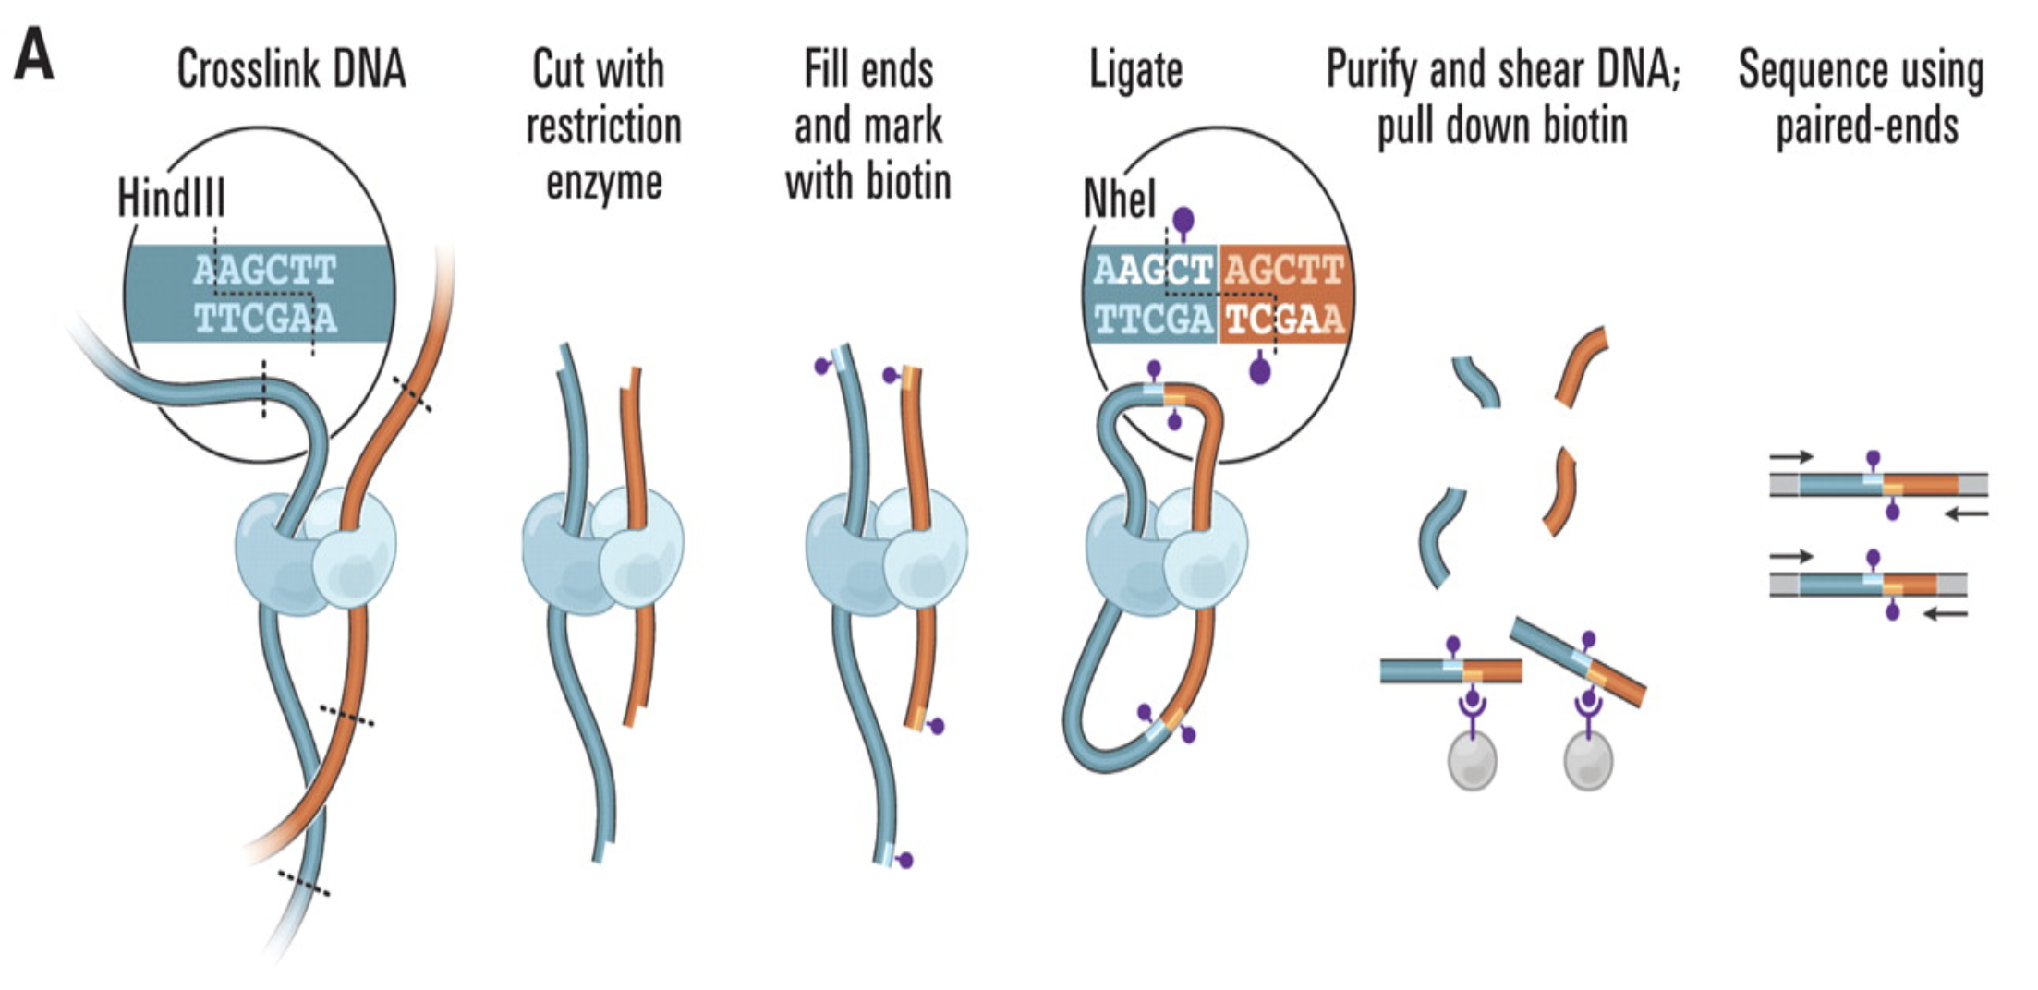
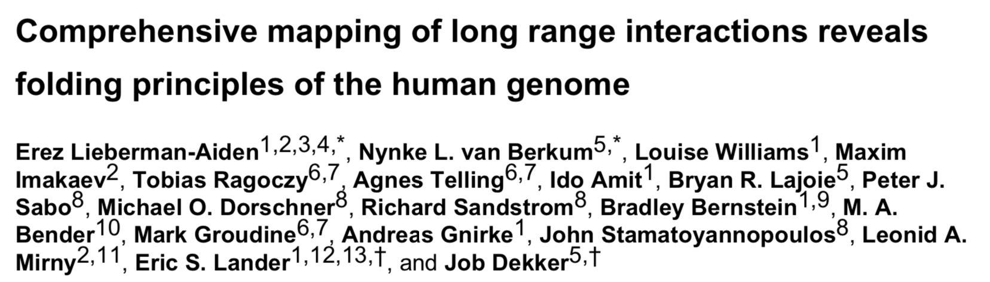
HiC: genome-wide chromatin contacts

Slide 19
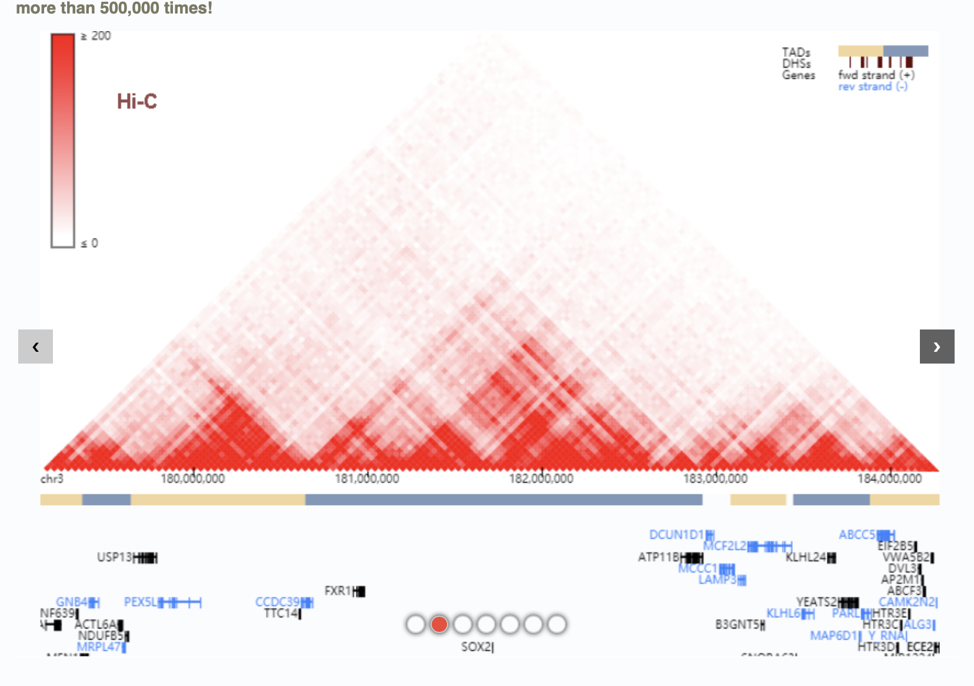
HiC: output visualisation

Slide 20
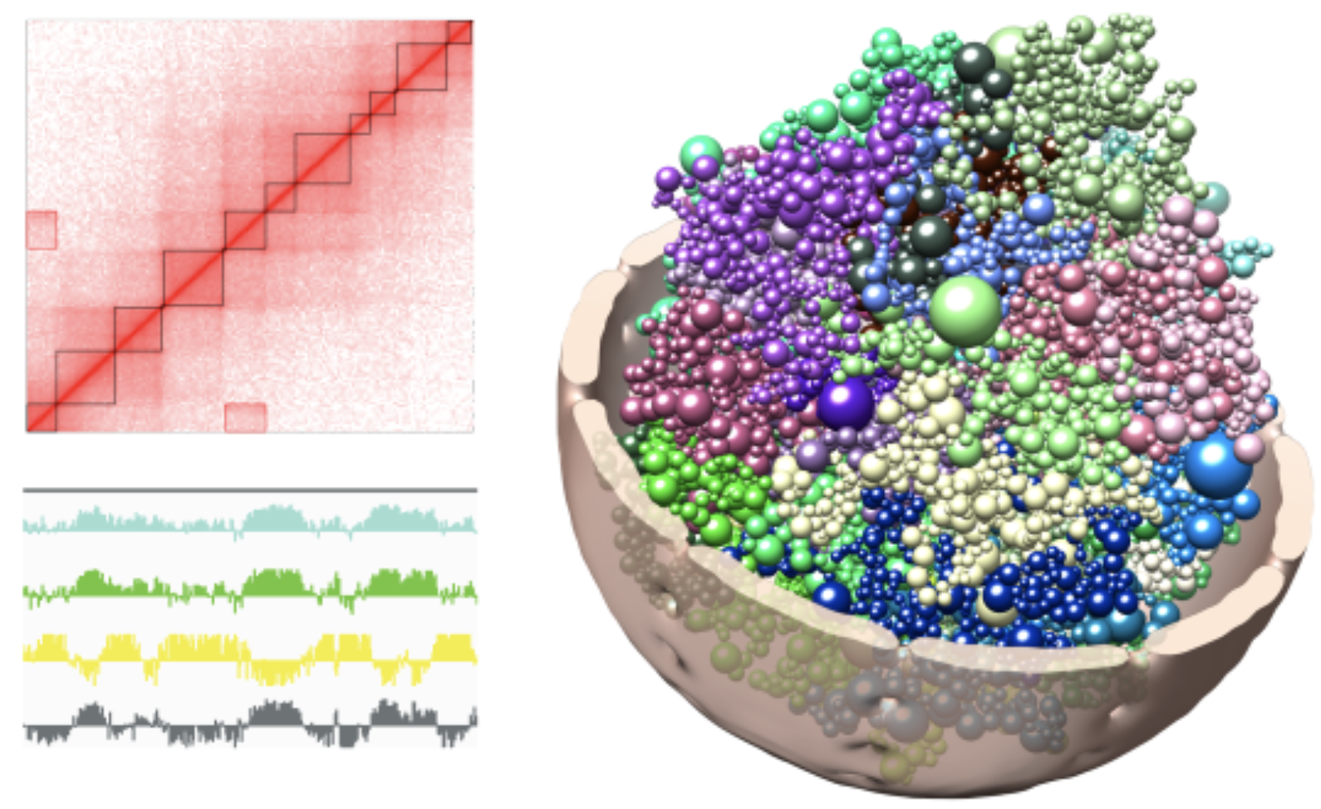
HiC data allow for modelling
DNA structure

Slide 21
More data -> “multi-omics” analyses
Cross-correlations
Multivariate regression
Partial Least squares
Ping-pong algorithm

Slide 22
Cross-correlations
Auto-correlations:
1
300
1
30k
1
300
C
=
E^{T}
·
E
C = E^{T}·E /(n-1)
300
300
/(n-1)
30k
cross-correlations:
1
200
1
30k
1
200
C
=
E^{T}
·
X
C = E^{T}·X /(n-1)
300
300
/(n-1)
30k
Which samples from different assays are most similar across all genes?

Slide 23
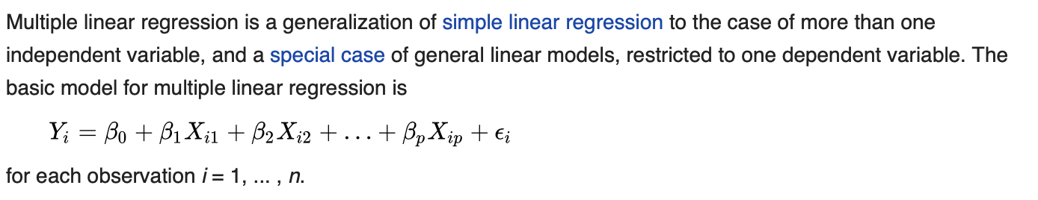
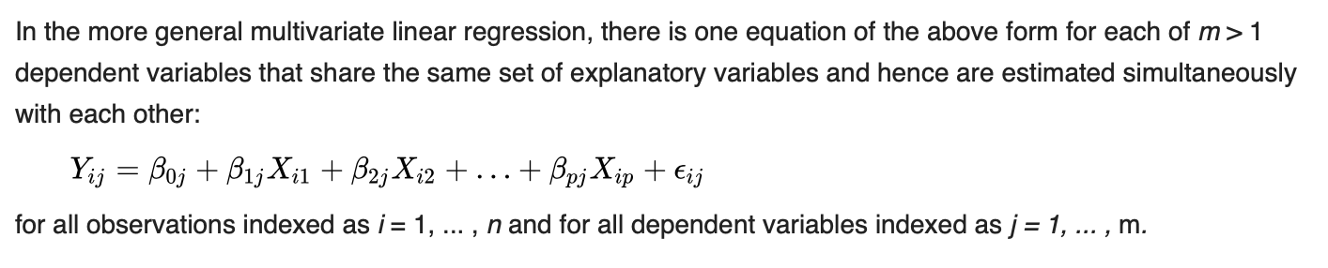
Multiple and Multivariate linear regression
https://en.wikipedia.org/wiki/General_linear_model

Slide 24
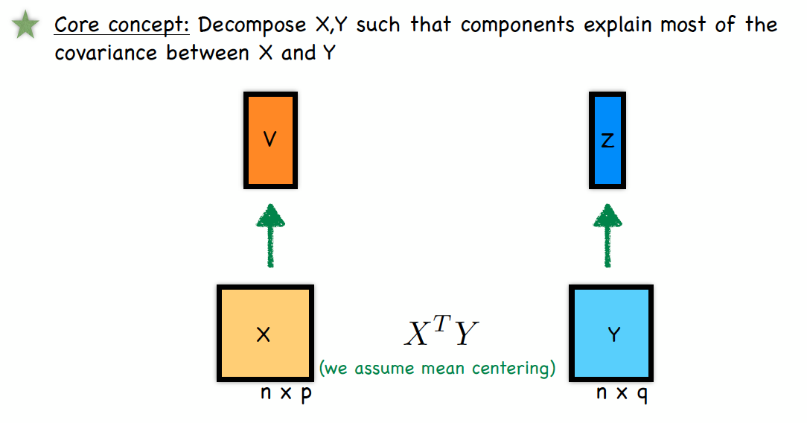
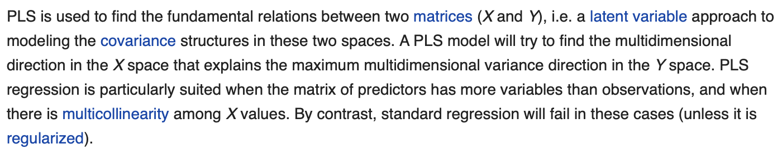
Partial Least Squares regression
https://en.wikipedia.org/wiki/Partial_least_squares_regression

Slide 25


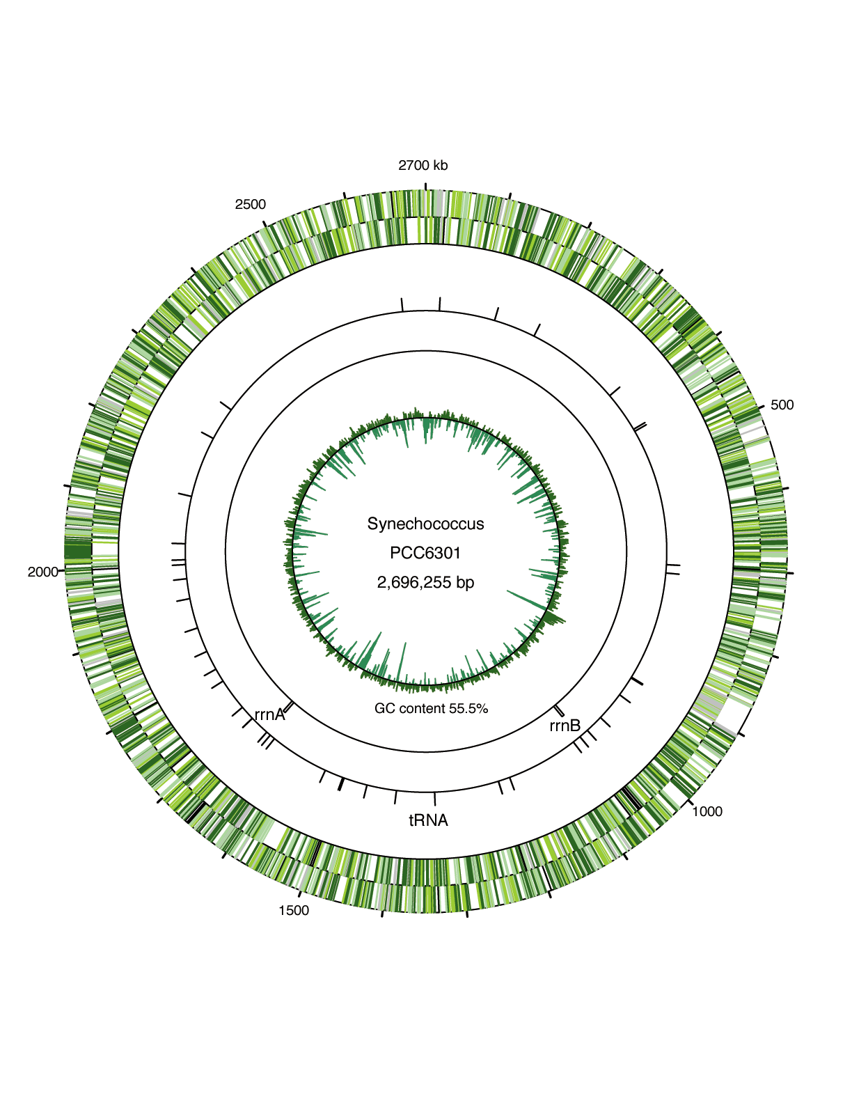
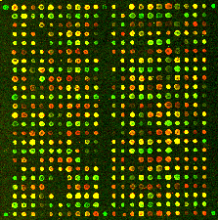
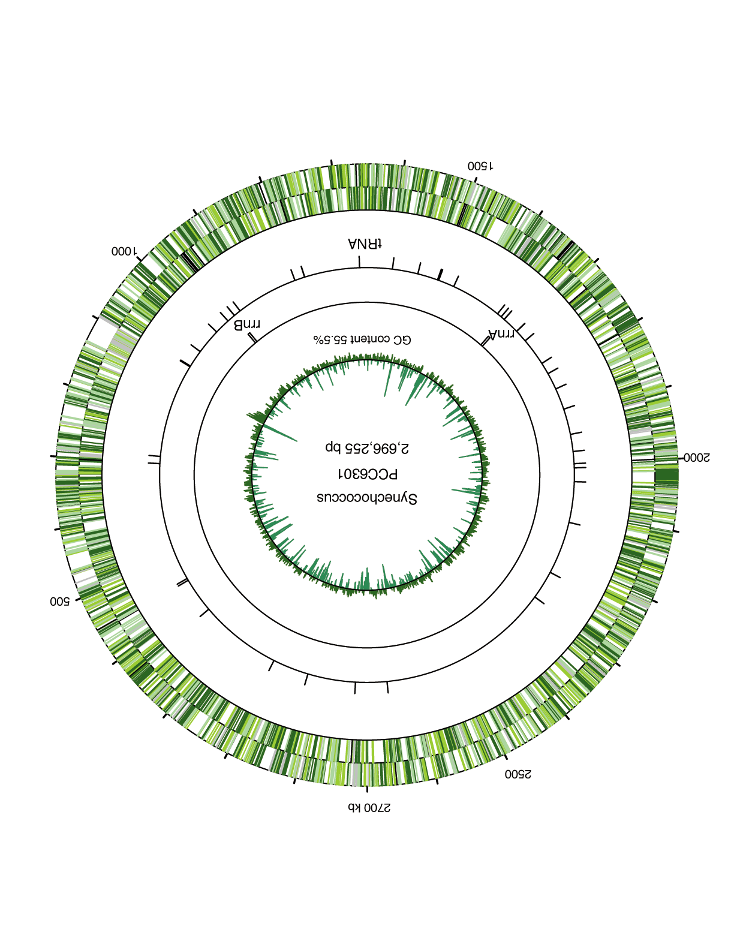

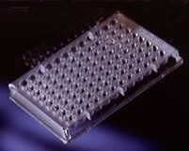
Modules and Co-modules
Gene-modules
Co-modules
C
M_{E}
M_{ED}
C₃
C₄
C₁
C₂
G₃
[A_{GF}]
F₁
G₁
G
=
E
[B_{FC}]
[C_{DF}]
G₄
G₂
G₁
C₁
D₁
M_{D}
Drug-modules
G₂
C₂
C₅
C₆
D₂
D₁
D₃
[A_{GF}]
[B_{FC}]
[C_{DF}]
D
=
R
F₂
D₂
D₄
Z Kutalik, J Beckmann & SB, Nature Biotechnology (2008)

Slide 26
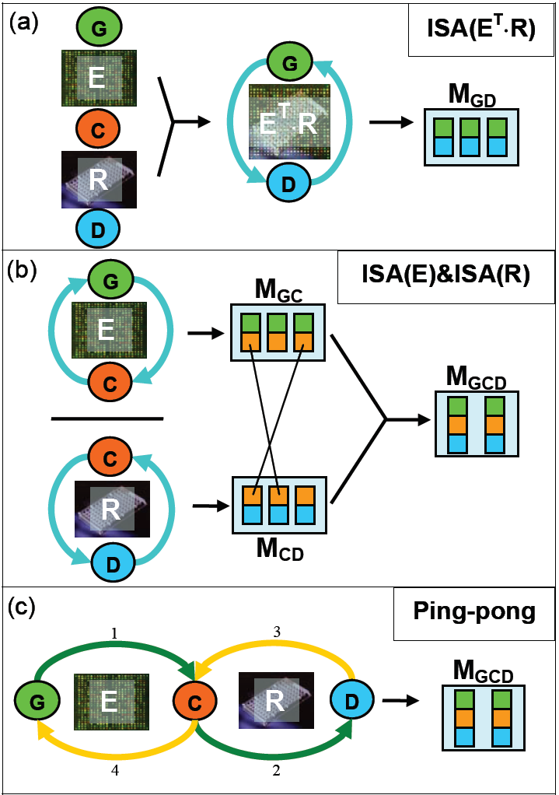
How to identify Co-modules?
Search Modules in Gene-drug correlation!

Slide 27
How to identify Co-modules?
First identify Gene- and Drug-modules,
Then match those with similar conditions!

Slide 28
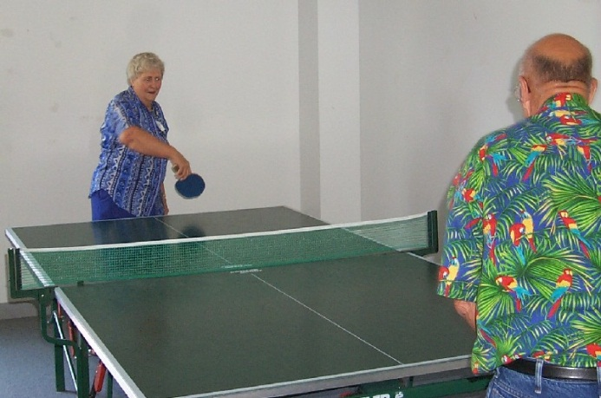
How to identify Co-modules?
Iteratively refine genes, cell-lines and drugs to get co-modules

