Slide 1
Genetics and Genome Evolution (GGE)
Bioinformatics for Genomics
Lecture 3:
More seq-data
Sven Bergmann
Department of Computational Biology
(Sven.Bergmann@unil.ch)

Slide 2
DNA sequencing assays
ChIP-seq: Which DNA segment bind to proteins?
DNase-seq, Mnase-seq, FAIRE-seq & ATAC-seq: Which chromatin regions are accessible?
RiboProfiling: Which mRNAs bind to ribosomes?
HiC: Which DNA segments make contacts?
and many more ...

Slide 3
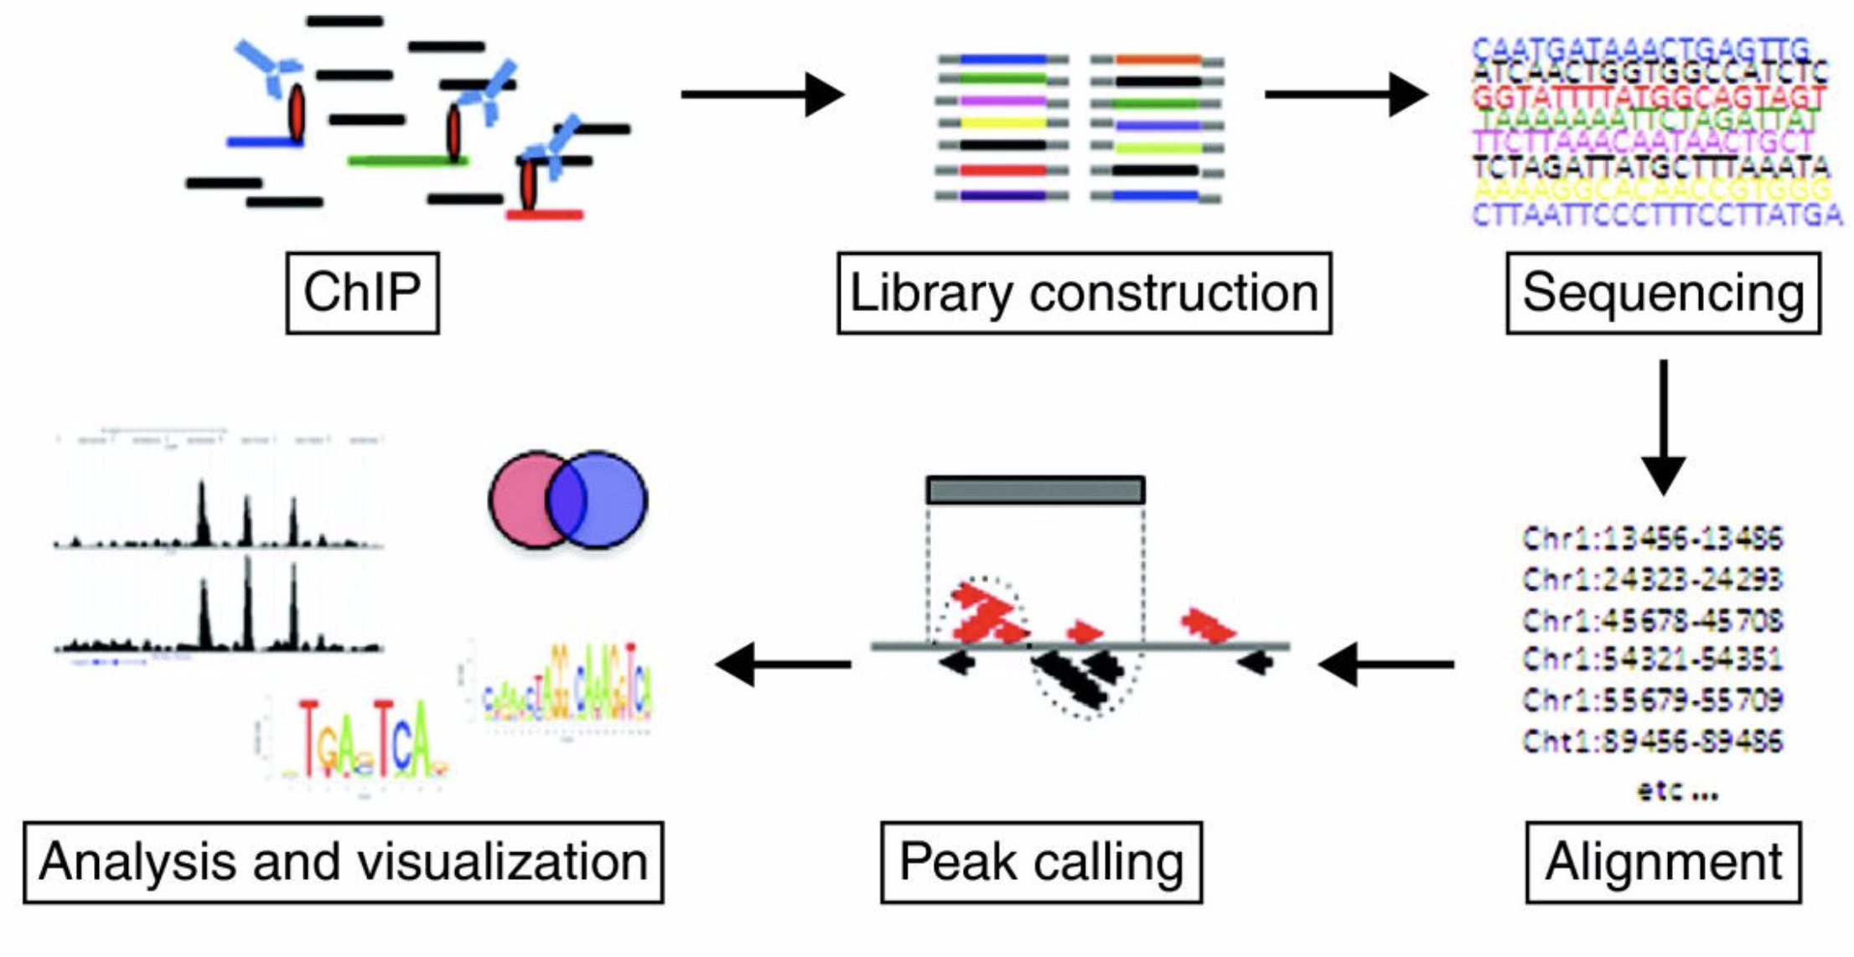
ChIP-seq overview
(Chromatin Immuno-Precipitation)

Slide 4
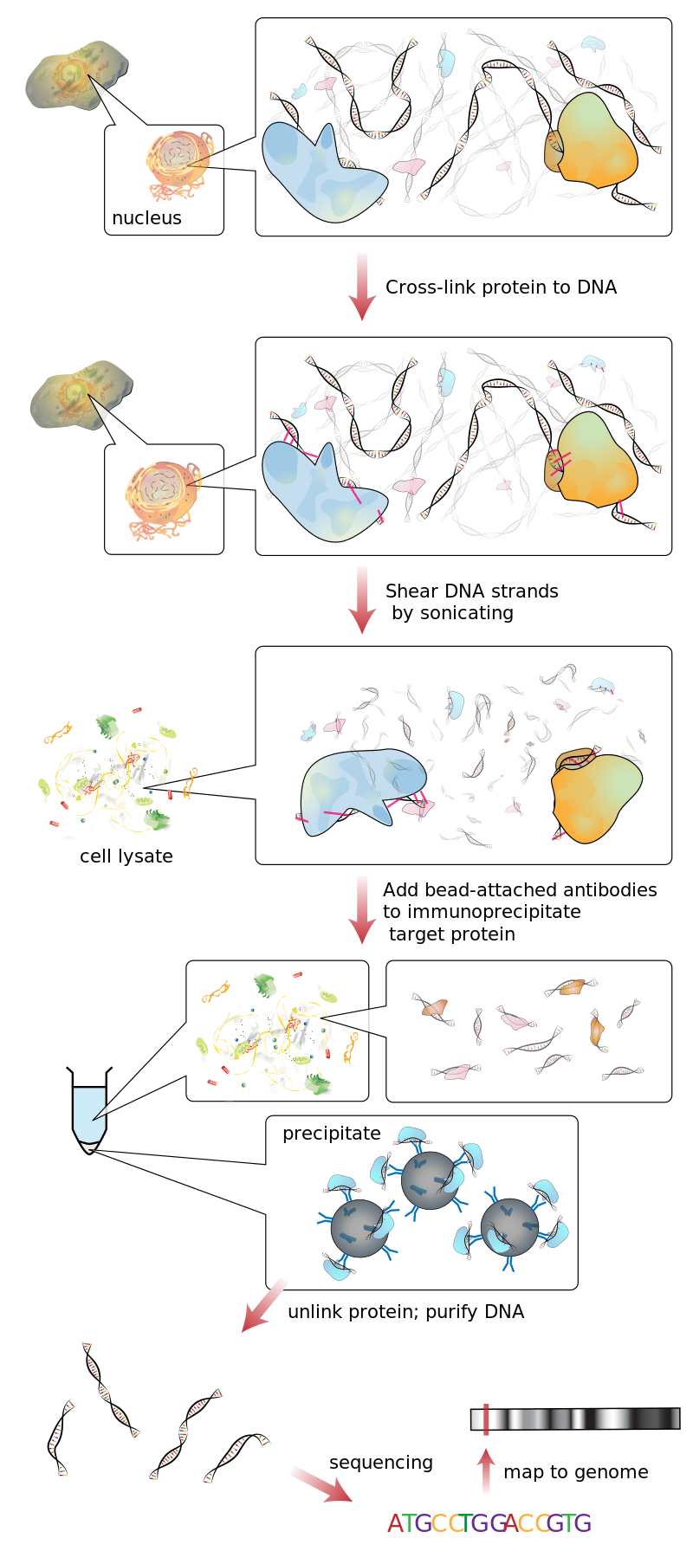
ChIP-seq protocol

Slide 5
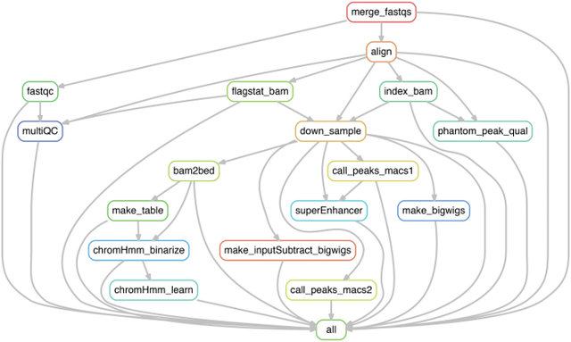
ChIP-seq analysis workflow

Slide 6
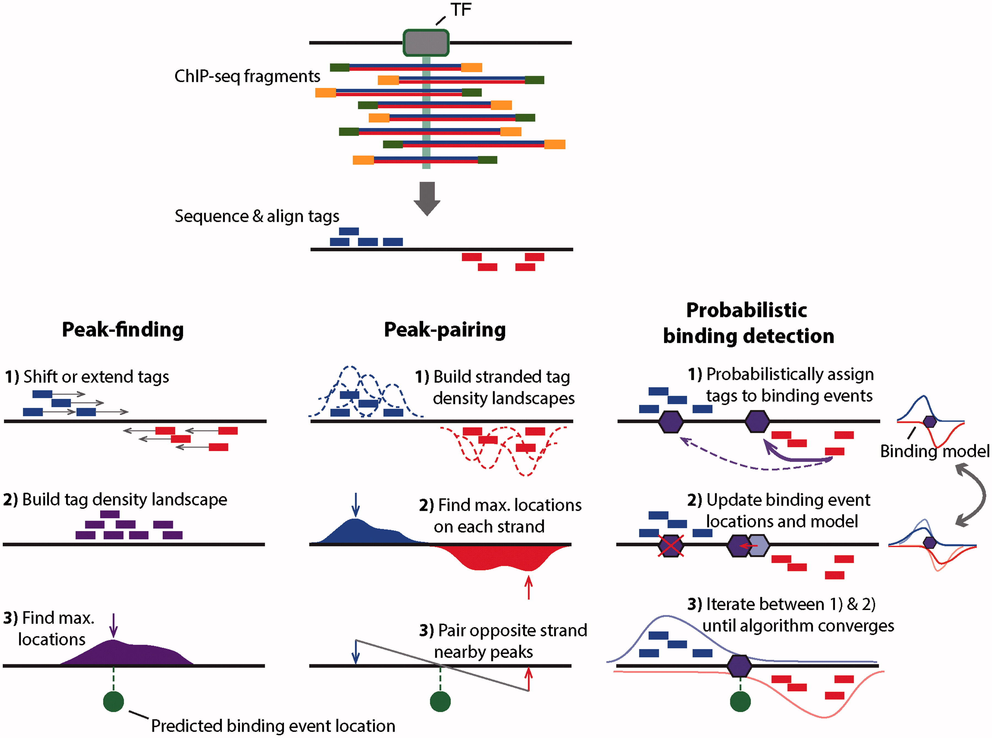
ChIP-seq binding predictions

Slide 7
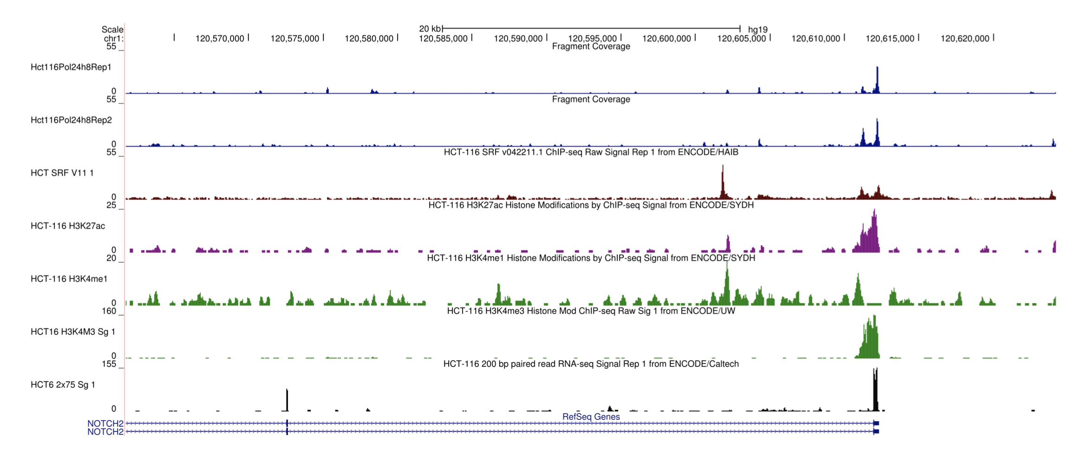
ChIP-seq output visualisation

Slide 8
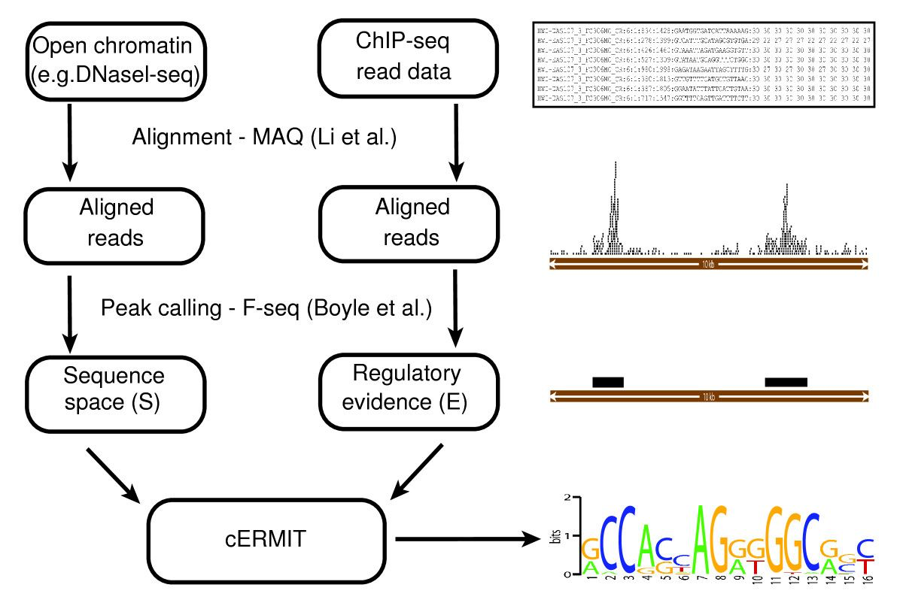
ChIP-seq for binding motif prediction

Slide 9
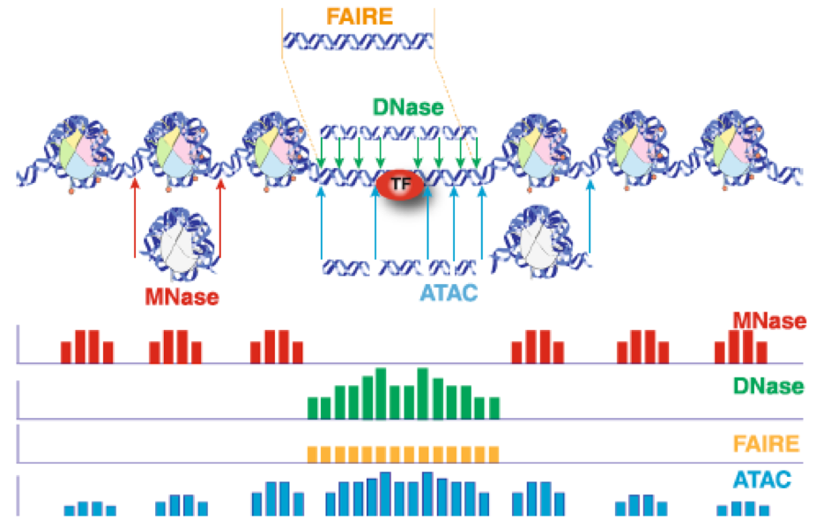
Chromatin structure methods
DOI //dx.doi.org/10.13070/mm.en.9.2797

Slide 10
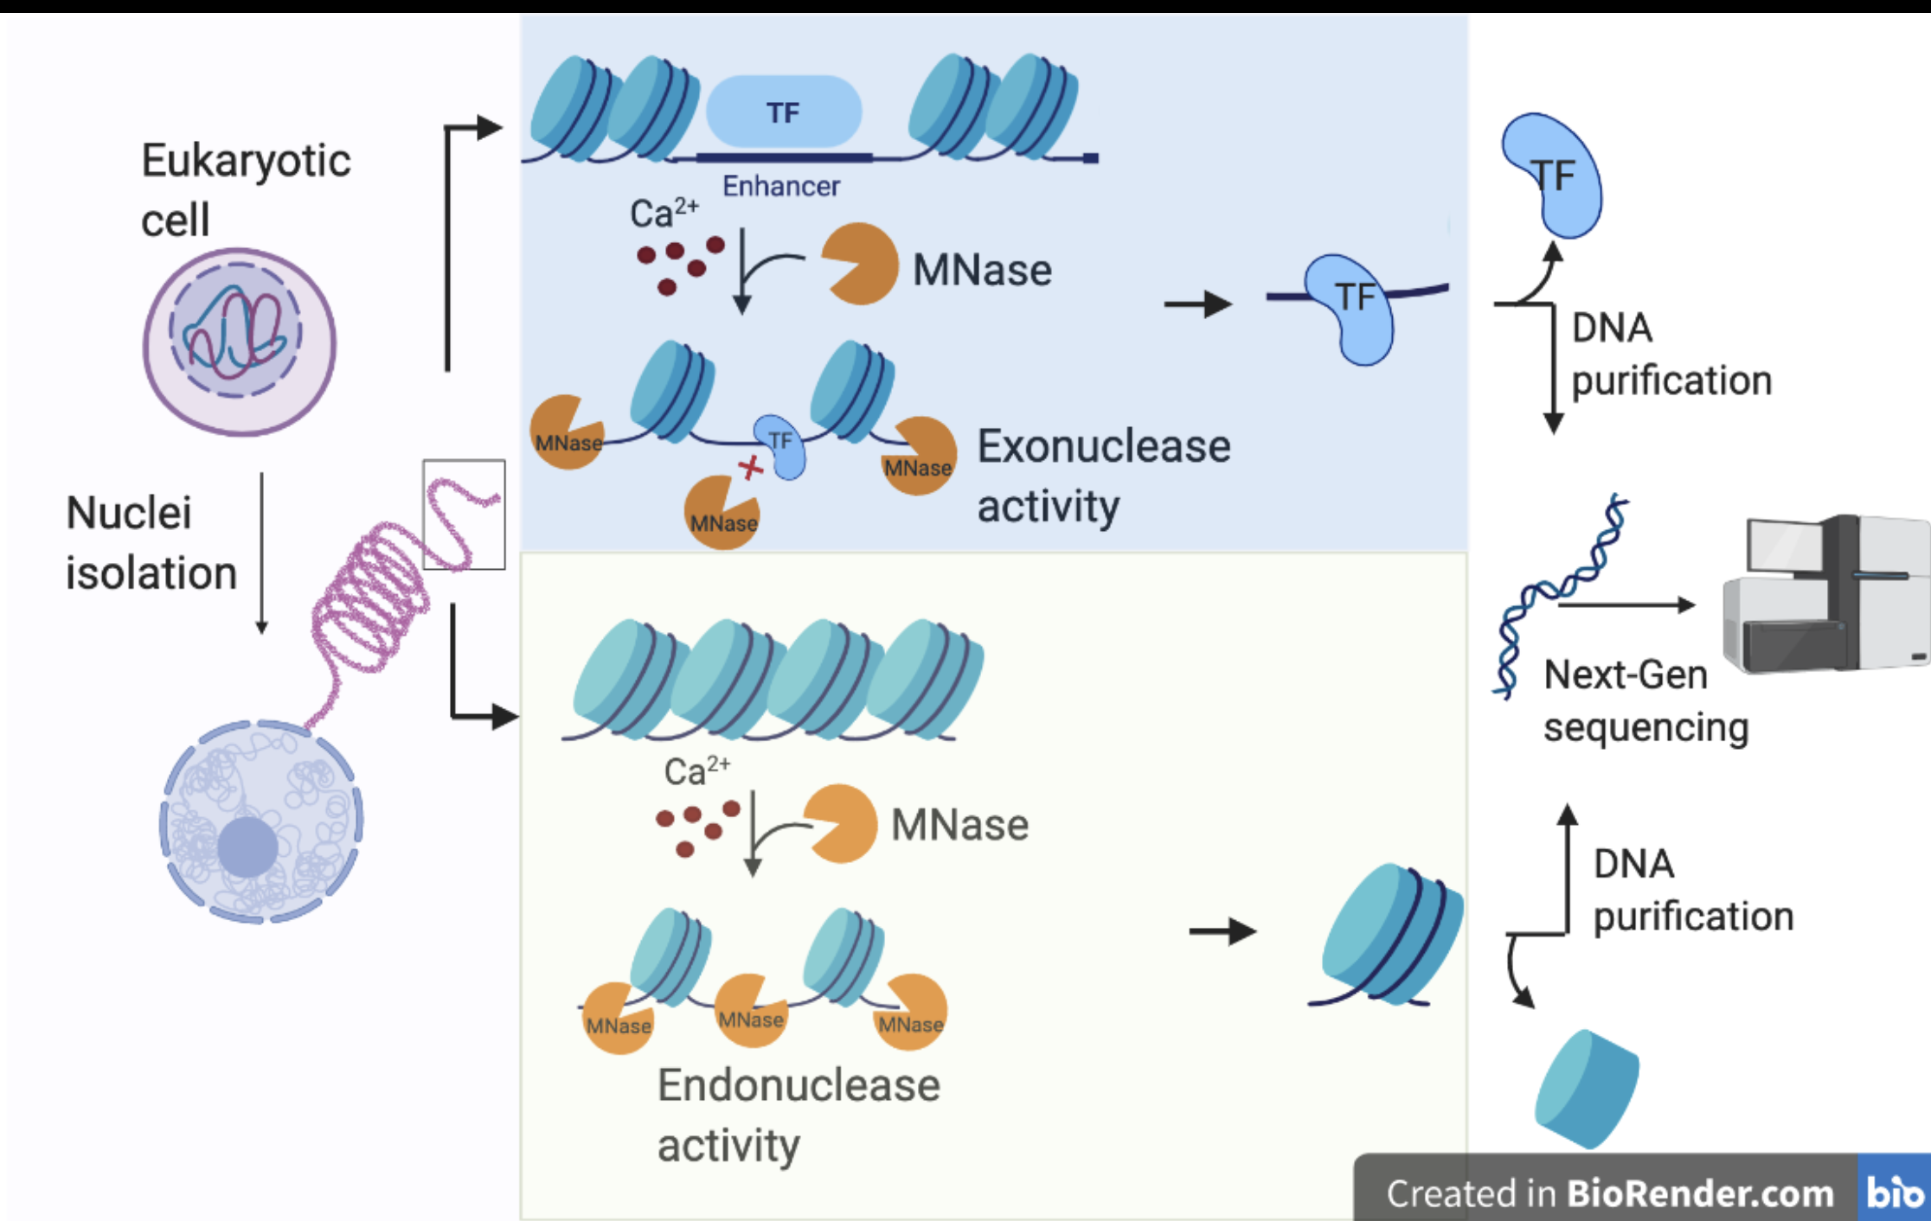
MNAse-seq reveals DNA on nucleosomes
(Micrococcal Nuclease digestion)
https://en.wikipedia.org/wiki/MNase-seq

Slide 11
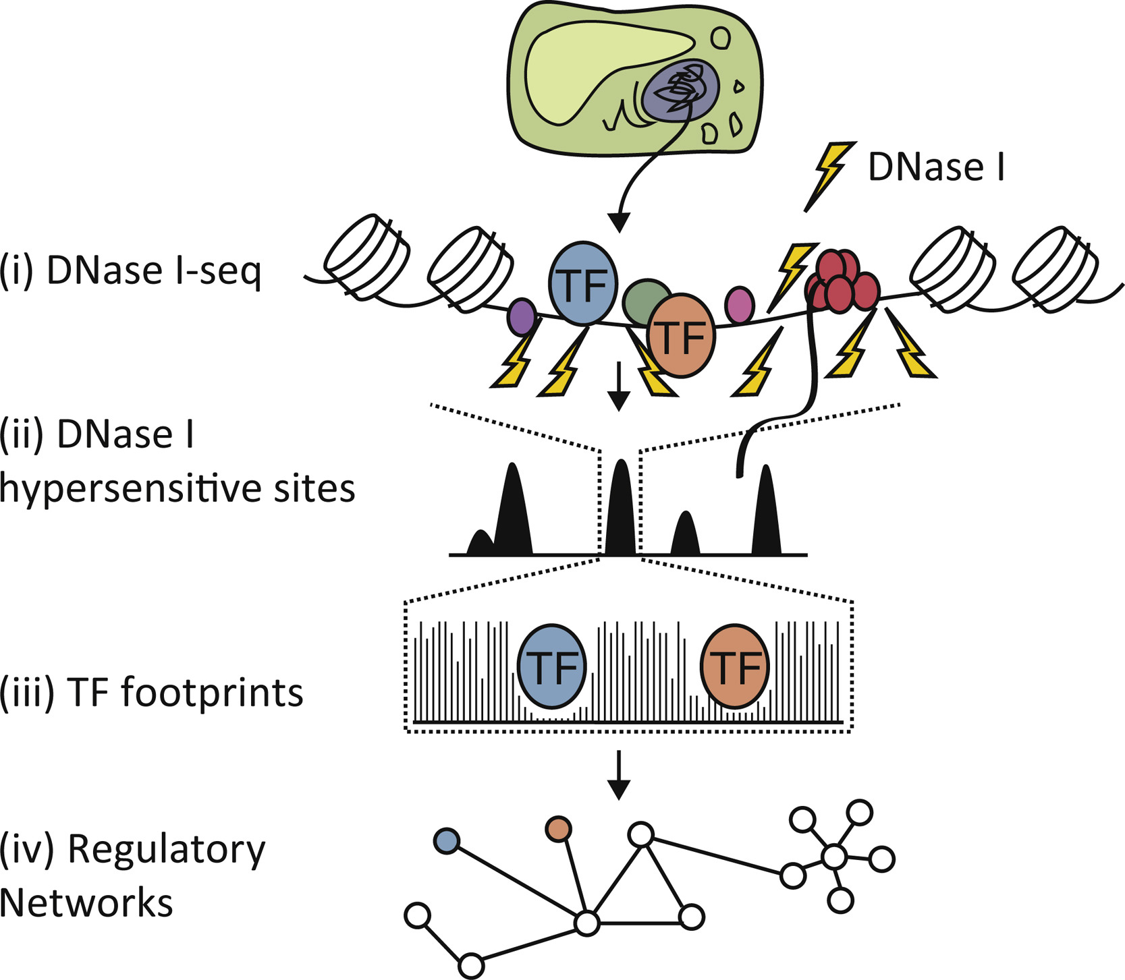
DNAse-seq reveals open, unoccupied DNA

Slide 12
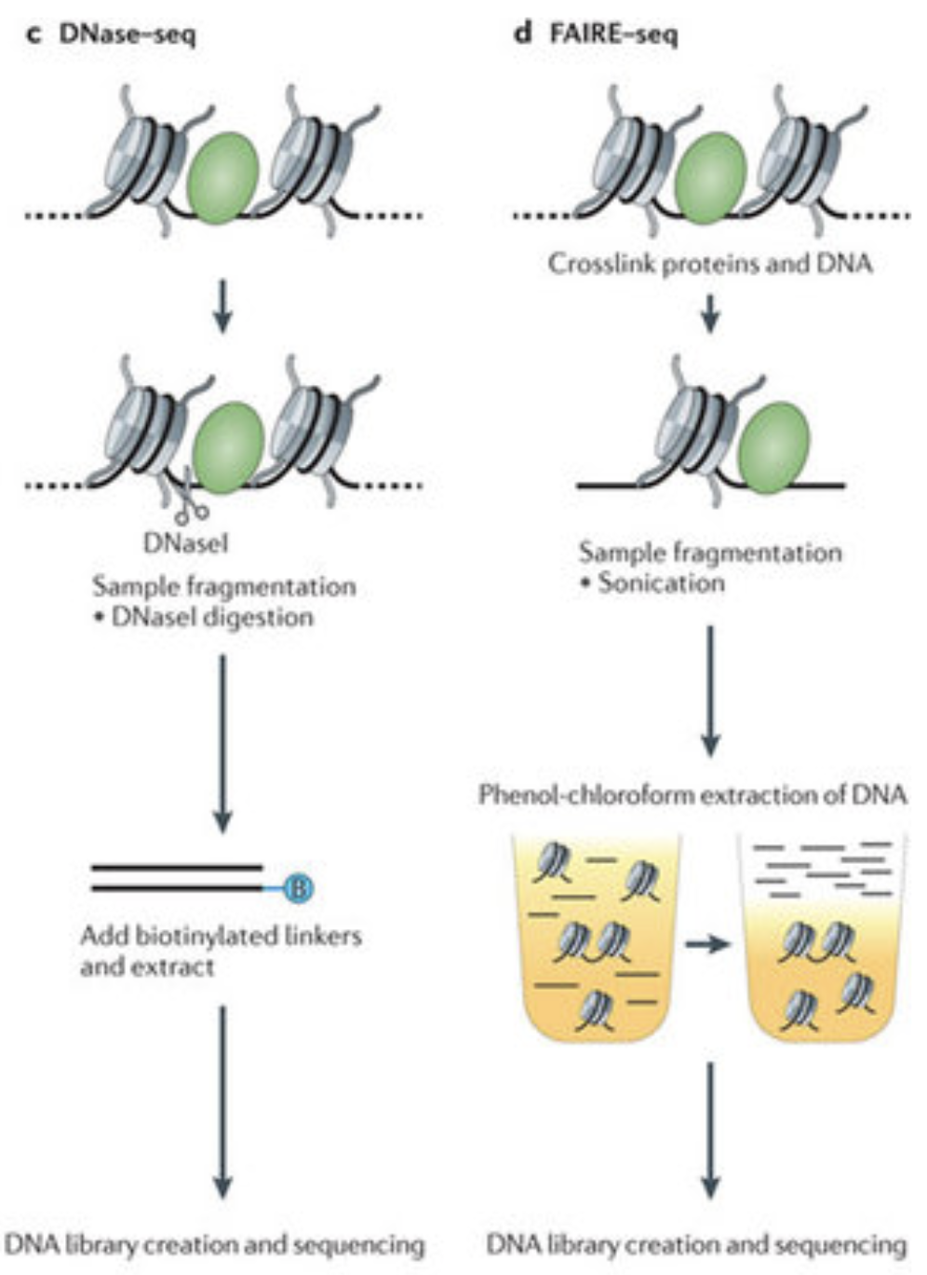
FAIRE-seq reveals open chromatin
(Formaldehyde-Assisted Isolation of Regulatory Elements)

Slide 13
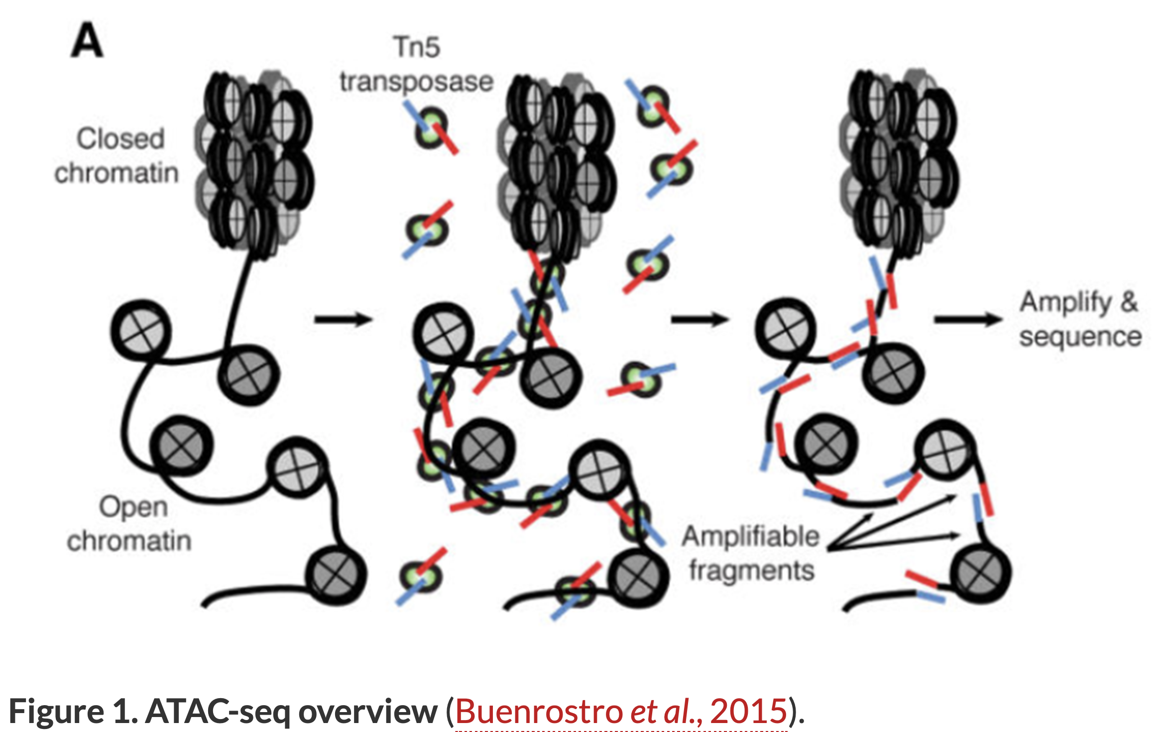
ATAC-seq reveals accessible DNA (including between nucleosomes)
Assay for Transposase-Accessible Chromatin

Slide 14
Chromatin structure methods
DOI //dx.doi.org/10.13070/mm.en.9.2797

Slide 15
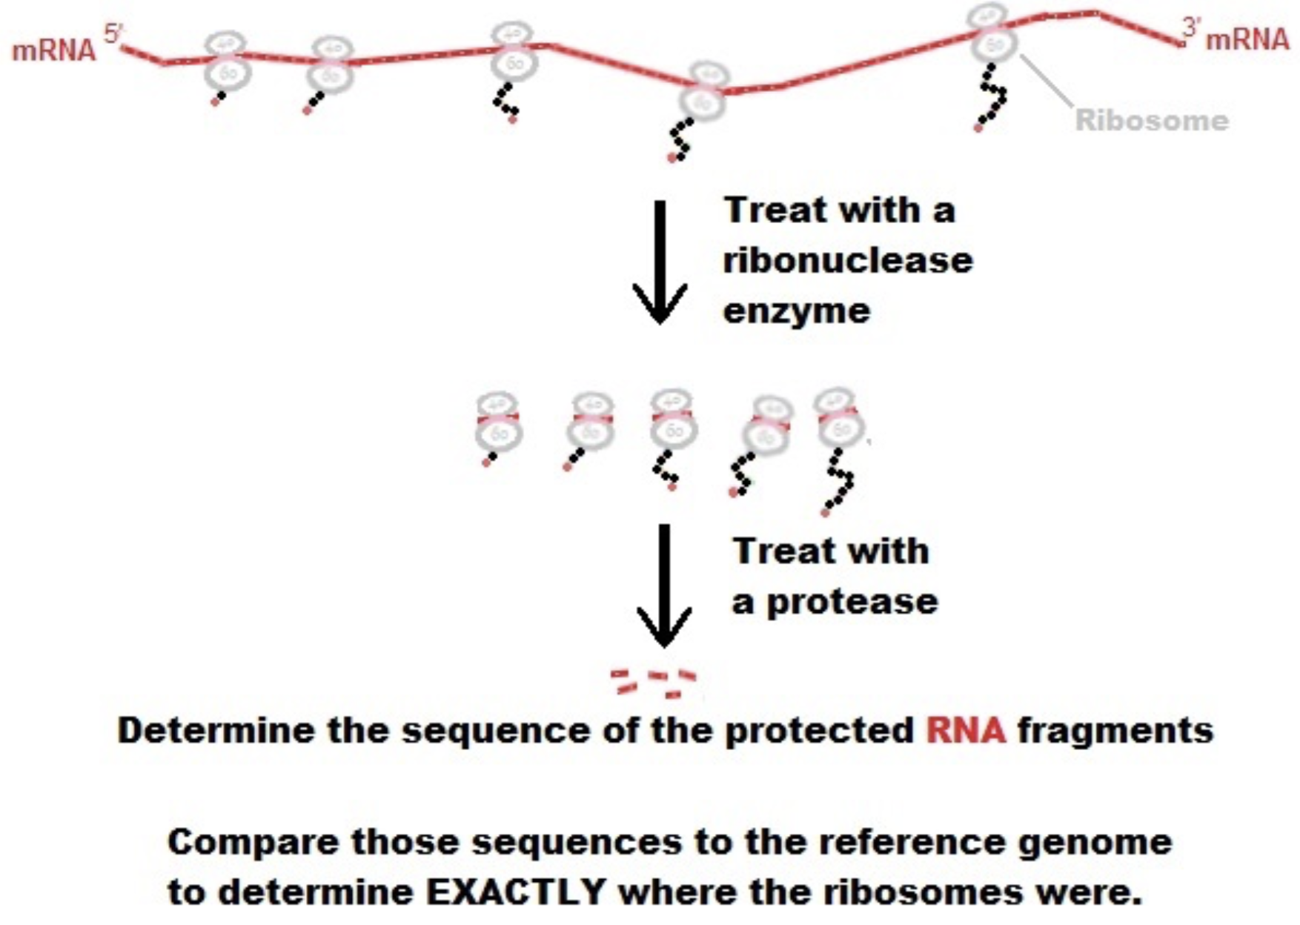
Ribo-seq reveals which RNA is bound to ribosomes (i.e. being translated)

Slide 16
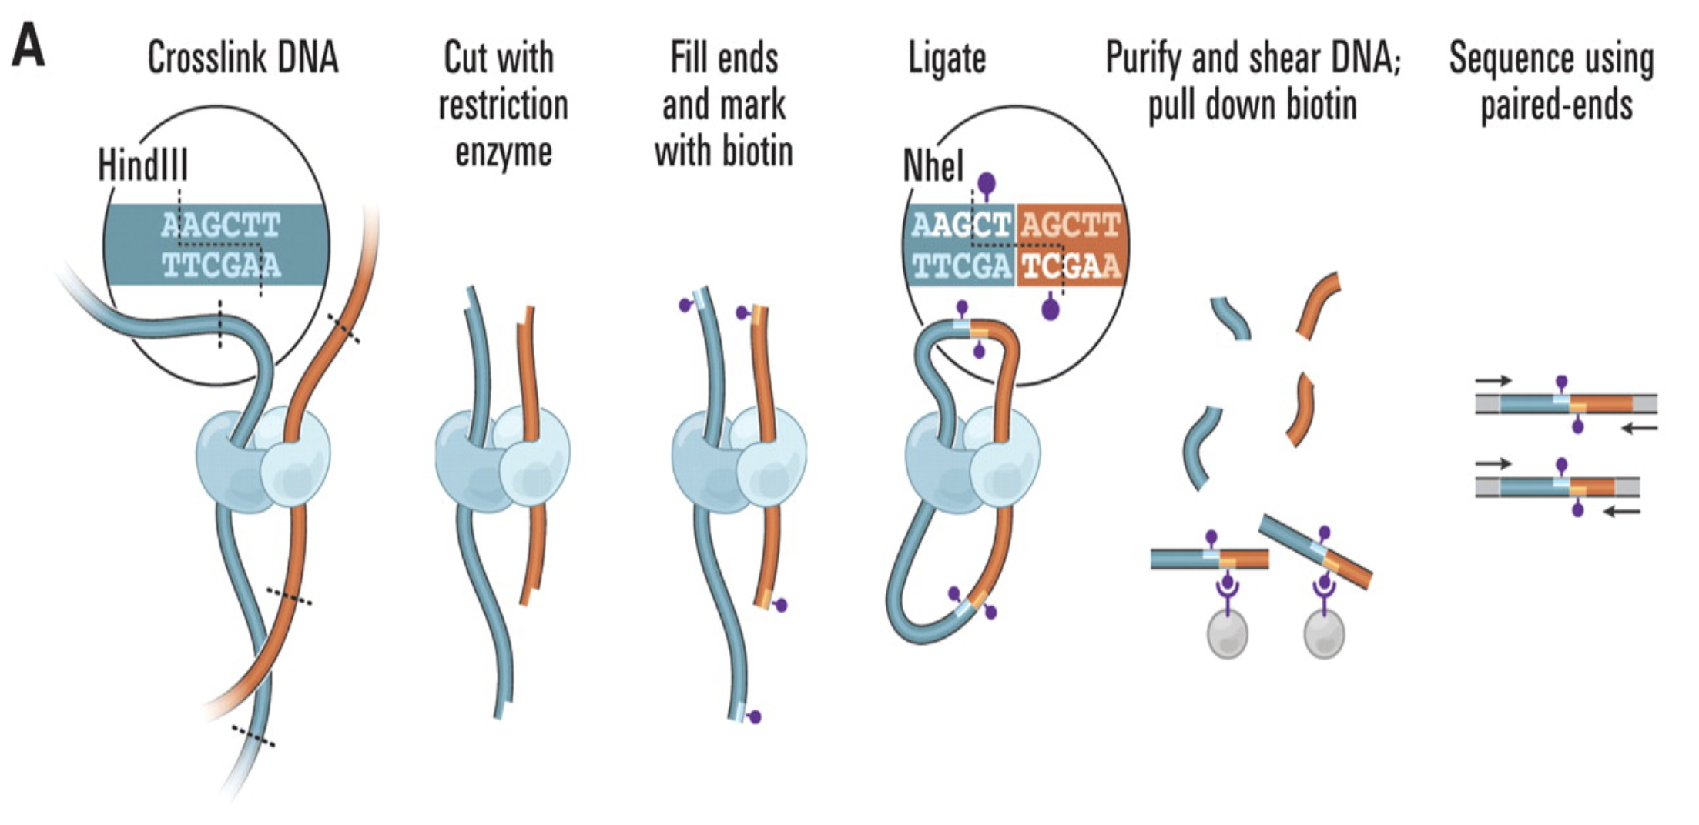
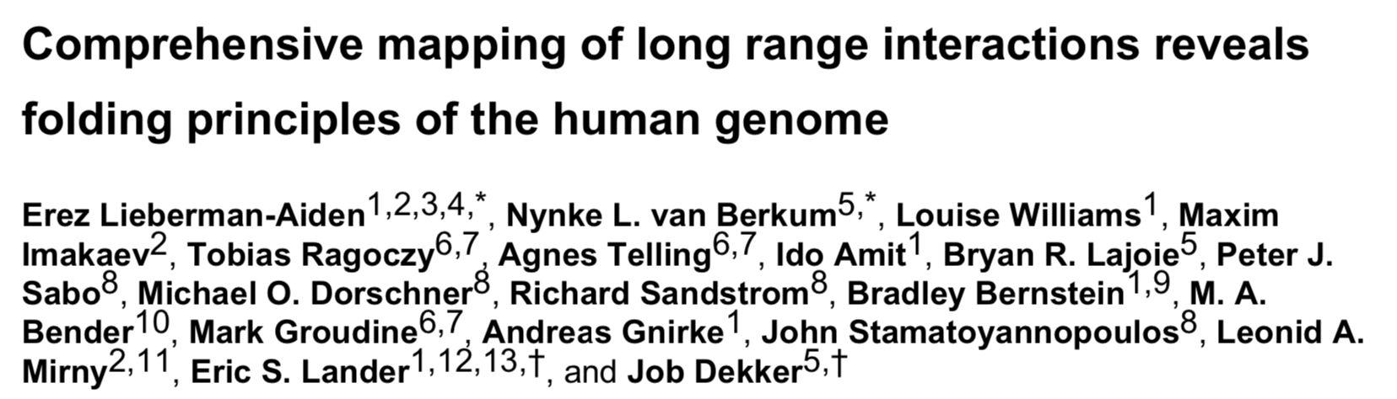
HiC: genome-wide chromatin contacts

Slide 17
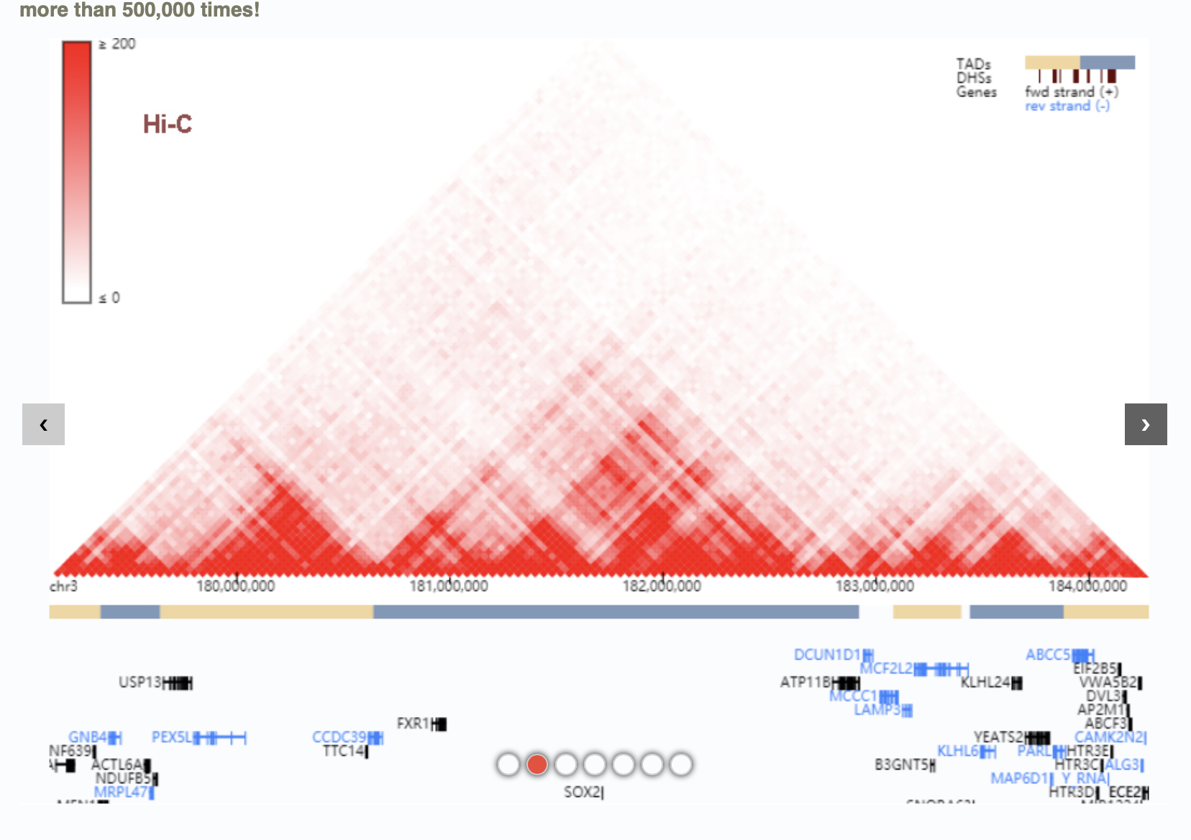
HiC: output visualisation

Slide 18
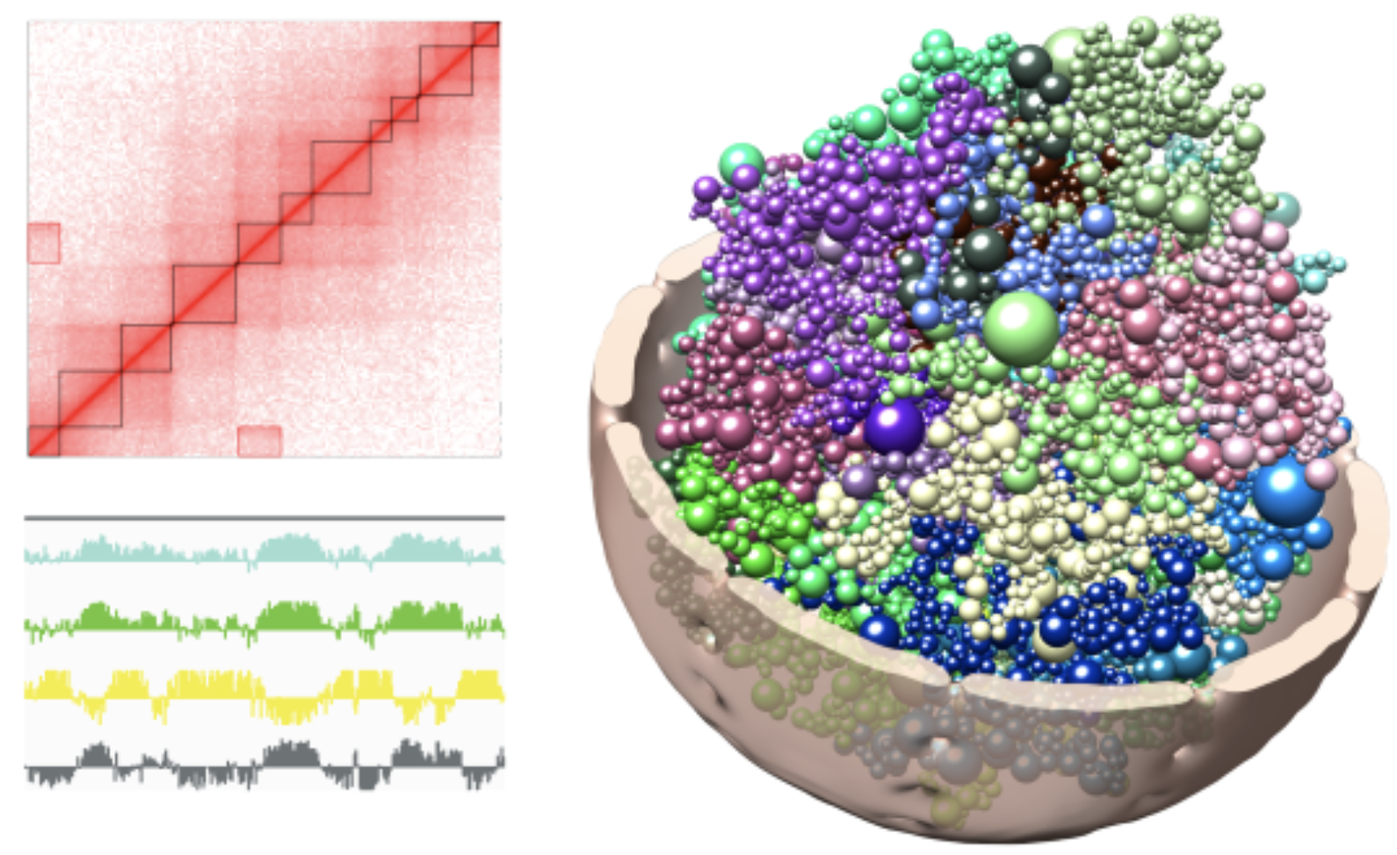
HiC data allow for modelling
DNA structure

Slide 19
More data -> “multi-omics” analyses
Singular Value Decomposition
Cross-correlations
Multivariate regression
Partial Least squares
Ping-pong algorithm

Slide 20
Singular Value Decomposition
“SVD = bi-PCA”
E = U·D·V^{T}
V: PC matrix of “eigen-genes”
(composed of eigenvectors of C = E^{T}·E)
U: PC matrix of “eigen-samples”
(composed of eigenvectors of C’ = E·E^{T})
D: diagonal matrix
http://public.lanl.gov/mewall/kluwer2002.html

Slide 21
SVD: Matrix representation
E = U·D·V^{T}
1
160
1
n
1
n
1
160
…
0
E
v₁
λ₁
…
v₂
=
·
λ₂
·
…
u₁
u₂
u_{n}
0
λ_{n}
v_{n}
30k
30k
U
n
D
n
V^{T}
u_{i}: eigen-samples v_{i}: eigen-genes λ_{i}: eigenvalues
i = 1, …, n n: rank(E) = #(independent samples)
Alter O., Brown P.O., Botstein D. Singular value decomposition for genome-wide
expression data processing and modeling. Proc Natl Acad Sci USA 2000; 97:10101-06.

Slide 22
E = U·D·V^{T} = ∑_{i} λ_{i}·u_{i}·v_{i}^{T} (full expansion)
E₁ = λ₁·u₁·v₁^{T} (rank-1 expansion)
Δ = |E - E₁|² (sum of residuals) minimize Δ for free u₁ and v₁:
E·v₁= λ₁·u₁ & E^{T}·u₁ = λ₁·v₁ implying:
E·E^{T}·u₁ = λ₁²·u₁ & E^{T}·E·v₁ = λ₁²·v₁
SVD: What is optimized?
Bergmann et al., Phys. Rev. E 67, 031902 (2003)

Slide 23
SVD: Example deletion mutants
E₁ = λ₁·u₁·v₁^{T}
1
160
1
E₁
u₁⁽¹⁾·v₁⁽¹⁾ ··· u₁⁽¹⁾·v₁⁽¹⁶⁰⁾
: :
: :
u₁^{(30k)}·v₁⁽¹⁾ ··· u₁^{(6k)}·v₁⁽¹⁶⁰⁾
=
·
·
=
v₁
λ₁
λ₁
1
160
30k
30k
u₁
high
high low
^{low low}
=
·
·
high
low
=
low

Slide 24
SVD: Example deletion mutants

Slide 25
SVD: Example deletion mutants

Slide 26
SVD: Example deletion mutants

