Slide 1
Identification of Auto-Immune disease associated Intergenic Long noncoding RNAs
Supervisor:
Yihong Jennifer Tan
Eric Gähwiler
Karim Hamidi
Virginie Ricci

Slide 2
Plan
Introduction - LincRNAs
Identification
Conservation and functions
Project Interests
Datasets
Reminder of our last presentation
New project goals
Tools and Methods
Data Manipulations
Correlation Test
Multiple Correction Test
Results
Conclusions
Prospective
Questions

Slide 3
LincRNA Identification
Long Intergenic Non-coding RNAs
> 200 base pairs
Not coding for proteins
No apparent open reading frame
Similarities with mRNAs:
Cap, polyA tails, splice junction
Transcribed by Pol II
Differences from mRNAs:
More lowly expressed
More tissues-specific
Many are found in the nucleus, although some are found in the cytoplasm

Slide 4
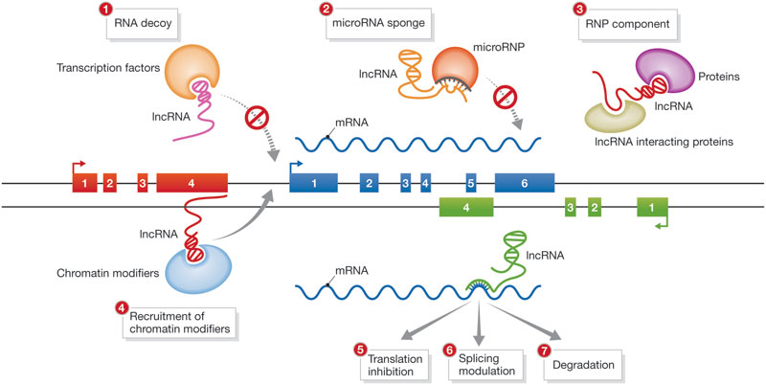
lincRNA conservation and functions
Some lincRNAs are conserved in species
Examples of lincRNA functions:
Notes:
Does it mean that the expression is conserved in particular tissues????

Slide 5
Project interests
Human genome completely sequenced in 2003
Use genome sequencing data to understand human biology
Identify links between lincRNAs and various human phenotypes
lincRNAs and disease traits

Slide 6
Dataset – LincRNAs & Genotype
LCL (lymphoblastoid cells line) of 373 European individuals from the Geuvadis dataset
Expression levels of lincRNAs (Gencode) →RNA sequencing
measured in RPKM
Genotypes of the individuals →SNP sequencing
e.x. C/C, C/T, T/T

Slide 7
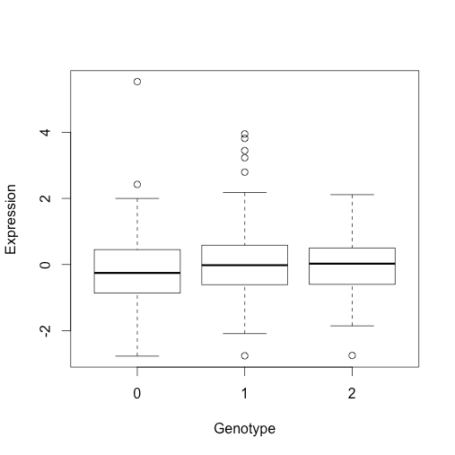
Reminder
Establish a correlation between the expression of lincRNAs and genetic variants recently linked to obesity and BMI – cis-eQTL analysis
Wrong tissues used to study BMI traits
Notes:
Ajouter le plot ou il n’y a pas de corrélation

Slide 8
News Goals
New goals
Determine whether long intergenic noncoding RNAs play a functional role in Auto-Immune traits and diseases
Establish a correlation between the lincRNA expression level and genetic variant associated to immune traits - cis-eQTL analysis

Slide 9
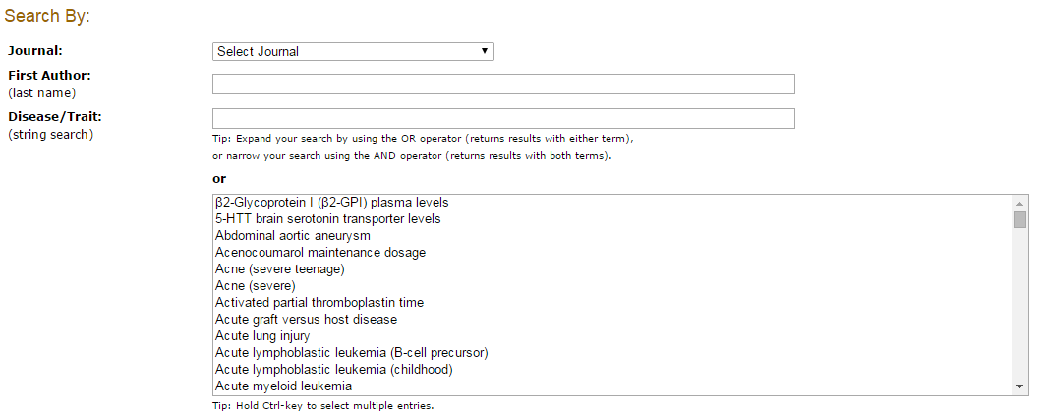
Dataset - SNPs
Auto-Immune traits associated SNPs
NIH:
Notes:
In genetic epidemiology, a genome-wide association study (GWA study, or GWAS), also known as whole genome association study (WGA study, or WGAS) or common-variant association study (CVAS), is an examination of many common genetic variants in different individuals to see if any variant is associated with a trait. GWAS typically focus on associations between single-nucleotide polymorphisms (SNPs) and traits like major diseases.
These studies normally compare the DNA of two groups of participants: people with the disease (cases) and similar people without (controls).
In genetic epidemiology, a genome-wide association study (GWA study, or GWAS), also known as whole genome association study (WGA study, or WGAS) or common-variant association study (CVAS), is an examination of many common genetic variants in different individuals to see if any variant is associated with a trait. GWAS typically focus on associations between single-nucleotide polymorphisms (SNPs) and traits like major diseases.
These studies normally compare the DNA of two groups of participants: people with the disease (cases) and similar people without (controls).

Slide 10
Dataset
Crohn's disease
Hypothyroidism
Multiple sclerosis
Psoriatic arthritis
Rheumatoid arthritis
Systemic lupus erythematosus and Systemic sclerosis
Type 1 diabetes
Only SNPs associated to the traits with a p.value < 5x10-8
579 SNPs associated to immune traits
Notes:
Explain each disease and put some disgusting pictures
stemic sclerosis (SSc) is a systemic connective tissue disease. Characteristics of systemic sclerosis include essential vasomotor disturbances; fibrosis; subsequent atrophy of the skin (see the image below), subcutaneous tissue, muscles, and internal organs (eg, alimentary tract, lungs, heart, kidney, CNS); and immunologic disturbances accompany these findings.
Multiple sclerosis (MS), also known as disseminated sclerosis or encephalomyelitis disseminata, is an inflammatory disease in which the insulating covers of nerve cells in the brain and spinal cord are damaged. This damage disrupts the ability of parts of the nervous system to communicate, resulting in a wide range of signs and symptoms,^{[1][2]} including physical, mental,^{[2]} and sometimes psychiatric problems.^{[3]} MS takes several forms, with new symptoms either occurring in isolated attacks (relapsing forms) or building up over time (progressive forms).^{[4]} Between attacks, symptoms may disappear completely; however, permanent neurological problems often occur, especially as the disease advances.^{[4]}
Rheumatoid arthritis (RA) is a chronic, systemic inflammatory disorder that primarily affects joints.^{[1]} It may result in deformed andpainful joints, which can lead to loss of function. The disease may also have signs and symptoms in organs other than joints.

Slide 11
Methodology
Data collecting and manipulations
Estimate correlation test between lincRNAs expression levels and genotypes of Auto-Immune diseases-SNPs – cis-eQTL
Randomized multiple correlation test

Slide 12
Methodology
+
LincRNAs location
(7256)
SNPs location
(579)
lincRNA close to the SNPs
(2409 pairs)
lincRNAs expression level
(467)
Genotypes of the SNPs
(402)
Pearsons’
Correlation Test
Multiple test correction

Slide 13
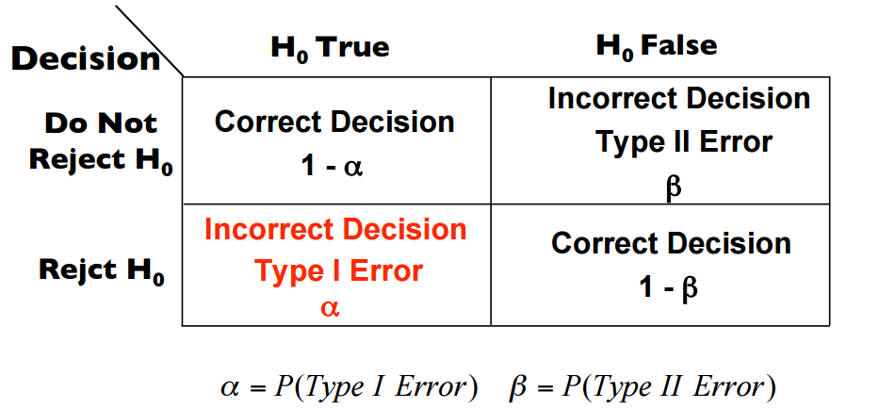
Multiple Correlation Tests
Multiple Test :
Many genotype ~ many expressions levels 373 / gene
Corresponding to do a correlation test for each expression levels and genotypes
Multiple Test problem :
For each individual correlation test → α error = 0.05
False Discovery Rate or FDR
Notes:
Alpha error = the probability to reject H0 if H0 is true…
If we had 1000 H0s taht we tests the error alpha is multiplied by 1000
Because there is a sum of all the error alpha so we are no more at alpha = 0.05 for the «global» H0 (?)

Slide 14
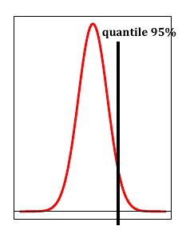
Multiple Test correction
1) For each lincRNA :SNP pair:
Randomize 373 lincRNA expression 1000 times
Evaluate 1000 correlation tests with permuted data
Store the maximum permuted correlation value
2) Obtain 95% quantile of the permuted correlation value (5%FDR)
3) Compare observed correlations with 5%FDR, and accept observed correlation values as significant only if it passes 5%FDR test.
Notes:
False discovery rate (FDR) is designed to control the proportion of false positives among the set of rejected hypotheses ®
We don’t have to speak about the FDR because we don’t FDR.
??????
1)We made 1000 correlation test with permuted data to find out if the value of the observed corraltion are significant
2)We tried to obtain the quantile 95% of the permuted values so that we can take in the last part…
3)Use the quantile 95% of the paermuted values as threshold, to only keep the significant value →greater than 95% in the normal distribution.
????????

Slide 15
Results
Gene name:
ENSG00000224950
Chromosome 1
SNP name:
rs2300747
Correlation coefficient:
0.210
Associated disease :
Multiple sclerosis
Corrected p.value:
0.079

Slide 16
Results
Gene name:
ENSG00000224950
Chromosome 1
SNP name:
rs1335532
Correlation coefficient: 0.210
Associated disease :
Multiple sclerosis
Corrected p.value:
0.079

Slide 17
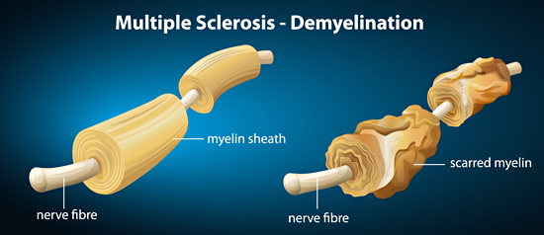
Visualization
lincRNA
(ENSG00000224950)
rs1335532
rs2300747
http://www.carefecthomecareservices.com/blog/multiple-sclerosis-definition-causes-types-symptoms/

Slide 18
Results
Gene name:
ENSG00000258701
Chromosome 14
SNP name:
rs2841277
Correlation coefficient:
-0.220
Associated disease :
Rheumatoid arthritis
Corrected p.value:
0.055
Notes:
Negative correlation

Slide 19
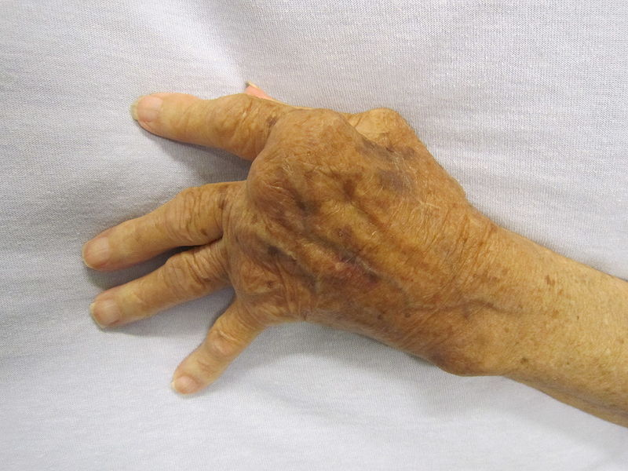
Visualization
lincRNA
(ENSG00000258701)
Visualisation tool
Rheumatoid arthritis
rs2841277
http://fr.wikipedia.org/wiki/Polyarthrite_rhumato%C3%AFde#/media/File:Rheumatoid_Arthritis.JPG
Notes:
Is it always necessary?

Slide 20
Conclusions
No correlation at FDR < 5%
Found 2 LincRNAs whose expression levels is correlated with SNPs associated with Multiple sclerosis & Rheumatoid arthritis
FDR < 10%
Notes:
With the FDR at 10% it means that we don’t have a clear correlation but indicates us that there is maybe something further analyse (to look after)

Slide 21
Prospects
Using other datasets, see if can reproduce the same results
Possibly in same or different tissues (i.e. neuronal tissues, skin etc.)
Further analyze the characteristics and functions of the lincRNAs
Whether there is an implication of the lincRNA in respective diseases
Multiple Sclerosis
Rheumatoid arthritis
Notes:
Roles of lincRNAs

Slide 22
Feedback
Difficulties
Keep a global vision of the project
Data manipulations
Find an error in many code line
Learnings
LincRNAs
R – programmation
Methodologyies in a study

Slide 23
Questions?
Thank you for your attention

