Slide 1
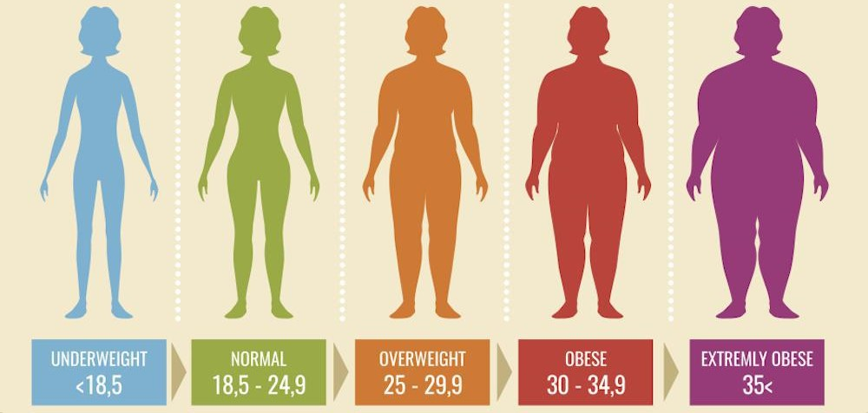
Clinically relevant measures of obesity and their genetics
Joaquim Barmaz, Jeanne Buchs, Aline Cinelli
Supervised by : Olga Trofimova and Sofia Ortin Vela

Slide 2
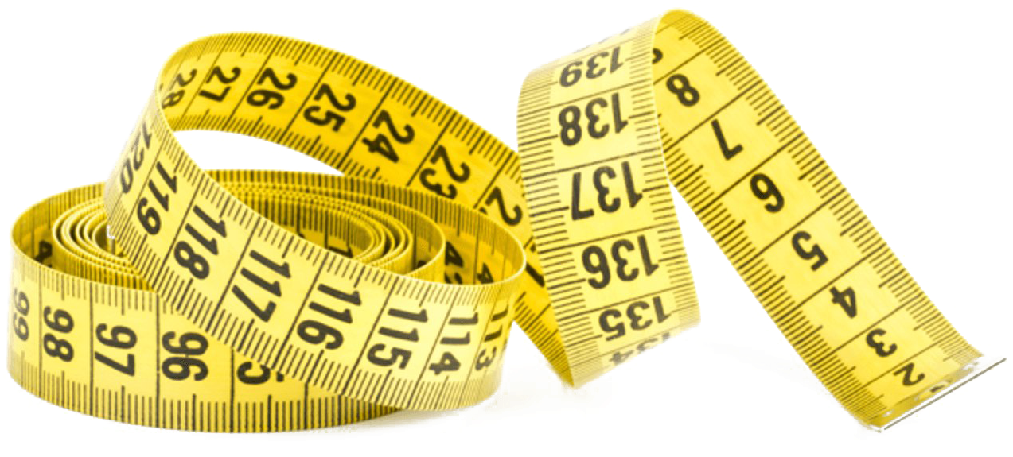
Goals
Find a measure of obesity that is relevant for cardiovascular disease
Find the genes associated with these measurements

Slide 3
Background
Obesity is associated with cardiovascular diseases
Different measures of obesity → different indexes with limitations
Index most frequently used : BMI = weight/height²
GWAS on the phenotypes to find relevant genes

Slide 4
Phenotypes of obesity
$\frac{weight}{{height}^{1.6}}$
$\frac{weight}{{height}^{2}}$
$\frac{weight}{{height}^{2.5}}$
$\frac{weight}{{height}^{3}}$
$\frac{waist}{hip circumference}$
$\frac{waist}{height}$
waist
BAI = $\frac{hip circumference}{{height}^{1.5}}−18$
$RFM= 64−\frac{20∗height}{waist}+12∗sex$
BMI variations
Waist phenotypes
% body fat

Slide 5
Methodology (Phenotypic part)
(1) Normalization of the phenotypes → $\frac{Phenotype−mean}{standard deviation}$
(2) Linear regression → SBP ~ phenotype * sex + age + age²
(3) Linear regression without interaction → SBP ~ phenotype + sex + age + age²
(4) Background → SBP ~ sex + age + age²
Adjusted R², β, p-value
Notes:
AJOUTER BACKGROUND

Slide 6
Methodology (Genetic part)
Covariants of the GWAS
Age
Sex
Genetic principal components
Qqplot, Manhattan plot, heritability, genes associated with SBP

Slide 7
Phenotypic results

Slide 8
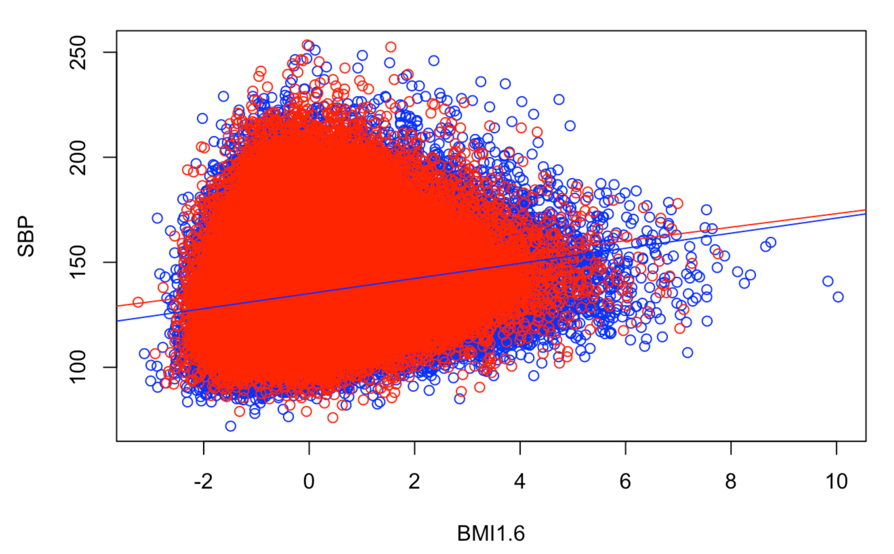
Results (Phenotypic part)
Assumptions of linear regression not violated
RFM: highly correlated with sex
→ difficult to compare
Positive significant relationship between SBP and all phenotypes
Interaction phenotype * sex : significant, but small difference
Men Women
Notes:
ASSUMPTIONS WERE NOT VIOLATED
1) Linearity. This means that the mean of the response variable is a linear combination of the parameters (regression coefficients) and the predictor variables
2) Constant variance (a.k.a. homoscedasticity). This means that the variance of the errors does not depend on the values of the predictor variables.
3) Independence of errors. This assumes that the errors of the response variables are uncorrelated with each other.
4) Weak exogeneity. This essentially means that the predictor variables x can be treated as fixed values, rather than random variables

Slide 9
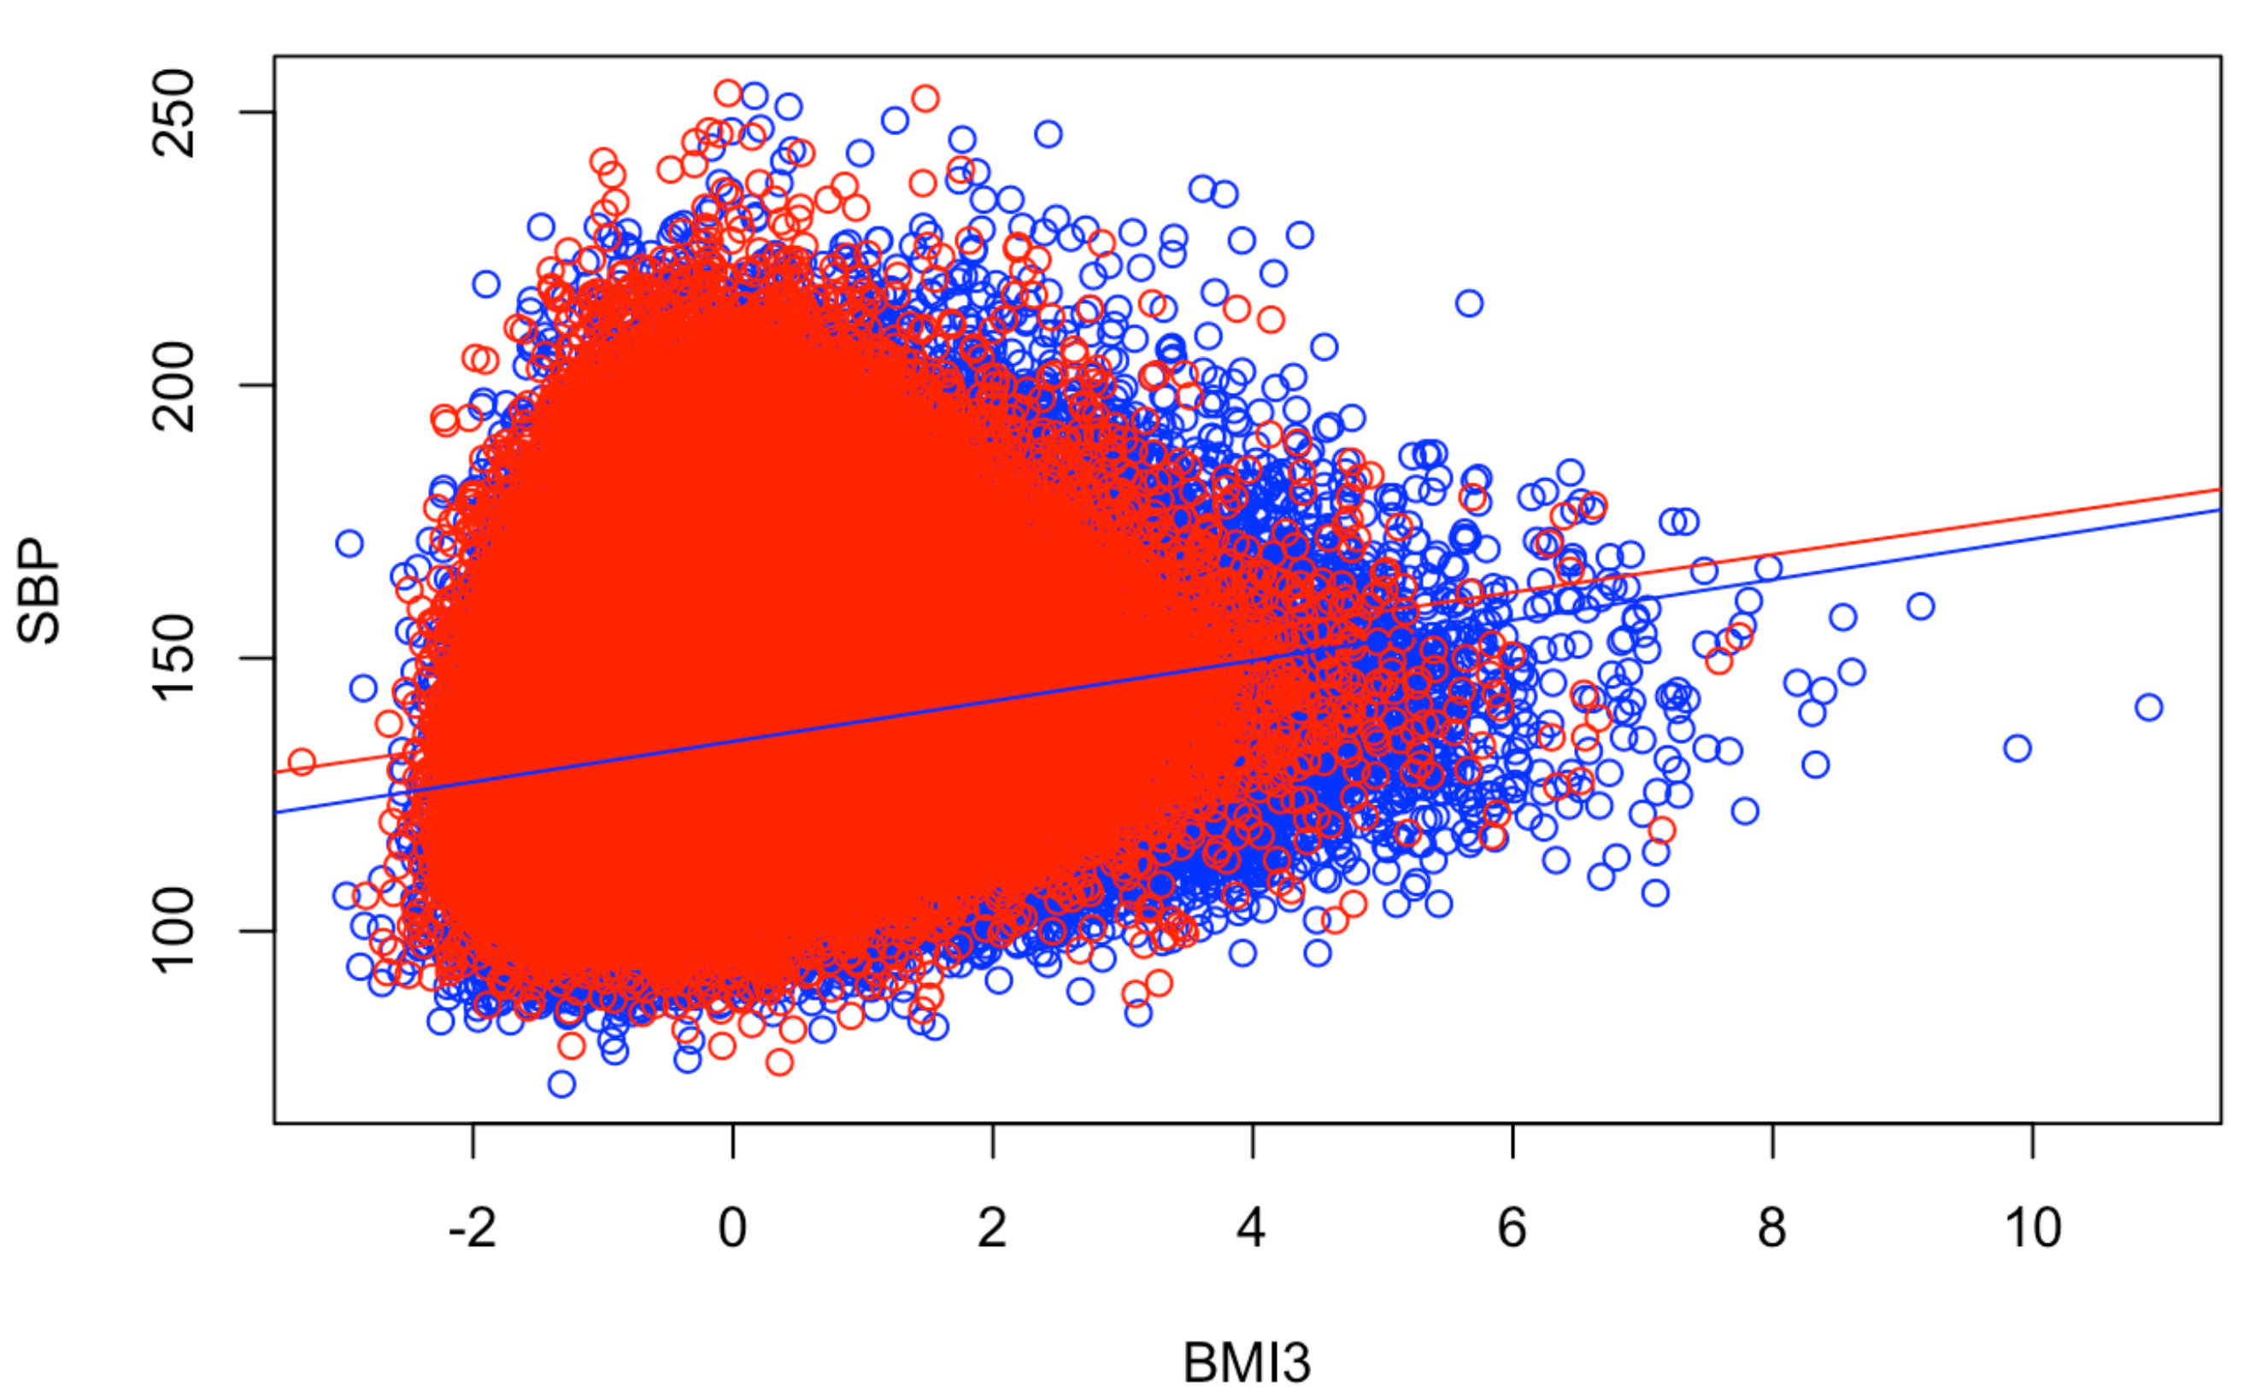
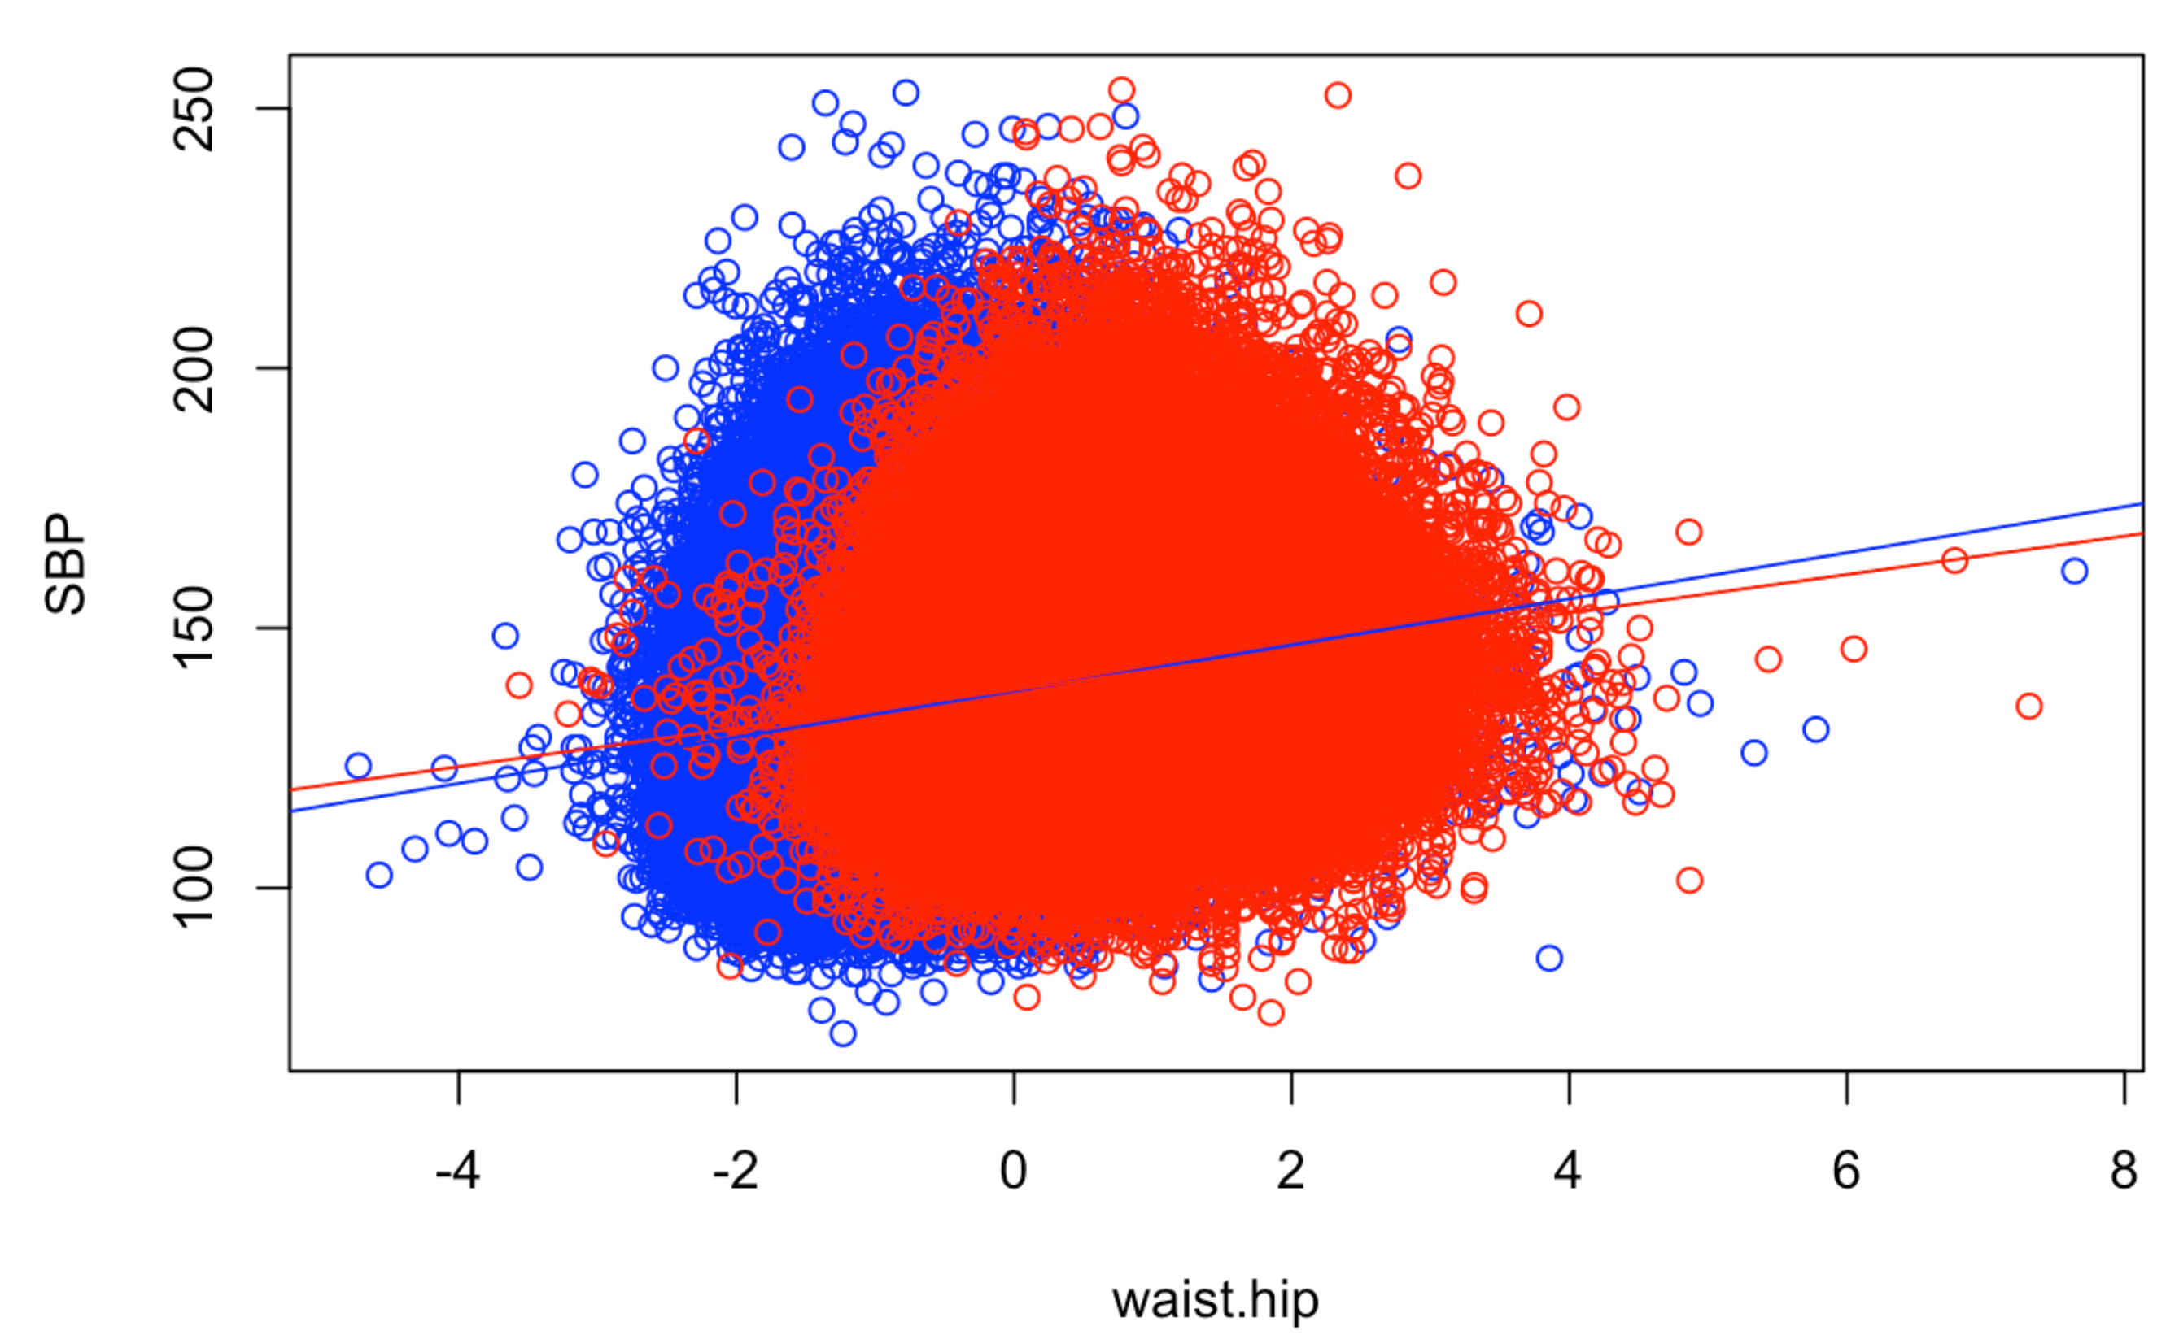
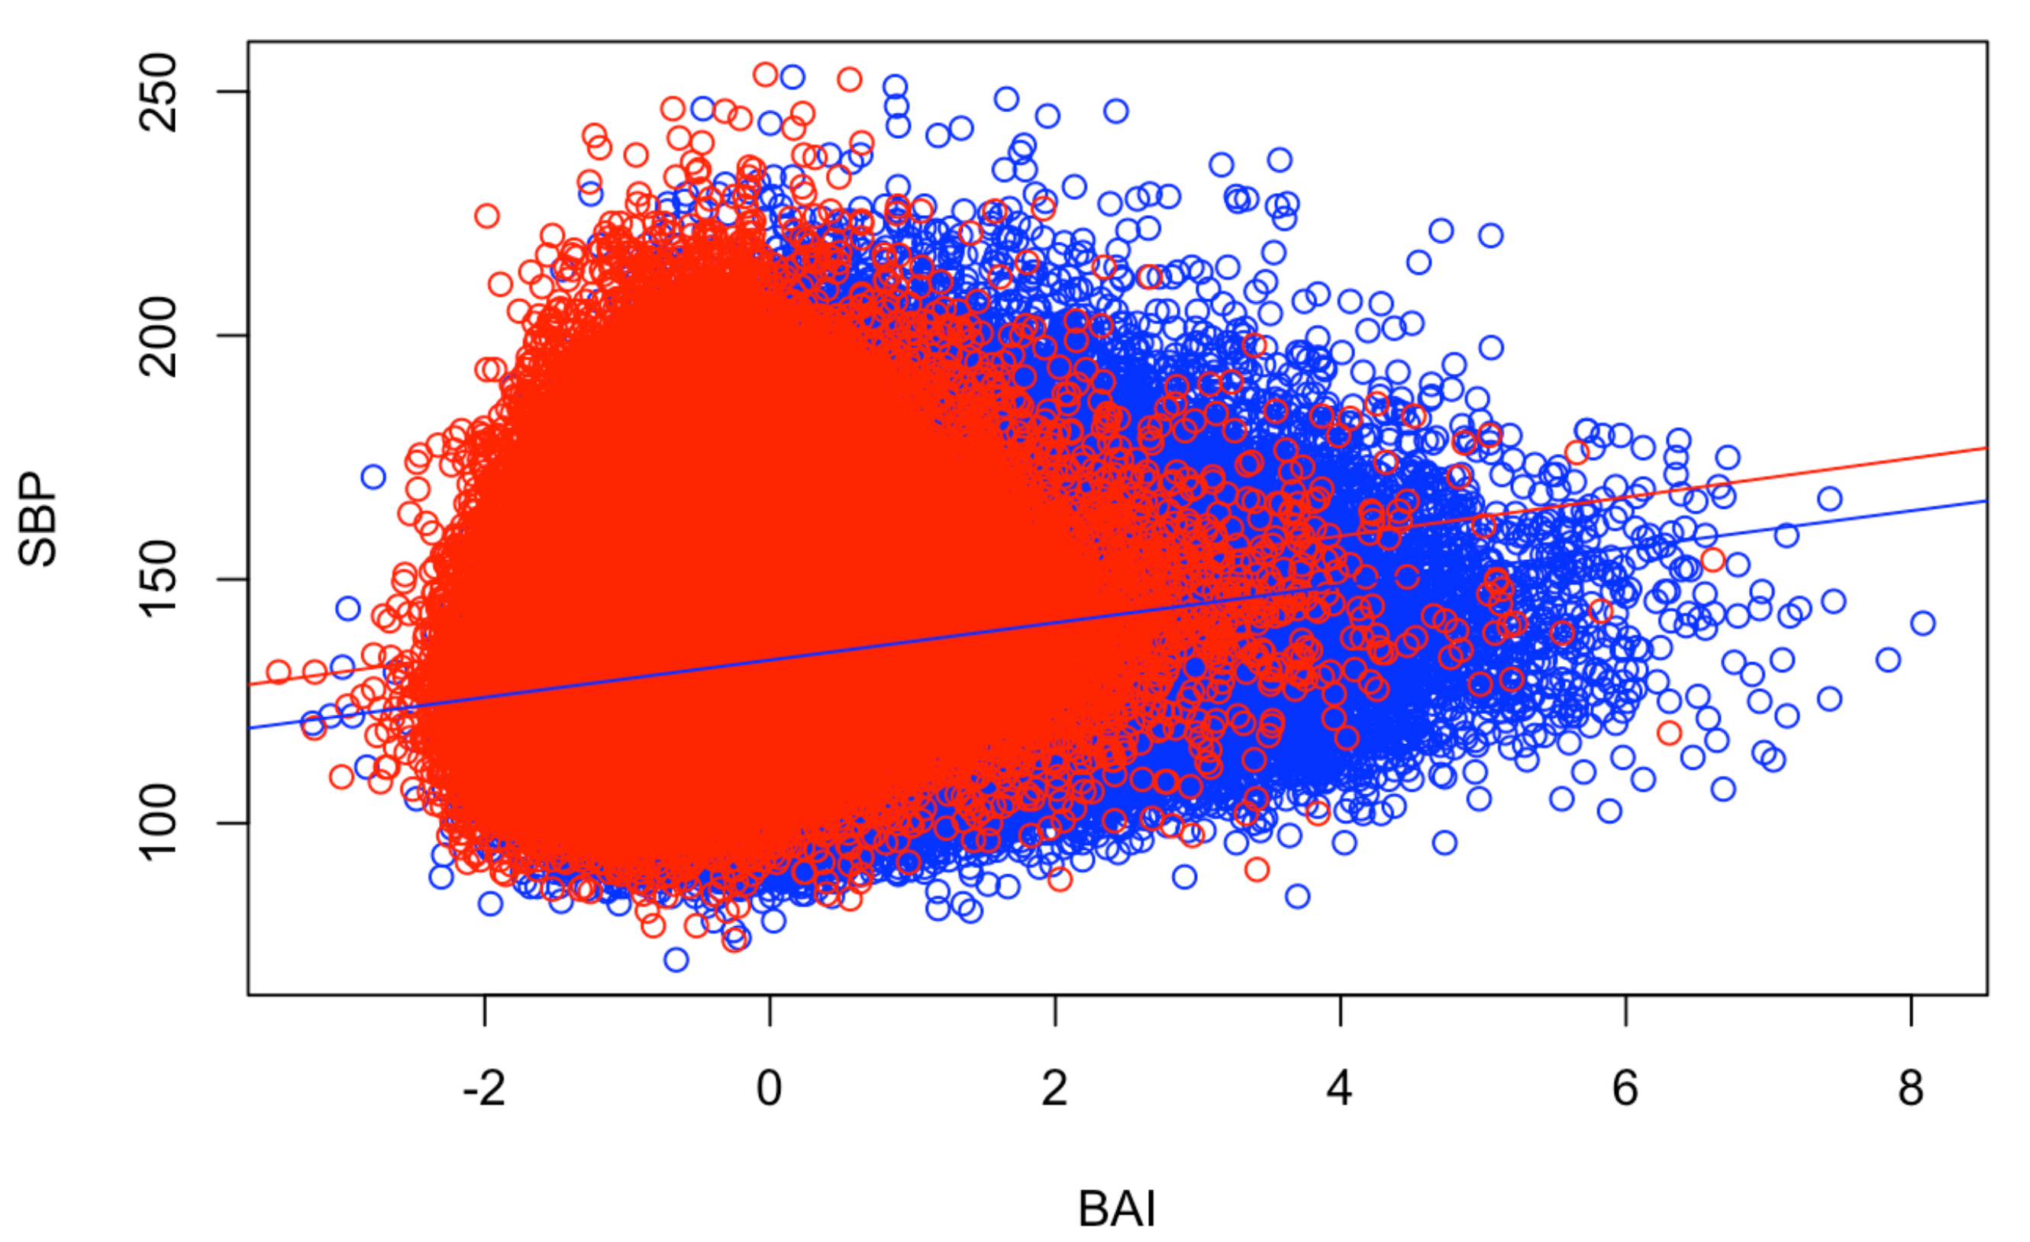
Results (Phenotypic part)

Slide 10
Results (Phenotypic part)
Divergent results between R^2 and β
Phenotype | Adj. R^2 | Expl. var | β (SD)
BMI 1.6 | 0.1548 | 2.77 % | 3.18 (0.025)
BMI | 0.1536 | 2.65 % | 0.663 (0.007)
BMI 2.5 | 0.1548 | 2.77 % | 0.849 (0.008)
BMI 3 | 0.1553 | 2.82 % | 3.21 (0.026)
Waist-hip ratio | 0.1402 | 1.30 % | 3.24 (0.045)
Waist-height ratio | 0.1520 | 2.49 % | 3.32 (0.026)
Waist | 0.1478 | 2.07 % | 3.44 (0.037)
BAI | 0.1474 | 2.03 % | 3.12 (0.030)
background | 0.1271 | 0.00 % | NA

Slide 11
Correlation between phenotypes and variables
Waist phenotypes more strongly correlated to sex and age
 | BMI1.6 | BMI2.5 | BMI3 | waist.hip | waist.height | BAI | RFM
age | 0.062 | 0.062 | 0.076 | 0.149 | 0.160 | 0.090 | 0.025
age2 | 0.060 | 0.060 | 0.074 | 0.149 | 0.159 | 0.089 | 0.027
sex | -0.029 | -0.029 | -0.134 | 0.653 | 0.204 | -0.500 | 0.999

Slide 12
GWAS results

Slide 13
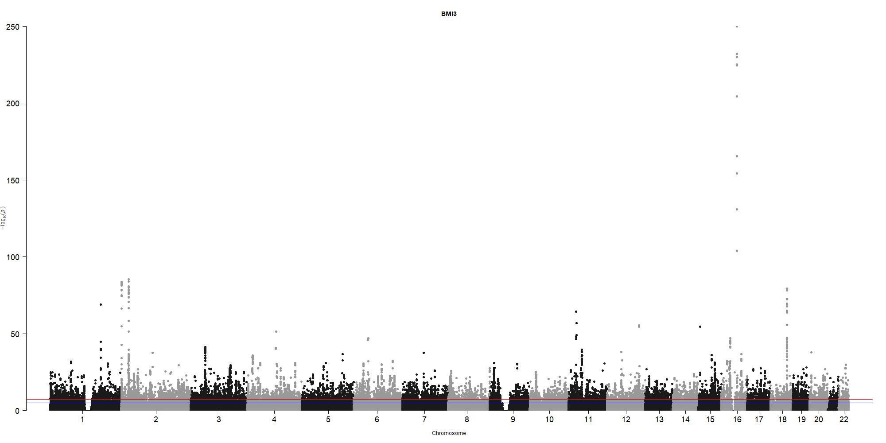
Manhattan plots
SNPs sorted by chromosomes
Above the red line = significant → a lot
More genes on first chromosomes
All phenotypes similar
Example : BMI3
Notes:
plots the association statistical significance as –log10(p-value) in the y-axis against chromosomes in the x-axis
Red line represents genome-wide significance threshold of 5.00E-08, while the blue line corresponds to the suggestive threshold of p = 1.00E-05

Slide 14
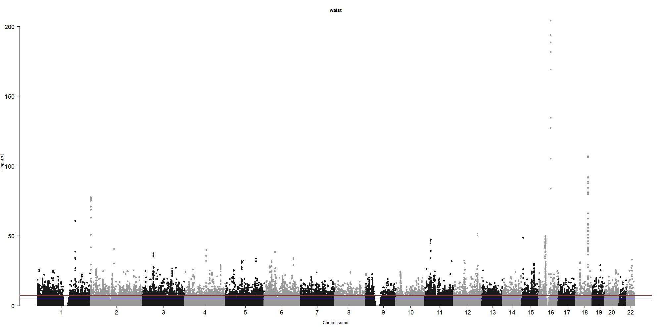
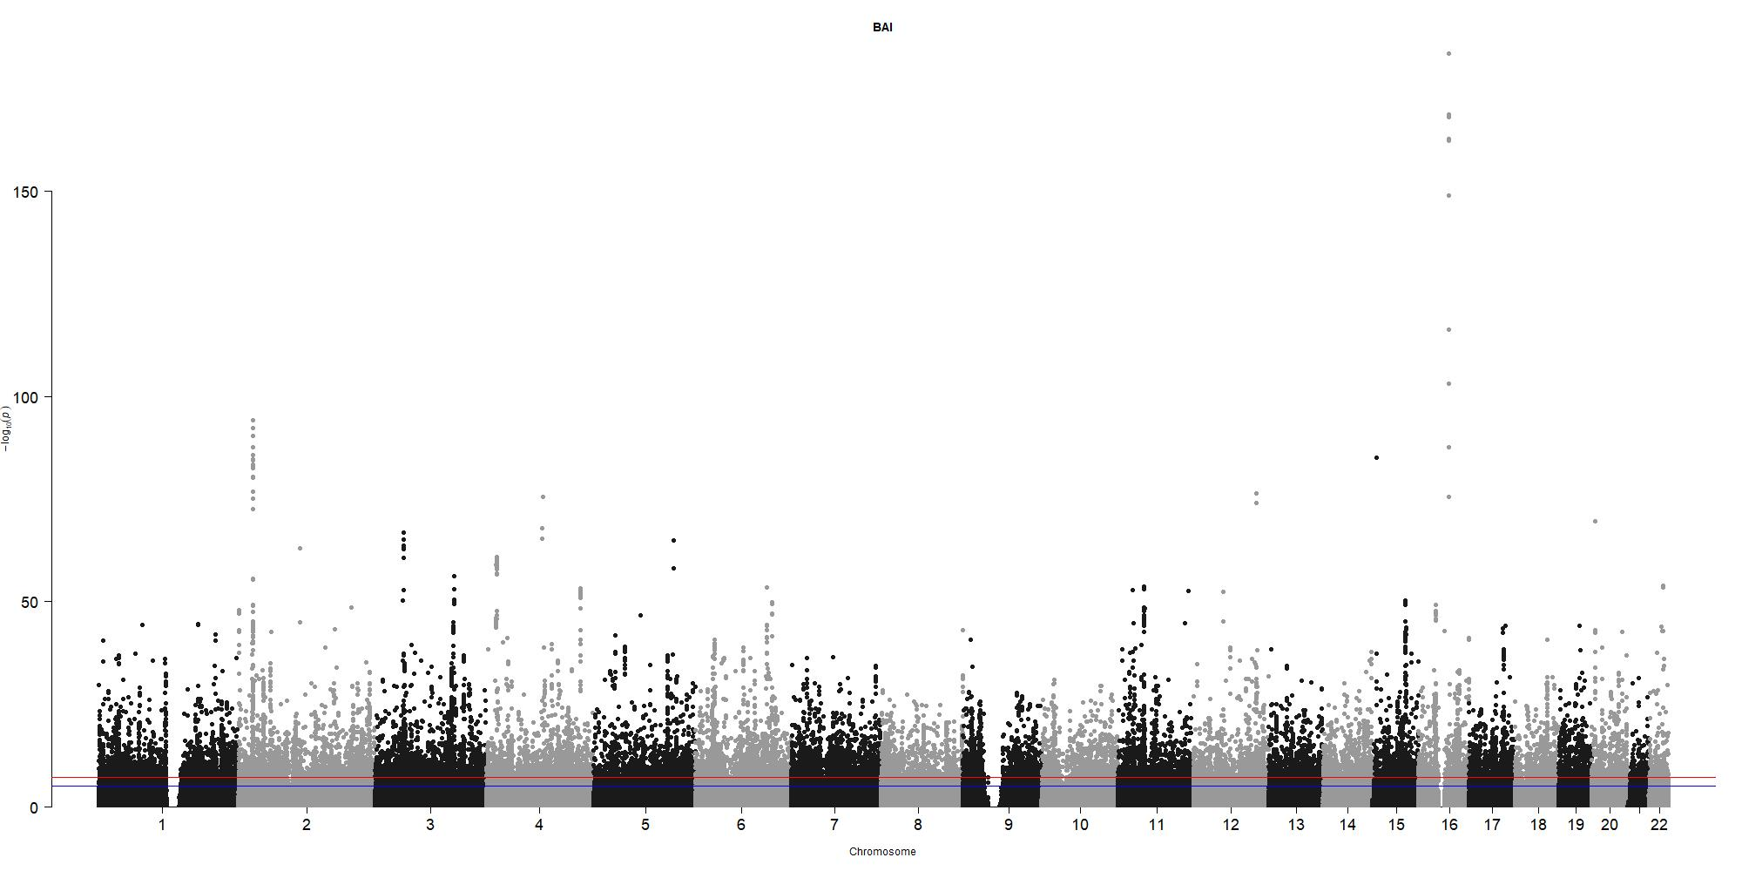
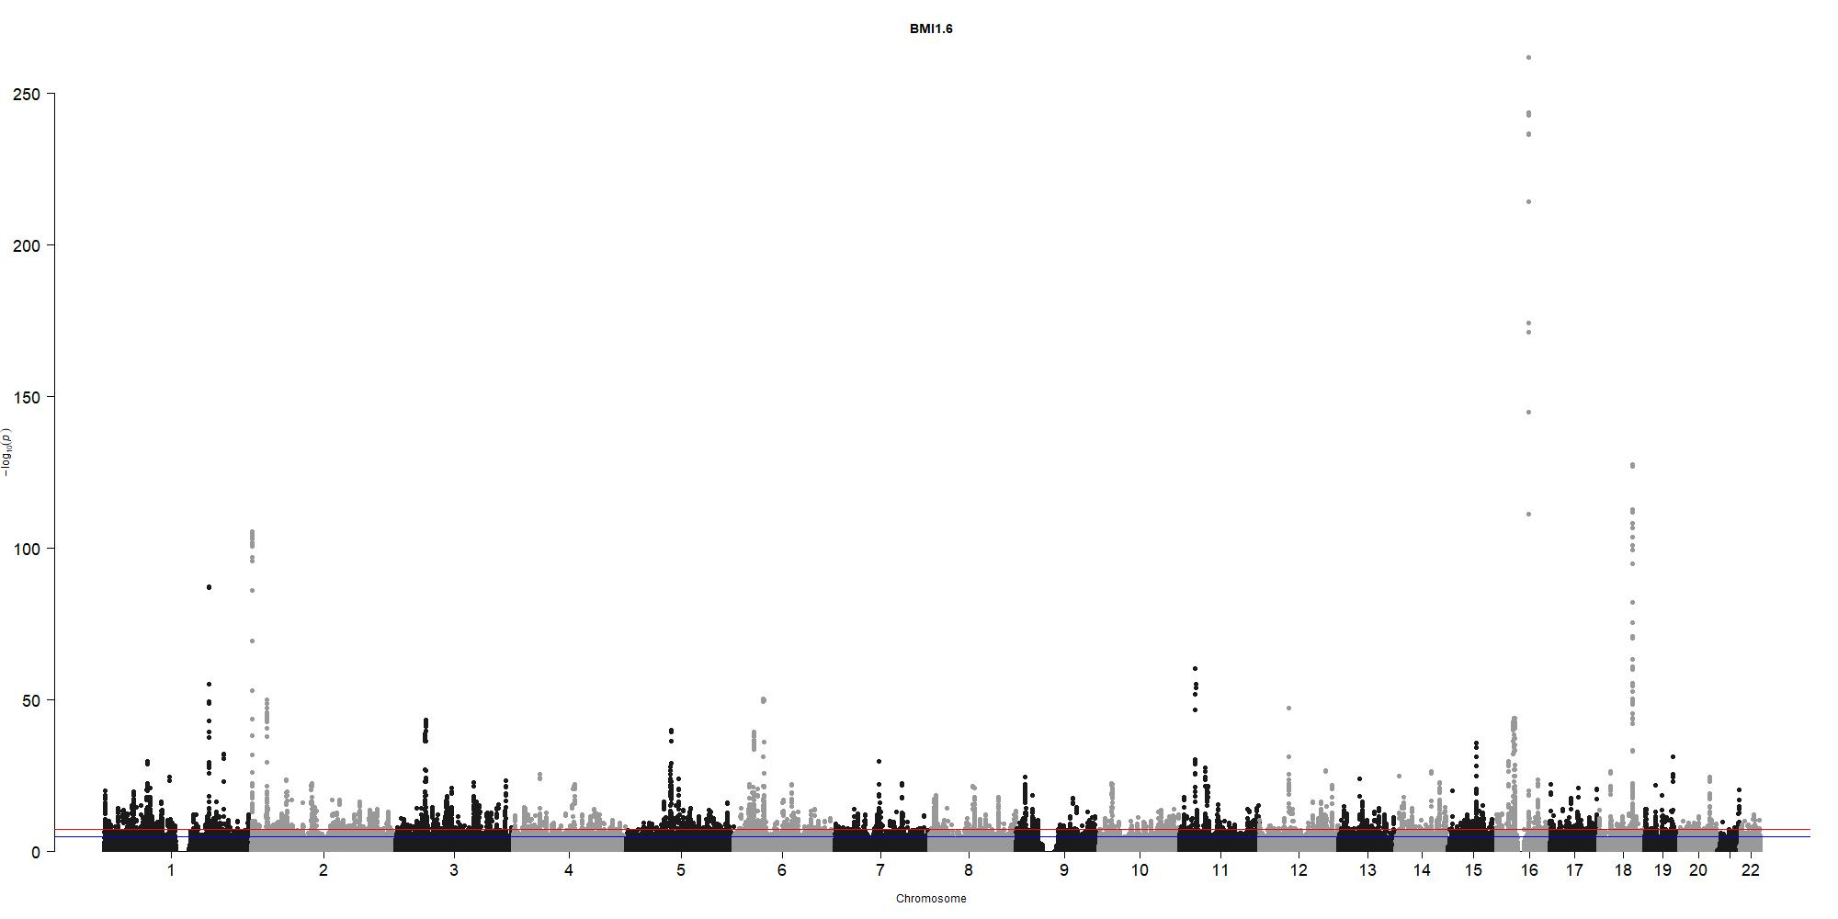
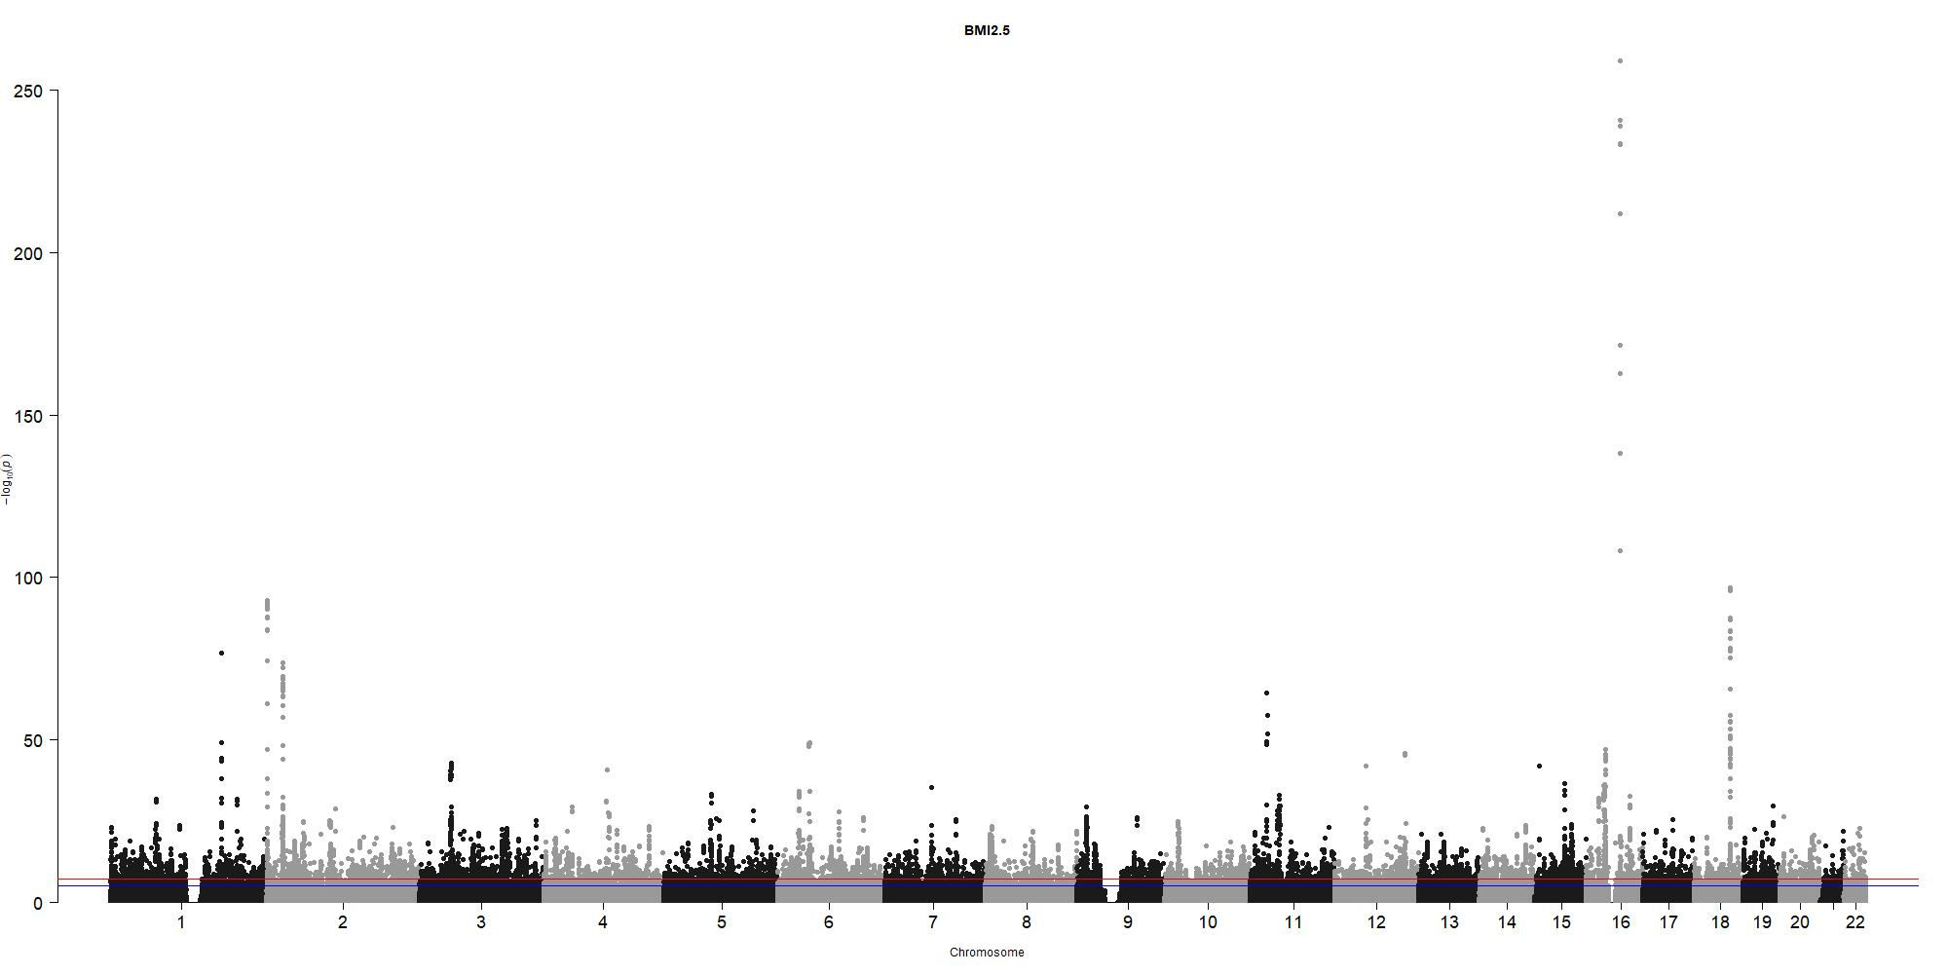
Manhattan plots
Waist
BAI
BMI 1.6
BMI 3

Slide 15
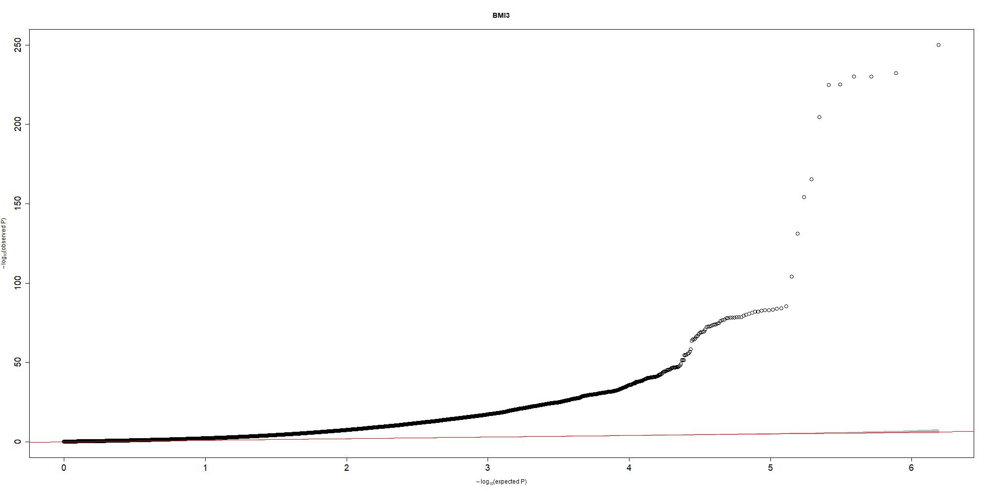
QQplots
On the red line ≠ significant
Red line : Probability of it occuring by chance
SNPs from all chromosomes mixed
Example : BMI3
Notes:
mais à droite c’est un peu plus dispersé et ca c’est good
Courbes un peu différentes MAIS même dispersion environ à droite

Slide 16
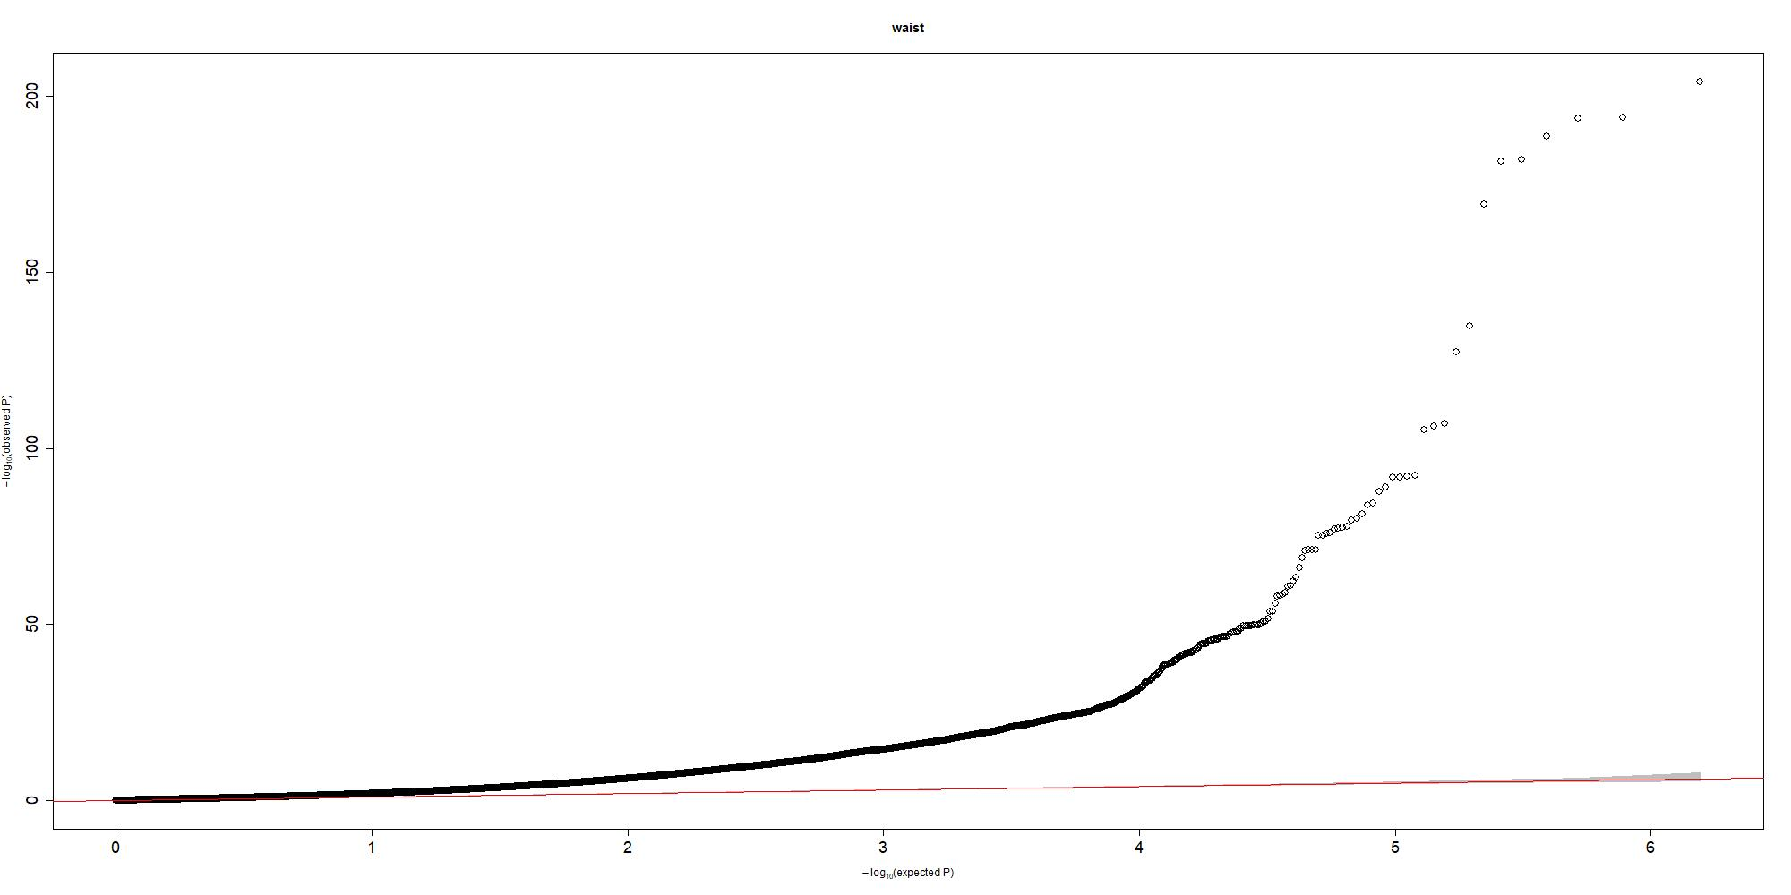
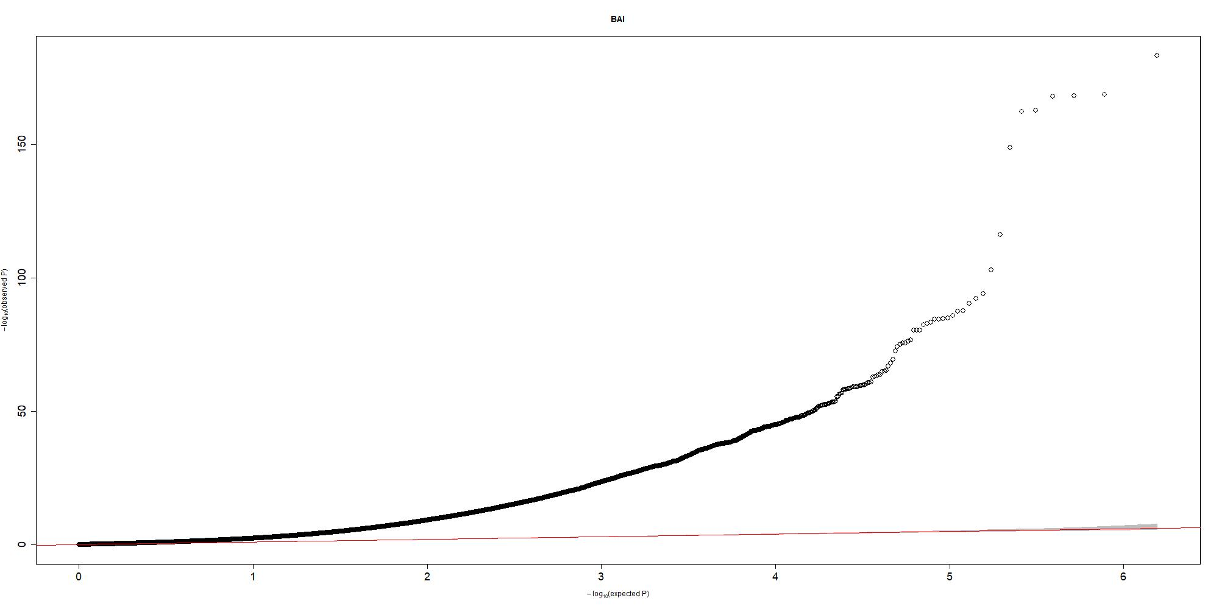
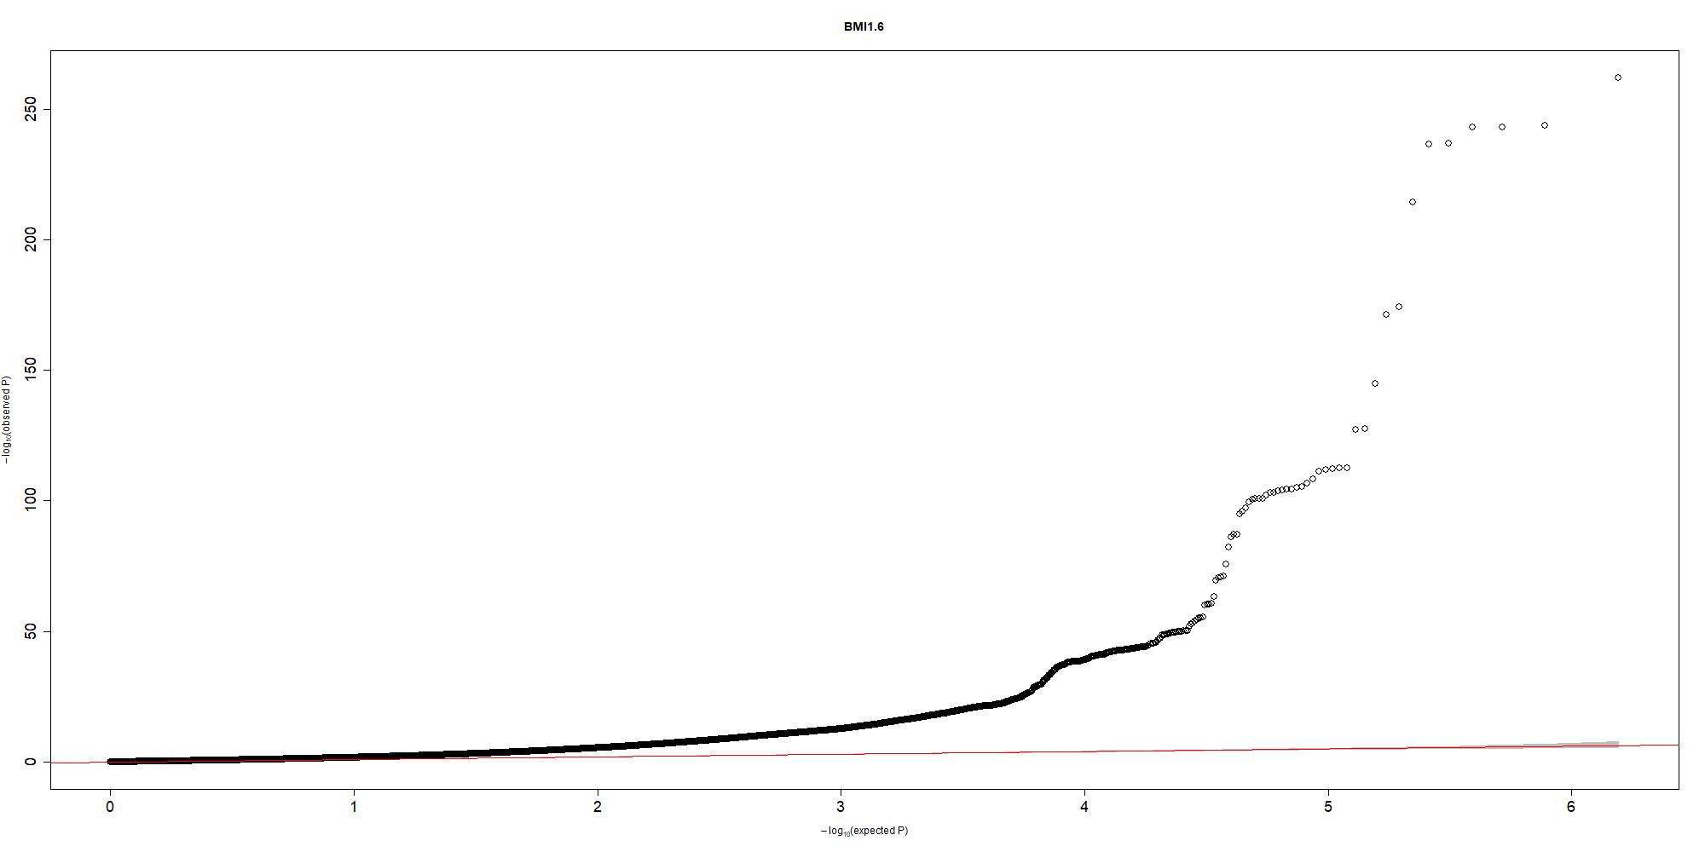
QQplots
Waist
BAI
BMI 1.6
BMI 3

Slide 17
Heritability
= « amount of phenotypic (observable) variation in a population that is attributable to individual genetic differences »
Low heritability → Big influence of the environment
Phenotype | Total observed scale h2
BMI 1.6 | 0.2313 (0.0116)
BMI | 0.2323 (0.0118)
BMI 2.5 | 0.2385 (0.0121)
BMI 3 | 0.249 (0.0126)
Waist-hip ratio | 0.1341 (0.0095)
Waist-height ratio | 0.1803 (0.0128)
Waist | 0.1841 (0.0108)
BAI | 0.2293 (0.0137)
RFM | 0.1695 (0.0116)
Heritability equation :
Phenotype = G + E + random effects
h²= var(G) / var(phenotype)
Notes:
High heritability → we cant do much

Slide 18
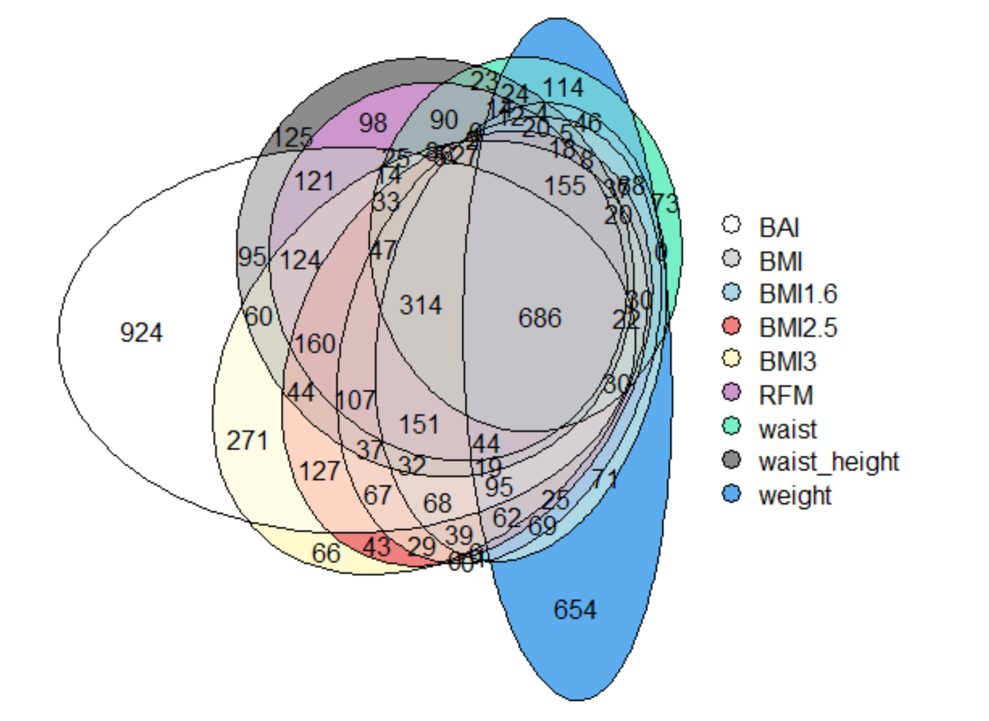
Genes – all results
A lot of statistically significant genes
686 associated with all the phenotypes = 11.3%
Specific to BAI and weight
Notes:
High heritability → we cant do much

Slide 19
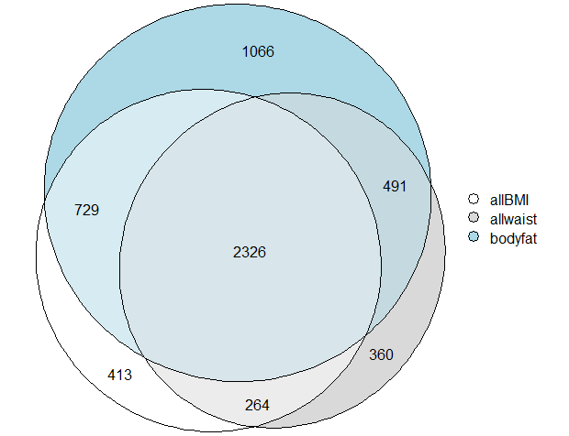
Genes – all results
A lot of statistically significant genes
686 associated with all the phenotypes = 11.3%
Specific to BAI and weight
Notes:
High heritability → we cant do much

Slide 20
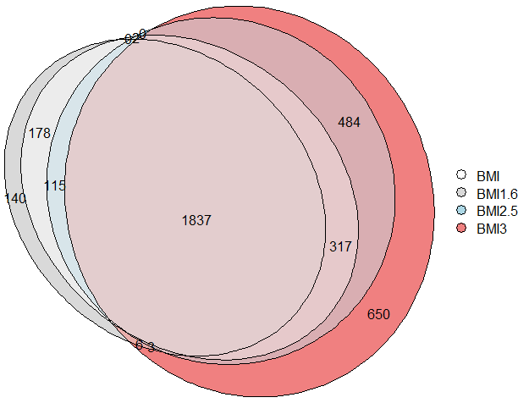
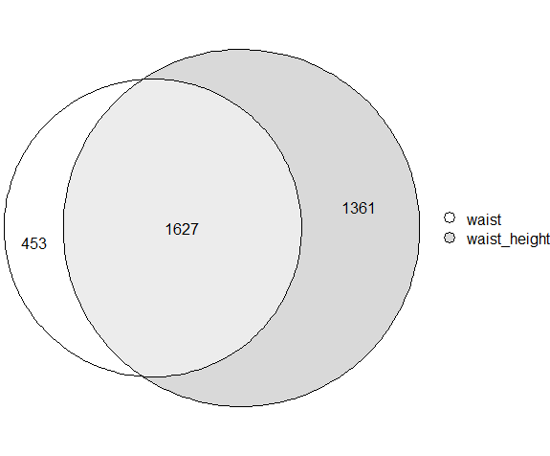
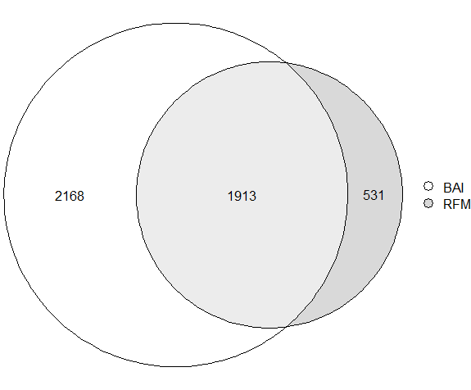
Genes – by phenotype category
BMI variants
Waist phenotypes
% Body fat

Slide 21
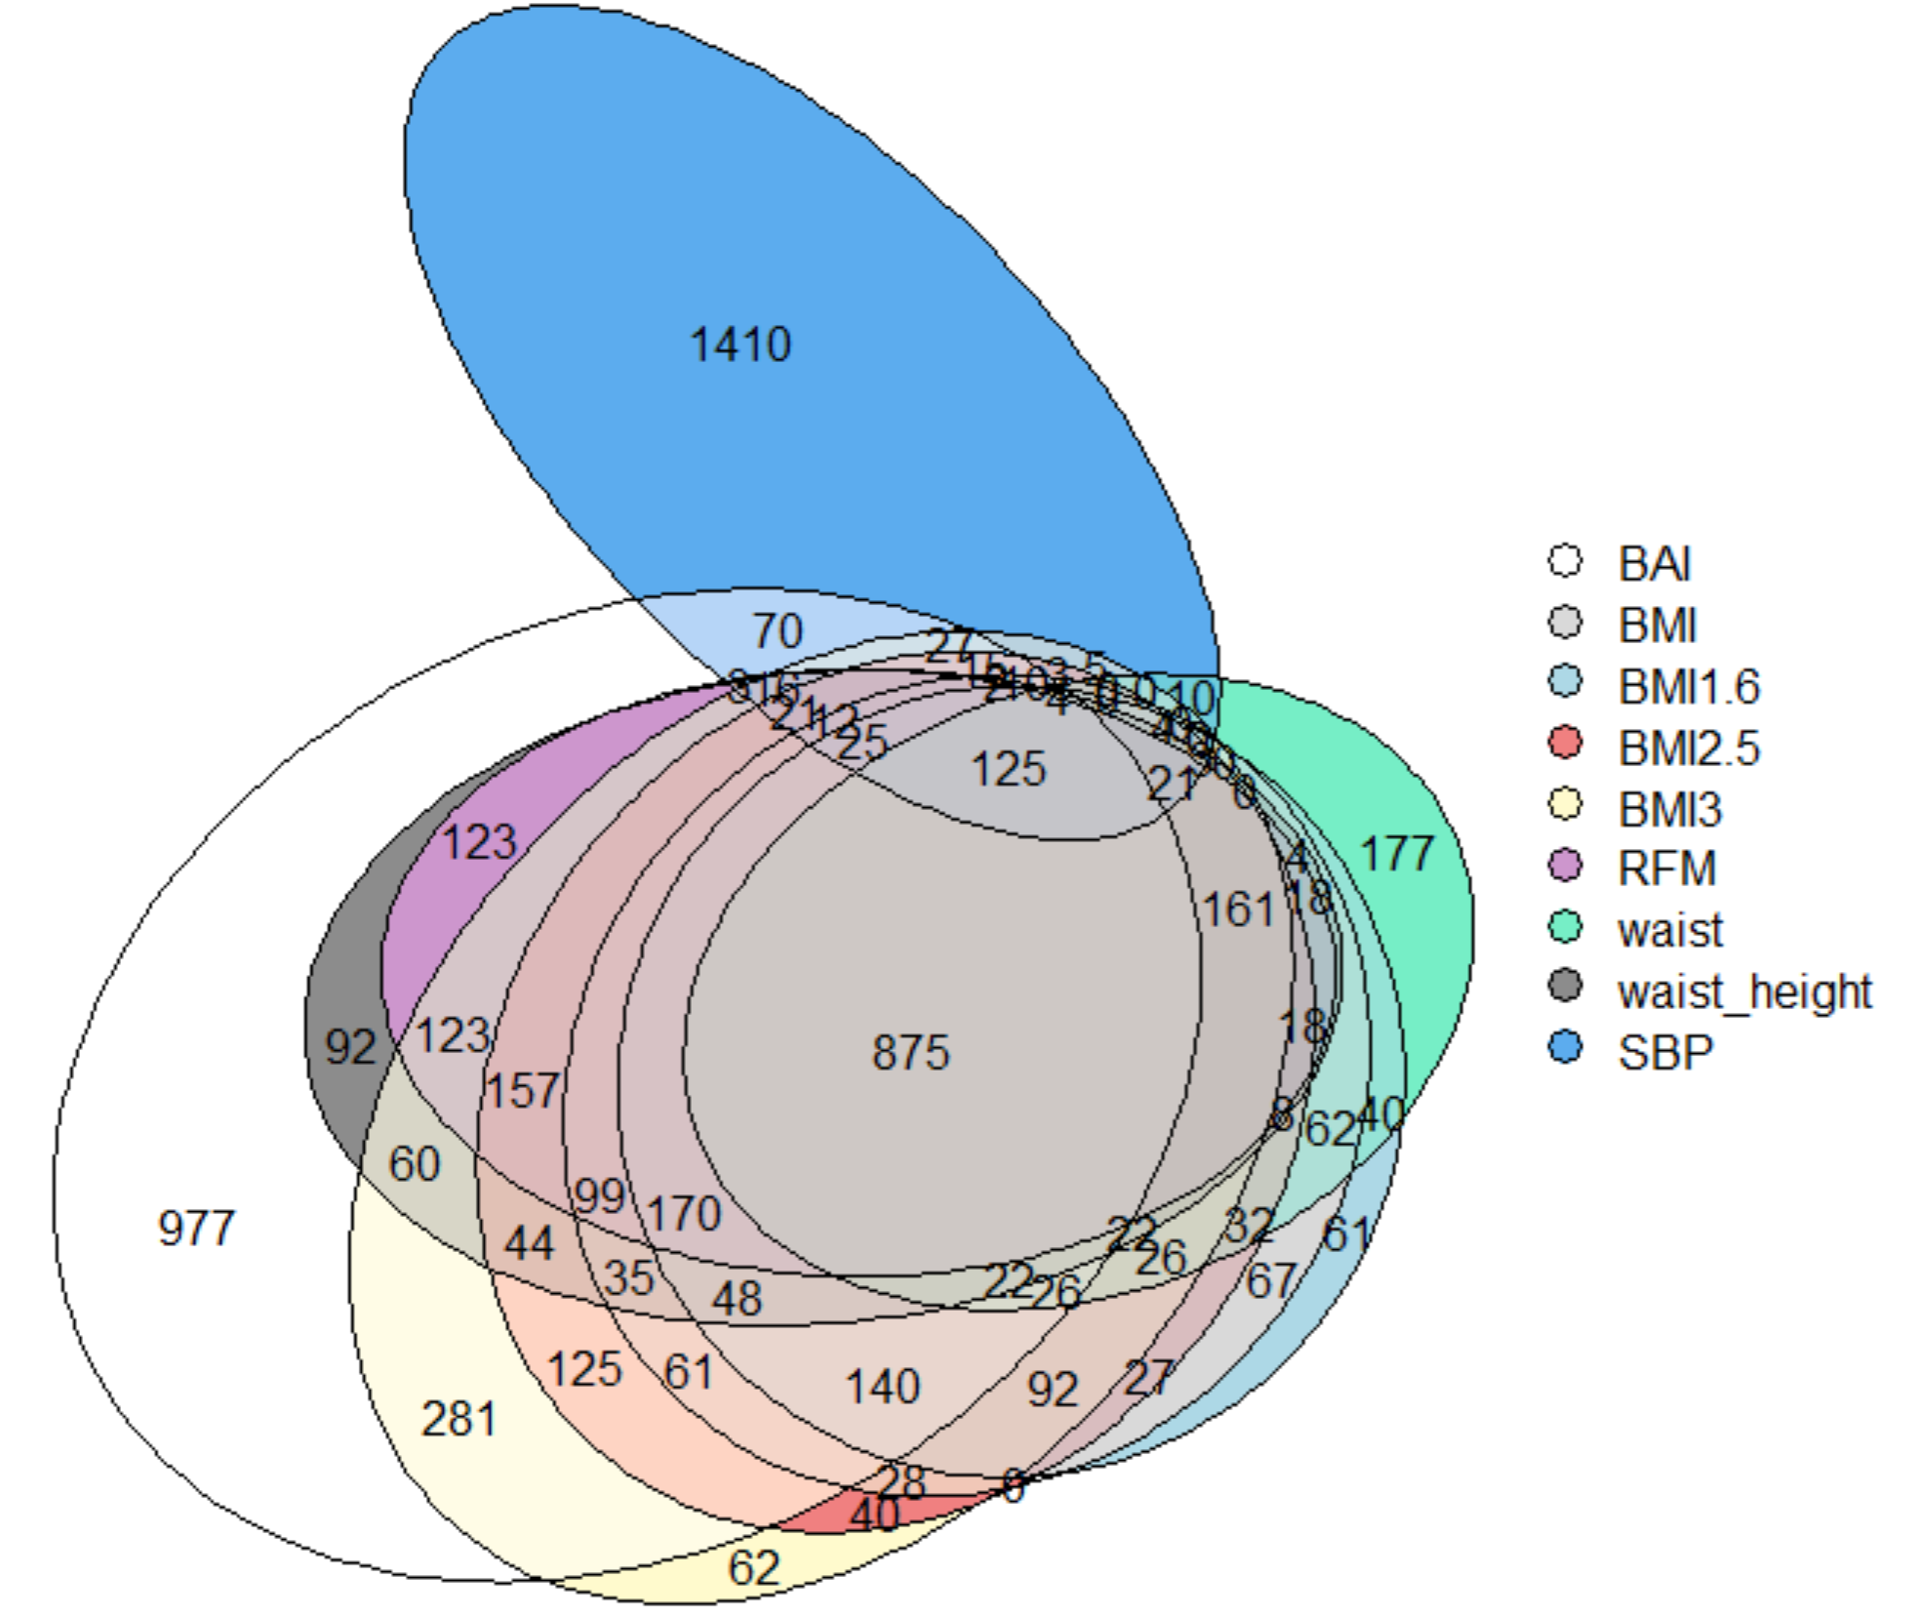
Genes – comparison with systolic blood pressure
Number of genes shared with SBP
BMI 1.6​​ | 279
BMI​​ | 291
BMI 2.5​​ | 328
BMI 3​​ | 374
Waist-height ratio ​​ | 323
Waist ​​ | 242
BAI​​ | 410
RFM​​ | 284
Genes associated w/ SBP | 1962
Notes:
High heritability → we cant do much

Slide 22
Take home messages
(1) Hard to find a better phenotype
(2) Perhaps variants of BMI: better R^2 and less correlated with sex and age
(3) Numerous SNPs significant
(4) Some genes are found in several phenotypes
(5) Heritability around 20% → high environnemental impact

Slide 23
Challenges
Linear regression part
Stratify the analysis by sex and by age
Test other phenotypes
Try with other cardiovascular disease markers
GWAS part
Perform the GWAS and not only the mini one
Compare genes and results with literature

Slide 24
Feedback
Well supervised
Freedom
Real problem → preview of research world
Weekly plan ?
Hard to know if too much or too less work
Name of the course ?

Slide 25
Thank you for your attention !

Slide 26
References
Slide 1 : https://www.google.com/url?sa=i&url=https%3A%2F%2Fwww.jerseymedweightloss.com%2Fblog%2Fis-body-mass-index-a-reliable-indicator-of-obesity&psig=AOvVaw0ATDSzE0wijepoFCC0P_zx&ust=1653118718184000&source=images&cd=vfe&ved=0CAwQjRxqFwoTCPCmxLjJ7fcCFQAAAAAdAAAAABAp
Slide 2 : https://www.google.com/url?sa=i&url=https%3A%2F%2Fwww.pngaaa.com%2Fdetail%2F770885&psig=AOvVaw0cSYGq-mu5zYYiBOsKzNye&ust=1653119980764000&source=images&cd=vfe&ved=0CAwQjRxqFwoTCNDMt_zN7fcCFQAAAAAdAAAAABAY
Slide challenge : https://i1.wp.com/tintinomania.com/wp-content/uploads/2018/04/Interrogation-2.png?w=500&ssl=1
Home image ; https://www.google.com/url?sa=i&url=https%3A%2F%2Fwww.rawshorts.com%2Ffreeicons%2F%3Fdownload%3Dhome-icon-9&psig=AOvVaw04eLO0riFbF9PZzdyYlcfX&ust=1653144385848000&source=images&cd=vfe&ved=0CAwQjRxqFwoTCNDzgPOo7vcCFQAAAAAdAAAAABAD

Slide 27
Annex

Slide 28
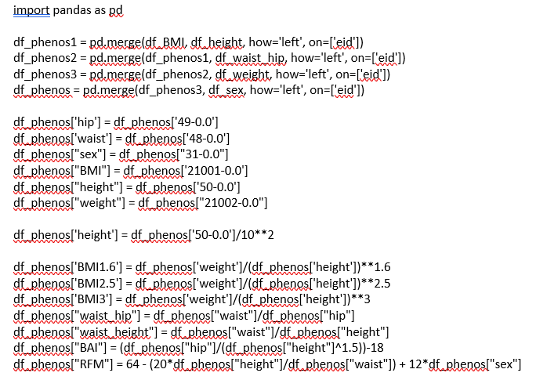
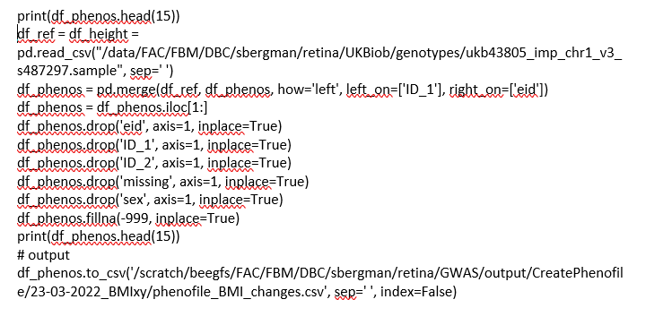
Python code for GWAS

Slide 29
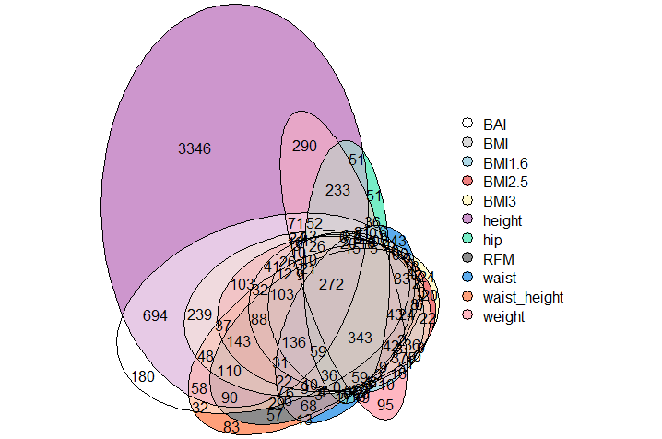
More Venn diagrams – intersection with height

Slide 30
