Slide 1
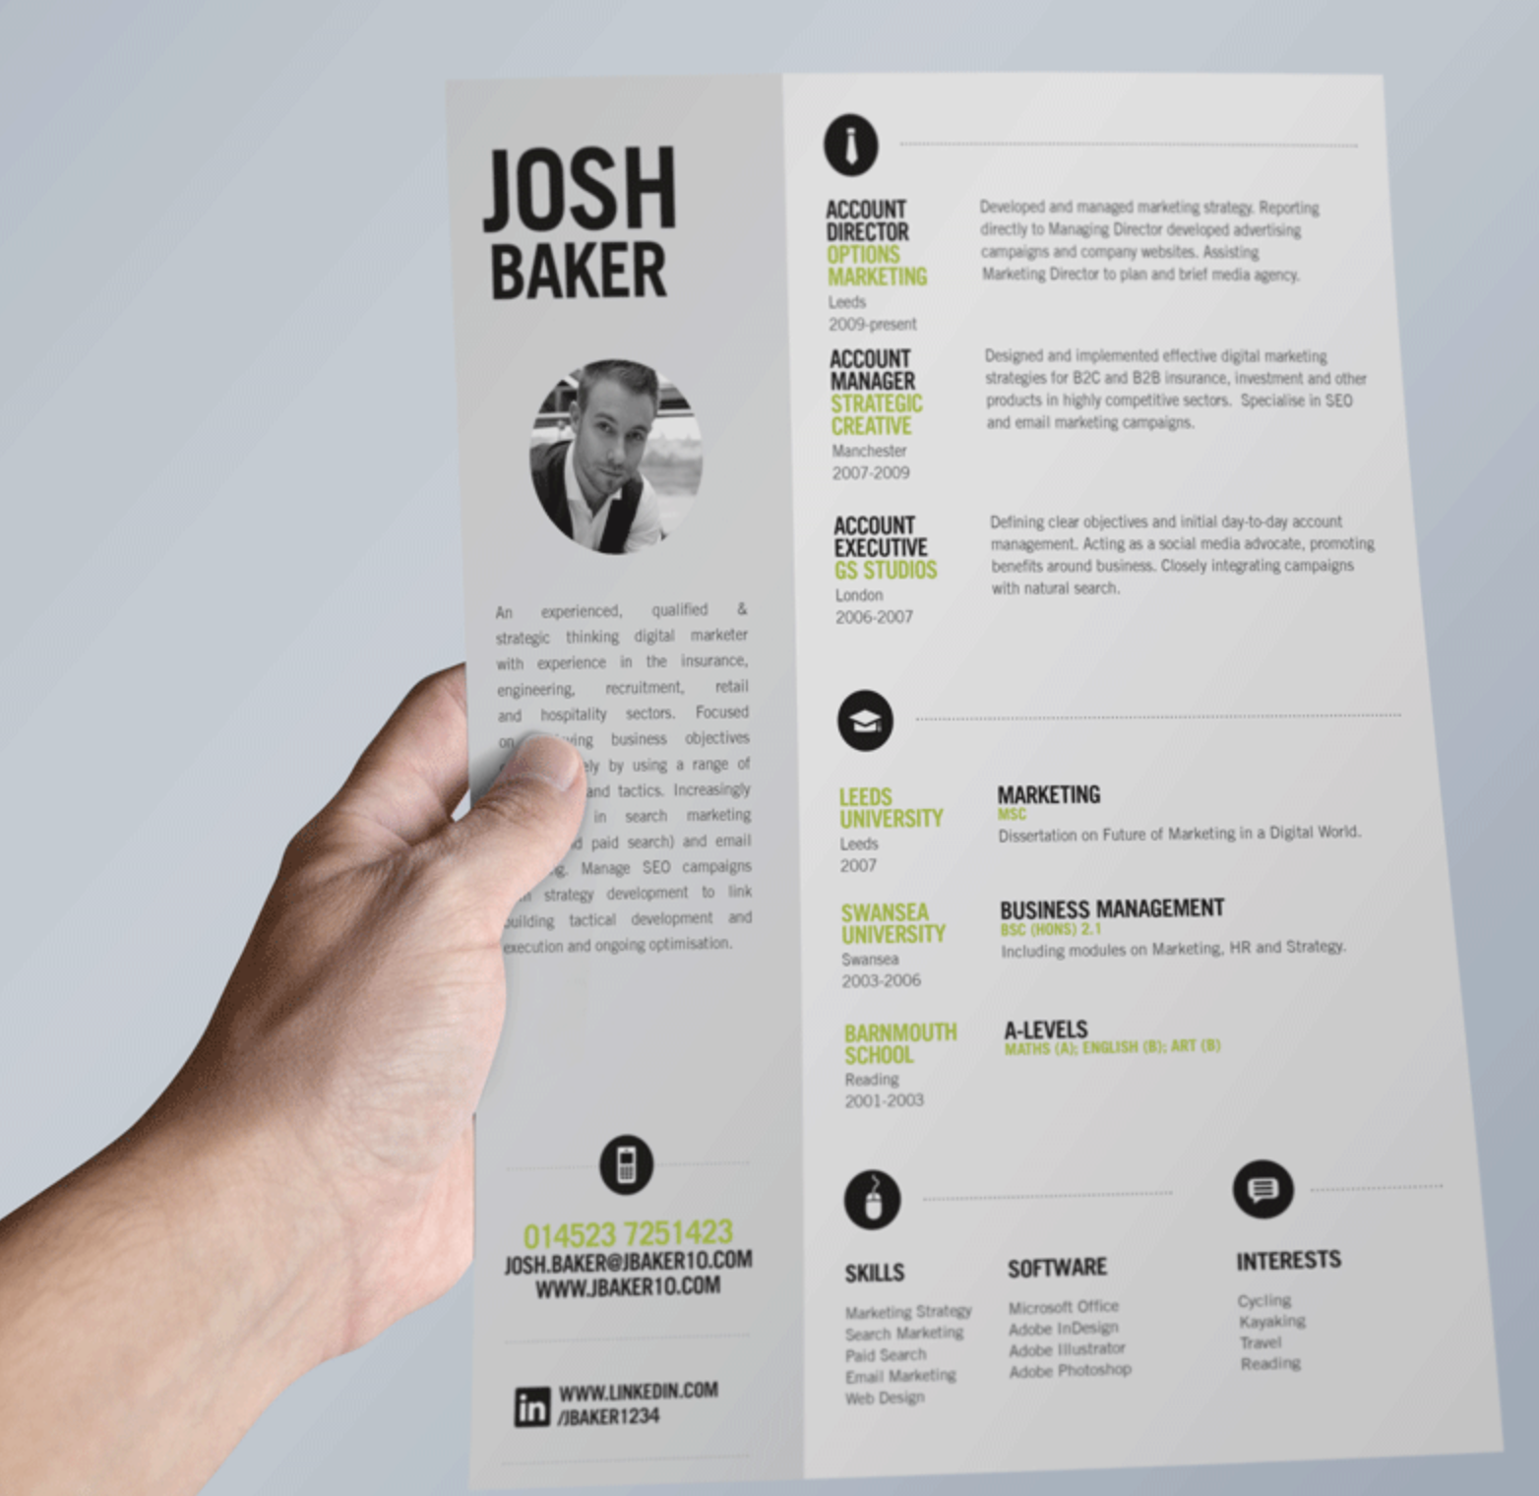
How to write a good CV?
Disclaimer: My personal view
(Sven.Bergmann@unil.ch)

Slide 2
1. Think what you want to achieve!
“good = effective!”
What is your goal?

Slide 3
2. Be concise!
Less is more!
What is absolutely necessary to stick out?

Slide 4
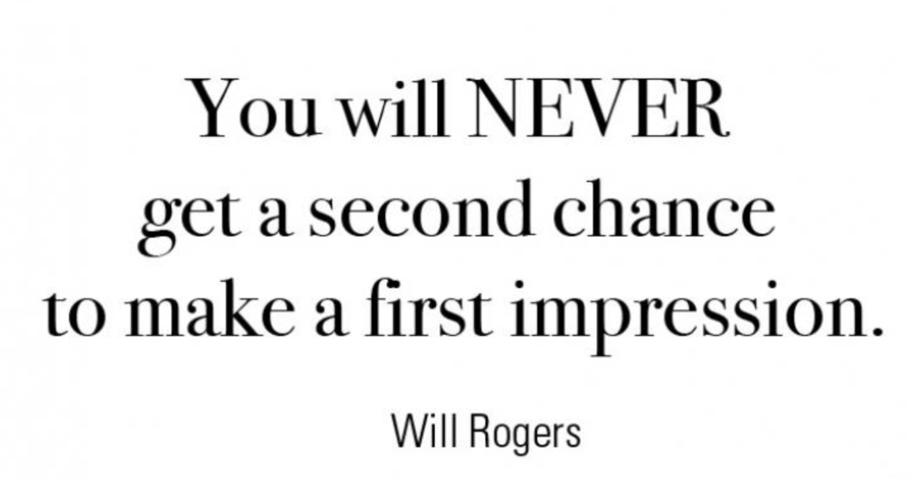
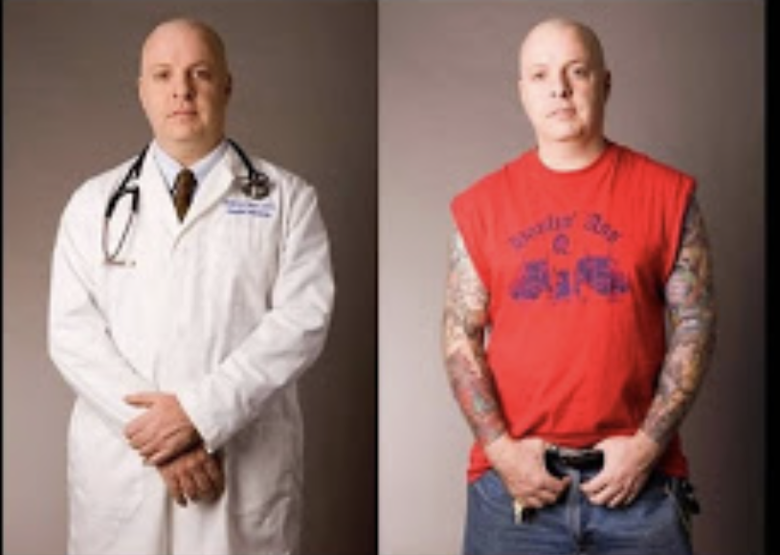
3. First impression counts!
How does your CV look at first glance?

Slide 5
4. Don’t underestimate esthetics
The cleaner the better.

Slide 6
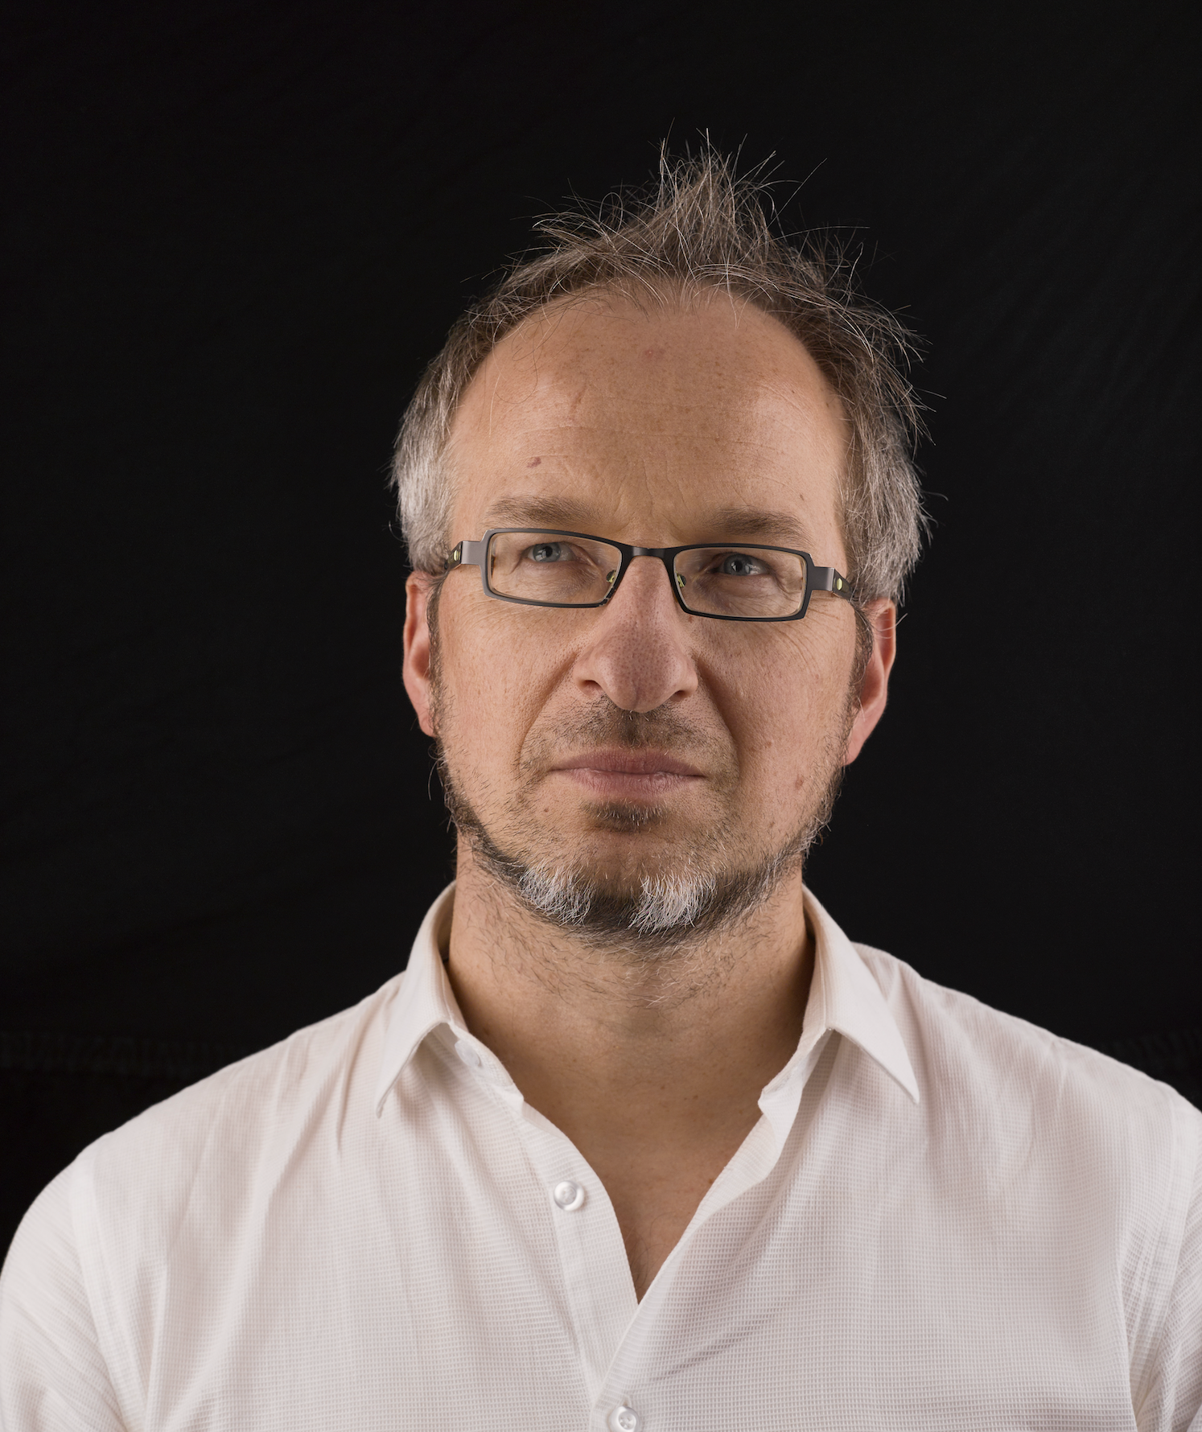
5. Personal advise: Add a picture!
But choose carefully!

Slide 7
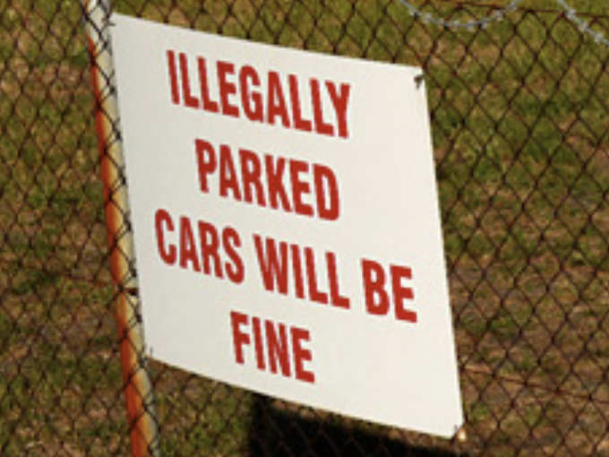
6. Zero typos!
Read it again. And again!
(+spell checker +colleague)

Slide 8
7. Avoid long lists
Can you summarize the essence?

Slide 9
8. Highlight key achievements
H-factor? Citations? Author role? Impact factor?
Scholarships? Prizes?

Slide 10
9. Tailor your CV to the job application
Read the job description and understand what the recruiter is looking for in terms of competencies, skills and experience

Slide 11
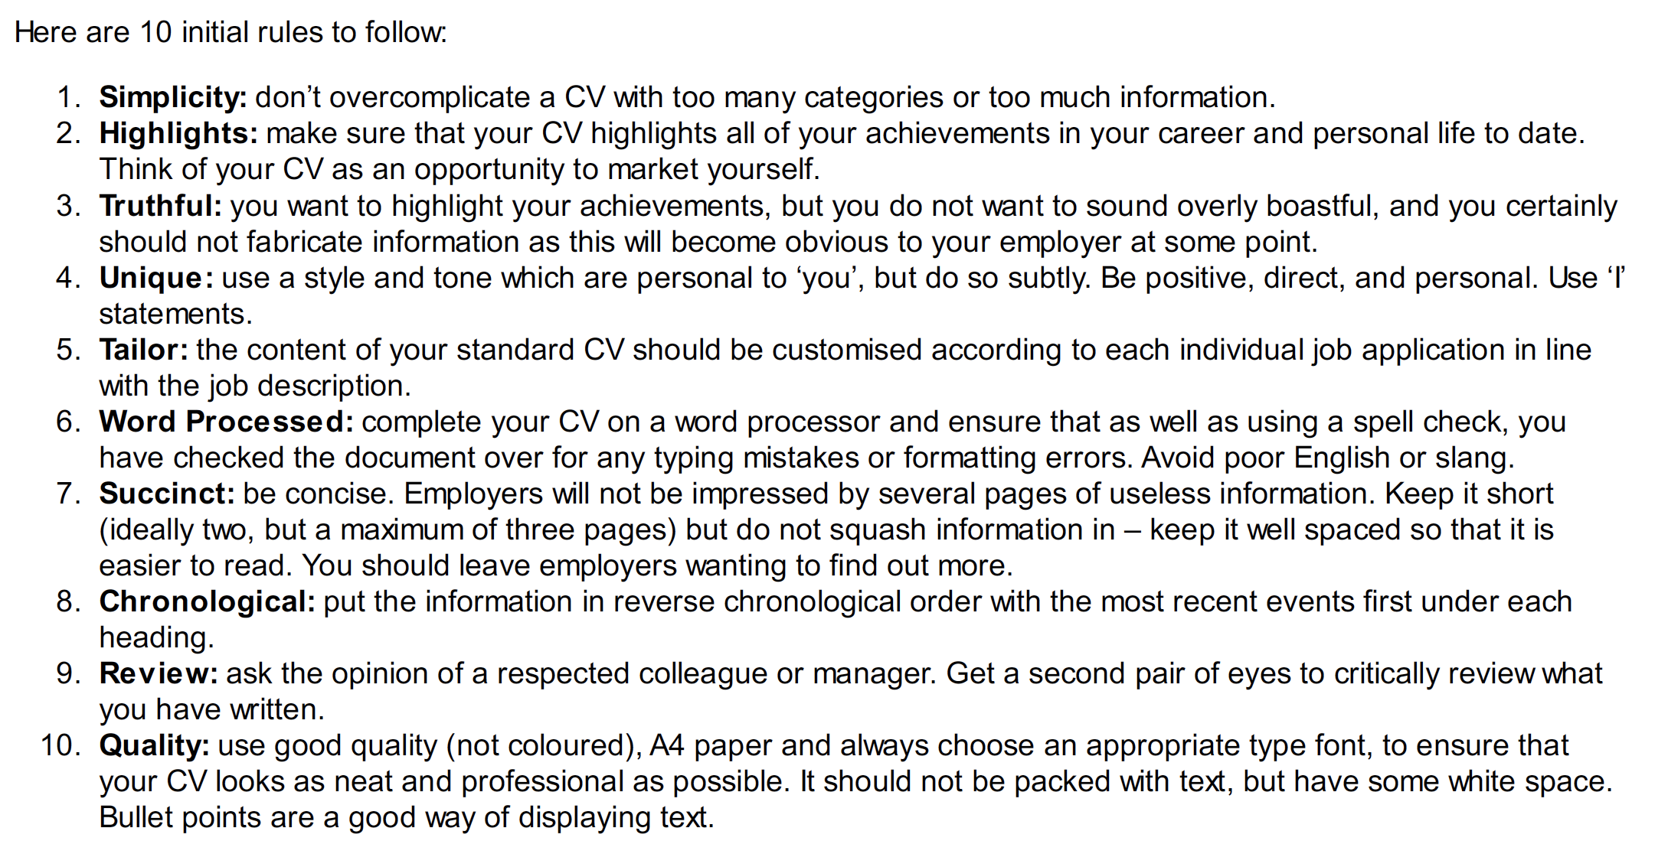
10. Don’t believe me
Check out what others say and trust your own judgement.

