Slide 1
Genetics and Genome Evolution (GGE)
Bioinformatics for Genomics
Lecture 3:
Biclustering
Sven Bergmann
Department of Computational Biology
(Sven.Bergmann@unil.ch)

Slide 2
Singular Value Decomposition
“SVD = bi-PCA”
E = U·D·V^{T}
V: PC matrix of “eigen-genes”
(composed of eigenvectors of C = E^{T}·E)
U: PC matrix of “eigen-arrays”
(composed of eigenvectors of C’ = E·E^{T})
D: diagonal matrix
http://public.lanl.gov/mewall/kluwer2002.html

Slide 3
SVD: Matrix representation
E = U·D·V^{T}
1
300
1
n
1
n
1
300
…
0
E
v₁
λ₁
…
v₂
=
·
λ₂
·
…
u₁
u₂
u_{n}
0
λ_{n}
v_{n}
30k
30k
U
n
D
n
V^{T}
u_{i}: eigen-arrays v_{i}: eigen-genes λ_{i}: eigenvalues
i = 1, …, n n: rank(E) = #(independent arrays)
Alter O., Brown P.O., Botstein D. Singular value decomposition for genome-wide
expression data processing and modeling. Proc Natl Acad Sci USA 2000; 97:10101-06.

Slide 4
E = U·D·V^{T} = ∑_{i} λ_{i}·u_{i}·v_{i}^{T} (full expansion)
E₁ = λ₁·u₁·v₁^{T} (rank-1 expansion)
Δ = |E - E₁|² (sum of residuals) minimize Δ for free u₁ and v₁:
E·v₁= λ₁·u₁ & E^{T}·u₁ = λ₁·v₁ implying:
E·E^{T}·u₁ = λ₁²·u₁ & E^{T}·E·v₁ = λ₁²·v₁
SVD: What is optimized?
Bergmann et al., Phys. Rev. E 67, 031902 (2003)

Slide 5
SVD: Example deletion mutants
E₁ = λ₁·u₁·v₁^{T}
1
300
1
E₁
u₁⁽¹⁾·v₁⁽¹⁾ ··· u₁⁽¹⁾·v₁⁽³⁰⁰⁾
: :
: :
u₁^{(6k)}·v₁⁽¹⁾ ··· u₁^{(6k)}·v₁⁽³⁰⁰⁾
=
·
·
=
v₁
λ₁
λ₁
1
300
30k
6k
u₁
high
high low
^{low low}
=
·
·
high
low
=
low

Slide 6
SVD: Example deletion mutants

Slide 7
SVD: Example deletion mutants

Slide 8
SVD: Example deletion mutants

Slide 9
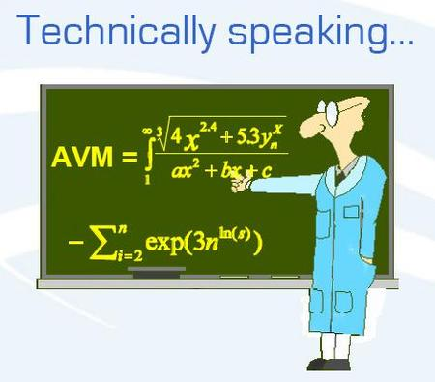
Analysis tools for large datasets
Standard tools
k-means, PCA, SVD
Modular analysis tools
CTWC, ISA, PPA

Slide 10
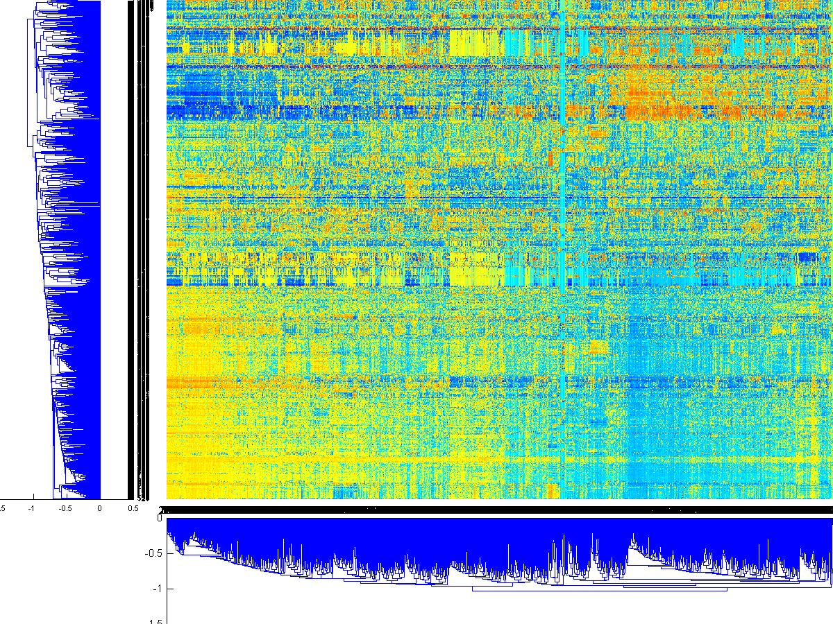
How to extract biological information from large-scale expression data?
Hierarchical clustering and other
correlation-based methods may be
good for small data sets, but:
Problems with large data:
Clusters cannot overlap!
Clustering based on
correlations over
all conditions:
- sensitive to noise
- computation intensive

Slide 11
How to extract biological information from large-scale expression data?
Search for transcription modules:
Set of genes co-regulated under
a certain set of conditions
context specific
allow for overlaps

Slide 12
Overview of “modular” analysis tools
Cheng Y and Church GM. Biclustering of expression data.
(Proc Int Conf Intell Syst Mol Biol. 2000;8:93-103)
Getz G, Levine E, Domany E. Coupled two-way clustering analysis of gene microarray data. (Proc Natl Acad Sci U S A. 2000 Oct 24;97(22):12079-84)
Tanay A, Sharan R, Kupiec M, Shamir R. Revealing modularity and organization in the yeast molecular network by integrated analysis of highly heterogeneous genomewide data. (Proc Natl Acad Sci U S A. 2004 Mar 2;101(9):2981-6)
Sheng Q, Moreau Y, De Moor B. Biclustering microarray data by Gibbs sampling. (Bioinformatics. 2003 Oct;19 Suppl 2:ii196-205)
Gasch AP and Eisen MB. Exploring the conditional coregulation of yeast gene expression through fuzzy k-means clustering.
(Genome Biol. 2002 Oct 10;3(11):RESEARCH0059)
Hastie T, Tibshirani R, Eisen MB, Alizadeh A, Levy R, Staudt L, Chan WC, Botstein D, Brown P. 'Gene shaving' as a method for identifying distinct sets of genes with similar expression patterns. (Genome Biol. 2000;1(2):RESEARCH0003.)
… and many more!

Slide 13
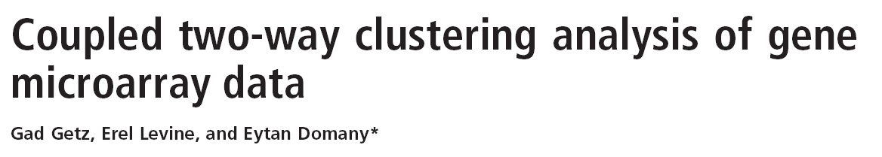

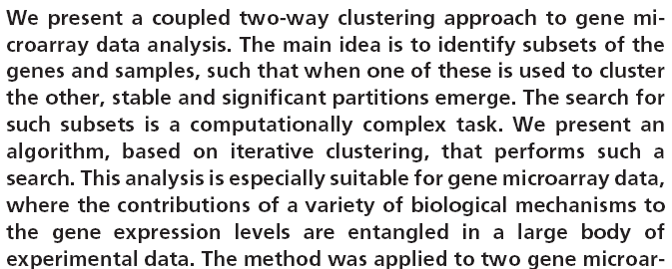
Coupled two-way Clustering

Slide 14

How to “hear” the relevant genes?
Song A
Song B

Slide 15

Inside CTWC: Iterations
Depth | Genes |  | Samples
Init |  | G1 |  | S1
1 | G1(S1) | G2,G3,…G5 | S1(G1) | S2,S3
2 | G1(S2) G1(S3) | G6,G7,….G13 G14,…G21 | S1(G2) … S1(G5) | S4,S5,S6 S10,S11 None
3 | G2(S1)…G2(S3) … G5(S1)…G5(S3) | G22… … …G97 | S2(G1)…S2(G5) S3(G1)…S3(G5) | S12,… …S51
4 | G1(S4) … G1(S11) | G98,..G105 … G151,..G160 | S1(G6) … S1(G21) | S52,... S67
5 | G2(S4)...G2(S11) … G5(S4)...G5(S11) | G161… … …G216 | S2(G6)...S2(G21) S3(G6)…S3(G21) | S68… …S113
Two-way clustering

Slide 16
One example in more detail:
The (Iterative) Signature Algorithm:
No need for correlations!
decomposes data into “transcription modules”
  integrates external information
  allows for interspecies comparative analysis
J Ihmels, G Friedlander, SB, O Sarig, Y Ziv & N Barkai Nature Genetics (2002)

Slide 17


Trip to the “Amazon”:

Slide 18
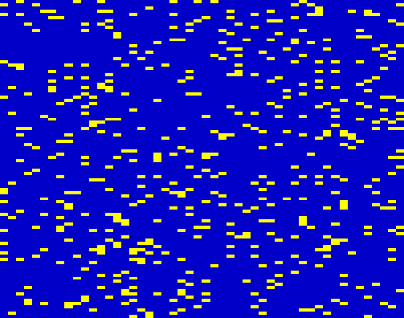
How to find related items?
items
10
re-
commended items
20
30
40
50
60
your
choice
70
80
customers with similar choice
90
100
5
10
15
20
25
30
35
40
45
50
customers

Slide 19

False Positives:

Slide 20
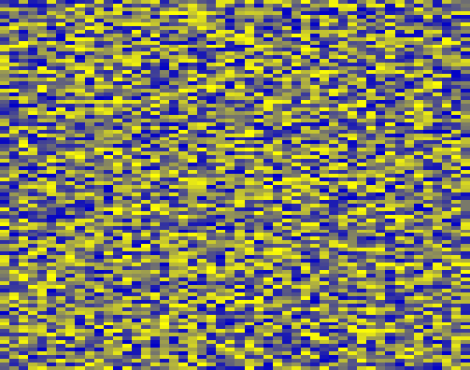
How to find related genes?
genes
10
similarly expressed genes
20
30
40
50
60
your
guess
70
80
relevant conditions
90
100
5
10
15
20
25
30
35
40
45
50
conditions
J Ihmels, G Friedlander, SB, O Sarig, Y Ziv & N Barkai Nature Genetics (2002)

Slide 21
Signature Algorithm: Score definitions
Notes:
The signature algorithm uses a set of genes as INPUT.
These genes could be a putative group of related genes,
Or just a random selection of genes.
The algorithm uses the expression data to generate its OUTPUT.
Genes that are not correlated with the bulk of the input-genes are rejected.
And other co-regulated genes that were not part of the INPUT are added.

Slide 22
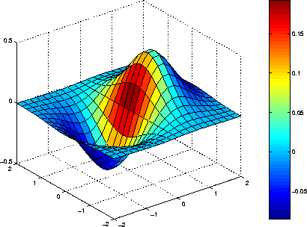
How to find related genes? Scores and thresholds!
condition scores
thresholding:
initial guesses
(genes)

Slide 23
How to find related genes? Scores and thresholds!
condition scores
gene scores
thresholding:

Slide 24
How to find related genes? Scores and thresholds!
condition scores
thresholding:
gene scores

Slide 25

Iterative Signature Algorithm
OUTPUT = INPUT
“Transcription Module”
INPUT
OUTPUT
SB, J Ihmels & N Barkai Physical Review E (2003)
Notes:
An extension of this algorithm is the “Iterative Signature Algorithm”.
Here the OUPUT is re-used as INPUT, such that further iterations can bring in more co-regulated genes.
We repeat this procedure until the OUTPUT equals to the INPUT.
We refer to the final OUTPUT as a “transcription module”.
As before it contains both the set of co-regulated genes and the conditions that induce their co-regulation.
By definition, all genes outside the module are less co-regulated than the module genes under these conditions.

Slide 26
Identification of transcription modules
using many random “seeds”
Transcription modules
random
“seeds”
Independent identification:
Modules may overlap!
Notes:
In order to identify the transcription modules encode in the expression data we proceed as follows:
We assemble a large number of random INPUT seeds.
Applying the iterative signature algorithm to each seed converges into a specific transcription module.
Since each transcription module is identified independently, it may overlap with other modules.

Slide 27
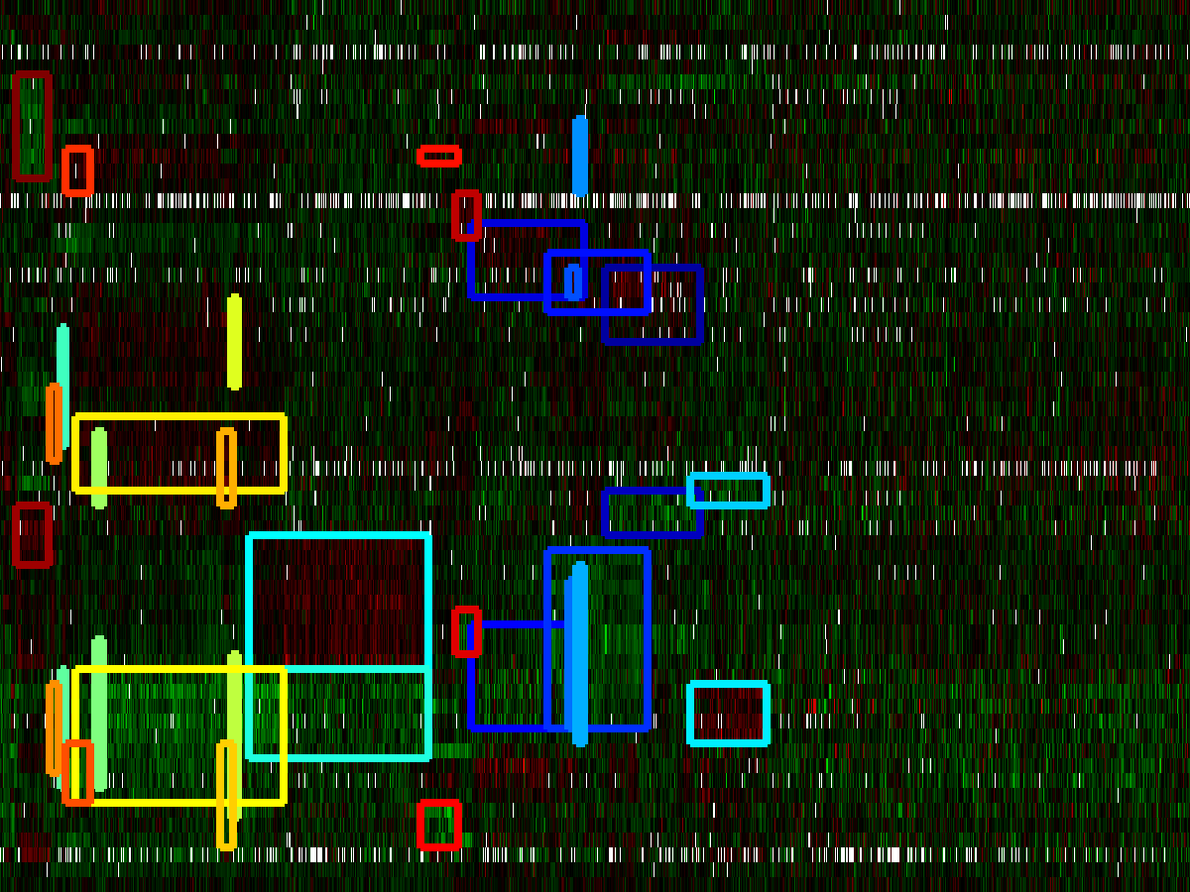
New Tools: Module Visualization
http://serverdgm.unil.ch/bergmann/Fibroblasts/visualiser.html

Slide 28
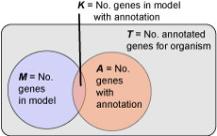
Gene enrichment analysis
The hypergeometric distribution f(M,A,K,T) gives the probability
that K out of A genes with a particular annotation match with a
module having M genes if there are T genes in total.
http://en.wikipedia.org/wiki/Hypergeometric_distribution

