Slide 1
Genetics and Genome Evolution (GGE) Bioinformatics for Genomics Lecture series 2020
Sven Bergmann
Department of Computational Biology
(Sven.Bergmann@unil.ch)

Slide 2
Bioinformatics for Genomics Overview
March 23 Lecture 1: RNA-seq & DE
March 24 Lecture 2: Clustering March 30 Lecture 3: Biclustering
March 31 Lecture 4: CHIP-seq & HiC
April 1 Lecture 5: Networks

Slide 3
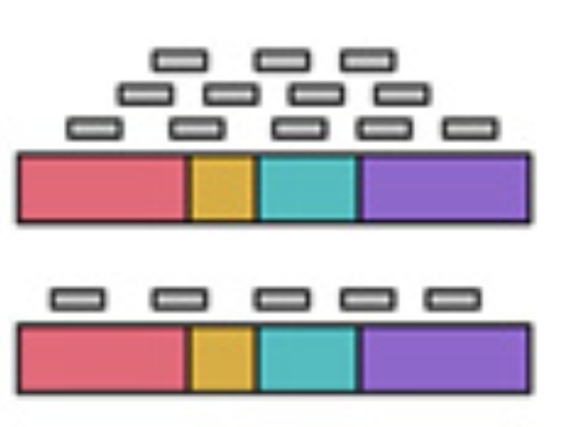
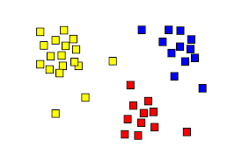
What will you learn?
Analysis of gene expression data
What information do you get from RNA-seq?
How to do a simple differential expression analysis?
How to correct for multiple hypotheses testing?
How do use some standard tools for large-scale data analysis (PCA, SVD, clustering)?
How to perform functional enrichment analysis (given known gene sets)?
Analysis of epigenetic data and integrative analysis
What information do you get from CHIP-seq (and similar techniques)?
What do you learn from HiC data on chromatin structure?
How to perform integrative analysis with gene expression data?

Slide 4
Genetics and Genome Evolution (GGE) Bioinformatics for Genomics Lecture 1: RNA-seq & DE
Sven Bergmann
Department of Computational Biology
(Sven.Bergmann@unil.ch)

Slide 5
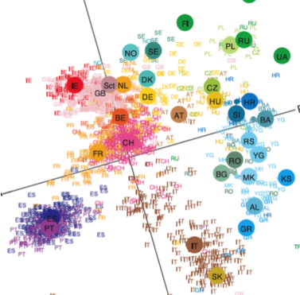
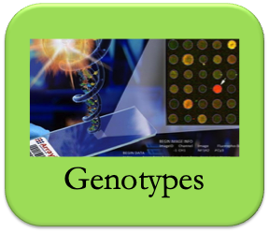
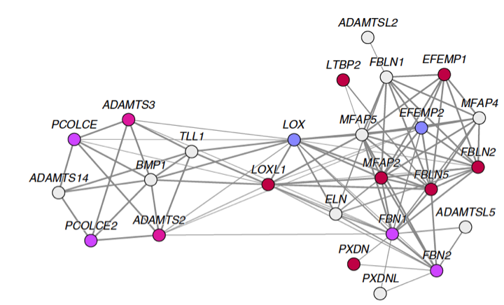
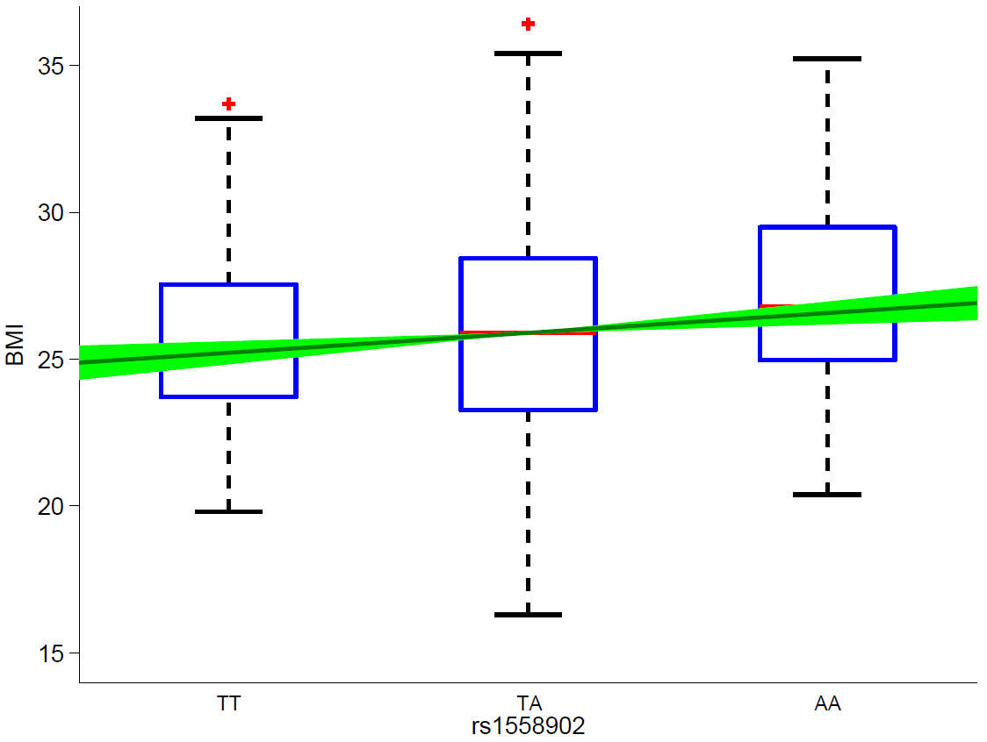
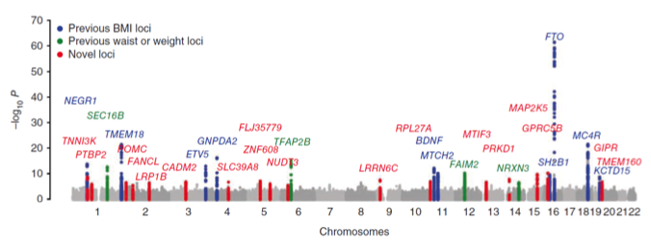
Module on GWAS
GWAS
PCA
Network
Genetic
Risk
Score

Slide 6
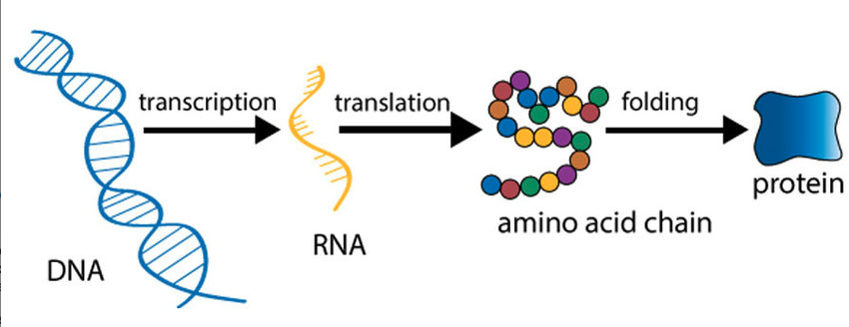
What is gene expression?

Slide 7
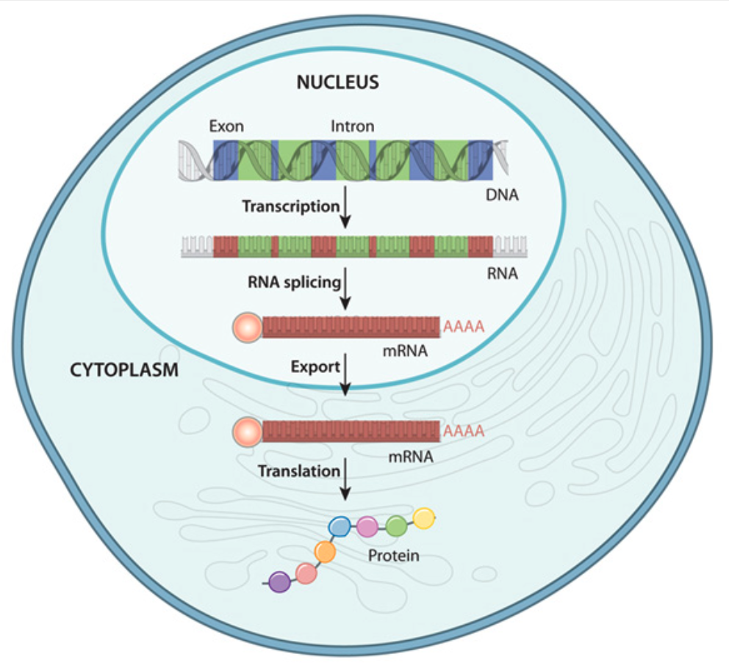
Where is gene expression?

Slide 8
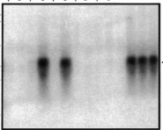
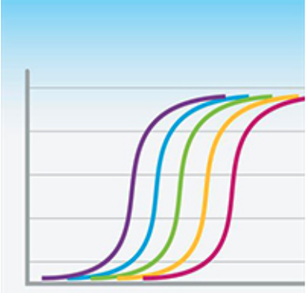
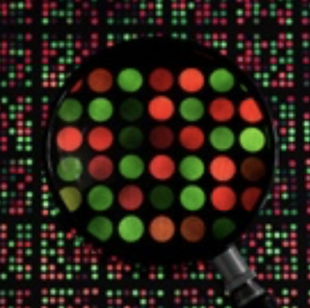
How to measure gene expression?
Northern Blot: Single genes
RT-PCR: Multiple genes
Microarrays: Whole genomes
RNA-seq: Whole genomes+

Slide 9
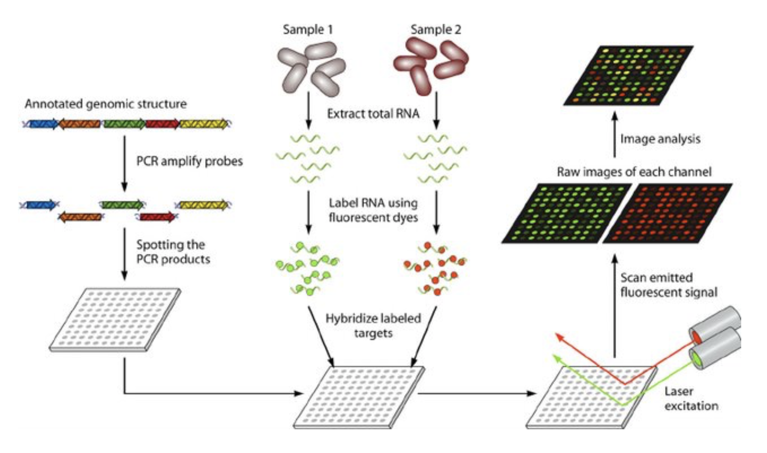
Microarrays

Slide 10
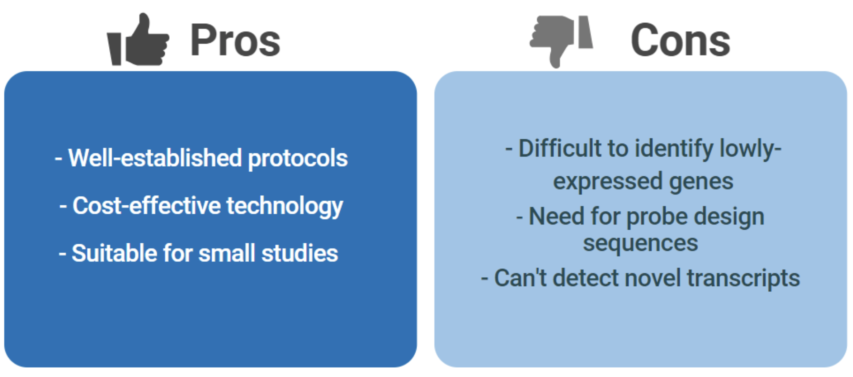
Microarrays

Slide 11
RNA seq
RNA quantification using
next generation sequencing (NGS)

Slide 12
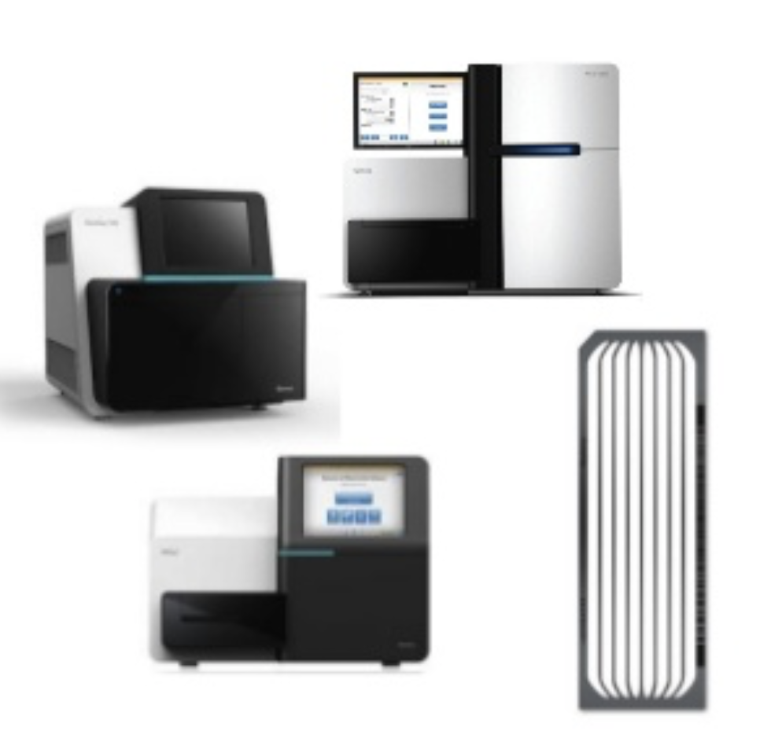
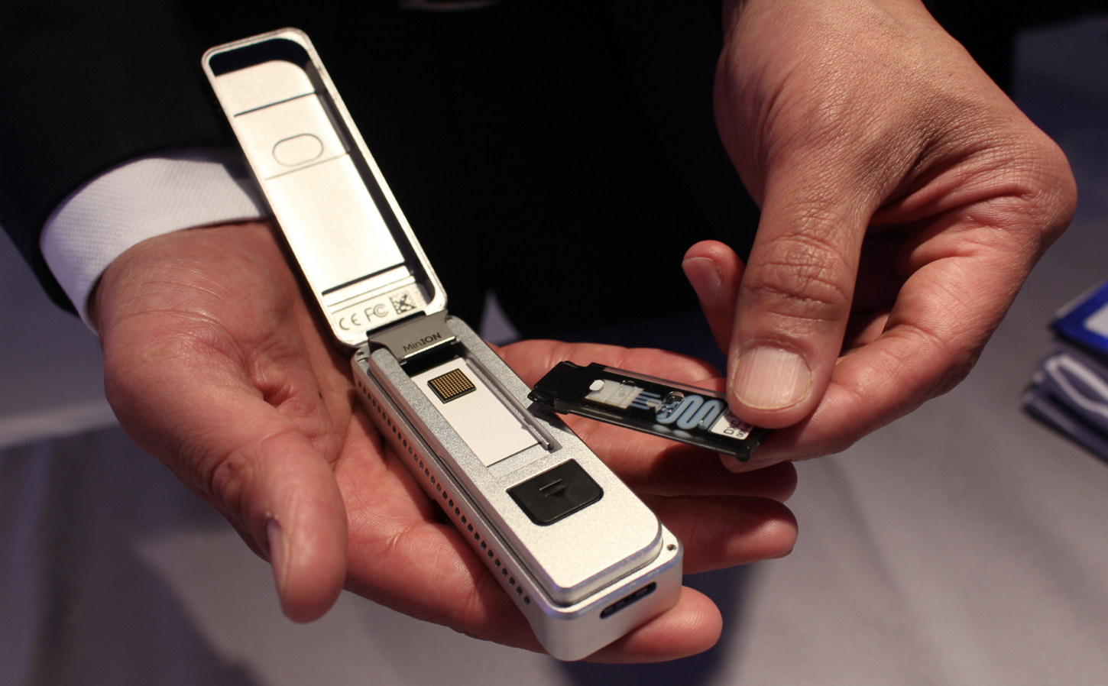
NGS platforms
Illumina:
sequence by synthesis
market leader
Oxford Nanopore:
direct, electronic analysis of single molecules
The future?

Slide 13
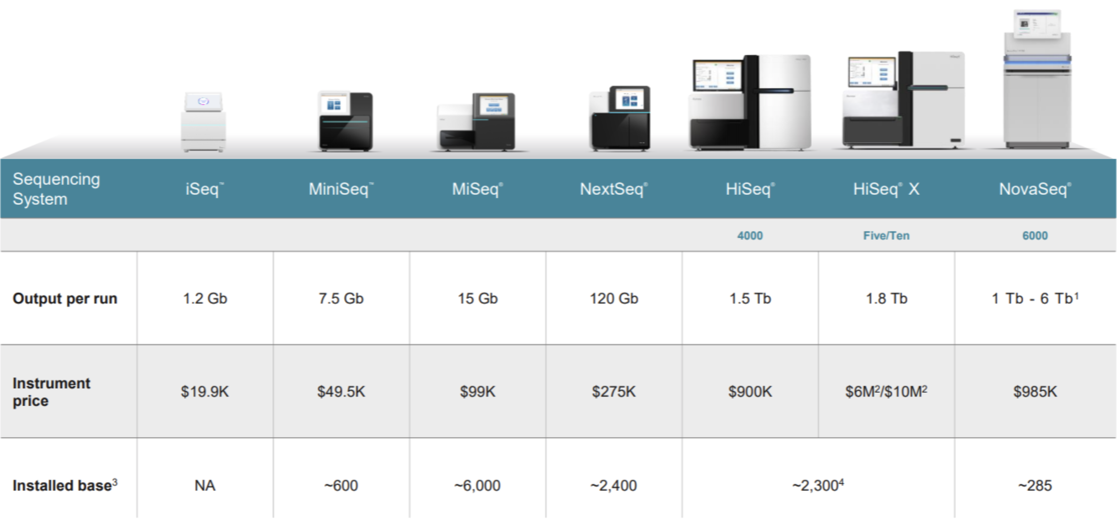
Illumina products:

Slide 14
Illumina procedure:
Three basic steps:
Amplify
Sequence
Analyze

Slide 15
Illumina amplification:
The process begins with purified DNA (cDNA when analyzing RNA).
The DNA gets chopped up into smaller pieces and given adapters, indices, and other kinds of molecular modifications that act as reference points during amplification, sequencing, and analysis.
The modified DNA is loaded onto a specialized chip (“ ”) where amplification and sequencing will take place.
Along the bottom of the chip are hundreds of thousands of oligonucleotides (short, synthetic pieces of DNA).
They are anchored to the chip and able to grab DNA fragments that have complementary sequences. Once the fragments have attached, a phase called cluster generation begins. This step makes about a thousand copies of each fragment of DNA.

Slide 16
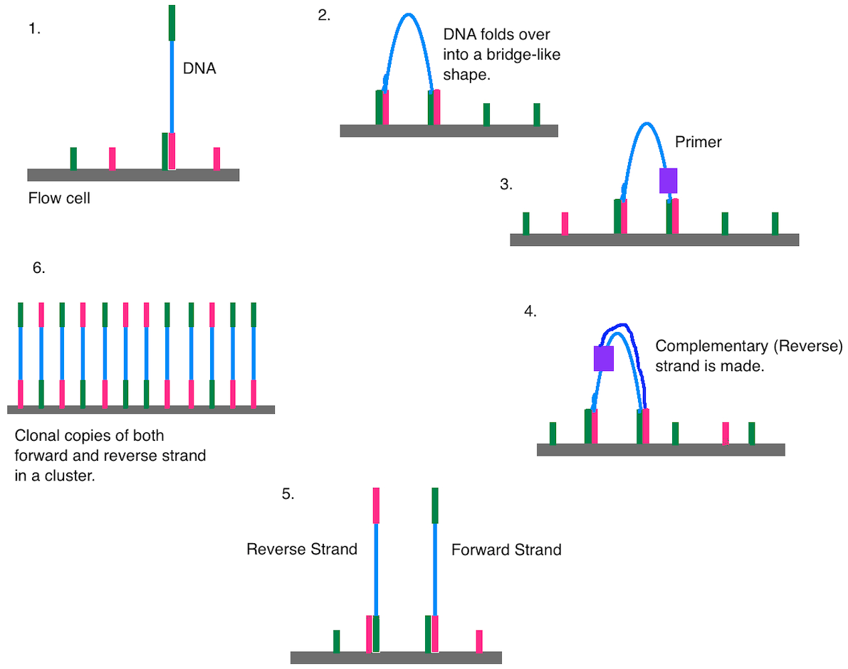
Cluster generation

Slide 17
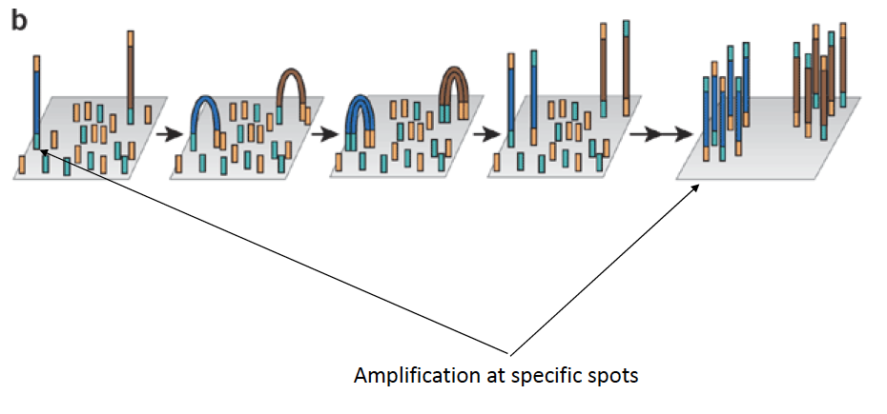
Cluster generation

Slide 18
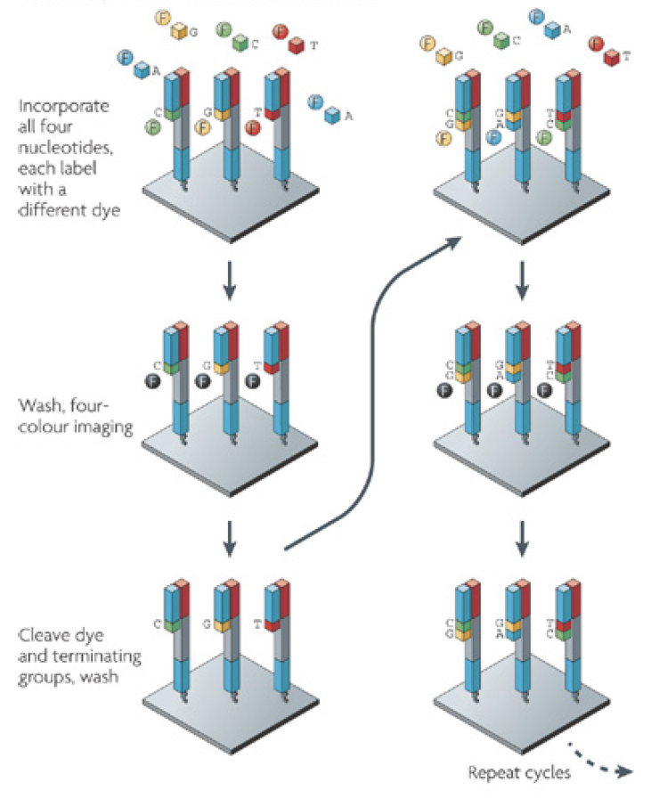
Illumina sequencing:
Primers and modified nucleotides enter the chip. These nucleotides have reversible 3' blockers that force the polymerase to add on only one nucleotide at a time as well as fluorescent tags.
After each round of synthesis, a camera takes a picture of the chip. A computer determines what base was added by the wavelength of the fluorescent tag and records it for every spot on the chip.
After each round, non-incorporated molecules are washed away. A chemical deblocking step is then used in the removal of the 3’ terminal blocking group and the dye in a single step.

Slide 19
Illumina sequencing:
Massive image processing to generate the sequence

Slide 20
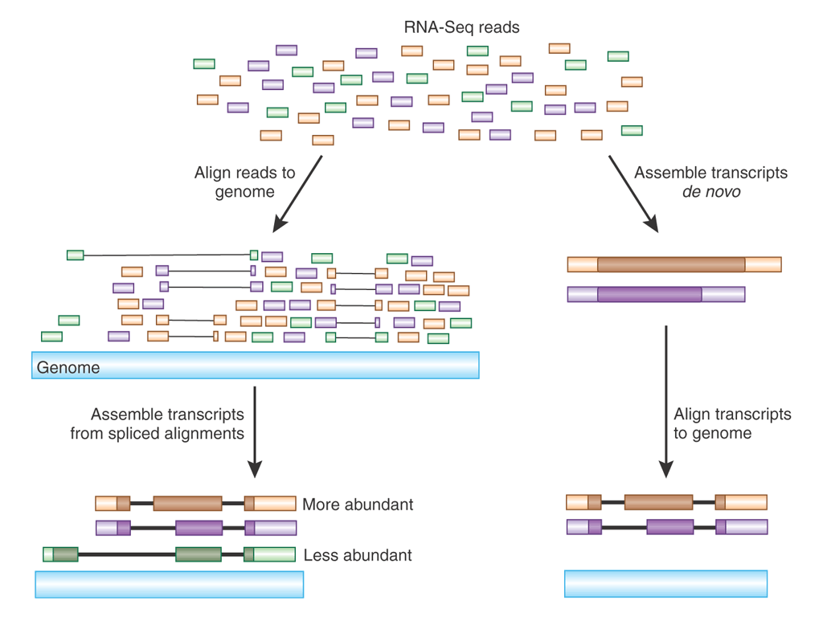
Illumina short reads analysis:

Slide 21
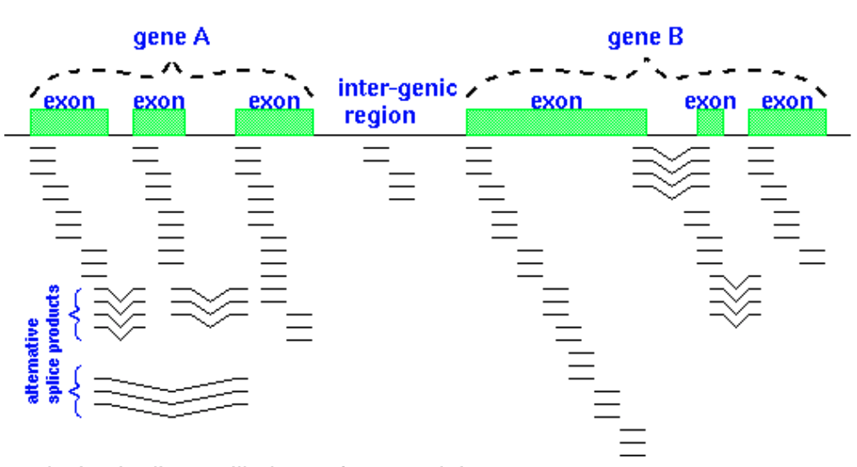
Detecting splice variants:

Slide 25
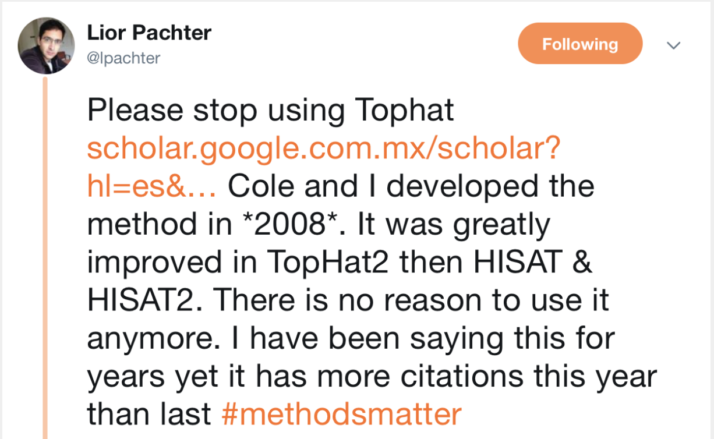
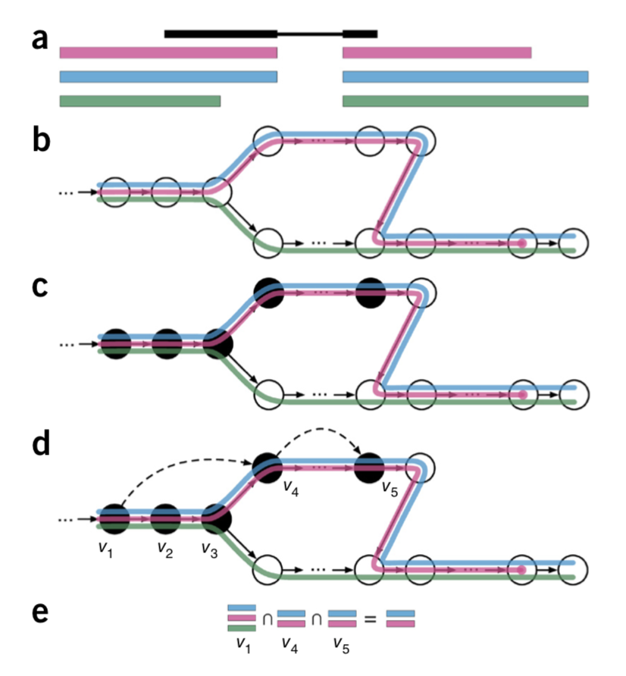

Slide 26
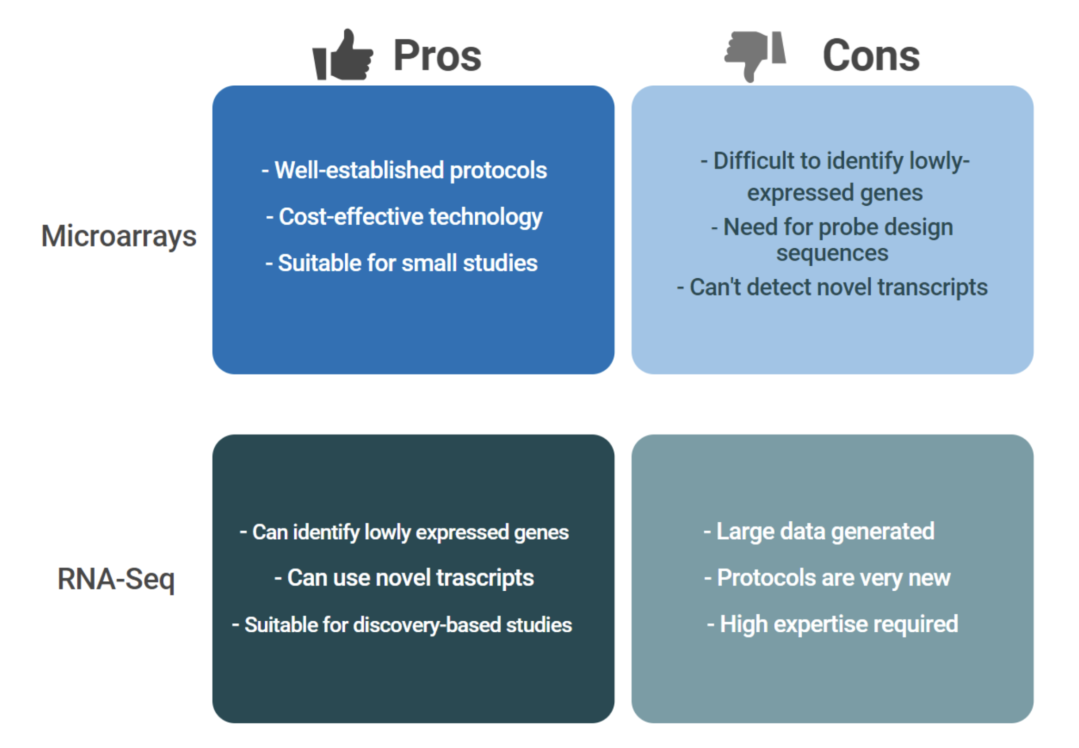
RNAseq vs microarrays

Slide 27
What is RNA-seq good for?
RNA-seq uses NGS to reveal the presence and quantity of RNA in a biological sample at a given moment:
quantifies mRNA, as well as long-non-coding RNA
can quantify de-novo transcripts
facilitates the ability to look at alternative gene spliced transcripts
can quantify small RNA, such as miRNA, tRNA

Slide 28
Applications

Slide 29
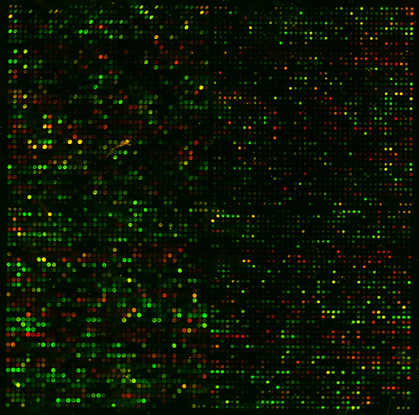
Differential gene expression analysis
What is the genome-wide response of the transcriptome when challenge with some “test” as compared to a “control”?
When using microarrays this could be done in a single experiment:
control
test

Slide 30
Better experimental design: Replicates for both test (T) and control (C) group
Test
Control
Which genes are expressed differently in the two groups?

Slide 31
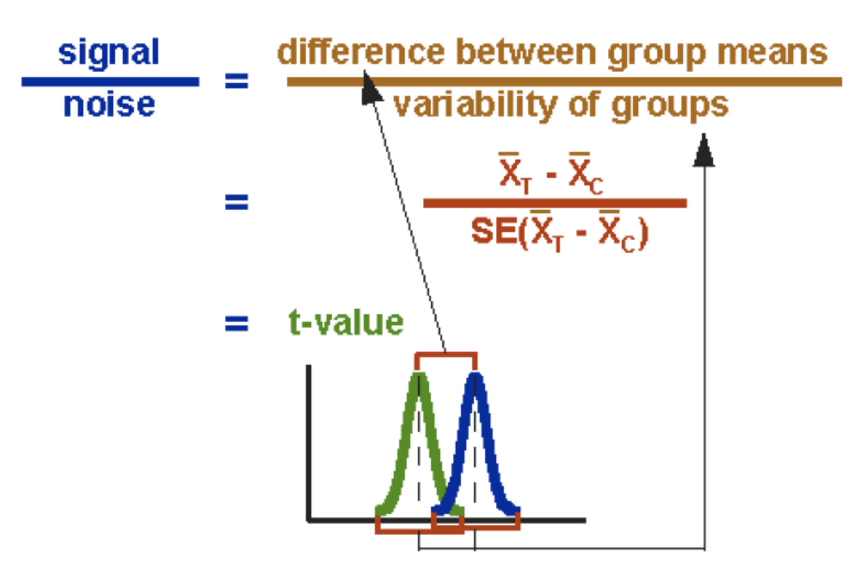
Simplest approach: t-test
t-statistic: difference between means in units of average error Significance can be translated into p-value (probability) assuming normal distributions
http://www.physics.csbsju.edu/stats/t-test.html

Slide 32
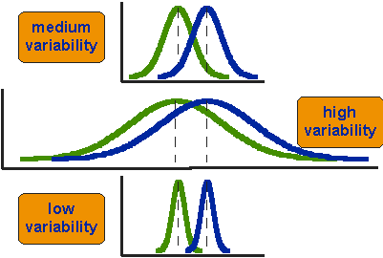
Same difference in mean,
but different variance

Slide 33
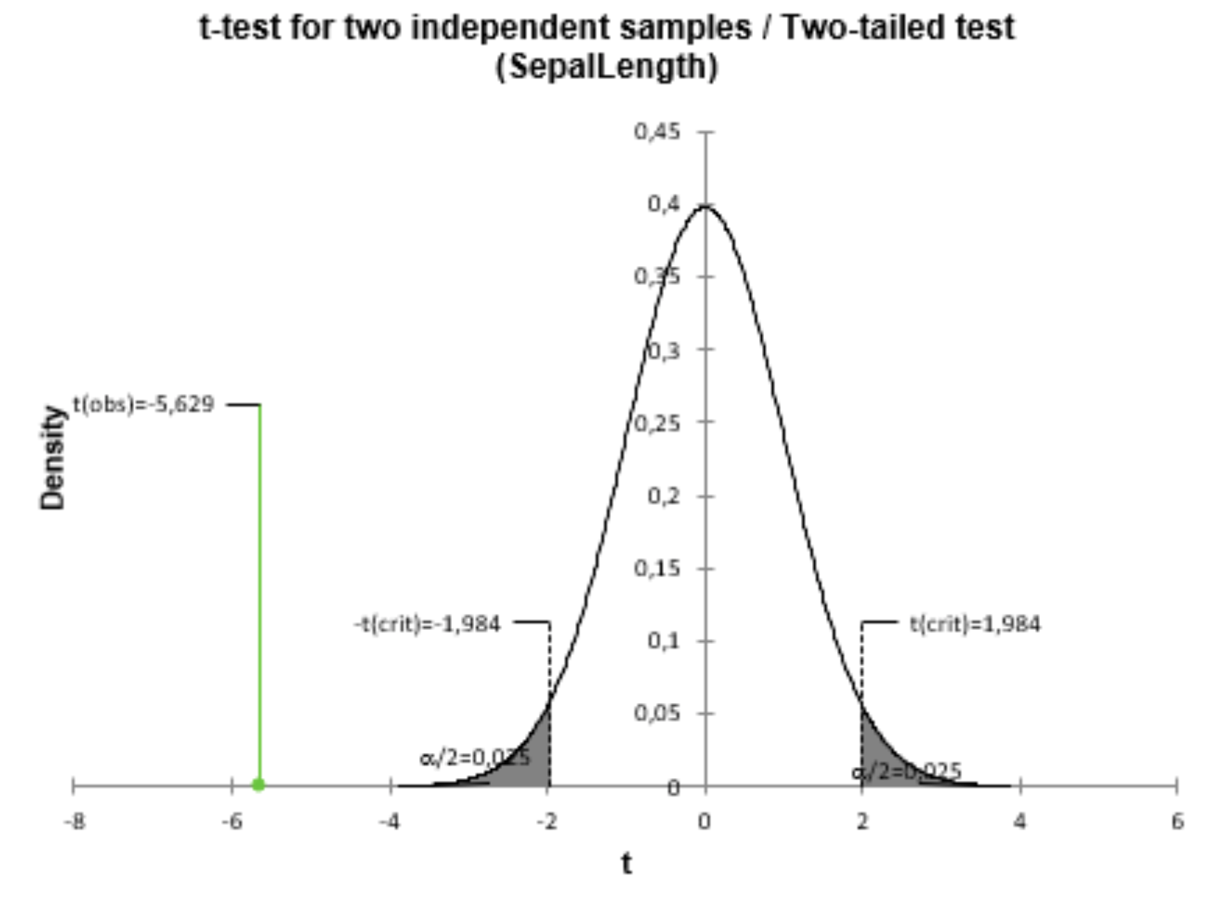
Quantifying Significance

Slide 34
T-test limitations
Assumption of normality is not fulfilled for small sets of tests and controls (One cannot estimate any distribution well based on small sample size.)
Assumption of normality is usually not fulfilled for lowly expressed genes (Counts are discrete and follow Poisson or negative binomial distribution.)
Possible workaround: Estimate p-values using permutation analysis:

Slide 35
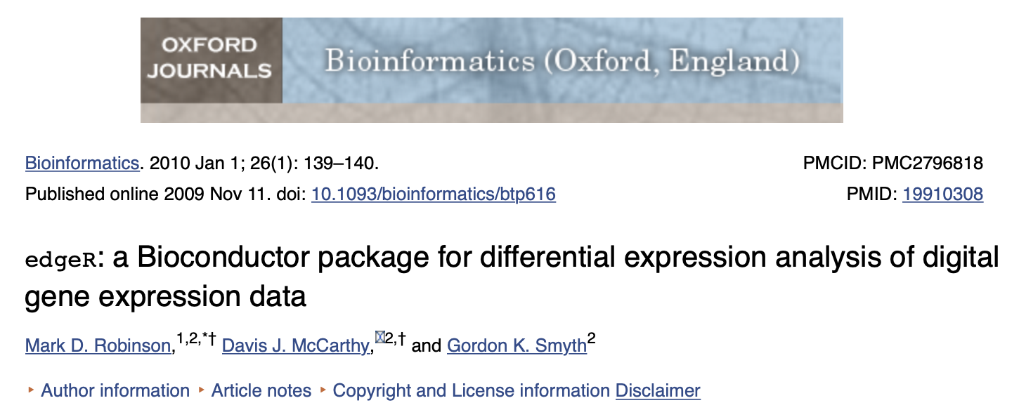
Tool of choice for RNA-seq differential expression analysis: EdgeR

Slide 36
Let’s try it out!
https://bioinformatics-core-shared-training.github.io/cruk-bioinf-sschool/Day3/rnaSeq_DE.pdf

