Slide 1
HMM based classification for conserved protein domains (SNARE)
Marius Audenis, Gabriel Chiche, Leana Ortolani
Supervisor: Carlos Pulido Quetglas
1

Slide 2
01
Background
2

Slide 3
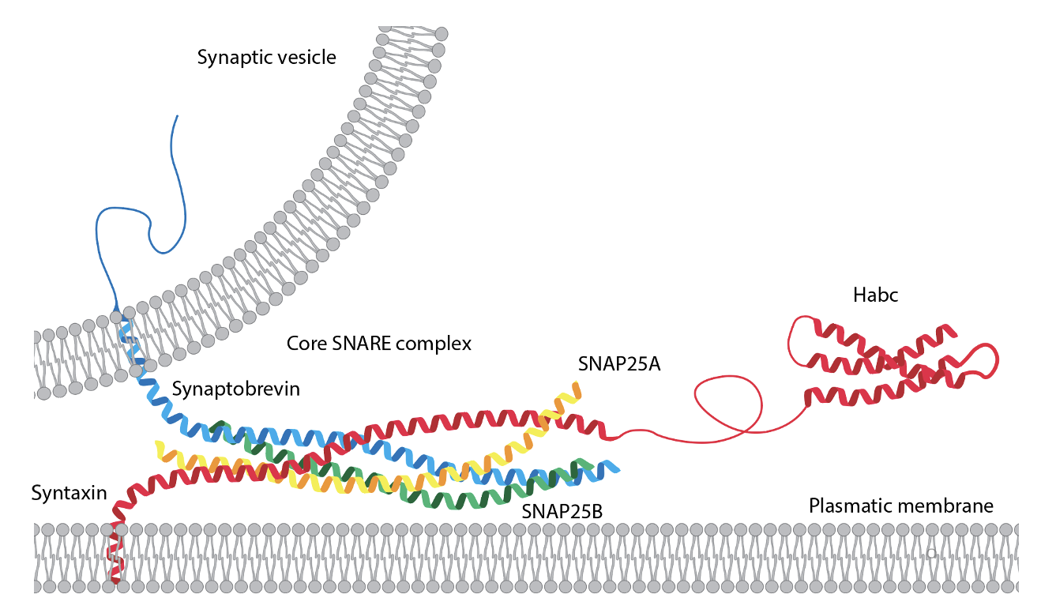
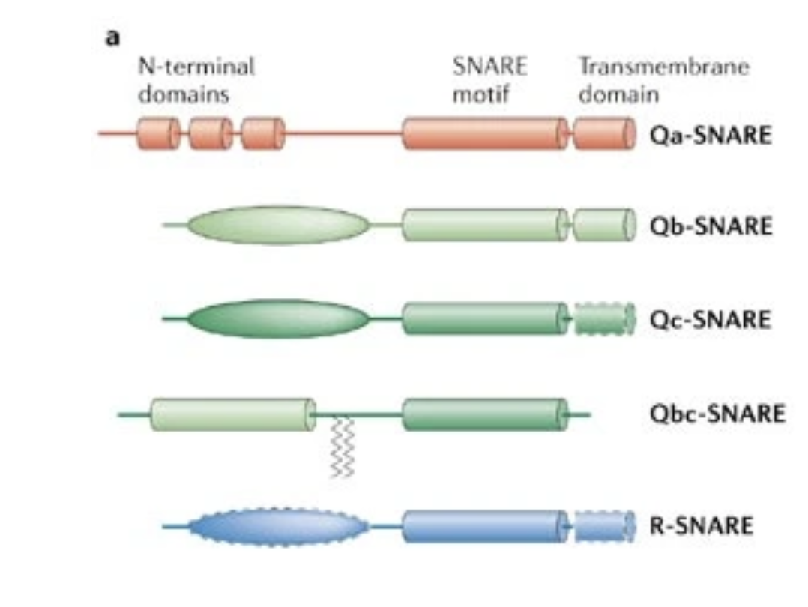
SNAREs
3
Role : membrane fusion
Conserved domain : SNARE motif
Classification : Qa, Qb, Qc, R, SNAP
Goal : automatise the classification with a model
Classification can be used to hypothesize important informations about a protein (function, location, etc...)
Notes:
Role : small fusion protein that are essential to mediate the fusion of vesicles with the target membrane
SNAP : small subfamily, contain one Qb-SNARE motif and one Qc-SNARE motif

Slide 4
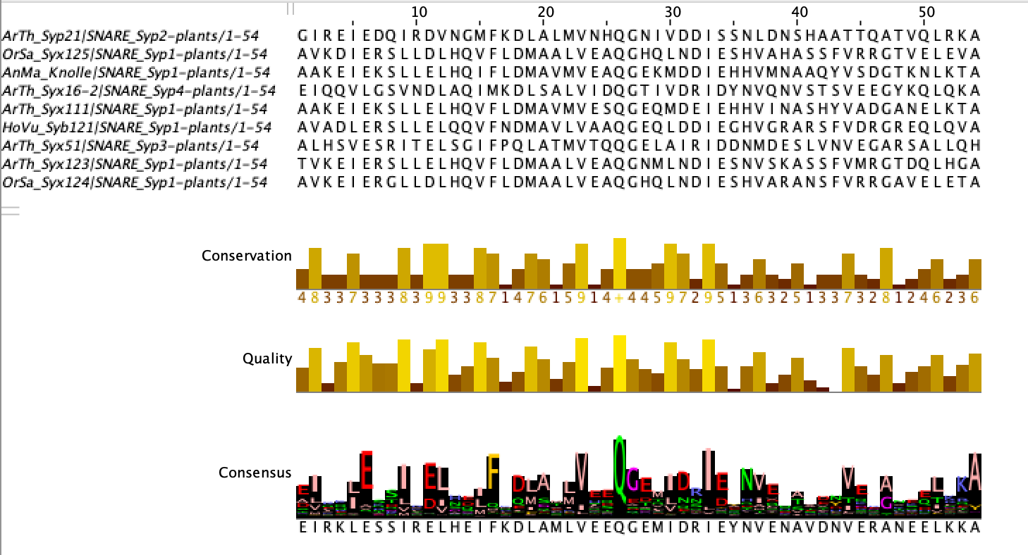
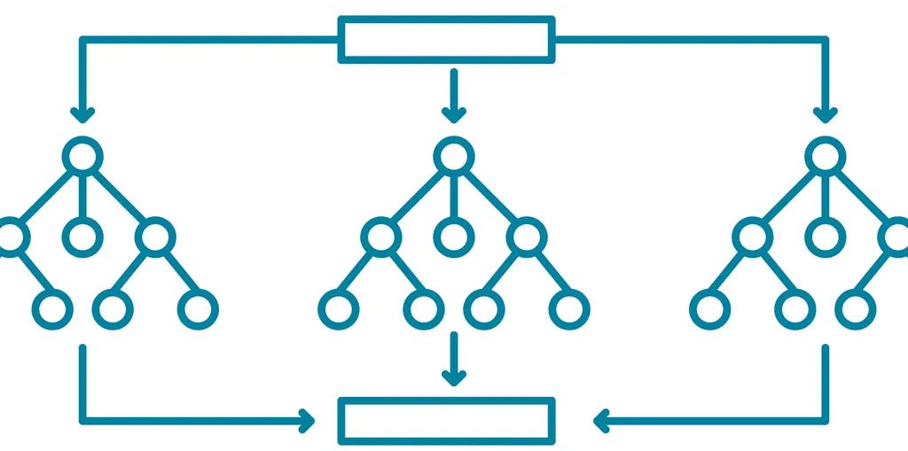
Classification – broad picture
4
MSA
Sequences
HMM profiles
Scores and E-values
Classification
Random forest
Goal : input = sequence | output = classification of the sequence (group & subgroup)

Slide 5
02
MSA
5
Multiple Sequence Alignment

Slide 6
Data Collection
6
Tracey database : SNAREs protein collection
Motif sequences and full sequences
Sequences from specific taxa :
Archaeplastida --> Viridiplantae
Opisthokonta --> Metazoa and Fungi

Slide 7
Alignment
7
Python script that calls MAFFT, a tool for multiple sequence alignment
Motif sequences : alignment for Qa, Qb, Qc and R
Full sequences : alignment for Qa, Qb, Qc, R and SNAP
HoSa_Cellub
Notes:
For motif sequ --> classid based on only the snare motif
For full --> classif not only based on snare motif, include potential other conserved domain present in the sequ
Alignemtn of main group --> threshold, bc if too much gaps --> introduce noise when building hmm profile
As use threshold --> check that didn’t lose info --> compare with human sequ well studied

Slide 8
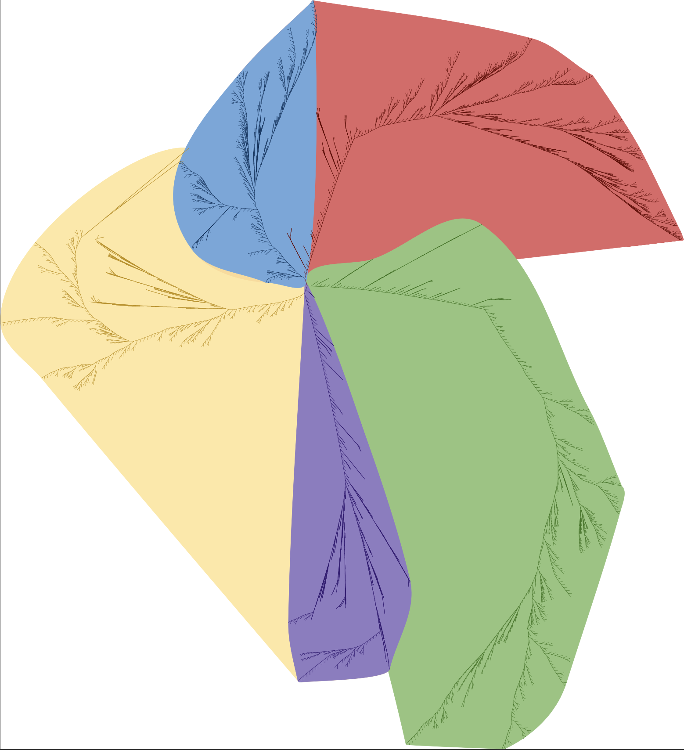
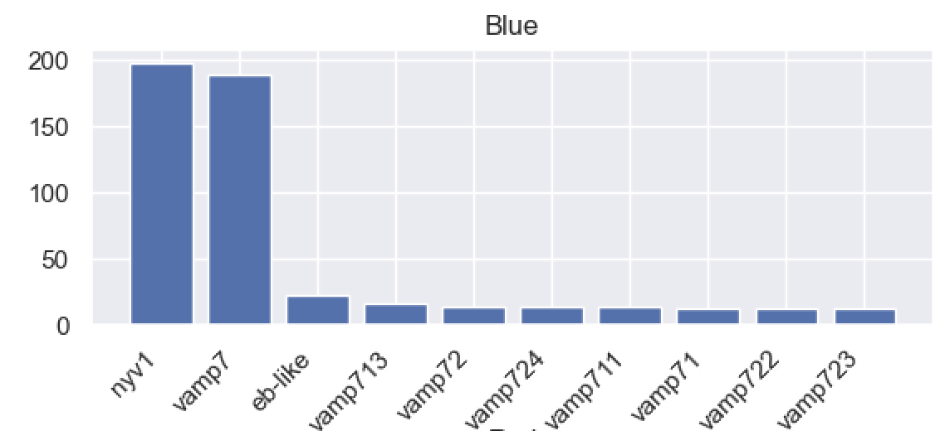
Identification of sub-groups
8
Full sequences alignment to build the trees
Average distance, visualisation with ITOL
Labelling of sub-groups
MSA for each of the sub-groups
R III
R IV
R.Reg
R I
R Tree
R II
Notes:
For subgroup, decided to identified ourselves the groups, not use the one already identified in the classif
Composition of the subgroups
Early endosomal compartment, Nyv1 pour fungi, Vamp pour M et P

Slide 9
Sequences distribution across taxa
9
 | V | M | F
Qa | 471 | 3081 | 1481
Qb | 316 | 1042 | 972
Qc | 335 | 947 | 1327
R | 448 | 2294 | 1416
SN | 60 | 786 | 283

Slide 10
03
HMM
10
Hidden Markov Models, Profiles and search

Slide 11
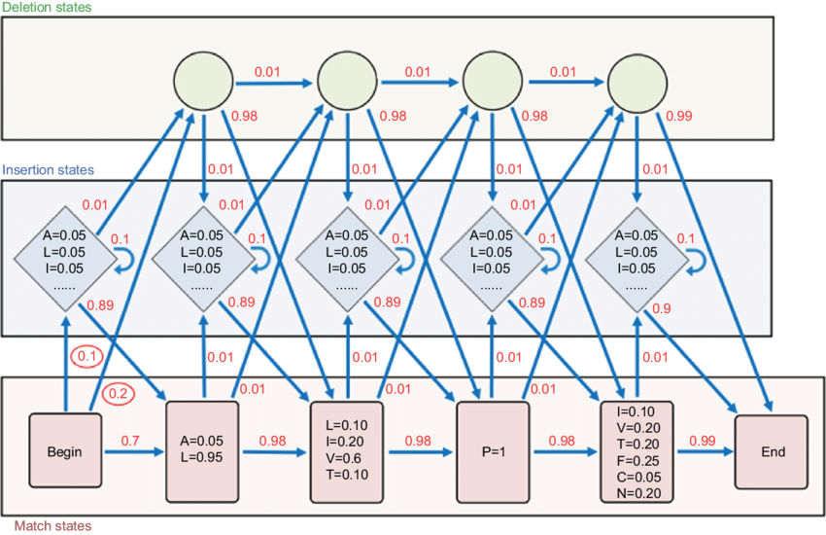
What are HMM profiles?
11
Based on multiple sequences alignements
Probabilistic models used to represent a family of sequences
They capture conserved and variable regions, as well as insertions and deletions
Allow to determine how likely it is for a sequence to belong a specific group
Arthur Gruber ResearchGate

Slide 12
Building and using the HMM profiles
12
Sequences
MSA
HMMER
HMM profile
HMM-based sequence database searching
Input matrix for ML

Slide 13
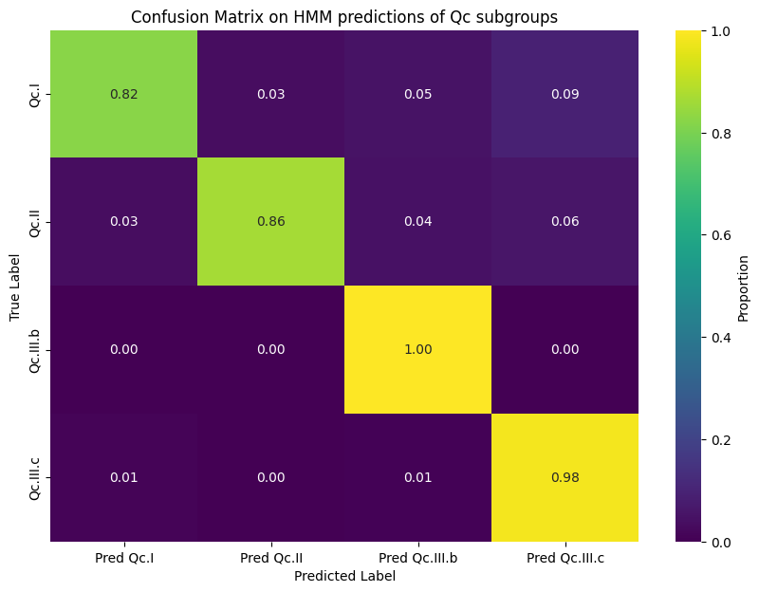
HMM profiles performance
13
Accuracy = 0.92

Slide 14
04
Machine learning
14
Random forests

Slide 15
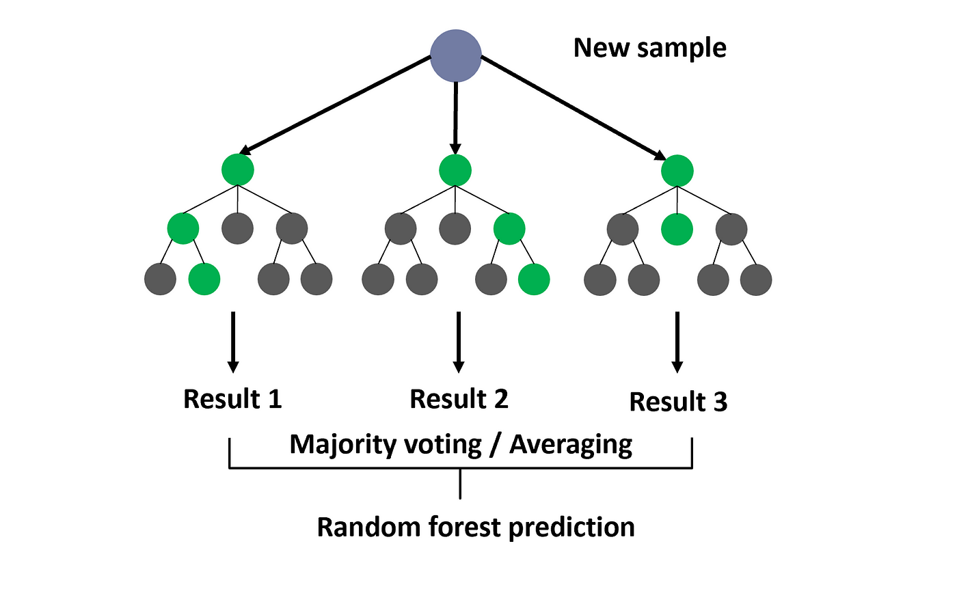
Machine learning – Random forests
15
Commonly used model for classification
Ensemble learning technique
Creation of multiple decision trees
Aggregation of results
High accuracy and reduced overfitting
Dr Roi Yeoshua, Medium

Slide 16
Machine learning - input
16
Sequence | Score/length Qa | EvalQa | Score/lengthQb | Eval Qb | Score/lengthQc | Eval Qc | Score/length R | Eval R | Label
DiOr_Syx1a | 0.86254 | 2.2e-79 | NaN | NaN | 0.076 | 6.6e-06 | NaN | NaN | Qa
TrVi_Bos1 | NaN | NaN | 0.47964 | 8.2e-40 | NaN | NaN | NaN | NaN | Qb
ChMy_Syx6 | 0.38248 | 9.4e-15 | 0.13983 | 0.0011 | 1.1024 | 6.2e-41 | NaN | NaN | Qc
… | … | … | … | … | … | … | … | … | …
No hits from the HMM profile do not return anything
Need to set an appropriate value for the missing data for the model to work
Different replacement values were tested, from 0.001 to 0.95
Specific to the score
Specific to the E-value

Slide 17
Machine learning - input
17
Sequence | Score/length Qa | EvalQa | Score/lengthQb | Eval Qb | Score/lengthQc | Eval Qc | Score/length R | Eval R | Label
DiOr_Syx1a | 0.86254 | 2.2e-79 | 0.01 | 0.9 | 0.076 | 6.6e-06 | 0.01 | 0.9 | Qa
TrVi_Bos1 | 0.01 | 0.9 | 0.47964 | 8.2e-40 | 0.01 | 0.9 | 0.01 | 0.9 | Qb
ChMy_Syx6 | 0.38248 | 9.4e-15 | 0.13983 | 0.0011 | 1.1024 | 6.2e-41 | 0.01 | 0.9 | Qc
… | … | … | … | … | … | … | … | … | …
No hits from the HMM profile do not return anything
Need to set an appropriate value for the missing data for the model to work
Best working values :
Low replacement value for the score : 0.01
High replacement value for the E-values : 0.9

Slide 18
Machine Learning – Example tree
18

Slide 19
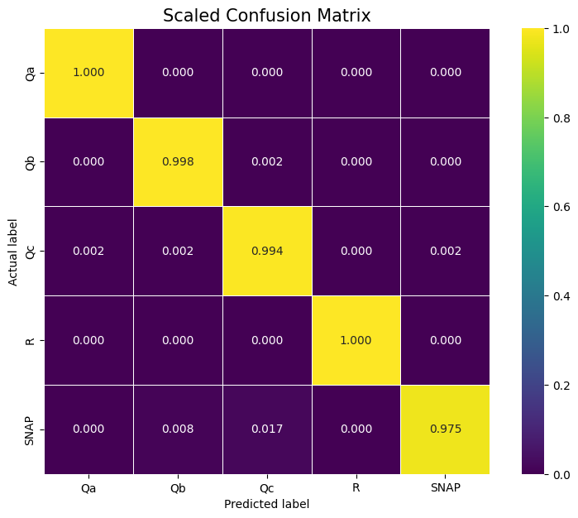
Machine learning – Main group results
19
Confusion matrix
Evaluation metrics:
Accuracy: Correctly classified instances out of the total instances
Precision: Ratio of TPs to the sum of TPs and FPs
Recall: Ratio of TPs to the sum of TPs and FNs
F1 score: Harmonic mean of precision and recall
Accuracy: 0.9996
Precision: 0.9996
Recall: 0.9996
F1: 0.9996

Slide 20
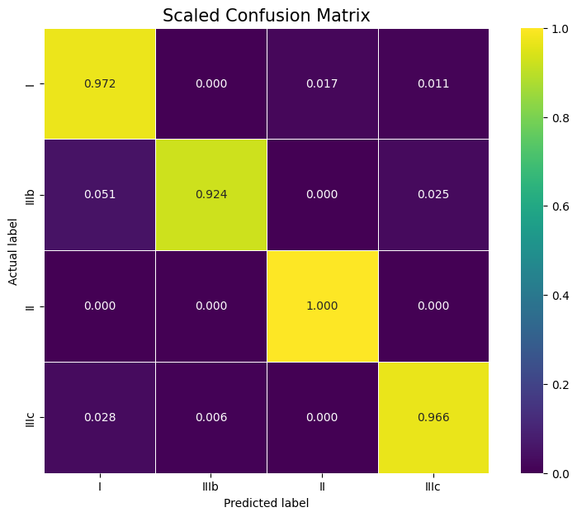
Machine learning – Qc subgroups results
20
Evaluation metrics:
Accuracy: Correctly classified instances out of the total instances
Precision: Ratio of TPs to the sum of TPs and FPs
Recall: Ratio of TPs to the sum of TPs and FNs
F1 score: Harmonic mean of precision and recall
Accuracy: 0.967
Precision: 0.967
Recall: 0.967
F1: 0.967
Confusion matrix

Slide 21
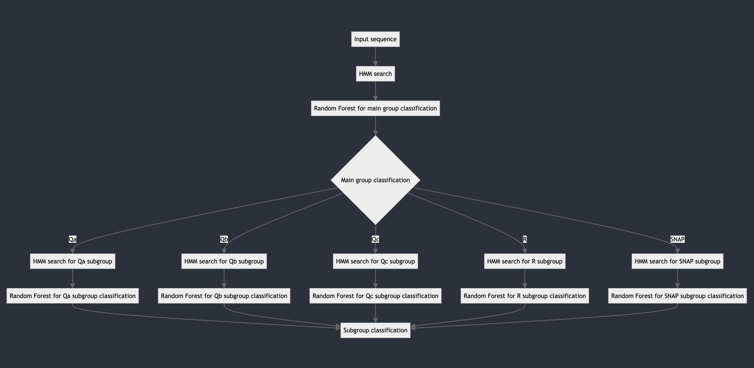
21

Slide 22
05
What’s next ?
22
Future things to implement

Slide 23
Challenges
23
Using IqTree for better classification
Using a tree to classify the main groups
Investigating other ML models to upgrade the HMMs performance

Slide 24
Feedback
24
It was really interesting to work practically
Projects had a real biological meaning and were based on real data
More time for the presentation would be appreciated

Slide 25
Thanks!
Do you have any questions?
Gabriel Chiche, Marius Audenis, Leana Ortolani
Supervisor Carlos Pulido Quetglas

Slide 26
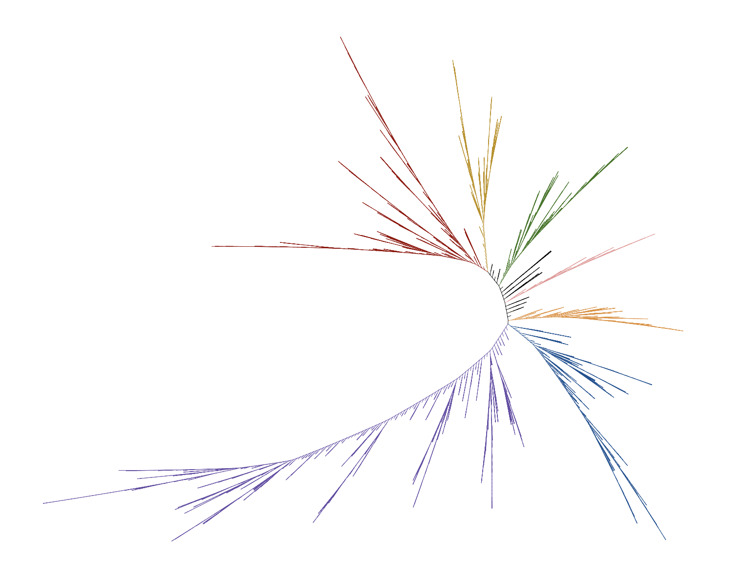
Qa Tree

Slide 27
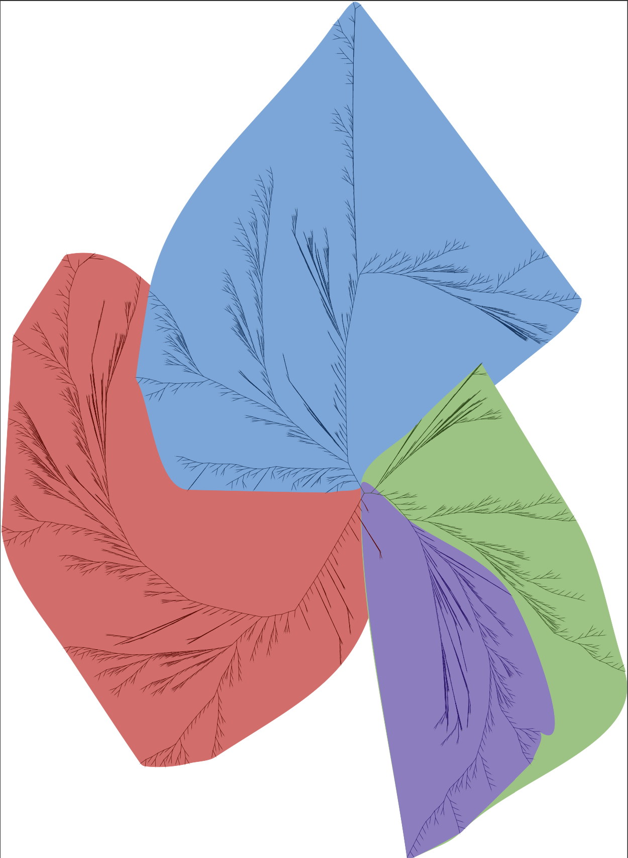
Qc Tree

Slide 28
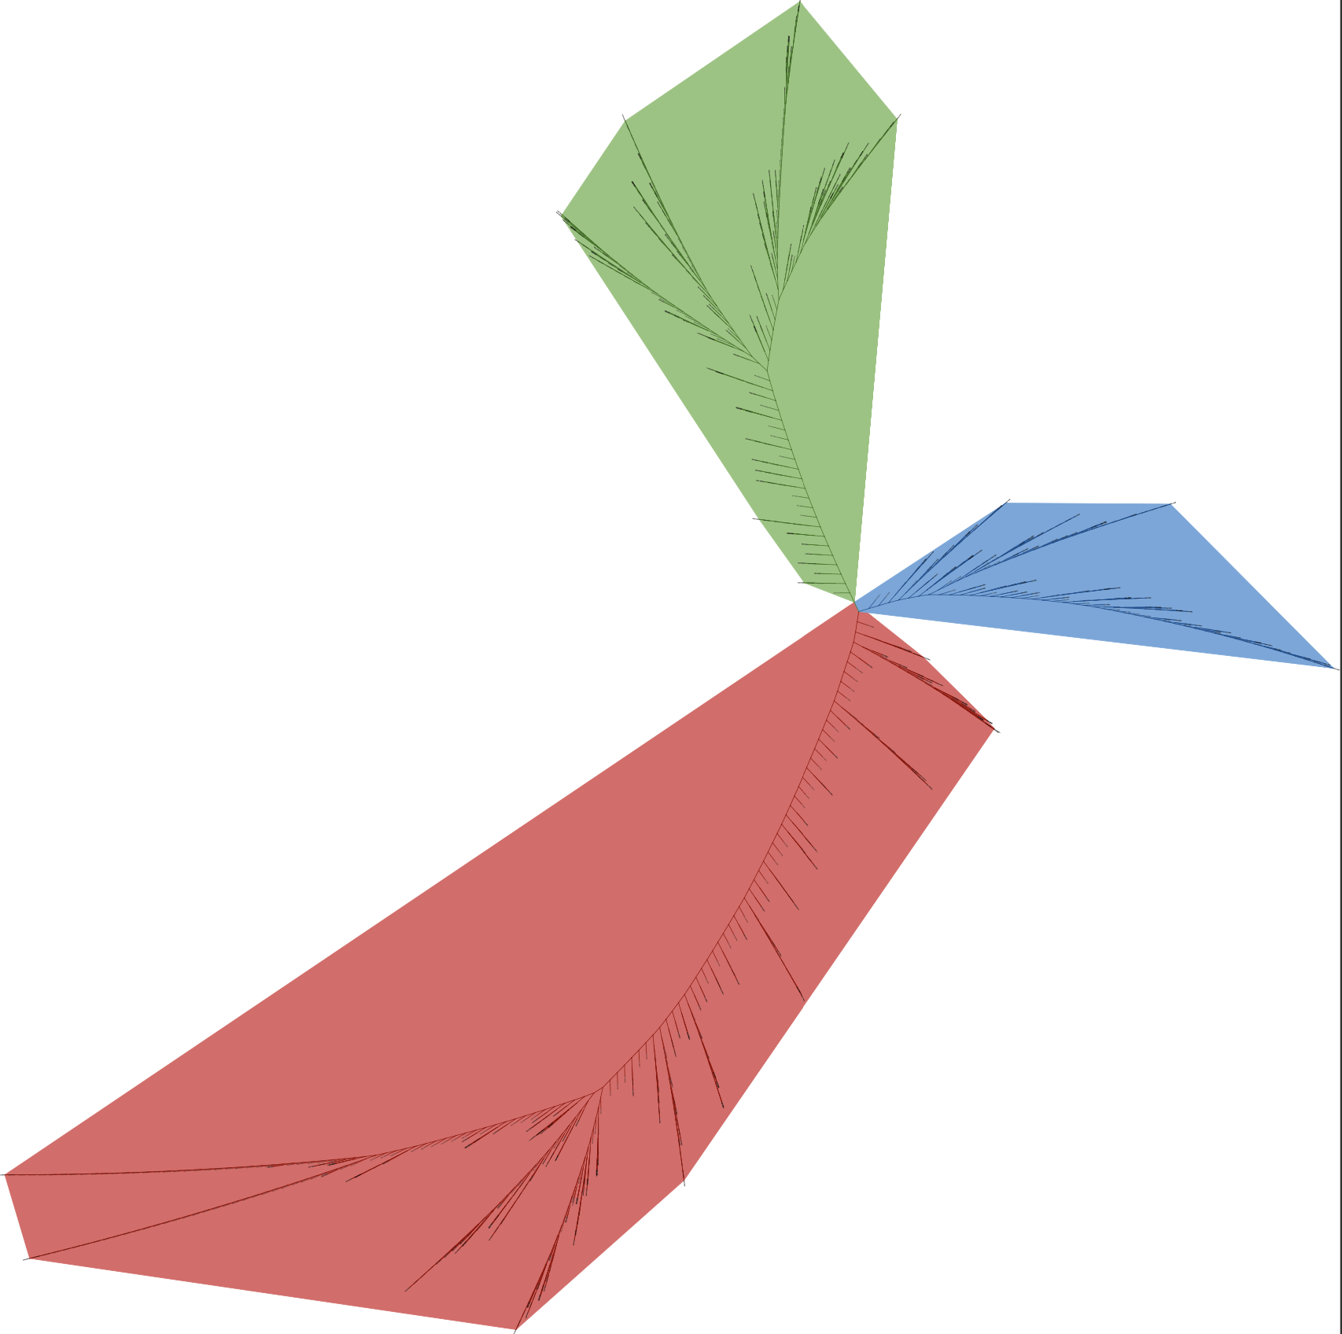
SNAP Tree

Slide 29
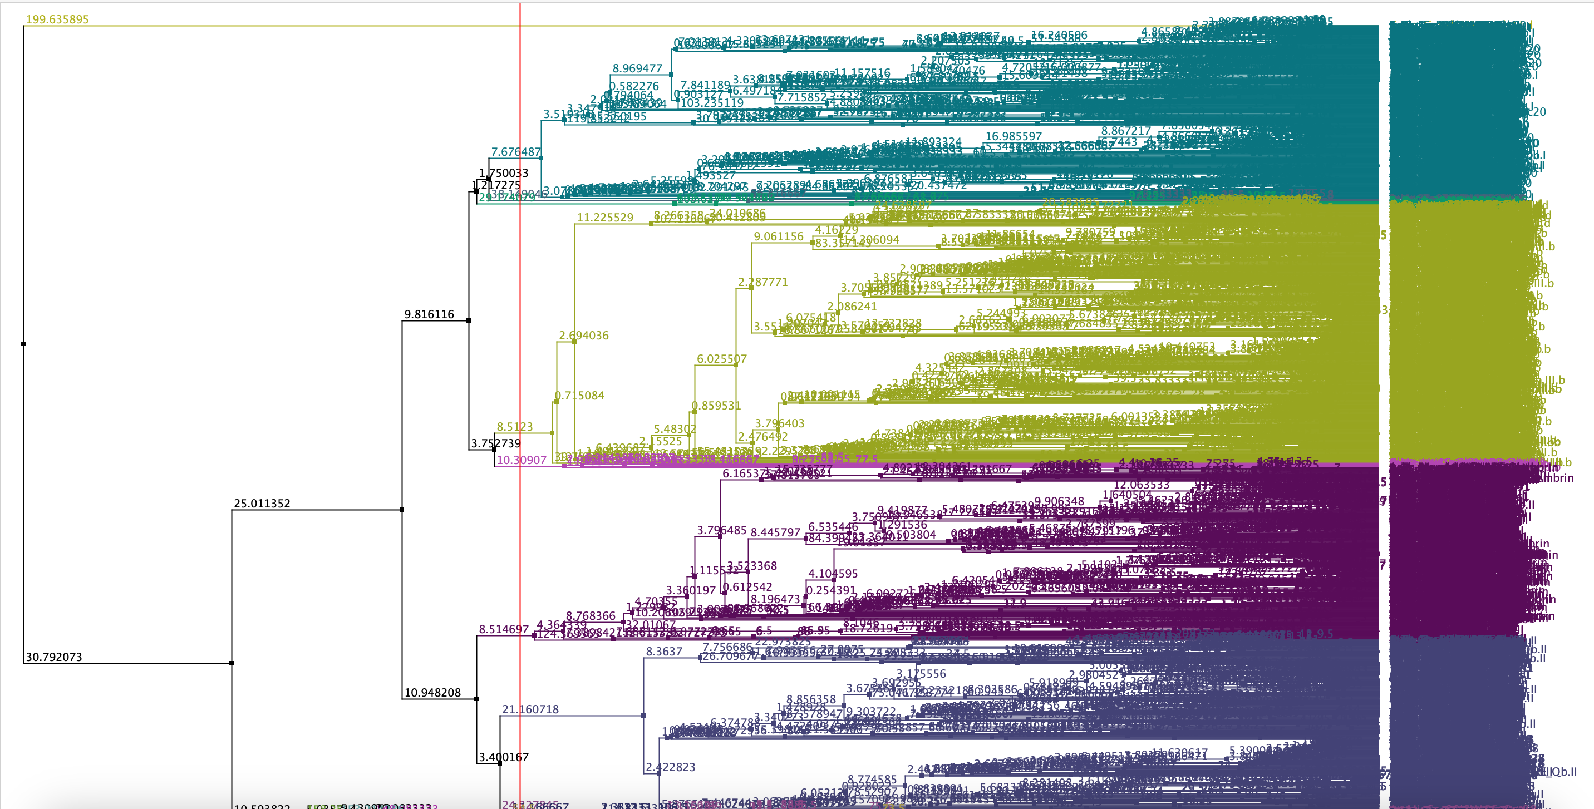
What's next
Building models for the subgroups :
The SNARE domain family is subdivided into other subgroups, for which we need to build new models

Slide 30
What’s next ?
Using the full sequences :
Instead of using only the motif sequences, using the full sequences may allow for more precise classification
Building a full pipeline :
Building a full pipeline linking the different models together would allow us to enter a sequence and directly get a classification.

Slide 31
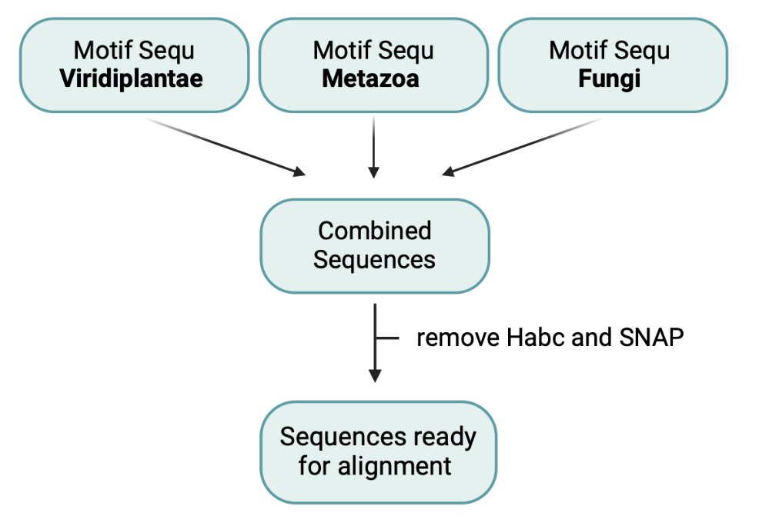
Data Collection
Tracey database : SNAREs protein collection
Motif sequences and full sequences
Sequences from specific taxa :
Archaeplastida --> Viridiplantae
Opisthokonta --> Metazoa and Fungi
For each group (Qa, Qb, Qc, R) :
Notes:
Cleaning the data for the motif sequences :
Keep only the SNARE motif, remove the Habc motif
Remove the SNAP

