Slide 1
Segmenting X-ray angiograms to predict severity of peripheral artery disease
Audenis M, Besançon L, Chiche G, Ribeiro Galheto N
Supervised by Michael Beyeler
Solving biological problems that require math 2024
1/33

Slide 2
Table of contents
1
4
2
5
3
6
Goals
Results
What did we want to achieve in this project ?
Final segmentation and measures
Background
Challenges
Biological context, PAD
Possible advancements
Methodology
Feedback
Neural networks
2/33

Slide 3
Goals of the project
Building a model from scratch
Getting an accurate segmentation
We wanted to build our own model for segmentation, to have a better understanding of neural networks.
We needed to get an accurate segmentation model, both on the training data and on unseen data to go further.
Getting appropriate measurements
Using the segmentation masks obtained with the model, we wanted to obtain appropriate measurements to predict PAD severity.
3/33

Slide 4
2
Background
Biological context
4/33

Slide 5
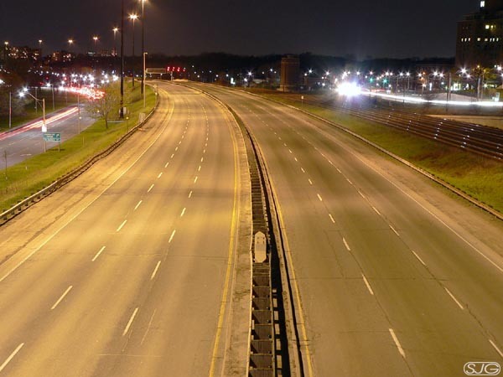
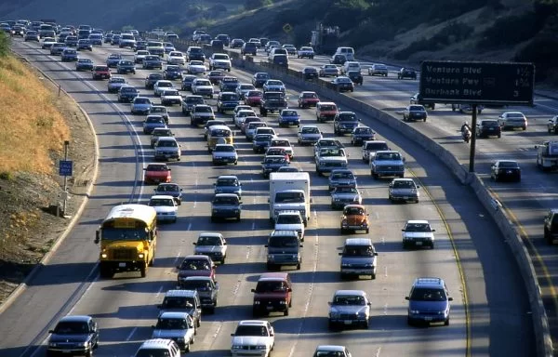
Biological Background
No PAD
PAD
https://1000awesomethings.com/wp-content/uploads/2010/09/empty-highway.jpg
https://www.its.ucla.edu/wp-content/uploads/sites/6/2018/01/los-angeles-1396606_960_720-600x384.jpg
5/33

Slide 6
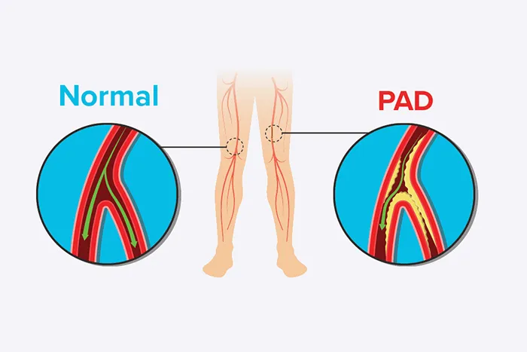
Biological Background
What is PAD ?
→ High cholesterol / Tobacco smoking/ Diabetes
→ Narrowed or blocked arteries
→ Buildup of fatty deposits
→ Reduced blood flow
(Modern Heart and Vascular, 2023)
6/33

Slide 7
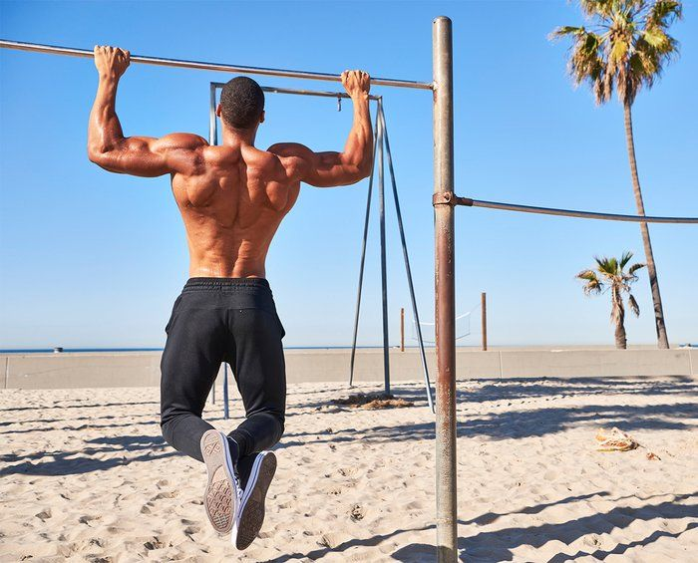
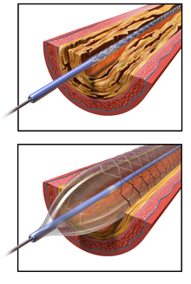
Biological Background
Treatments :
→ Physical exercise
→ Angioplasty
Bruce Blaus, CC BY-SA 4.0
https://i.pinimg.com/736x/2a/48/8c/2a488c0e6f3cb12903cd5cfb50d119e3.jpg
7/33

Slide 8
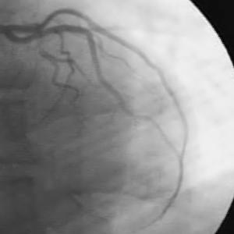
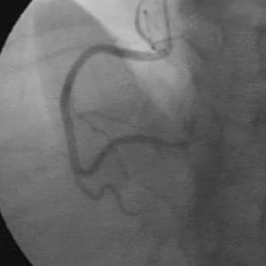
X-ray Image Segmenting
→ Detailed images of blood vessels → These data can be used in several ways to treat PAD (prevention) → Better way to diagnosis and assess PAD
Heart arteries from our dataset
8/33

Slide 9
3
Methodology
Neural networks and training data
9/33

Slide 10
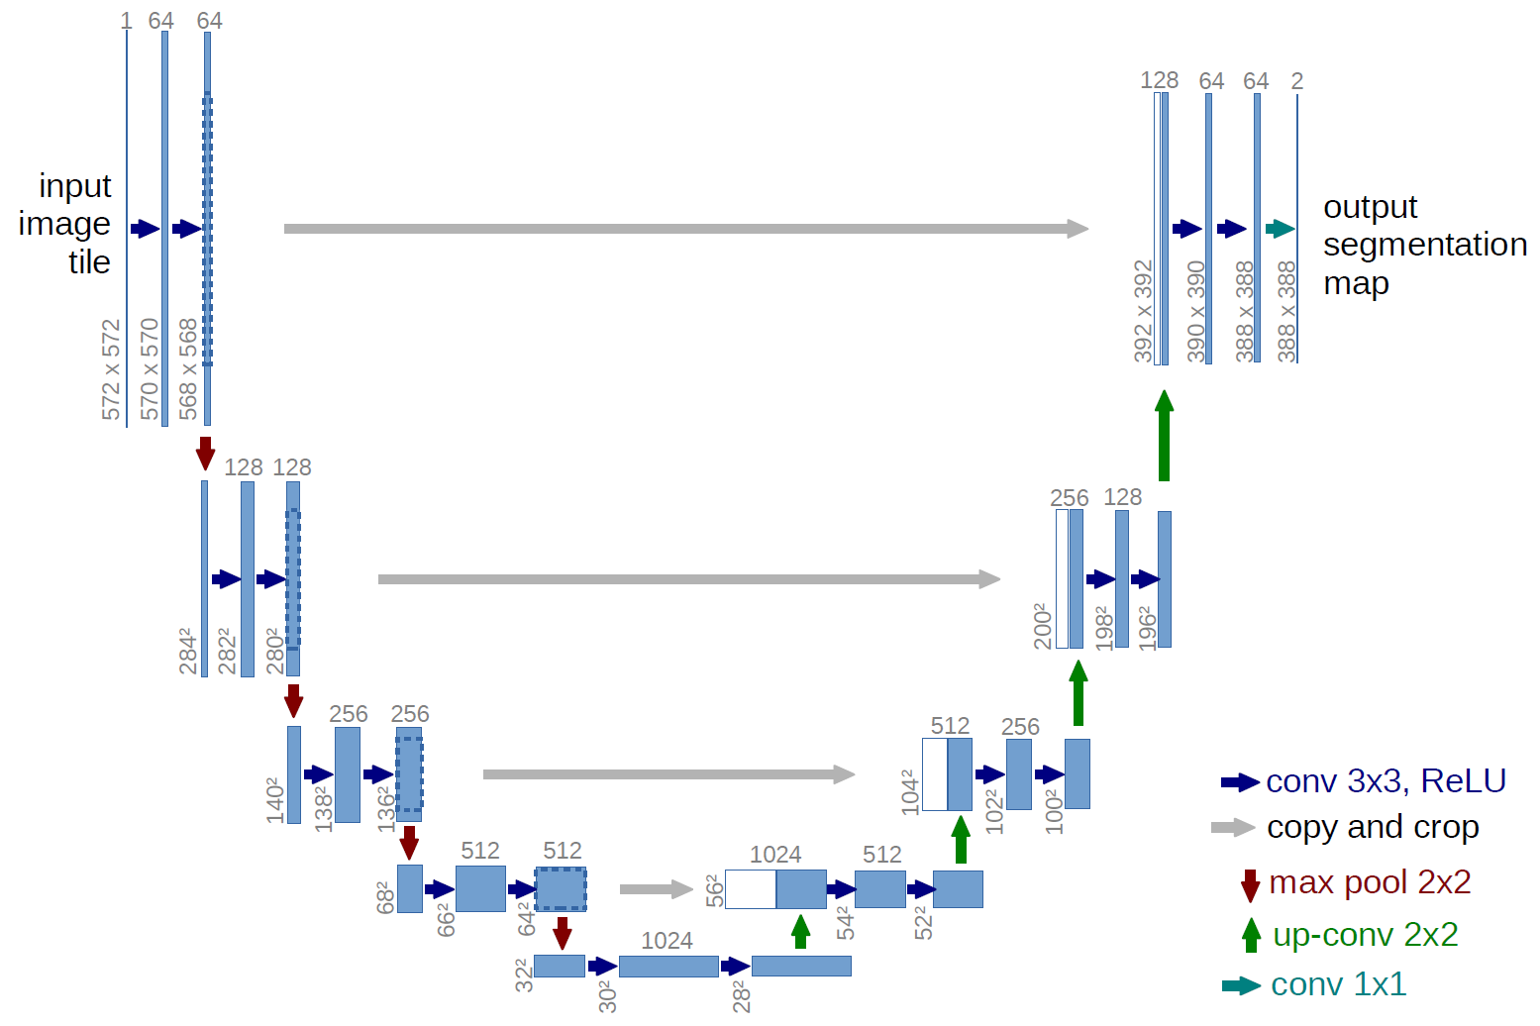
U-Net structures
10/33
Notes:
So now without going too much into the details I will show you the main idea behind the architecture model that we used during the project.
The first model that we used and actually built ourselves from scratch with pytorch is the classic Unet model.
The Distinctive structure of this model is it’s U-shaped architecture wich consist of two main path, the downsampling path and the upsampling path.
The downsampling path also named contracting path consist of multiple convolution with some max pooling operations. Basically the image is getting shrunk to a smaller size the more it goes into the downsampling path. By doing so the network is able to gain a good understanding of the context of the sample as the image is contracted.
The upsampling path or the expanding path is basically the opposite of the downsampling path as the image will go through some up convolutions and convolution it’s dimension are now expanding again. This process with the help of the skip-connection is useful to segment precisely the images without losing any details after having understood it’s context with the contracting path.
The final layer will be used to classify each pixel to obtain a final image with clear segmentation.

Slide 11
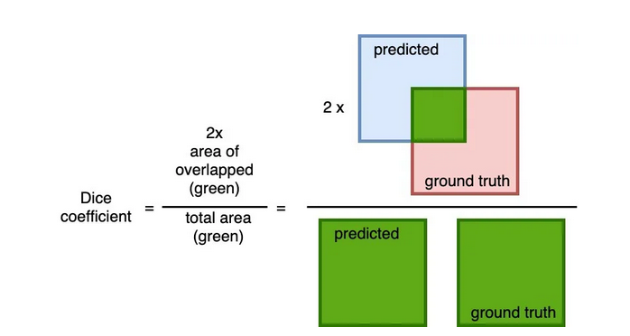
U-Net Training
1. Data augmentation 2. Loss Function 3. Optimizer 4. Backpropagation
11/33
Notes:
The challenge once we have the infrastructure is to train the model with images that are already segmented to adjust the parameters of the convolutions in order to have a model with parameters that are efficient to analyse the kind of data that we have.
To do that we use Loss functions. There is multiple loss functions that exist and the goal of a loss function is basically to compare the segmentation predicted by the model with the ground truth to asses it’s quality, based on that we will use optimizer function and backpropagation to adjust the parameters of the model and try to obtain a better loss score.
This process is repeated as many times as necessary to obtain the best score possible based on our model and the training data that we gave him.
To “artificially” augment the number of data that we had for the training process we used data augmentation which consist of applying small modifications to the data that we already possessed to increase the number of image to train. These small modifications can be for example rotating the images, change the contrast or stuff like that.
Once the results of the training is satisfactory we can use it on picture of interest with no annotation already known.
The downside of this approach is that the base architecture and parameters must be created and adjusted manually and that after the training the Unet can usually be used only with the same type of data it has been trained on.

Slide 12
nnU-net
12/33
Notes:
Slide nnUnet
That’s why we also used a more recent type of Unet, the nnUnet.
The nnUnet is basically a more advanced architecture of the Unet with a more complexe and automated methodology.
The nnUnet is able to automatically chose and set the model based on the data that we gives us, like the topology of the network, training strategies and so on.
The nnUnet start with a phase of analyse of the training data, like the size of the images, the number of canals etc.. in order to chose the architecture and the parameters.
Then it will process the images and augment them on it’s own.
The strength of this model is that it’s capable of evolving at each step of the training.
It will be able to combine different structures training with post-processing algorithms to obtain the best results possible for the segmentation.
The advantages of the nnUnet is it’s adaptability, efficacity and that it can be applied to nearly any dataset for image segmentation especially in the fields of biology and medicine.

Slide 13
The data that we used
The training Dataset
The Dataset of interest
13/33
Notes:
I will now introduce you the datasets that we used for this project. As explained before we needed to have data that were already segmented in order to train our model efficiently, that’s why we can separate our data into two datasets, the training dataset and the dataset of interest.

Slide 14
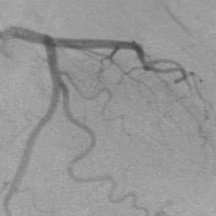
The training dataset
1. Coronary angiograms pictures 2. Segmented masks as ground truth 3. 134 pictures 4. ground-truth image outlined by an expert cardiologist
14/33
Notes:
For the training dataset we used some coronary angiograms pictures that are publicly available online. The dataset come from the paper of Cervantes_sanchez and al from 2019 : “automatic segmentation of coronary arteries in x-ray angiograms using Multiscale analysis and artificial Neural networks”.
The dataset is composed of 134 different images of 300 pixels by 300 with their ground-truth segmented masks outlined by an expert cardiologist. The images are all in gray-scale.
Even if the training data are coronary blood vessels and our data of interest are peripheral leg blood vessels it is not an issue, our model should be able to recognize the blood vessels independently from their location even if it might change a little bit their overall characteristics.

Slide 15
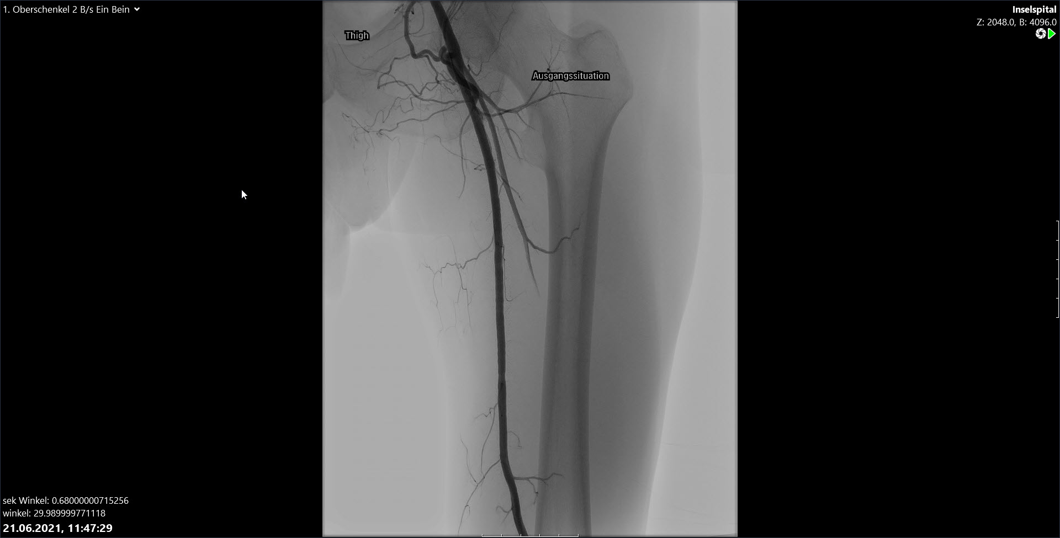
The dataset of interest
1. Peripheral legs angiograms pictures 2. Only bad quality screenshots 3. No ground-truth 4. 15 pictures 5. Hospital should send the dataset soon
15/33
Notes:
Initially the Hospital should have sent to Micheal the complete dataset of the Thighs angiograms but unfortunately it was delayed so we had to work with only bad quality screenshots like the one you can see here.
We had only 15 pictures with different sizes and naturally no ground truth. 15 is a little small and not optimal but as marius and Gabriel will present you we still obtained some results.

Slide 16
4
Results
Different models and measurements
16/33

Slide 17
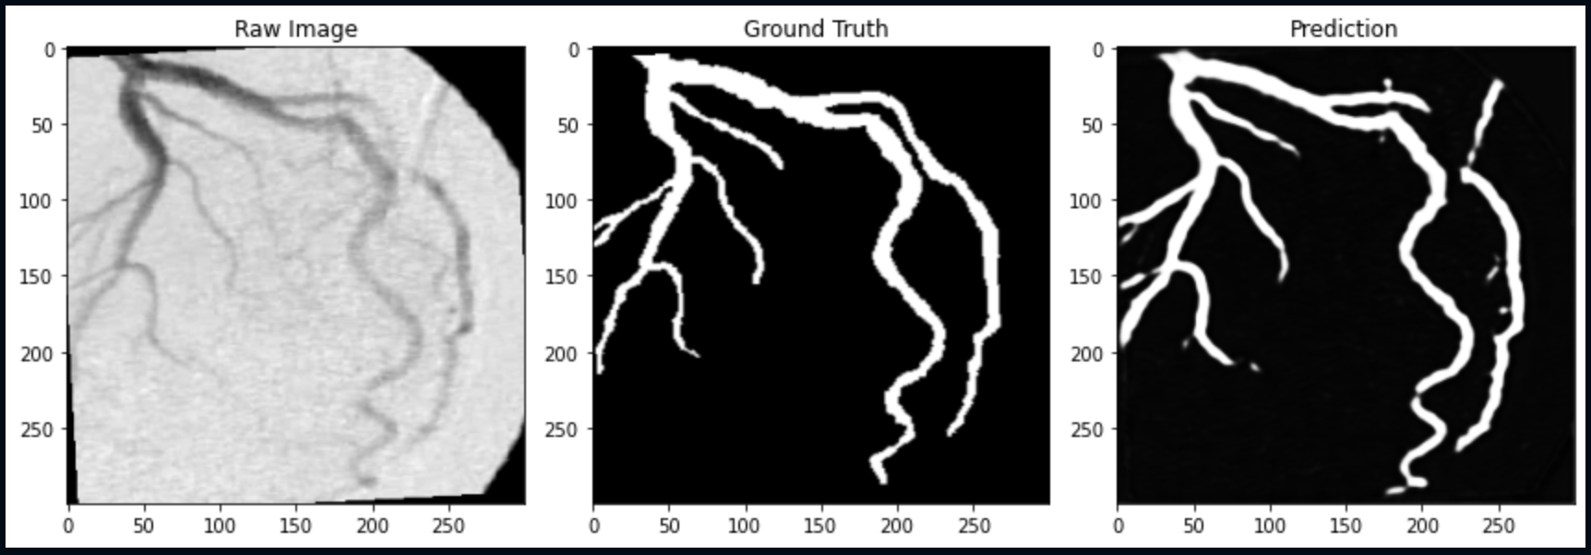
UNET performance - Training
Trained model
Mean validation DICE loss: 0.45
17/33

Slide 18
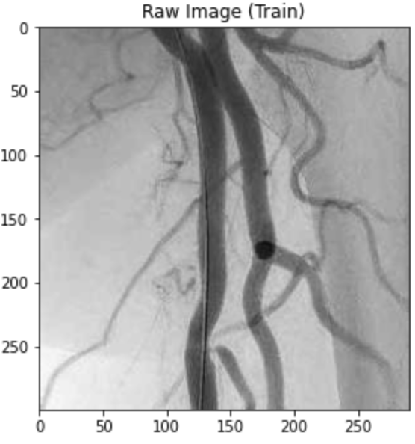
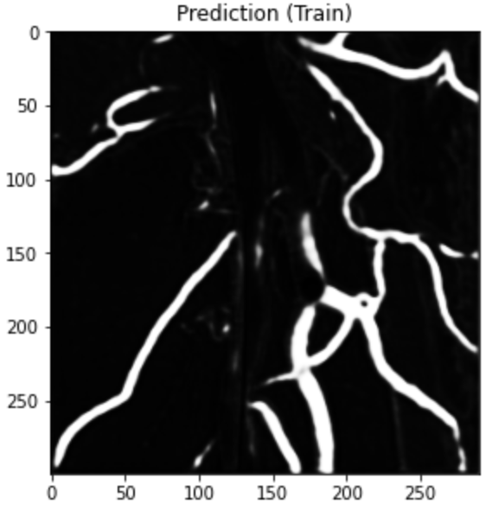
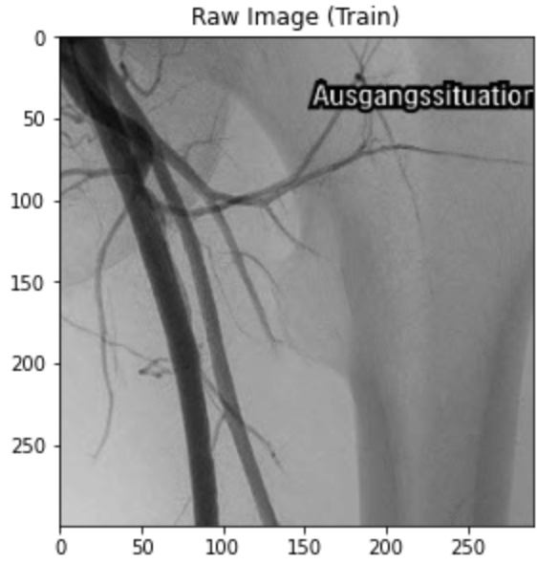
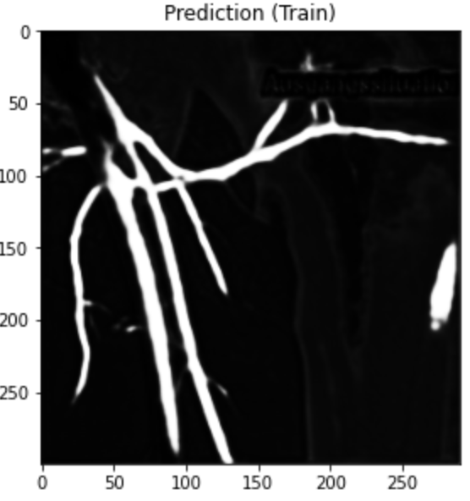
Predictions on new data - UNET
18/33

Slide 19
Other changes in the nn-UNET
Image pre- and post-processing
Need for correct data formatting
Aggressive data augmentation
Trained using 75% of the dataset
Faster training on the GPU (~5 hours/1000 epochs)
5-fold cross validation performed
19/33

Slide 20
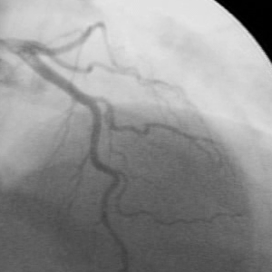
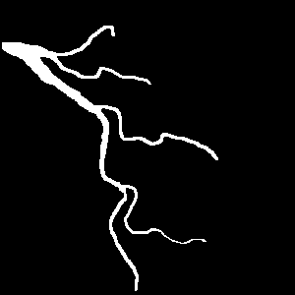
nn-UNet performance - Training
Raw image
Ground truth
Prediction
Mean validation DICE loss: 0.20
20/33

Slide 21
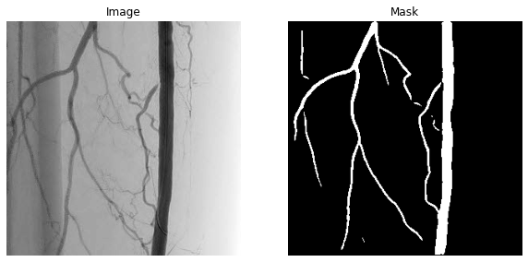
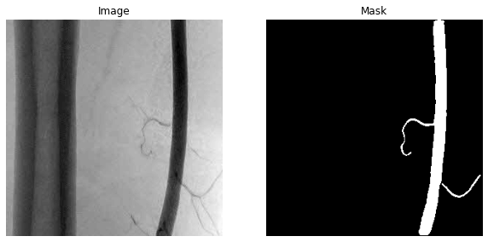
Predictions on new data - nnUNET
21/33

Slide 22
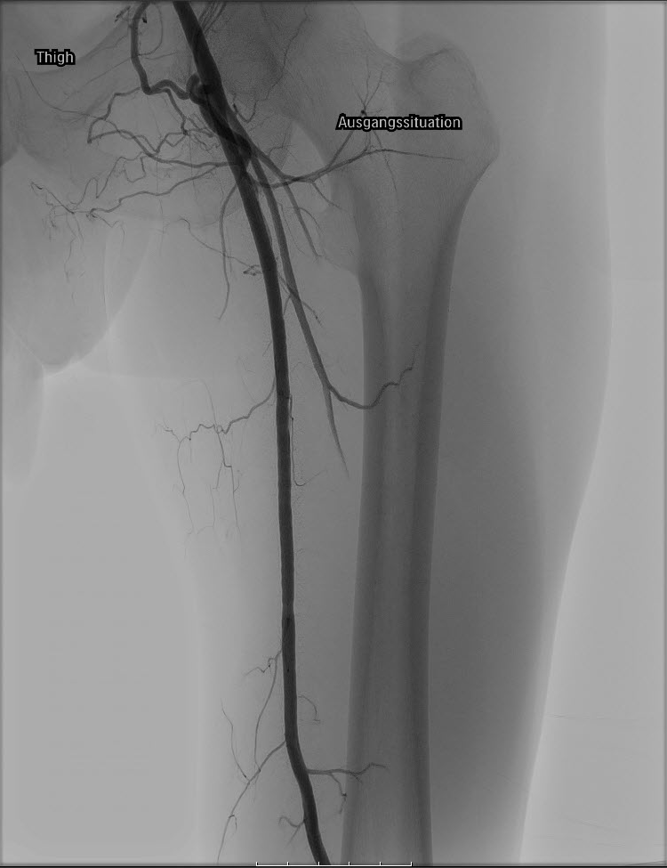
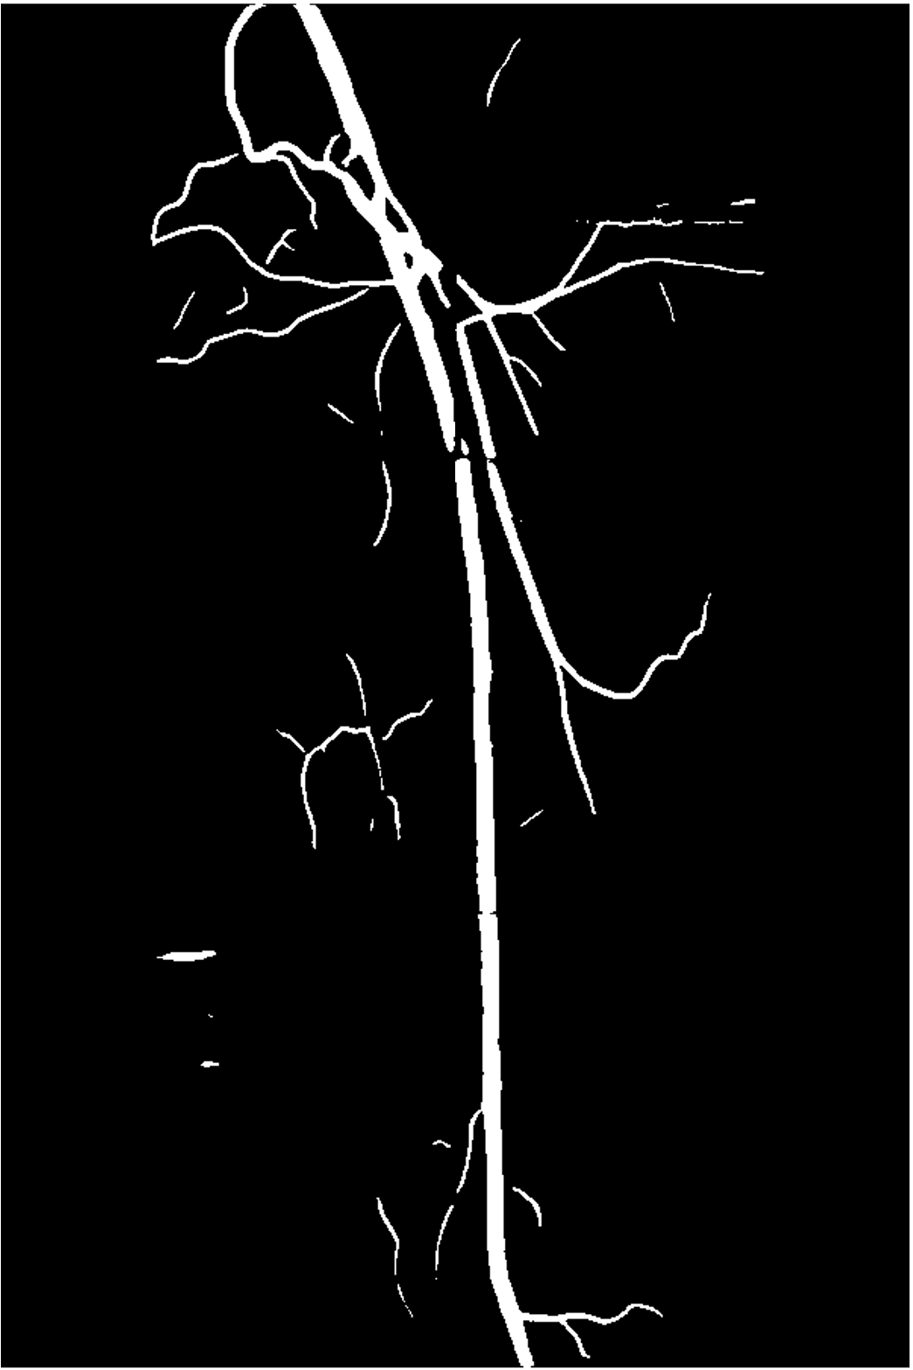
Reconstructed mask – nnUNet
22/33

Slide 23
Measurements
Fractal dimension | Vascular densitiy
1.53 | 0.08
1.03 | 0.03
1.21 | 0.5
23/33

Slide 24
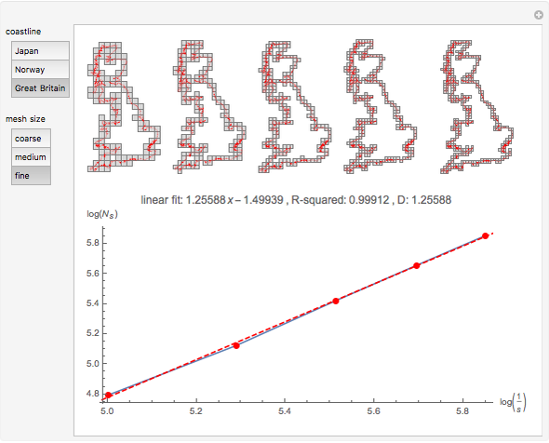
Measurements
Fractal dimention
Quantifies how the complexity of the shape evolves at different scales
Biologically, quantifies how much a vessel branches out
To do this, we used the box counting method on the segmented masks
Erik Mahieu, Wolfram demonstrations project
24/33

Slide 25
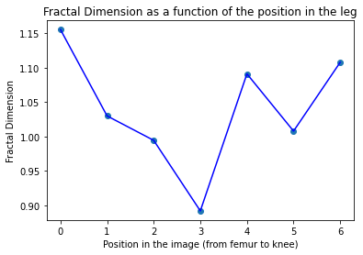
Measurements – Fractal dimension
25/33

Slide 26
Measurements
Vascular density
The fraction of blood vessels in a given area
Biologically, it quantifies how much vessels are in the image
To do this, we divided the number of white pixels in the mask by the total number of pixels
Calculation of the vascular density
on segmented images
+
26/33

Slide 27
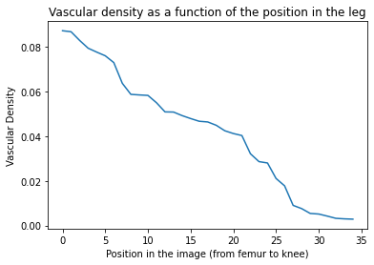
Measurements – Vascular density
27/33

Slide 28
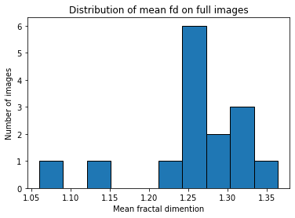
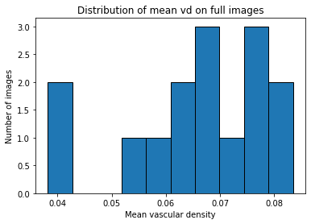
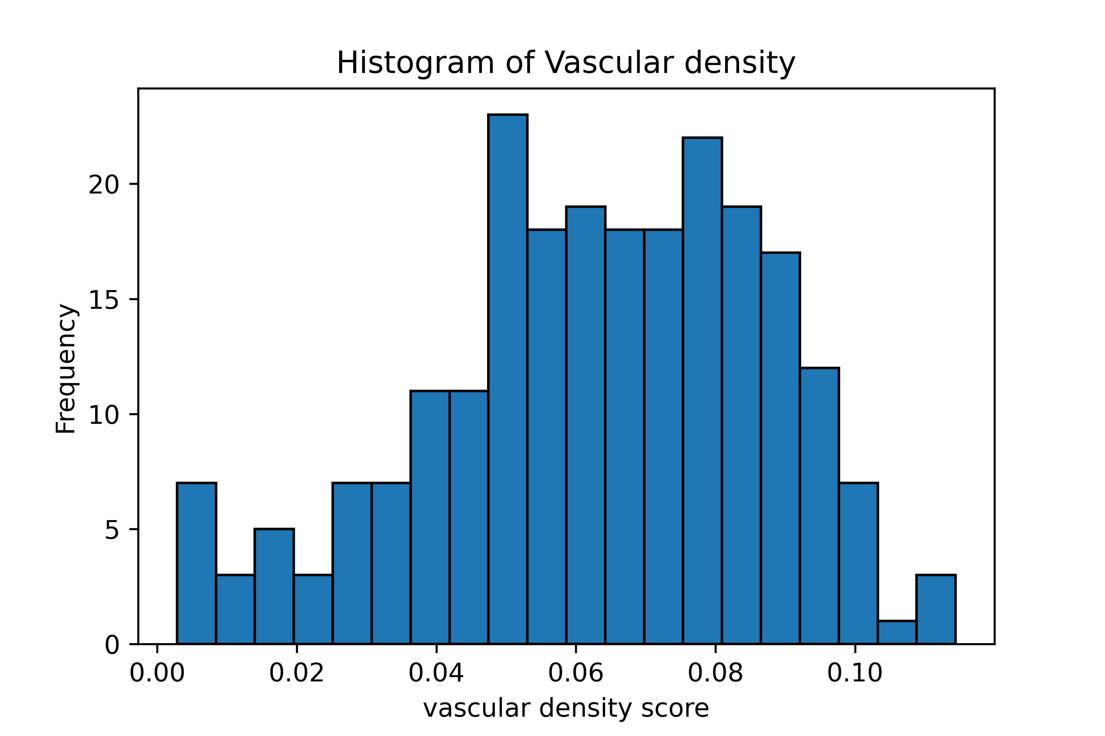
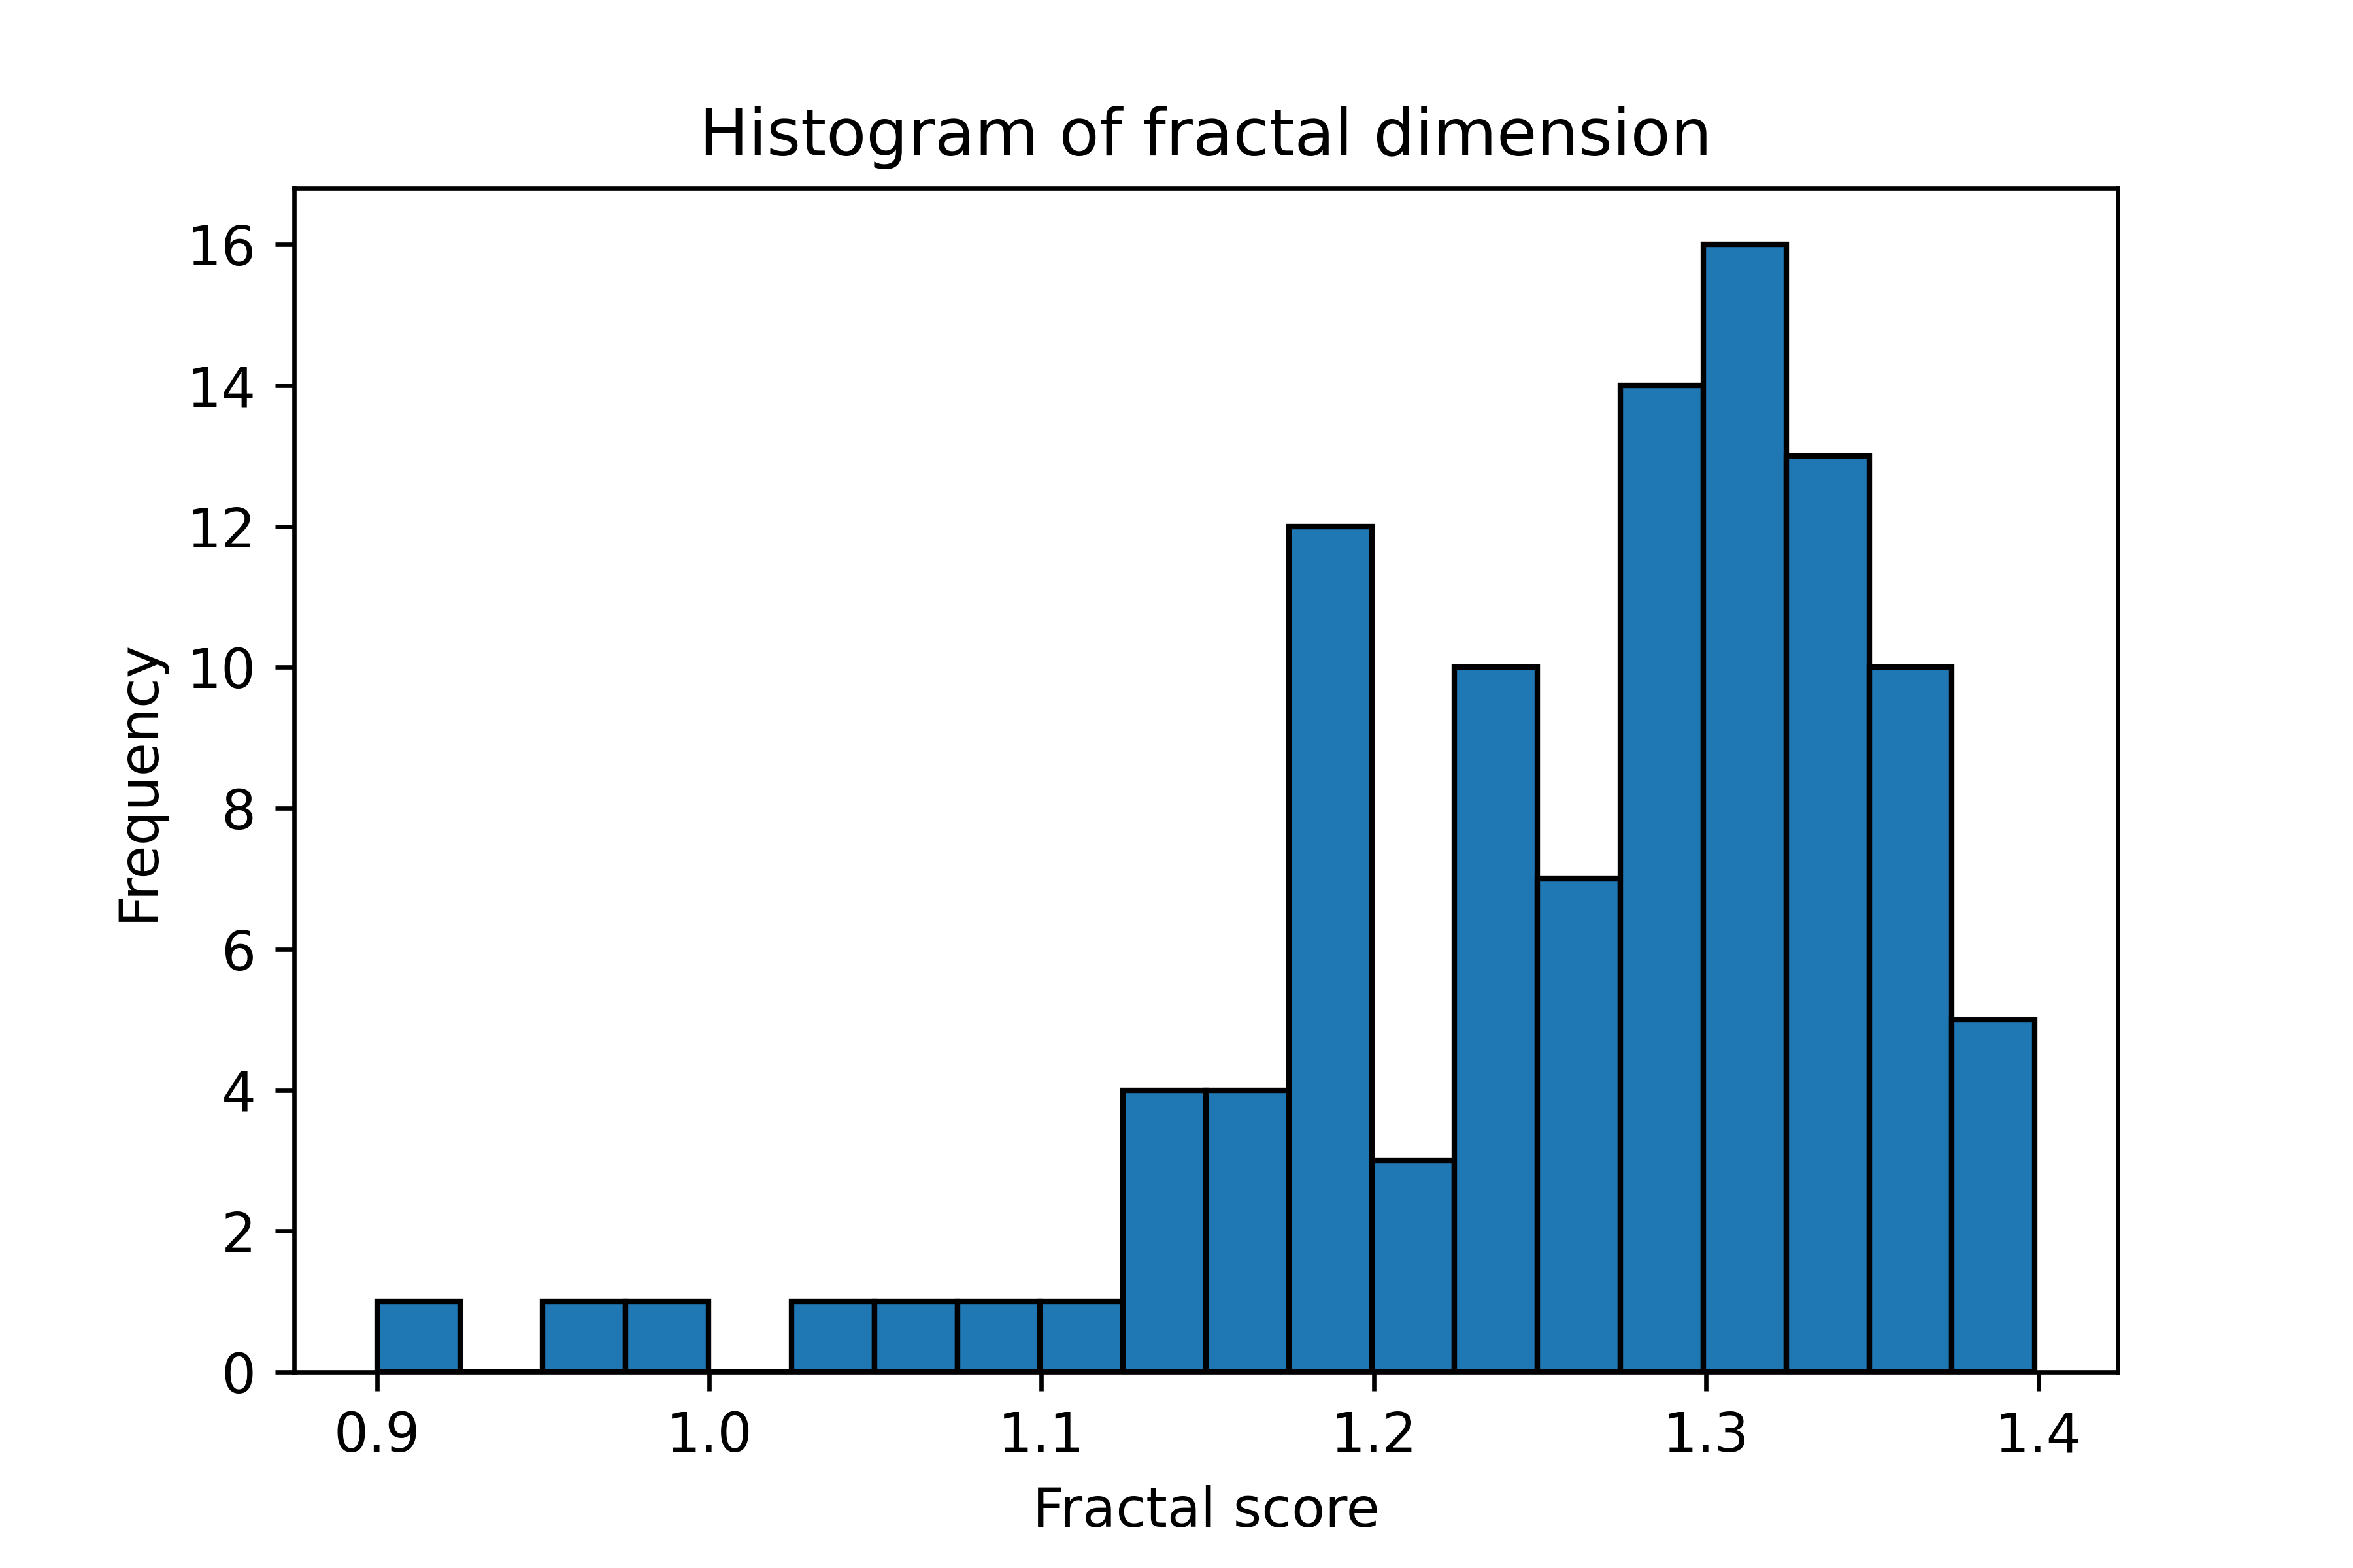
Measurements - Distribution
28/33

Slide 29
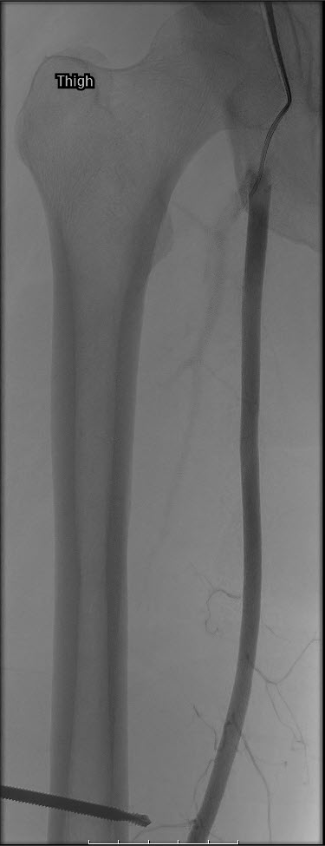
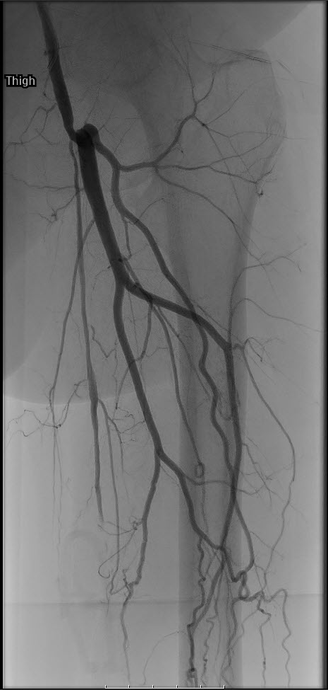
Highest vs lowest measurements
Lowest
Highest
FD = 1.059
VD = 0.038
FD = 1.363
VD = 0.083
29/33

Slide 30
5
Challenges
What could we have done if we had more time ?
30/33

Slide 31
Challenges
Skeletonization to obtain more measures
Lack of data for thigh images
Low quality images were used for the measurements
Missing clinical data from the patients from whom we got the images
More measurements could be obtained from the images than FD and VD
Make a more streamlined path to go from raw images to measurements
Statistical analysis
31/33

Slide 32
Feedback
Very cool to do practical stuff
The liberty we had in the project made it even more interesting!
Our supervisor was really helpful and available
32/33

Slide 33
Thank you for your attention !
bisous
33/33

Slide 34
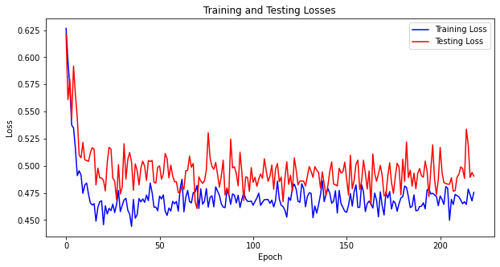
Evolution of the loss function - UNET

Slide 35
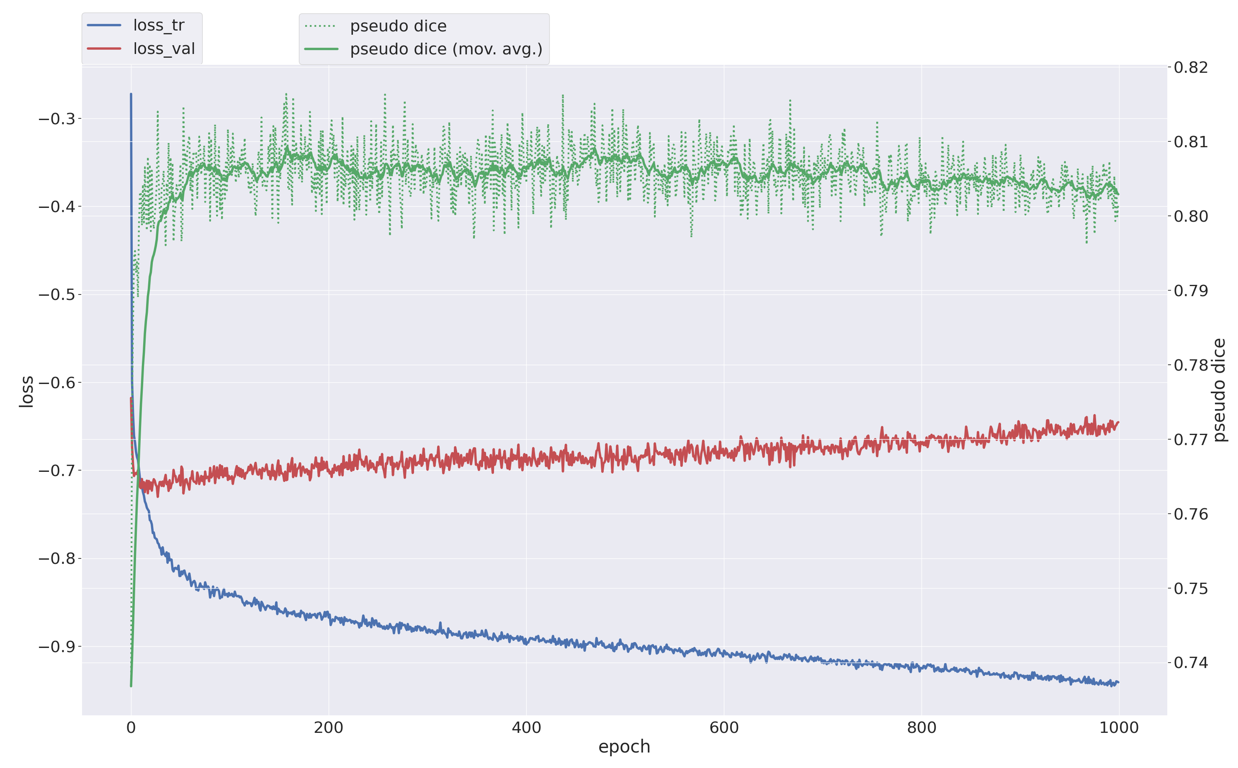
Evolution of the loss function – nn-UNET

