Slide 1
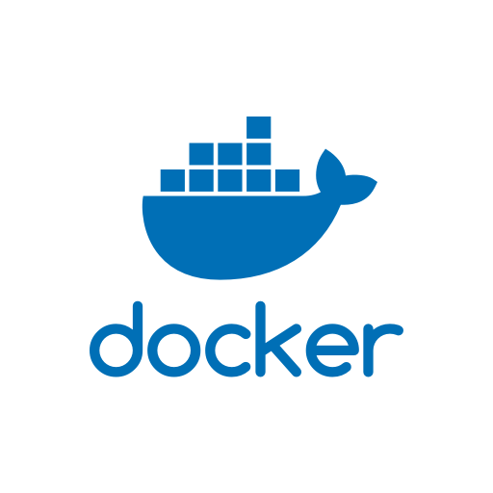
DOCKERIZING CODE 101 How to package your code into a docker
MATTIA TOMASONI
Bergmann’s Lab
JOINT GROUP MEETING – 14 JUNE 2018

Slide 2
A DOCKER IS A WRAPPER YOU CAN PACKAGE YOUR CODE IN TOGETHER WITH ALLL NECESSARY DEPENDENCIES

Slide 3
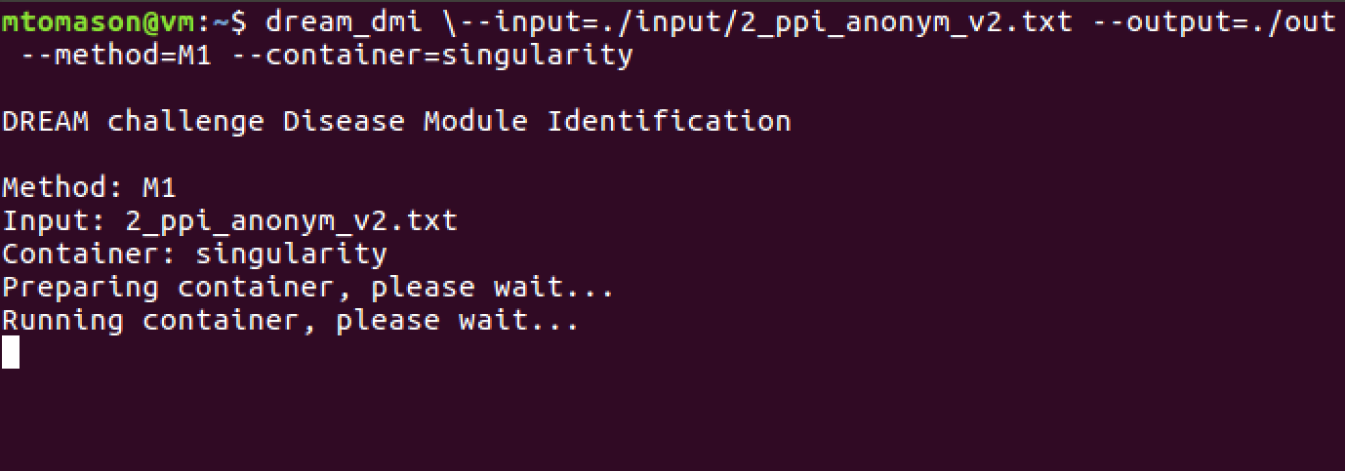
I WILL TO SHARE MY EXPERIENCE Dockerizing the top methods from latest DREAM challenge

Slide 4
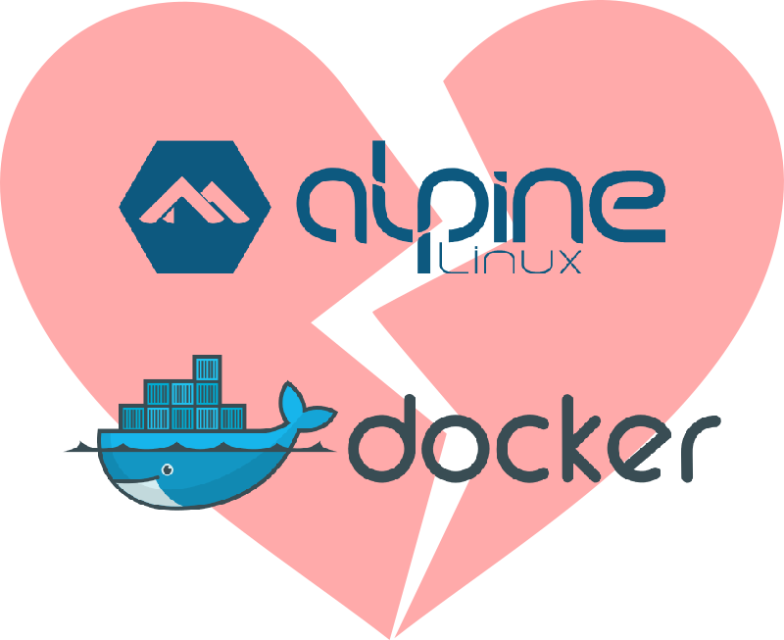
MINI-WORKSHOP TIME: LAPTOPS OUT!
Look up “CBG Unil” (my group’s website)
“people” -> “Mattia Tomasoni” -> “Docker”

Slide 5
…

Slide 6
CONTEINERIZING CODE WITHOUT THE NEED OF ROOT PRIVILEDGES: SINGULARITY
Docker requires root access
You sysadmins won’t typically grant you such privileges
Try asking Vital-IT: they won’t be happy
Alternative: Singularity
https://singularity.lbl.gov/quickstart
It is what I actually use

Slide 7
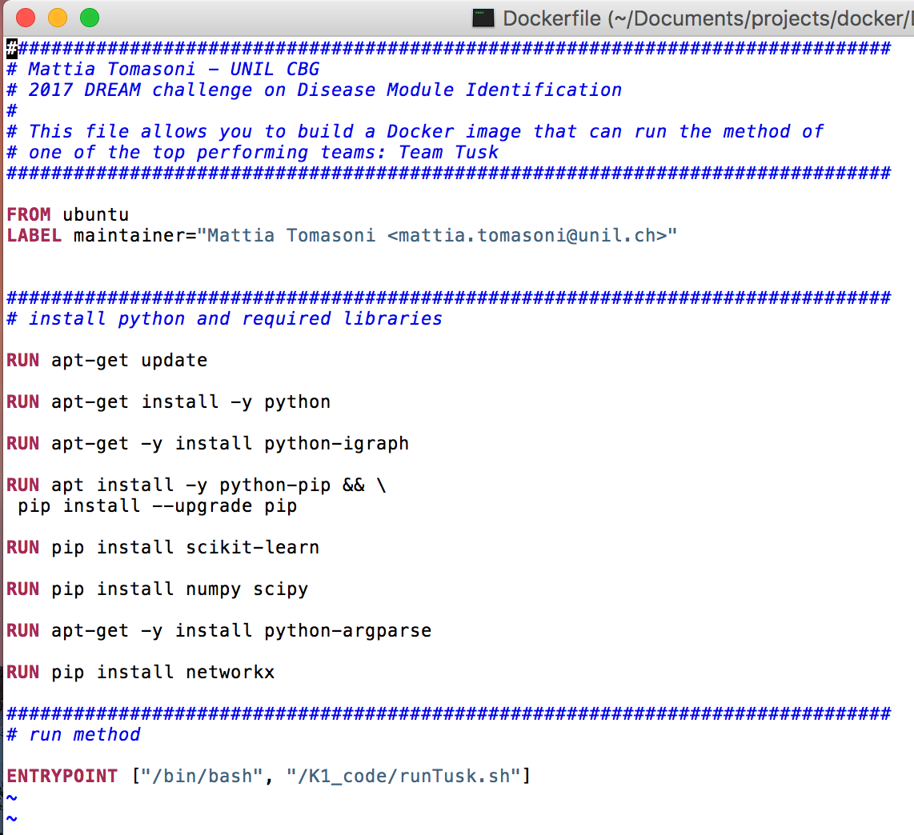
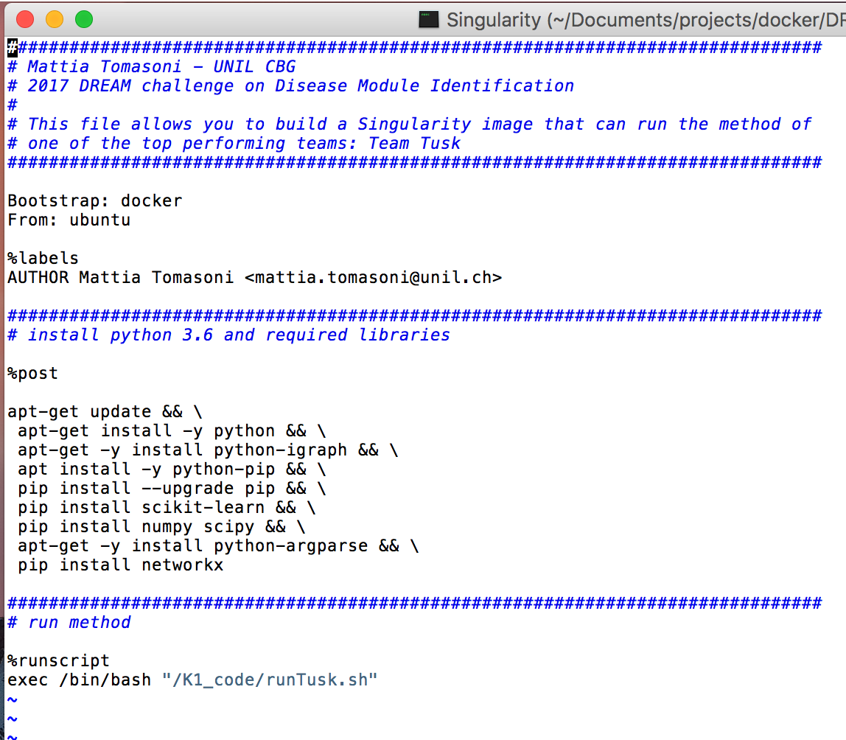
THE PRINCIPALS AND SINTAX AND NEARLY IDENTICAL: “Singularity” instead of “Dockerfile”

Slide 8
Thank you QUESITONS? - Avez-vous des questions? -

