Slide 1
Identification of obesity-associated intergenic long noncoding RNAs
Project for “Solving Biological Problems that require Math”
Jennifer Tan

Slide 2
Intergenic long noncoding RNAs
Pervasive transcription of eukaryotic genomes (not just in protein-coding regions)
Large proportion of functional information is embedded within noncoding regions
Notes:
- Completion of the human genome led to the surprising revelation that only 2% of the genome encode for proteins
- Evidence of biochemical activity and evolutionary constraint of sequences indicate that a much bigger proportion of the genome is likely to be biologically functional
a large proportion of functional information is embedded within noncoding regions of the genome
Indeed, many important noncoding functional elements have been identified
We focus on noncoding RNAs
Here we show a timeline showing the discoveries of functional RNAs in biological regulation
Timeline of discoveries of functional RNAs in biological regulation (Rinn and Chang, 2012).

Slide 3
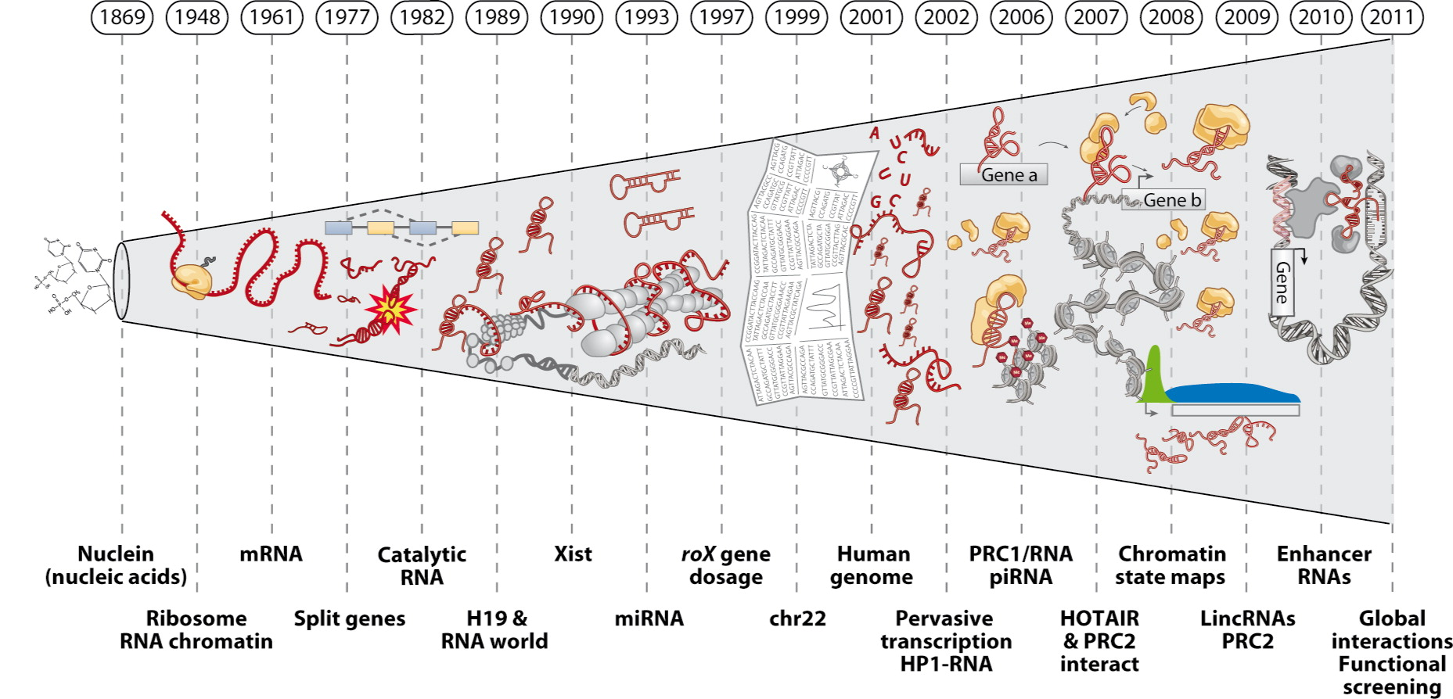
Intergenic long noncoding RNAs
Pervasive transcription of eukaryotic genomes (not just in protein-coding regions)
Large proportion of functional information is embedded within noncoding regions
Rinn and Chang, 2012
Notes:
- Completion of the human genome led to the surprising revelation that only 2% of the genome encode for proteins
- Evidence of biochemical activity and evolutionary constraint of sequences indicate that a much bigger proportion of the genome is likely to be biologically functional
a large proportion of functional information is embedded within noncoding regions of the genome
Indeed, many important noncoding functional elements have been identified
We focus on noncoding RNAs
Here we show a timeline showing the discoveries of functional RNAs in biological regulation
Timeline of discoveries of functional RNAs in biological regulation (Rinn and Chang, 2012).

Slide 4
Intergenic long noncoding RNAs
> 200 bp
No apparent open reading frame (ORF)
Pol II transcribed, capped and polyadenylated, and frequently spliced
Tend to be expressed at lower levels and with temporal/tissue-specific profiles
Currently > 10,000 lincRNAs annotated in human genome
Notes:
Similar to protein-coding messenger RNAs (mRNAs), a subset of lincRNAs are transcribed by RNA-polymerase II (Pol II), capped and polyadenylated and frequently spliced at canonical splicing sites, although at a seemingly reduced splicing efficiency compared to mRNAs.
In addition, lincRNAs are enriched in the same chromatin marks as protein-coding genes: histone H3K4 trimethylation at their 5’-end and histone H3K36 trimethylation across the gene body.
Lower expression (10 times lower), tend to be temporal and tissue-specifically expressed
Currently, there are more than 10,000 lincRNAs annotated in the human genome

Slide 5
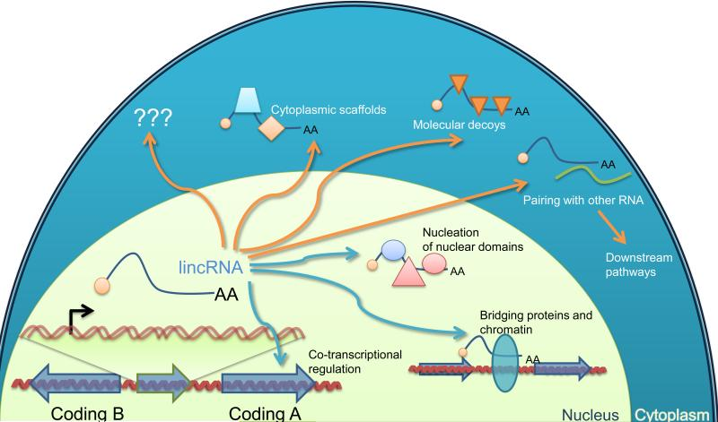
Intergenic long noncoding RNAs
lincRNAs have been implicated in all levels of gene regulation
< 0.5% of lincRNAs have an established biological function
Ulitsky and Bartel, 2013
Notes:
LincRNAs have already been implicated to contribute at all levels of gene regulation by modulating levels of genomically adjacent or distally located gene products via cis- or trans-acting molecular mechanisms, respectively
(1) transcriptional regulation, including regulatory element control, chromatin remodeling and epigenetic control
(2) post-transcriptional regulation where lincRNAs can act as molecular decoys for other species of RNA transcripts
However, only a relatively small number of lincRNAs having been functionally characterized to date
their frequent association with global signatures of functionality for a subset of these lincRNAs motivated continuous efforts from scientists in different research fields, including molecular biology, biochemistry, genetics, and computational genomics, to characterize and establish their molecular, cellular, and organismal functions.

Slide 6
Project aim
Identify lincRNAs likely associated with genetic variants (SNPs) linked to OBESITY
Obesity is a growing global health problem
Over 13% of adults were considered to be obese in 2014 (WHO)
Body Mass Index (BMI) is commonly used to assess obesity
Genetic factors found to contribute to variability in BMI between individuals
Notes:
Here, we use obesity as a disease model, which has a strong genetic basis.
We aim to identify lincRNAs likely associated with genetic variants (SNPs) recently linked to obesity through genome-wide association studies (GWAS)
Such lincRNAs would be excellent candidates for future validation and functional characterization studies.
Obesity is defined as abnormal or excessive fat accumulation that may impair health.
Obesity is a growing worldwide health problem associated with increase morbidity and mortality that imposes an enormous burden on individual and public health
According to WHO statistics, 13% of adults (over 18 years of age) were obese in 2014
BMI is commonly used as a proxy to assess obesity
and variability in BMI between individuals has been found to be attributed to genetic factors

Slide 7
Project aim
Identify lincRNAs likely associated with genetic variants (SNPs) linked to OBESITY
Notes:
Aim of the project is to identify lincRNAs whose expression is correlated with genetic variants recently linked to obesity/BMI through genome-wide association studies (GWAS)
Genome-wide association study (GWAS) is an examination of common genetic variants, typically single nucleotide polymorphisms (SNPs), across most of the genomic landscape that may be associated with a disease.
In Locke et al., the authored identified 97 BMI-associated genomic loci above genome-wide significance in a GWAS study.

Slide 8

Project aim
Identify lincRNAs likely associated with genetic variants (SNPs) linked to OBESITY
97 genomic loci linked to BMI
Notes:
Aim of the project is to identify lincRNAs whose expression is correlated with genetic variants recently linked to obesity/BMI through genome-wide association studies (GWAS)
Genome-wide association study (GWAS) is an examination of common genetic variants, typically single nucleotide polymorphisms (SNPs), across most of the genomic landscape that may be associated with a disease.
In Locke et al., the authored identified 97 BMI-associated genomic loci above genome-wide significance in a GWAS study.

Slide 9
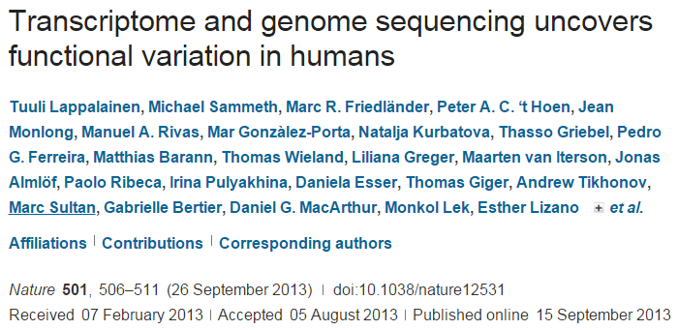
Project aim
Identify lincRNAs likely associated with genetic variants (SNPs) linked to OBESITY
97 genomic loci linked to BMI
RNAseq data for 373 individuals
Notes:
Geuvadis dataset, which has RNA seq for lymphoblastoid cell lines (LCLs) from 373 individuals of European descent

Slide 10
Project aim
Identify lincRNAs likely associated with genetic variants (SNPs) linked to OBESITY
cis-eQTL analysis: Test correlations between BMI/obesity associated variants and expression levels of lincRNAs in their genomic vicinity
Notes:
cis-eQTL analysis: Test correlations between BMI/obesity associated variants and expression levels of lincRNAs in their genomic vicinity

Slide 11
eQTL analysis
expression Quantitative Trait Loci (eQTL)
Goal : identify genomic locations where genotype significantly affects gene expression
Notes:
Genomic DNA loci
RNA transcripts transcribed in the loci
Genetic risk variant, such as SNPs, associated with potential diseases that we have genotype data for
In the vicinity of the genetic variant
We ask if there is an association between the genotype at the SNP with the expression levels of the RNA transcript

Slide 12
eQTL analysis
expression Quantitative Trait Loci (eQTL)
Goal : identify genomic locations where genotype significantly affects gene expression
DNA
Notes:
Genomic DNA loci
RNA transcripts transcribed in the loci
Genetic risk variant, such as SNPs, associated with potential diseases that we have genotype data for
In the vicinity of the genetic variant
We ask if there is an association between the genotype at the SNP with the expression levels of the RNA transcript

Slide 13
eQTL analysis
expression Quantitative Trait Loci (eQTL)
Goal : identify genomic locations where genotype significantly affects gene expression
DNA
SNPs
Genotype data
Notes:
Genomic DNA loci
RNA transcripts transcribed in the loci
Genetic risk variant, such as SNPs, associated with potential diseases that we have genotype data for
In the vicinity of the genetic variant
We ask if there is an association between the genotype at the SNP with the expression levels of the RNA transcript

Slide 14
eQTL analysis
expression Quantitative Trait Loci (eQTL)
Goal : identify genomic locations where genotype significantly affects gene expression
Gene expression
data
RNA
DNA
SNPs
Genotype data
Notes:
Genomic DNA loci
RNA transcripts transcribed in the loci
Genetic risk variant, such as SNPs, associated with potential diseases that we have genotype data for
In the vicinity of the genetic variant
We ask if there is an association between the genotype at the SNP with the expression levels of the RNA transcript

Slide 15
eQTL analysis
expression Quantitative Trait Loci (eQTL)
Goal : identify genomic locations where genotype significantly affects gene expression
Gene expression
data
RNA
Gene expression level
DNA
SNPs
Genotype data
C/C
C/T
T/T
Genotype of risk factor
Notes:
Genomic DNA loci
RNA transcripts transcribed in the loci
Genetic risk variant, such as SNPs, associated with potential diseases that we have genotype data for
In the vicinity of the genetic variant
We ask if there is an association between the genotype at the SNP with the expression levels of the RNA transcript

Slide 16
eQTL analysis
Goal : Test correlations between BMI/obesity associated variants and expression levels of lincRNAs in their genomic vicinity
Notes:
Here, we aim to identify lincRNAs likely associated with genetic variants (SNPs) recently linked to obesity through genome-wide association studies (GWAS)
Such lincRNAs would be excellent candidates for future validation and functional characterization studies.
Specifically, the majority of disease-associated SNPs (approximately 88%) were mapped to non-coding regions, revealing a larger than anticipated role for noncoding SNPs in diseases (Hindorff et al. 2009).

Slide 17
eQTL analysis
Goal : Test correlations between BMI/obesity associated variants and expression levels of lincRNAs in their genomic vicinity
Gene expression
data
RNA
DNA
SNPs
Genotype data
Notes:
Here, we aim to identify lincRNAs likely associated with genetic variants (SNPs) recently linked to obesity through genome-wide association studies (GWAS)
Such lincRNAs would be excellent candidates for future validation and functional characterization studies.

Slide 18
eQTL analysis
Goal : Test correlations between BMI/obesity associated variants and expression levels of lincRNAs in their genomic vicinity
Gene expression
data
RNA
DNA
BMI/obesity associated SNPs
Genotype data
Notes:
Here, we aim to identify lincRNAs likely associated with genetic variants (SNPs) recently linked to obesity through genome-wide association studies (GWAS)
Such lincRNAs would be excellent candidates for future validation and functional characterization studies.

Slide 19
eQTL analysis
Goal : Test correlations between BMI/obesity associated variants and expression levels of lincRNAs in their genomic vicinity
Gene expression
data
lincRNA
DNA
BMI/obesity associated SNPs
Genotype data
Notes:
Here, we aim to identify lincRNAs likely associated with genetic variants (SNPs) recently linked to obesity through genome-wide association studies (GWAS)
Such lincRNAs would be excellent candidates for future validation and functional characterization studies.

Slide 20
eQTL analysis
Goal : Test correlations between BMI/obesity associated variants and expression levels of lincRNAs in their genomic vicinity
Gene expression
data
lincRNA
Gene expression level
DNA
BMI/obesity associated SNPs
Genotype data
C/C
C/T
T/T
Genotype of risk factor
Notes:
Here, we aim to identify lincRNAs likely associated with genetic variants (SNPs) recently linked to obesity through genome-wide association studies (GWAS)
Such lincRNAs would be excellent candidates for future validation and functional characterization studies.

Slide 21
Project aim
eQTL analysis: Test correlations between BMI/obesity associated variants and expression levels of lincRNAs in their genomic vicinity
Data:
  RNAseq: gene expression levels from lymphoblastoid cell lines (LCLs) from 373 individuals of European descent (Lappalainen et al. 2013)
  Genotype: BMI/obesity associated genetic markers (Locke et al. 2015)
Notes:
To identify BMI/obesity associated lincRNAs, we will take advantage of publicly available RNA sequencing (RNAseq) data of lymphoblastoid cell lines (LCLs) from 373 individuals of European descent (Lappalainen et al. 2013).
LCL – derived from human B lymphocytes (B cells)
We will test the correlations between BMI/obesity associated variants and the expression levels of lincRNAs in their genomic vicinity.

Slide 22
Project aim
eQTL analysis: Test correlations between BMI/obesity associated variants and expression levels of lincRNAs in their genomic vicinity
Data:
  RNAseq: gene expression levels from lymphoblastoid cell lines (LCLs) from 373 individuals of European descent (Lappalainen et al. 2013)
  Genotype: BMI/obesity associated genetic markers (Locke et al. 2015)
What does it involve?
  Gene expression data normalization
  Estimation of correlation between lincRNA expression and genotype genetic variants
  Multiple hypothesis testing correction
Notes:
Data manipulation in R
The gene expression data will first be normalized to remove unwanted technical variations/confounding factors in order to ensure accurate inference of gene expression levels.
Next, correlations are estimated between expression levels of lncRNAs and genotypes of the GWAS variants, which are then compared to randomly permutated correlations for multiple hypothesis testing correction.
Significantly correlated lncRNA:SNP pairs above background levels will be useful for further functional characterizations and may provide insight on biological pathways involved in obesity.
Such lincRNAs would be excellent candidates for future validation and functional characterization studies.

Slide 23
Thank you ☺

