Slide 1
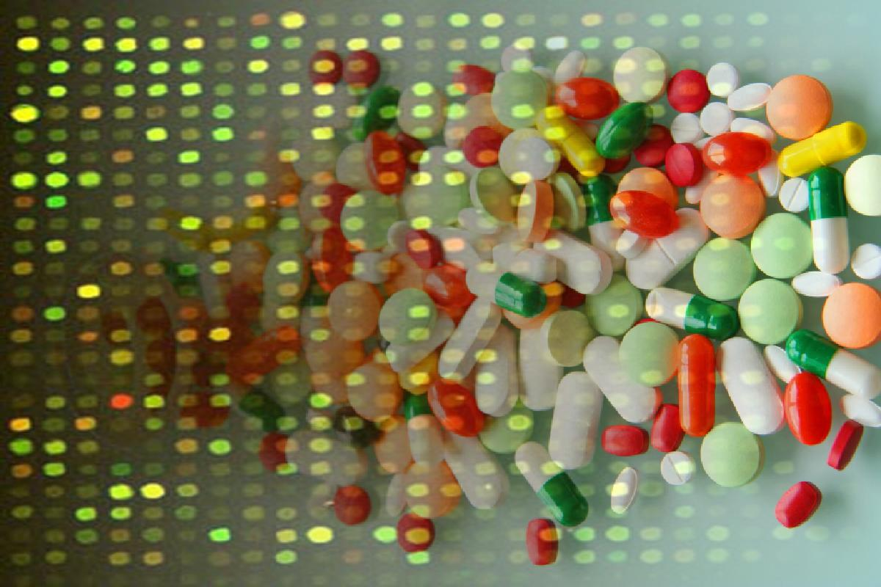

Medical Genetics in the Genomic Era:
Challenges in and solutions for analyzing large-scale phenotypic and genotypic data
Sven Bergmann
University of Lausanne &
Swiss Institute of Bioinformatics
http://www.unil.ch/cbg
SIB Meeting of the Council of Group Leaders Bern 5 April 2011

Slide 2
PHENOTYPIC
Large-scale data analysis

Slide 3
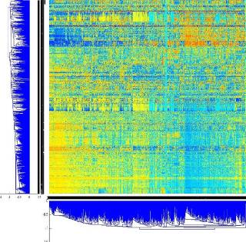
How to extract information from very large-scale expression data?
Search for transcription modules:
Set of genes co-regulated under
a certain set of conditions
context specific
allow for overlaps
J Ihmels, G Friedlander, SB, O Sarig, Y Ziv & N Barkai Nature Genetics (2002)

Slide 4
Identification of transcription modules
using many random “seeds”
Transcription modules
random
“seeds”
Independent identification:
Modules may overlap!
SB, J Ihmels & N Barkai Physical Review E (2003)
Notes:
In order to identify the transcription modules encode in the expression data we proceed as follows:
We assemble a large number of random INPUT seeds.
Applying the iterative signature algorithm to each seed converges into a specific transcription module.
Since each transcription module is identified independently, it may overlap with other modules.

Slide 5
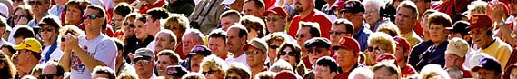
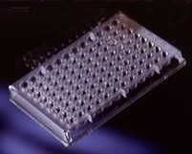
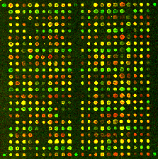
Data Integration: Example NCI60
60 cancer cell lines
(9 tissue types)
Drug Response Data
Gene
Expression
Data
~5,000 drugs
~23,000 gene probes

Slide 6
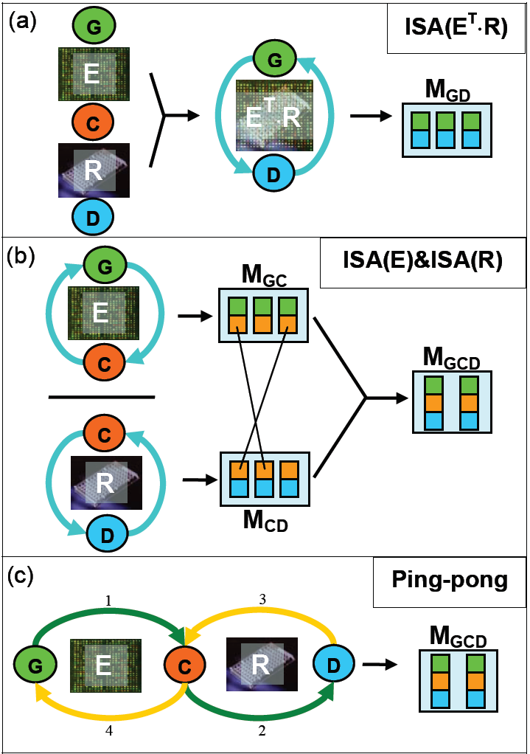
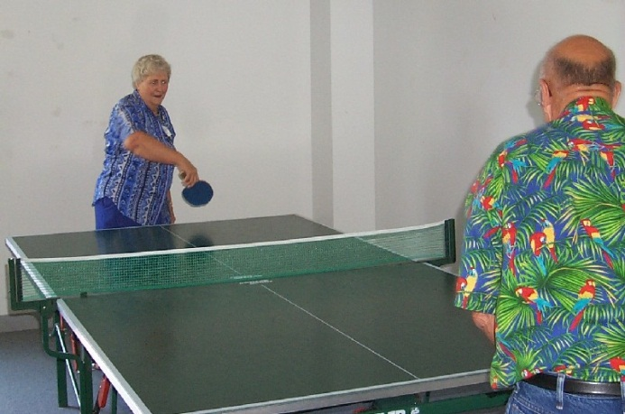
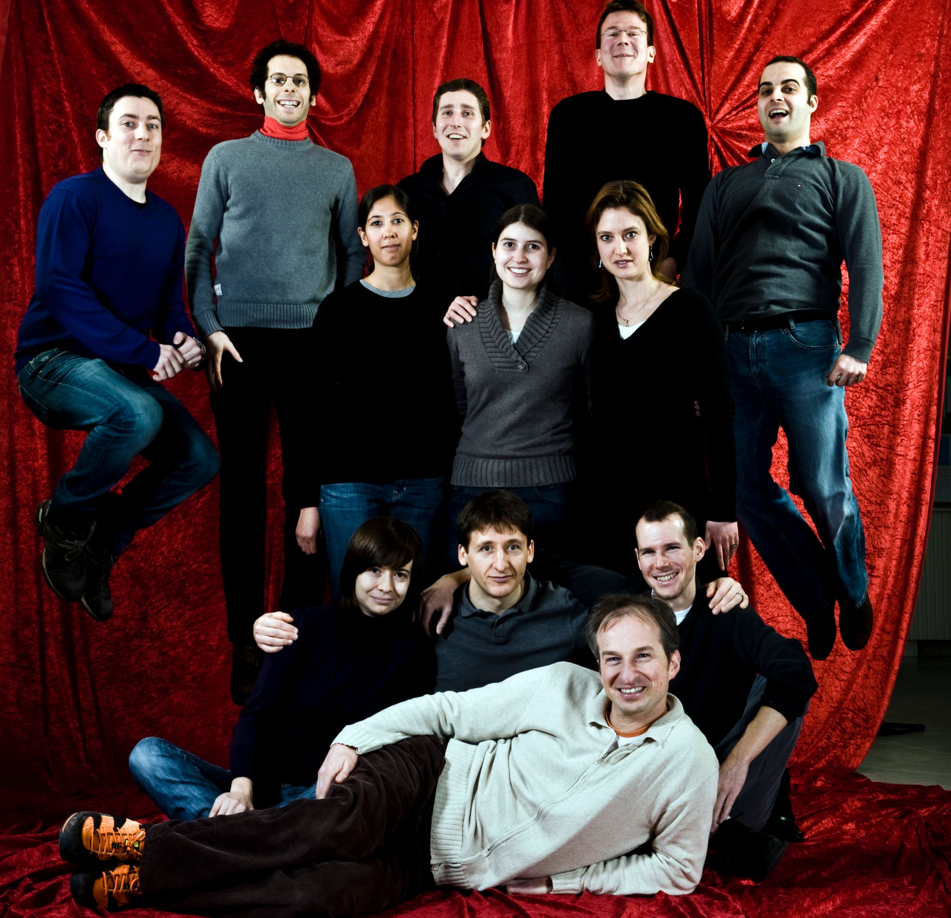
How to identify Co-modules?
Iteratively refine genes, cell-lines
and drugs to get co-modules
Z Kutalik, J Beckmann & SB, Nature Biotechnology (2008)

Slide 7
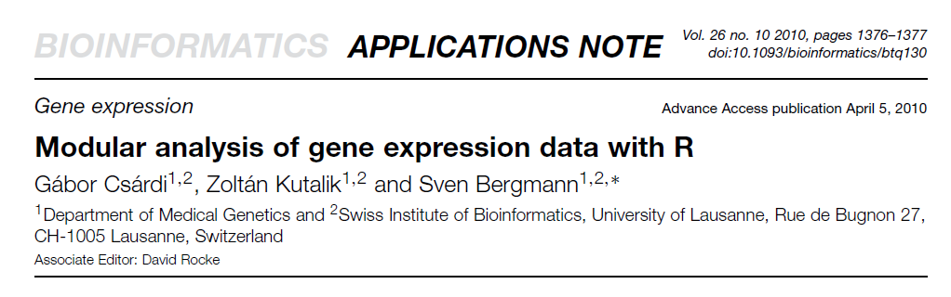
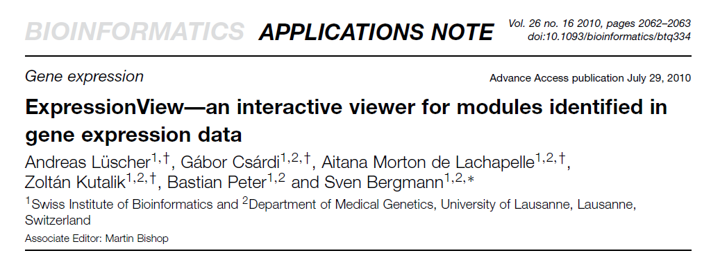

Slide 8
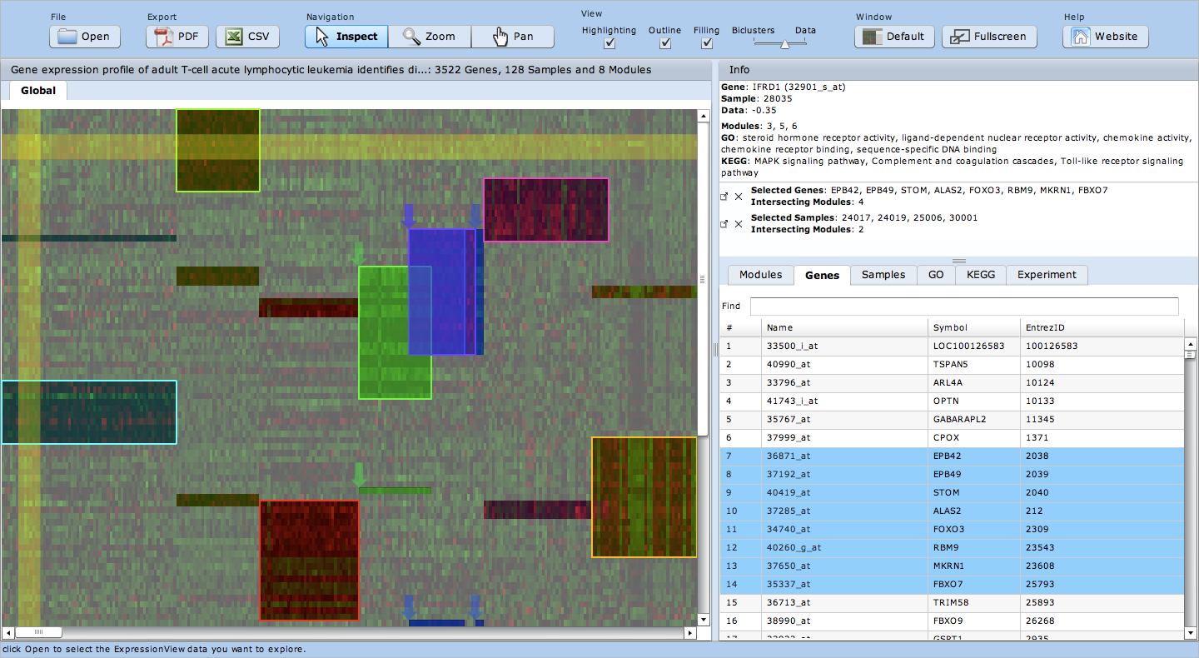
New Tools: Module Visualization
http://www2.unil.ch/cbg/index.php?title=ExpressionView

Slide 9
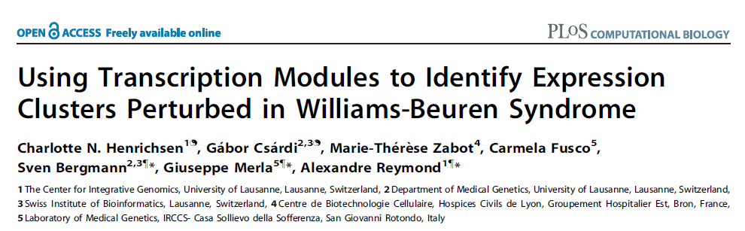
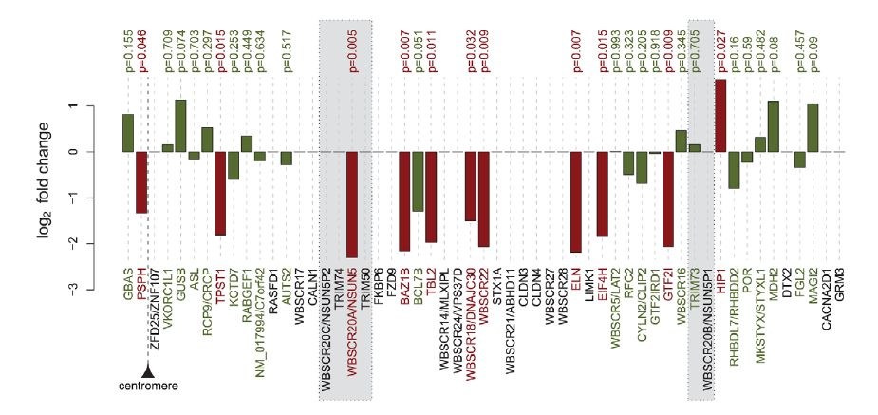
8 samples
9 controls
The William-Beuren Syndrome (WBS) is associated with a microdeletion within 7q11.23 encompassing 28 genes.

Slide 10
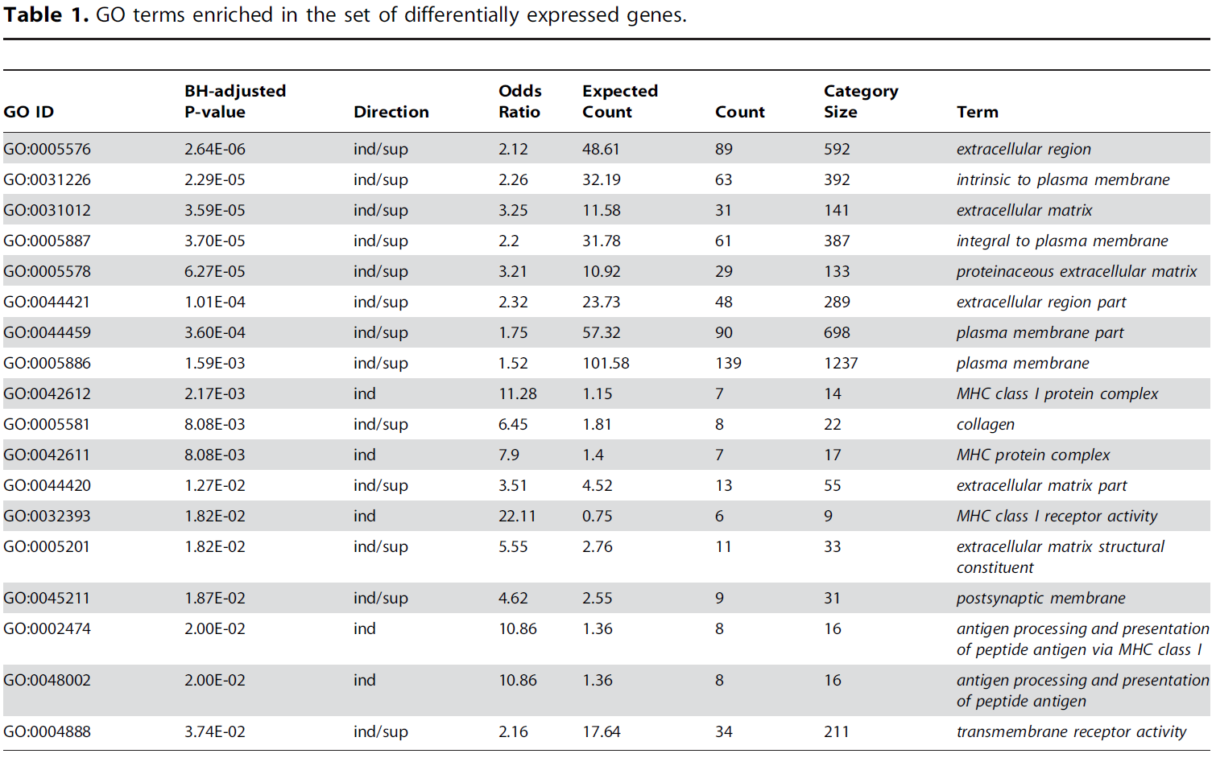
Standard approach: functional enrichment for differentially expressed genes

Slide 11
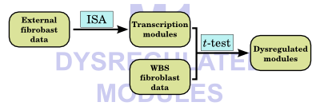
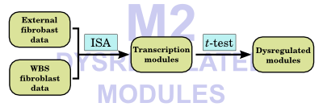
Two modular approaches for small datasets
http://www2.unil.ch/cbg/ISA/Fibroblasts/

Slide 12
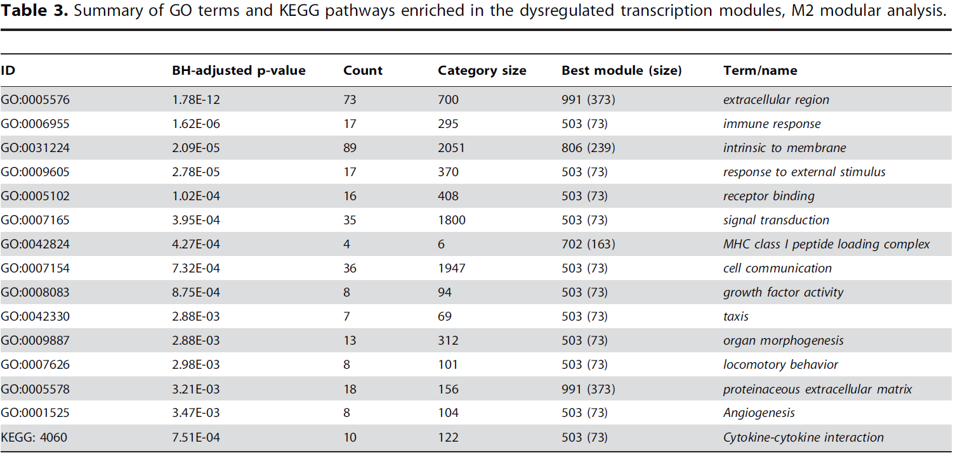
Modular approach: functional enrichment for differentially expressed modules gives more significant and detailed associations

Slide 13
GENOTYPIC
Large-scale data analysis

Slide 14
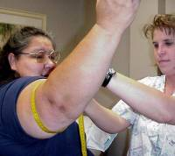
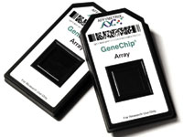
CoLaus = Cohort Lausanne
Genotypes
Phenotypes
6’189
individuals
500.000 SNPs
159 measurement
144 questions
Collaboration with:
Vincent Mooser (GSK), Peter Vollenweider & Gerard Waeber (CHUV)

Slide 15
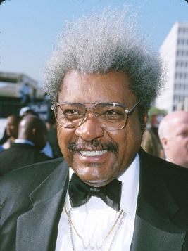

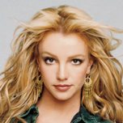

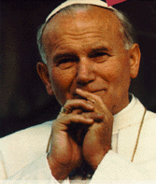



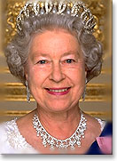
Genetic variation in SNPs
(Single Nucleotide Polymorphisms)
ATTGCAATCCGTGG...ATCGAGCCA…TACGATTGCACGCCG…
ATTGCAAGCCGTGG...ATCTAGCCA…TACGATTGCAAGCCG…
ATTGCAAGCCGTGG...ATCTAGCCA…TACGATTGCAAGCCG…
ATTGCAATCCGTGG...ATCGAGCCA…TACGATTGCACGCCG…
ATTGCAAGCCGTGG...ATCTAGCCA…TACGATTGCAAGCCG…
Notes:
Une fois ce catalogue génétique établi, nous trouvons des différences entre individus au niveau de l'ADN comme indiqué par les lettres de couleurs différentes
En zoomant sur la séquence d’ADN, on peut voir des différences entre individus.

Slide 16
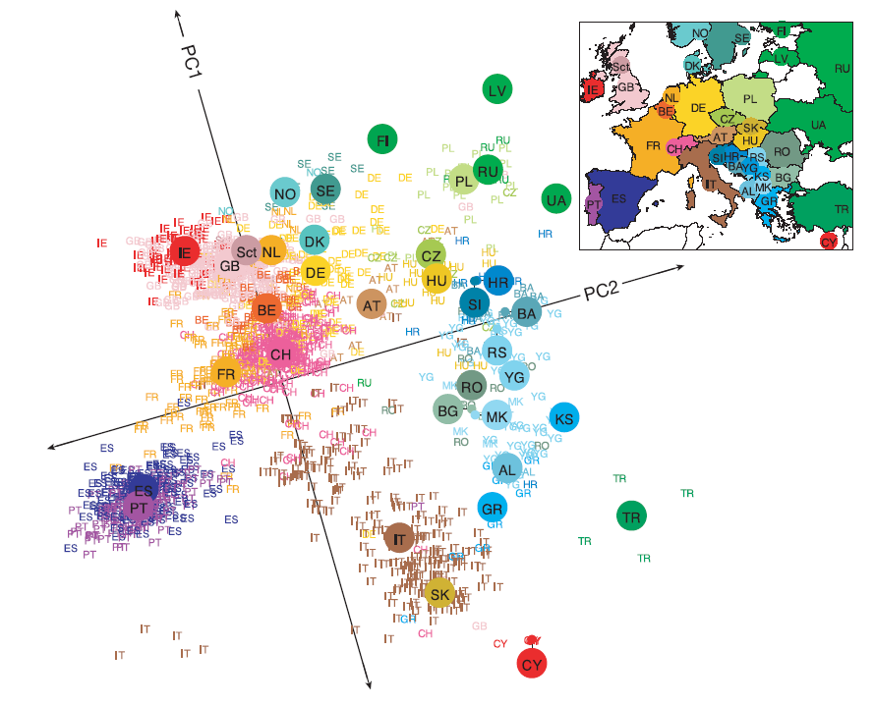
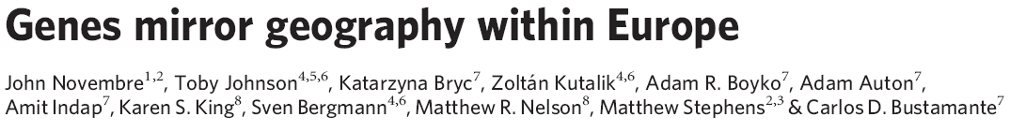
PCA of POPRES cohort

Slide 17
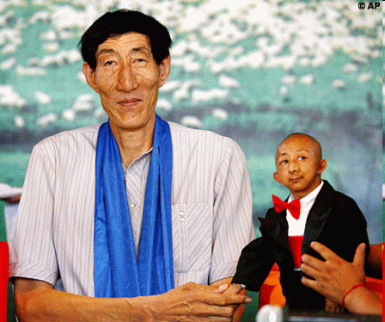
What is association?
SNPs
trait variant
chromosome
Genetic variation
yields phenotypic variation
Population with ‘ ’ allele
Population with ‘ ’ allele
Distributions of “trait”

Slide 18

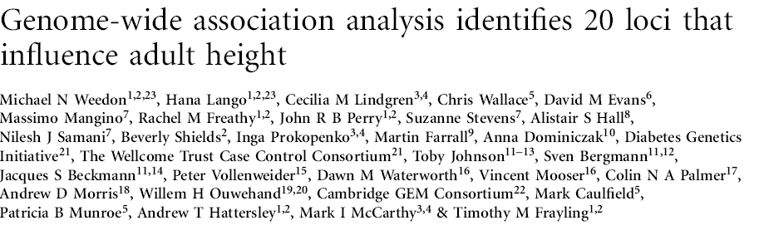
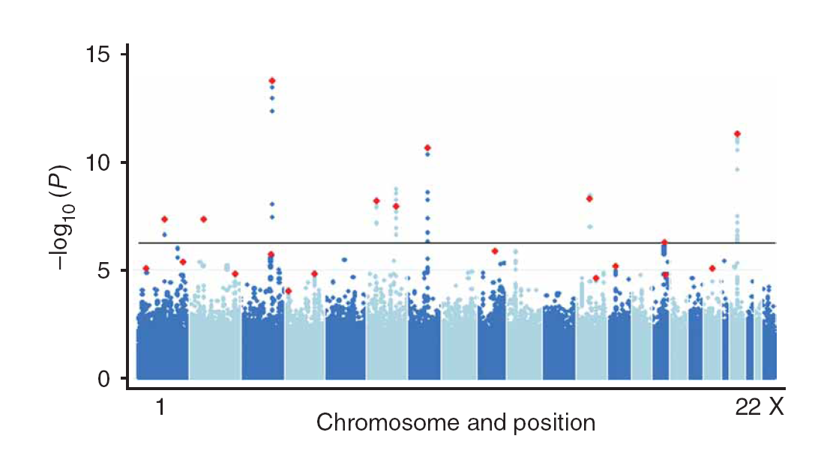


Slide 19

Current insights from GWAS:
Well-powered (meta-)studies with (ten-)thousands of samples have identified a few (dozen) candidate loci with highly significant associations
Many of these associations have been replicated in independent studies

Slide 20

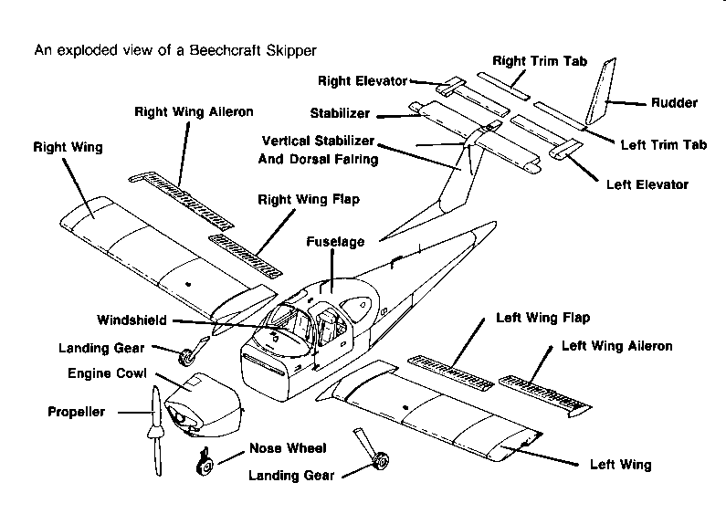
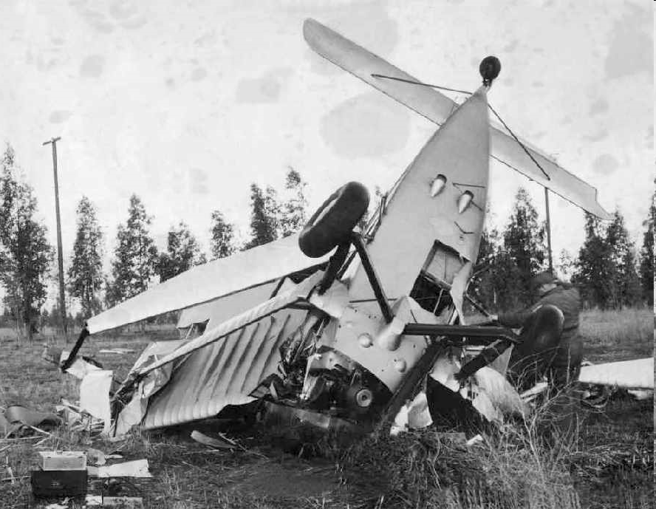
Current insights from GWAS:
Each locus explains but a tiny (<1%) fraction of the phenotypic variance
All significant loci together explain only a small (<10%) of the variance

Slide 21

How could our models become more predictive?
Improve measurements:
- measure more variants (e.g. by UHS)
- measure other variants (e.g. CNVs)
- measure “molecular phenotypes”
Improve models:
- proper integration of uncertainties
- include interactions
- multi-layer models

Slide 22
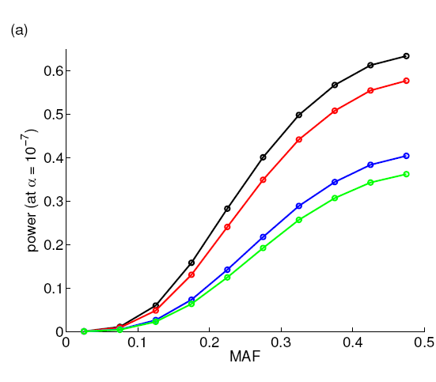
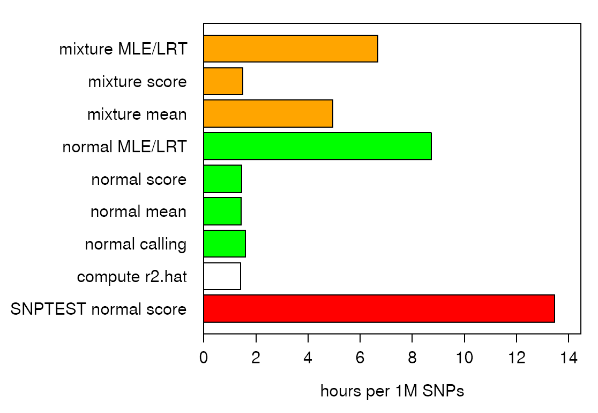
http://www2.unil.ch/cbg/index.php?title=QuickTest

Slide 23
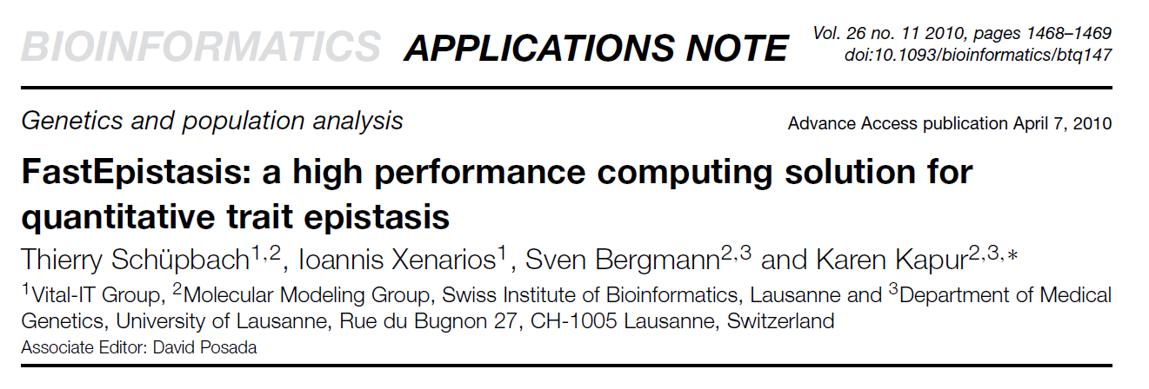
Using expression data
from Hapmap panel we
computed all 10¹² pairwise
interactions for several
expression values:
The strongest interactions
do not occur for SNPs with
high (marginal) significance!

Slide 24
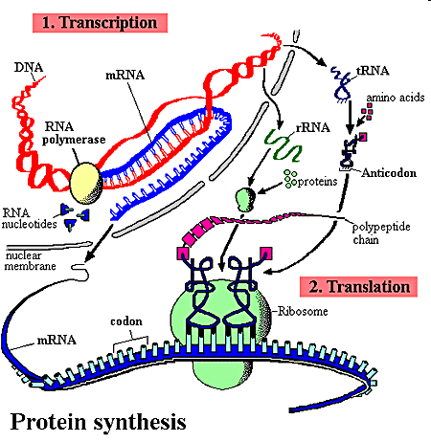
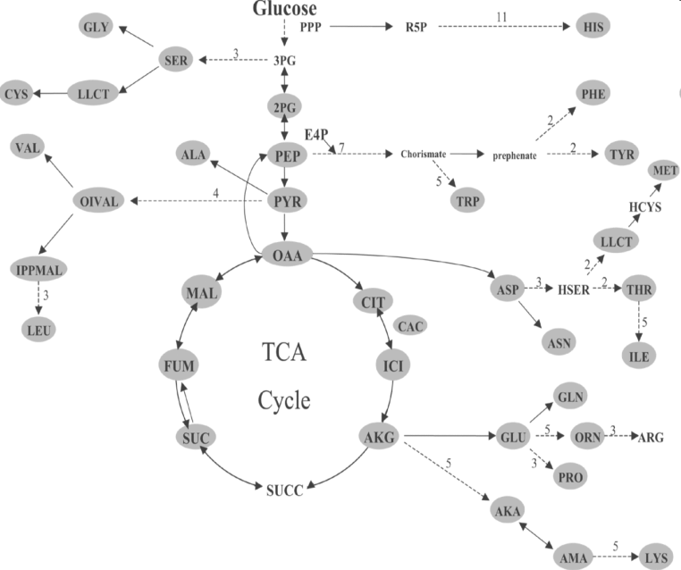
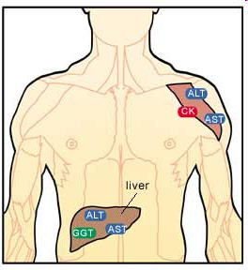
Towards a layered Systems Model
We need intermediate (molecular) phenotypes
to better understand organismal phenotypes

Slide 25
Transcription Modules reduce Complexity
http://www2.unil.ch/cbg/index.php?title=ExpressionView

Slide 26
Association of (average) module expression is often stronger than for any of its constituent genes

Slide 27
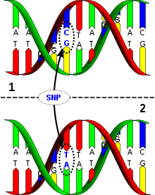
Intermediate phenotypes as pointers
1
2
Organismal
phenotype
genotype
Molecular
phenotype
3
Preliminary results show that integrating metabolomic
phenotypes an increase power for detecting
associations with organismal phenotypes

Slide 28

Acknowledgements to my group
People:
Armand Valsessia
Micha Hersch
Sascha Dalessi
Tim Hohm
Bastian Peter
Karen Kapur
Aitana Morton
Diana Marek
Barbara Piasecka
Gabor Csardi
Zoltán Kutalik
Funding: SystemsX.ch,
SNSF, SIB,
Cavaglieri,
Leenaards,
European FP

