Slide 1
Module 4:
How do unrealistic expectations confound the results of our analyses
Case Studies in Bioinformatics
Giovanni Ciriello
giovanni.ciriello@unil.ch

Slide 2
Outline
Fundamentals of Cancer Genomics
  Types of genetic alterations in cancer
  Most common alterations
  Most commonly altered pathways
  (Case studies)
Mutual exclusivity between alterations
  Why it occurs
  Why it is important
  How can we detect mutually exclusive alterations
The importance of null model designing
  3 null models for testing mutual exclusivity

Slide 3
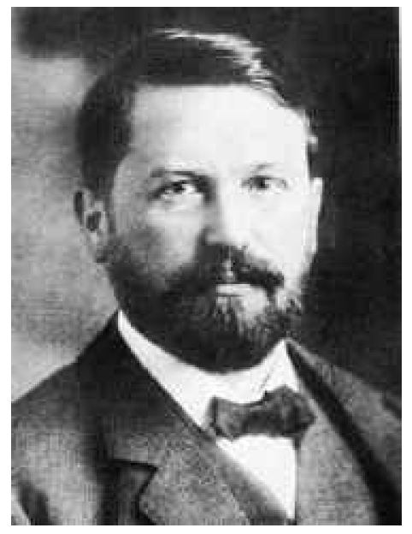
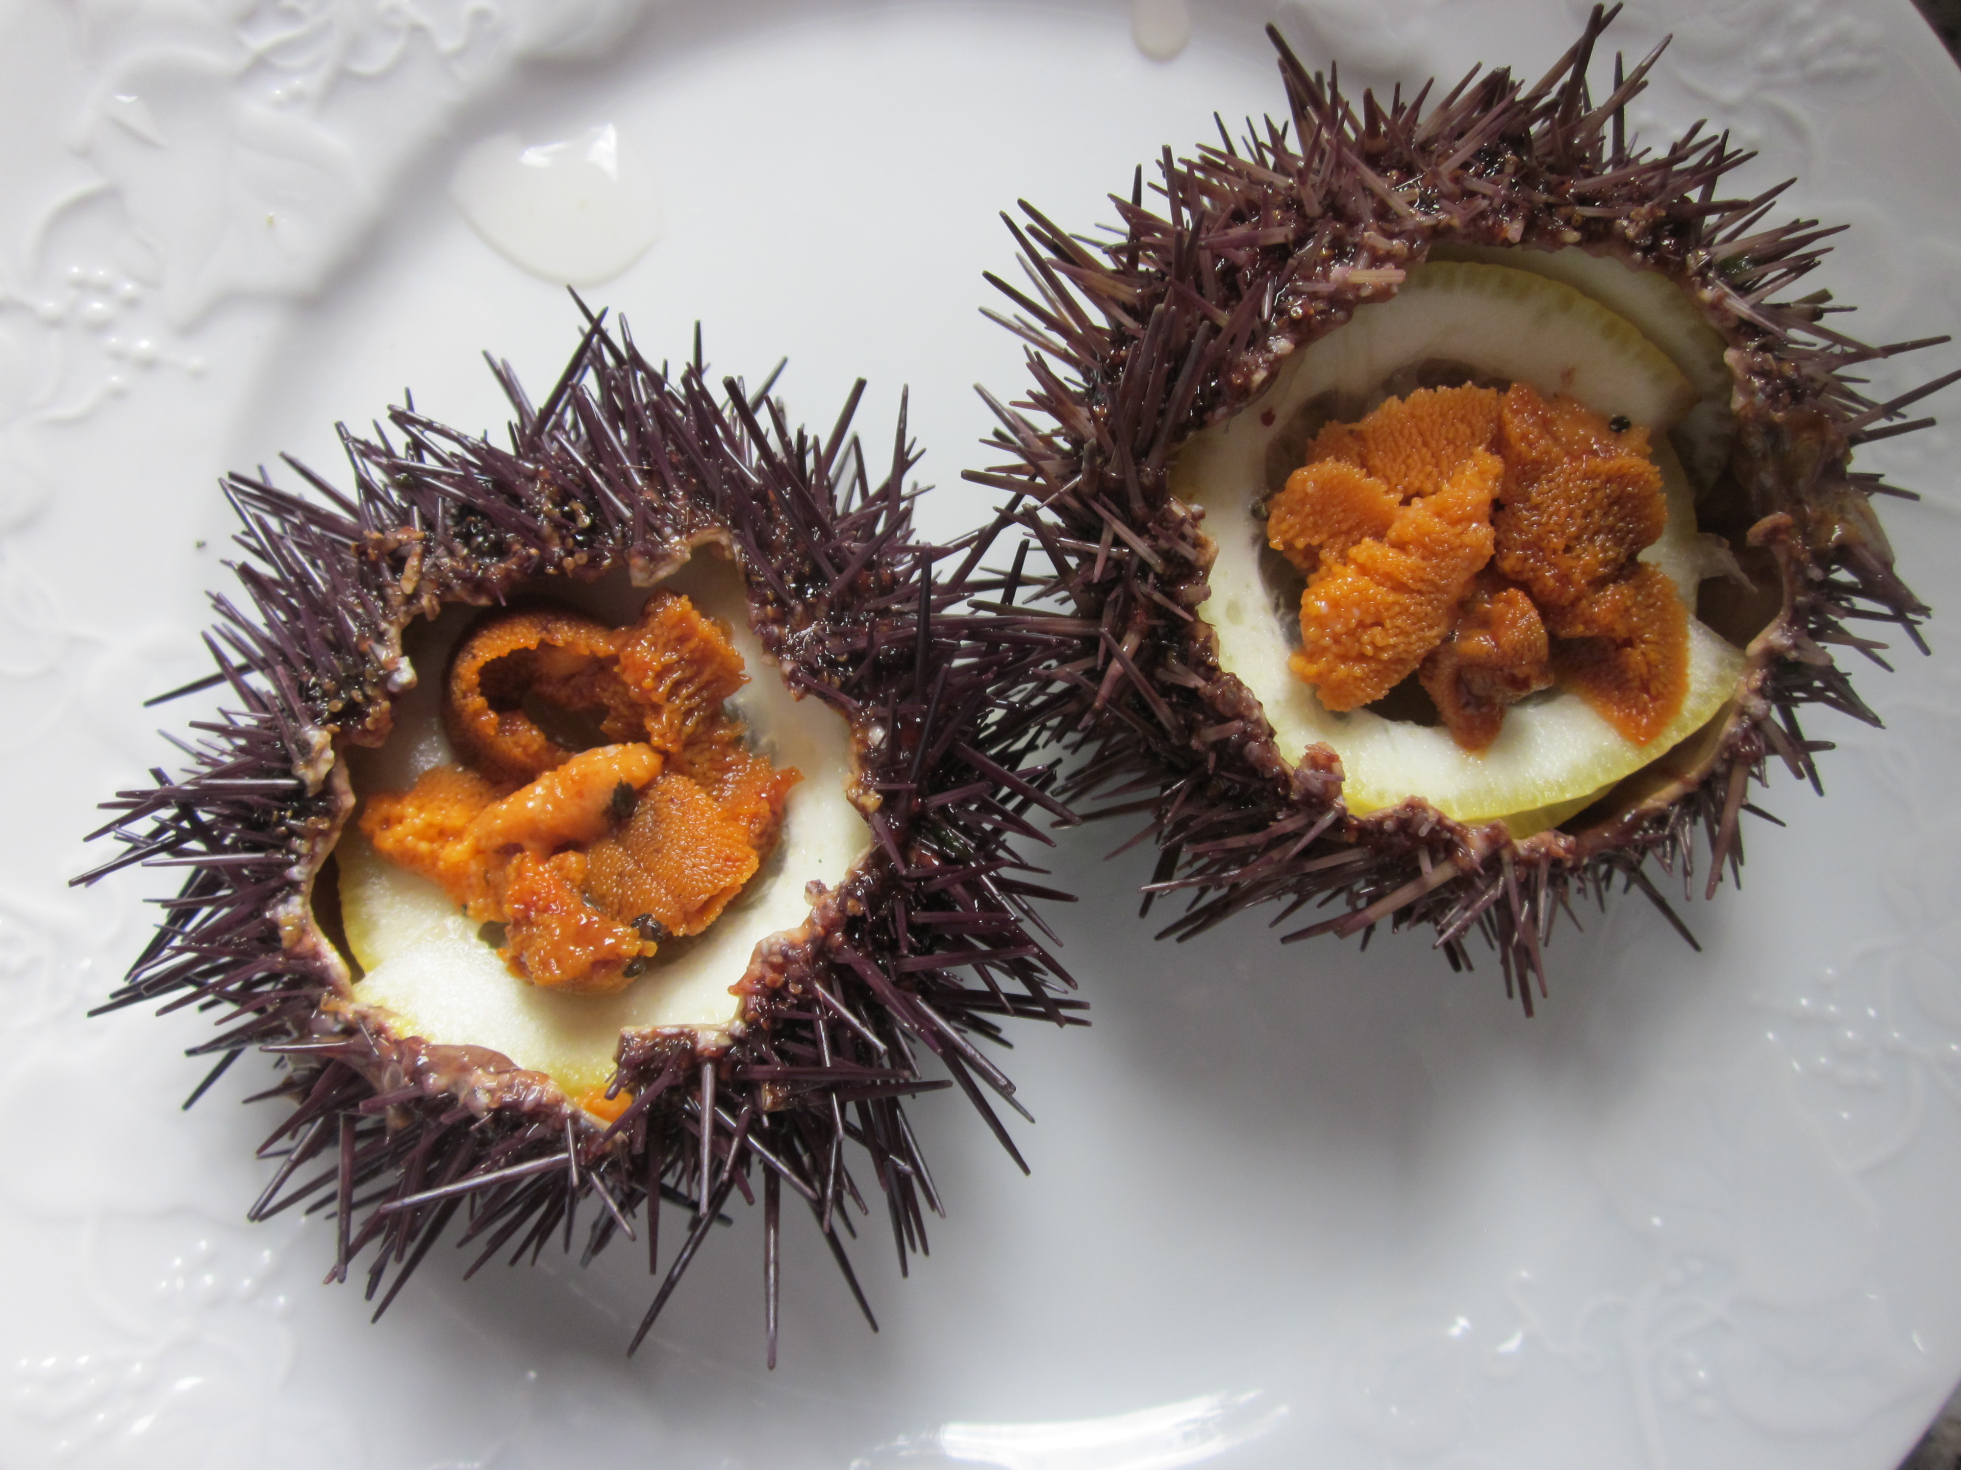
Cancer cells are associated with genetic abnormalities
Theodor Boveri (1862-1915)
Sea Urchin
Notes:
Boveri: double fertilized sea urchin eggs to induce 4 poles (4 mitotic spindles) instead of 2, thus to induce chromosomal abnormalities.
Boveri generate urchin with 4 poles, 3 poles and 2 poles (all abnormal), viability is worst with 4 as it is less likely to have 1 copy of each chromosome
He concludes that different chromosomes carry different properties (some vital some not, e.g. sometimes larvae are vital but show impaired properties)
From here he makes the jump to cancer: if certain properties, e.g. control of proliferation, is encoded in a specific chromosome, than it is likely that a cancer cell has lost this chromosome and so can proliferate freely.

Slide 4
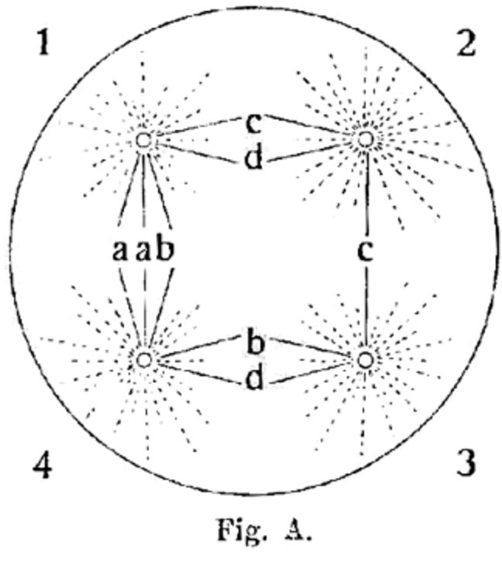
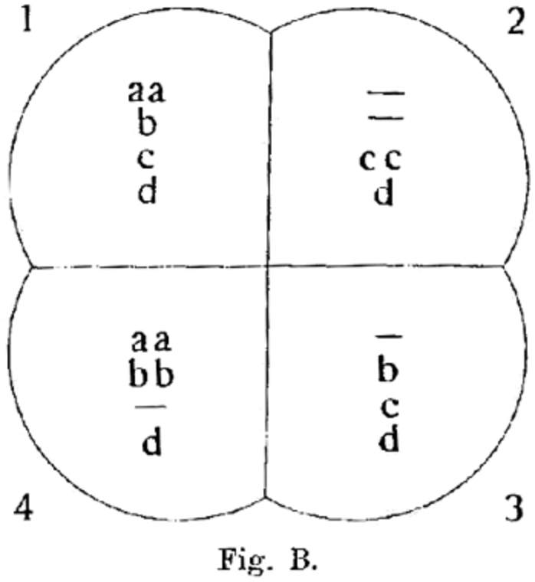
Cancer cells are associated with genetic abnormalities
“A malignant tumour cell is [...] a cell with a specific abnormal chromosome constitution.”
Concerning the origin of malignant tumors. (1914) T. Boveri J Cell Sci. doi:10.1242/jcs.o25742
Notes:
Boveri: double fertilized sea urchin eggs to induce 4 poles (4 mitotic spindles) instead of 2, thus to induce chromosomal abnormalities.
Boveri generate urchin with 4 poles, 3 poles and 2 poles (all abnormal), viability is worst with 4 as it is less likely to have 1 copy of each chromosome
He concludes that different chromosomes carry different properties (some vital some not, e.g. sometimes larvae are vital but show impaired properties)
From here he makes the jump to cancer: if certain properties, e.g. control of proliferation, is encoded in a specific chromosome,
than it is likely that a cancer cell has lost this chromosome and so can proliferate freely
Or if in one chromosome there is a character that stimulate proliferation, multiplicity of that could cause increase proliferation.

Slide 5
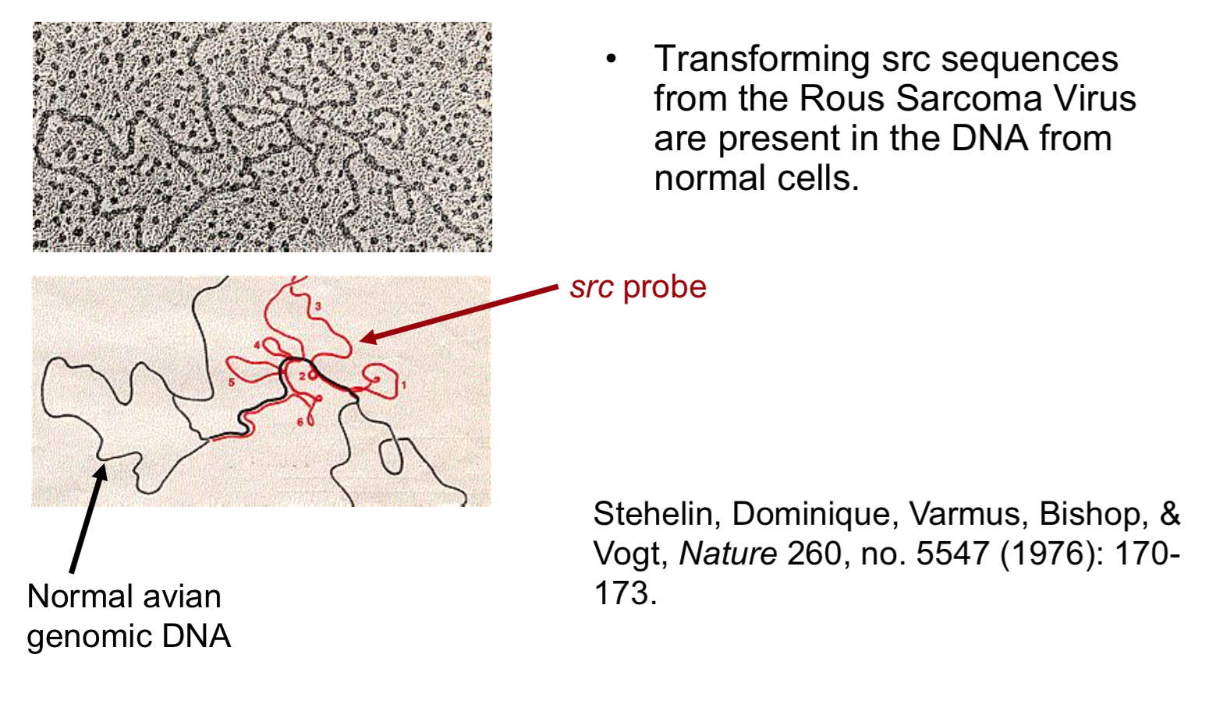
Cancer is a genetic disease

Slide 6

Cancer is a genetic disease
PBS Documentary
https://www.youtube.com/watch?v=iAbCa4k0Zfc
https://www.youtube.com/watch?v=gpjJIQK1QXA
https://www.youtube.com/watch?v=KYbxn1HtqFU

Slide 7
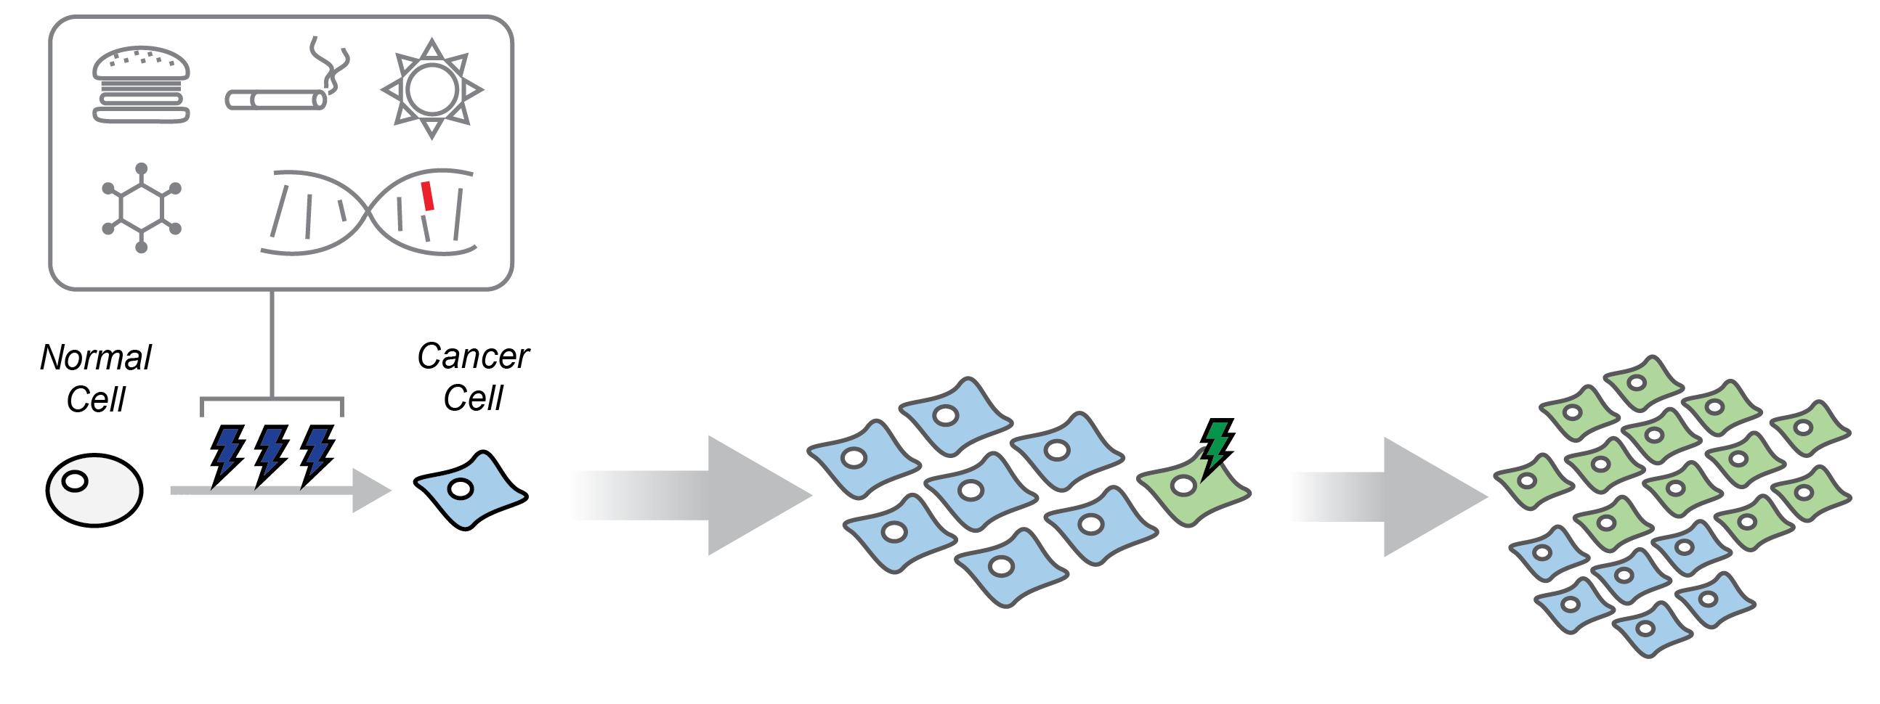
A simplified model of cancer evolution

Slide 8
A simplified model of cancer evolution

Slide 9

A simplified model of cancer evolution
Selected Alterations

Slide 10
A simplified model of cancer evolution

Slide 11
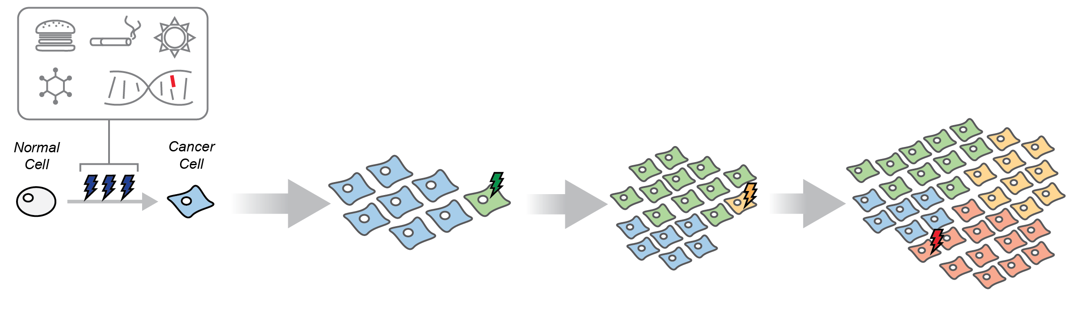
A simplified model of cancer evolution
Time of Diagnosis

Slide 12

A simplified model of cancer evolution
Time of Diagnosis
TUMOR MOLECULAR PROFILE
DNA/RNA sequencing

Slide 13
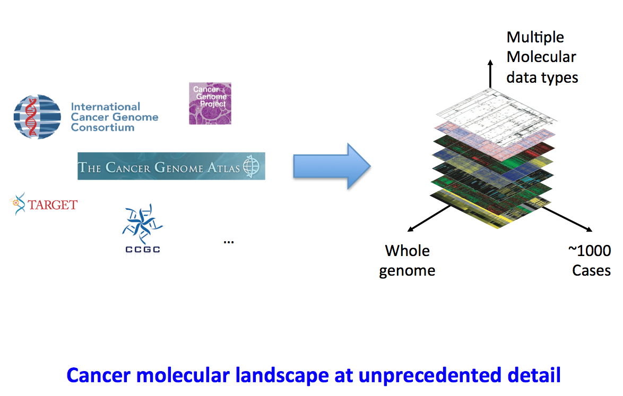
Cancer Genomics Projects

Slide 14
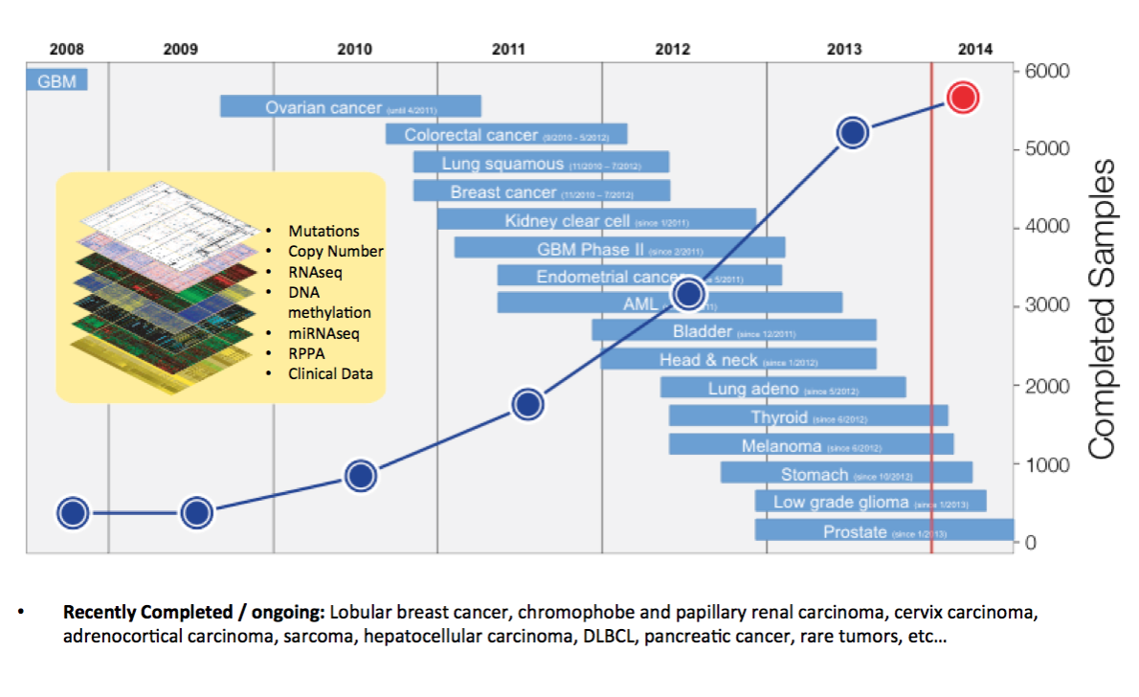
The Cancer Genome Atlas

Slide 15
Cancer molecular profiles
Alterations:
Mutations
Copy number changes
Translocations
Hyper/Hypo DNA Methylation
Deregulation of transcription and translation

Slide 16
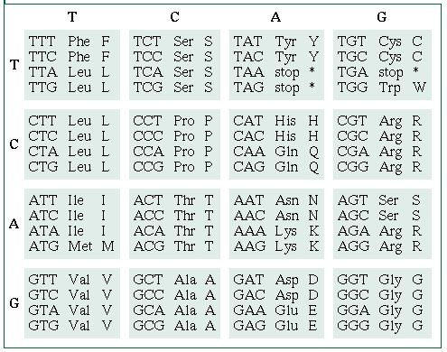
Gene Mutations
Single nucleotide changes

Slide 17
Gene Mutations
Single nucleotide changes
Silent mutations: nucleotide change no amino acid change
TCT=Serine
TCC=Serine

Slide 18
Gene Mutations
Single nucleotide changes
Missense: change a nucleotide and
encode for a different amino acid
TCT= Serine
CCT= Proline
Nonsense: change a nucleotide and induce a stop codon
TAT = Serine
TAA = Proline

Slide 19
Gene Mutations
Frame-shift mutations (change the reading frame)
Deletion: deletion of 1 or more nucleotide
ACC AGC TGC ACT ACC AGC TGA CT
Thr Ser Cys Thr Thr Ser STOP
Insertion: Add one or more extra-nucleotide to the DNA
ACC AGC TGC ACT ACC AGC TGC CAC CT
Thr Ser Cys Thr Thr Ser Cys His

Slide 20
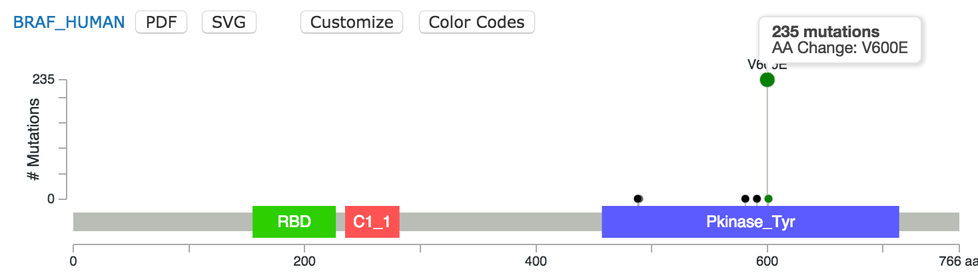
HOTSPOT mutations
(activating an oncogene)
BRAF V600E mutations in Thyroid Carcinoma (399 patients)
GTG = Valine (V)
GAG = Glutamate (E)
Notes:
Cycloheximide: block protein synthesis / translation
Mutants are more stable

Slide 21
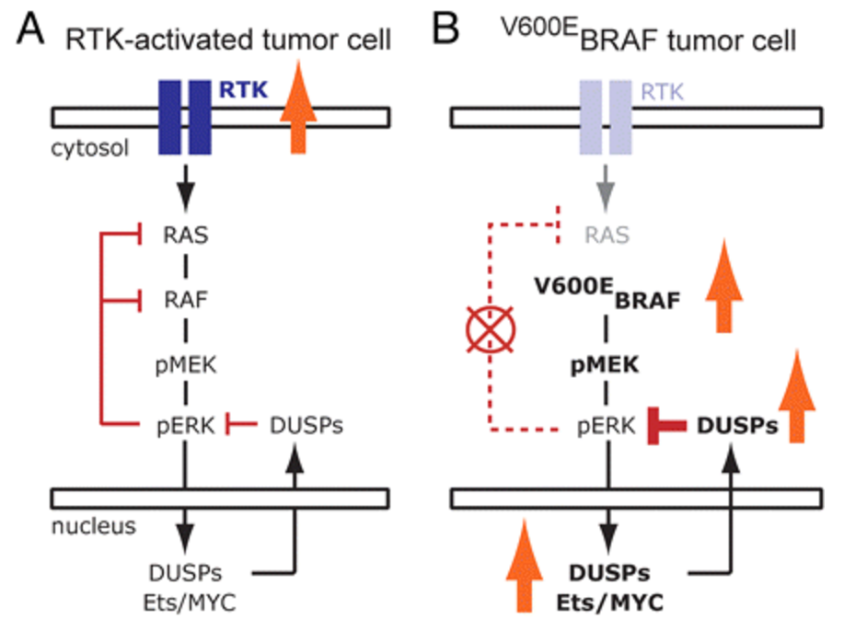
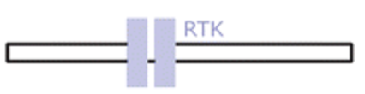
HOTSPOT mutations
(activating an oncogene)
BRAF V600E mutations in Thyroid Carcinoma (399 patients)
GTG = Valine (V)
GAG = Glutamate (E)
Normal Pathway
Cancer Pathway
Notes:
Cycloheximide: block protein synthesis / translation
Mutants are more stable

Slide 22
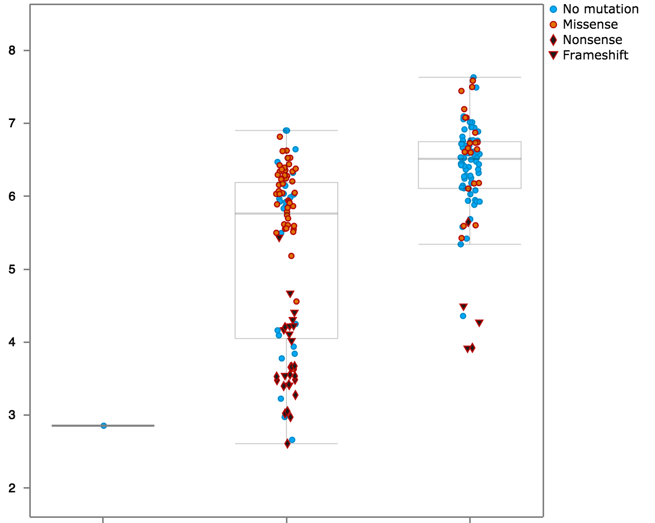
Truncating Mutations
(inactivating a tumor suppressor)
TP53 mutations in Colorectal cancer
Missense
mRNA Expression
Nonsense
Frameshift

Slide 23
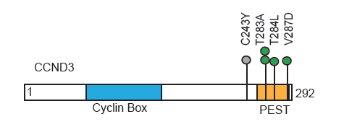
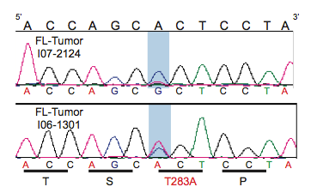
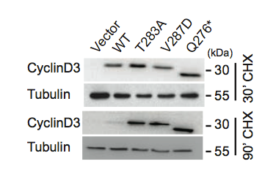
Truncating Mutations
(activating an oncogene)
In Lymphoma mutation in CyclinD3 occurs in ~10% of the cases
(Oricchio et al. JEM, 2014)
Notes:
Cycloheximide: block protein synthesis / translation
Mutants are more stable

Slide 24
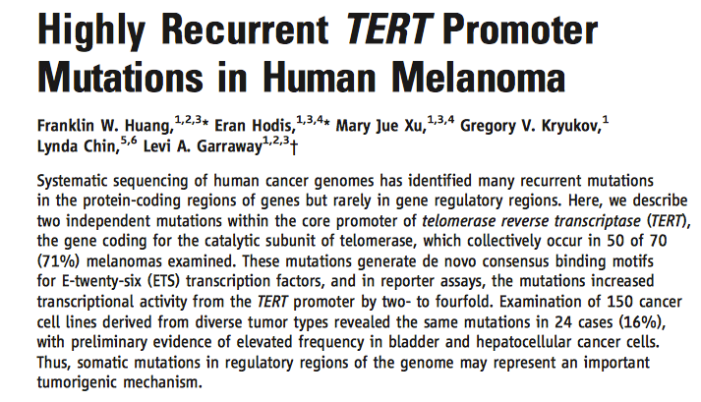
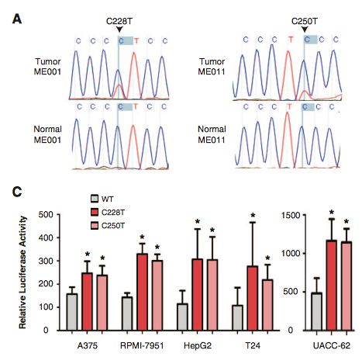
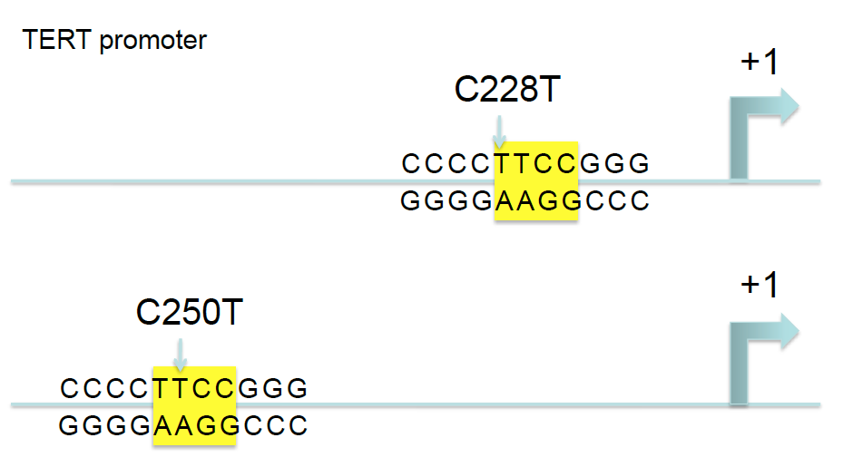
Non-coding Mutations
(Science, 2013)

Slide 25
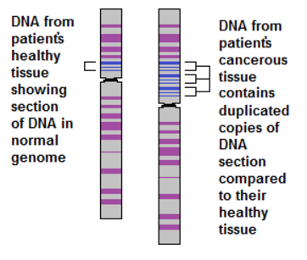
Copy Number Alterations
Deletion: Loss of chromosomal regions
(Heterozygous or Homozygous)
Amplifications: Acquire one or more copy of chromosomal regions (Duplication or Amplification)
Notes:
Replication defects at e.g. homologous recombination could give rise to chromosomal re-arrangements, duplication/loss of DNA fragments

Slide 26
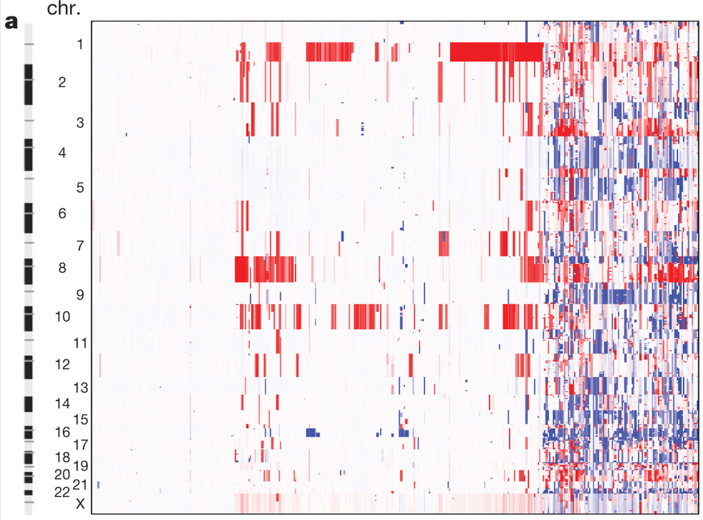
Copy Number Alterations
Endometrial Carcinoma
Patient Samples
Amplifications
Deletions
(TCGA, Nature 2013)

Slide 27
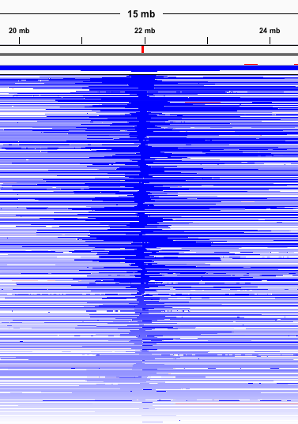
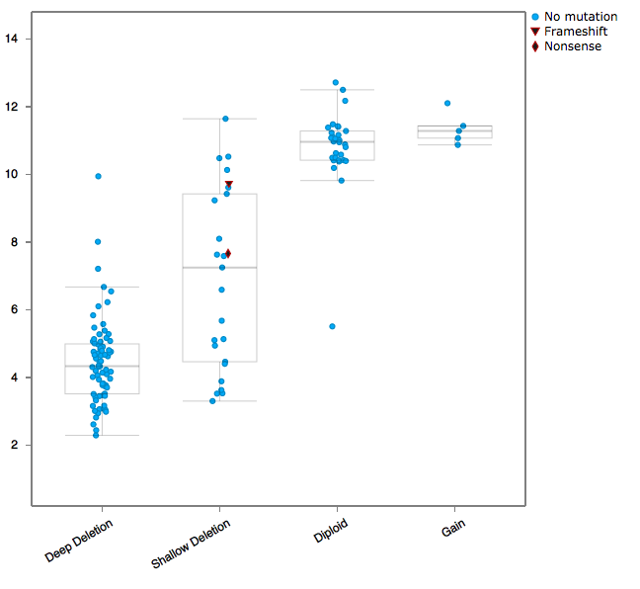
Focal Deletions
(inactivating a tumor suppressor)
Glioblastoma
mRNA expression
Patients Samples
CDKN2A
(ARF/p16)

Slide 28
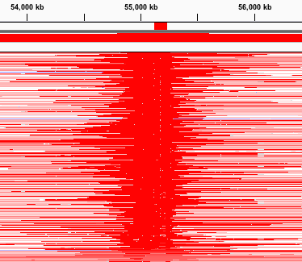
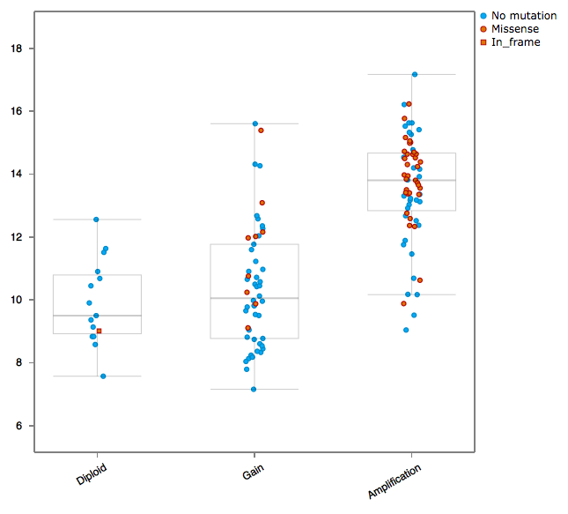
Focal Amplifications
(activating an oncogene)
Glioblastoma
mRNA expression
Patients Samples
EGFR

Slide 29
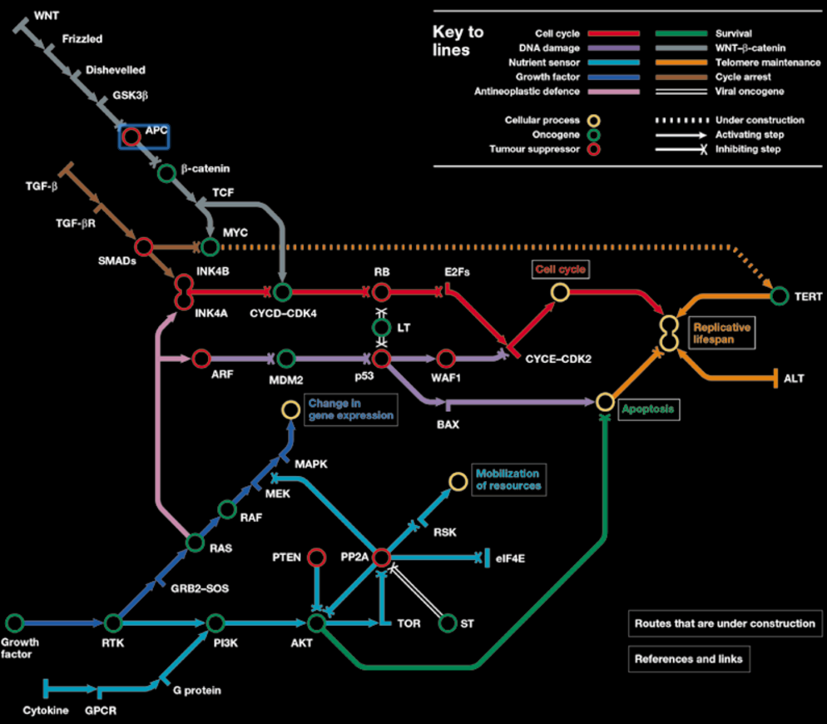
Cancer Pathways
Cell cycle
P53
PI3K/Akt
RTK/MAPK
Survival
WNT
Telomerase
TGFβ
http://www.nature.com/nrc/poster/subpathways/index.html

Slide 30
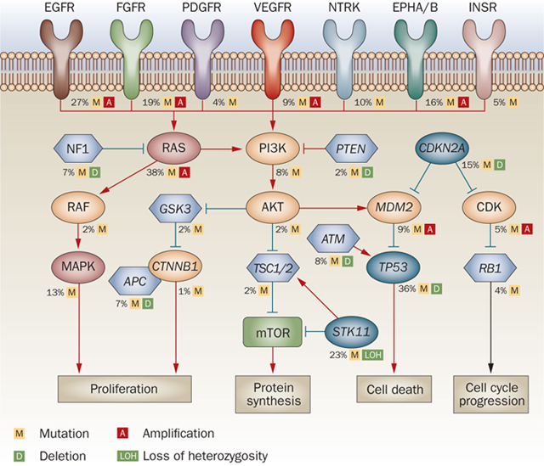
Rb Pathway
Cell cycle checkpoint G1/S phase
CDKN2A/CDKN2B
CCND1, CCND3, CCNE1
CDK2, CDK4, CDK6
RB1, E2F1

Slide 31
p53 pathway
Apoptosis
CDKN2A
MDM2, MDM4
TP53

Slide 32
PI3K/Akt pathway
Survival & Translation
PIK3CA, PIK3R1, PTEN
AKT1
TSC1, TSC2, MTOR

Slide 33
MAPK Pathway
Cell growth
NF1, KRAS, HRAS, NRAS
BRAF
MAP2K1

Slide 34
Receptor Tyrosine Kinases
Cell growth
EGFR, ERBB2, ERBB3
FGFR1
PDGFRA
KDR, KIT, MET
…

Slide 35
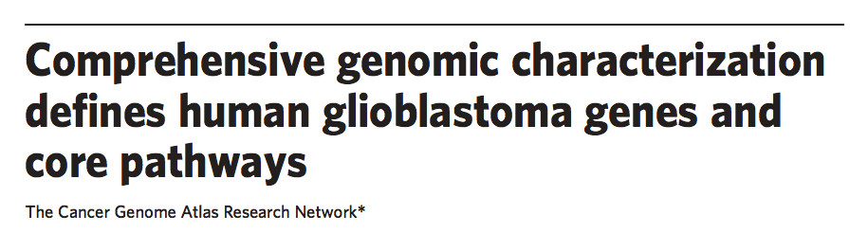
A Case Study
http://www.nature.com/nature/journal/v455/n7216/pdf/nature07385.pdf

Slide 36
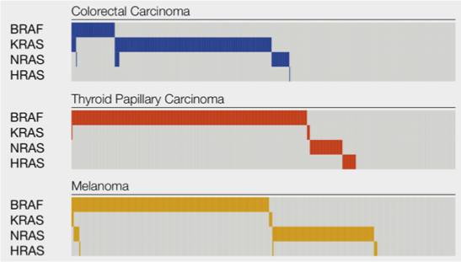
Mutual Exclusivity
Observations of mutually exclusive alterations
Patient Samples

Slide 37
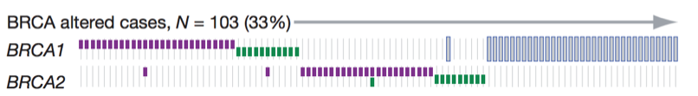
Mutual Exclusivity
Observations of mutually exclusive alterations
Germline mutations
Somatic mutations
Hyper-methylation
(TCGA, Nature, 2011)

Slide 38
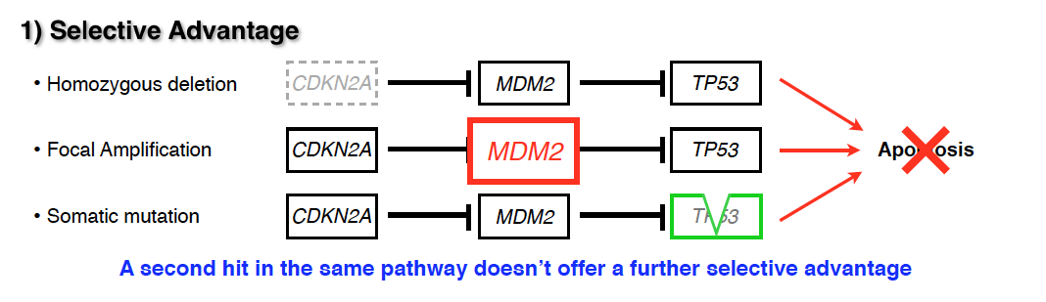
Why Mutual Exclusivity?

Slide 39
Why Mutual Exclusivity?

Slide 40
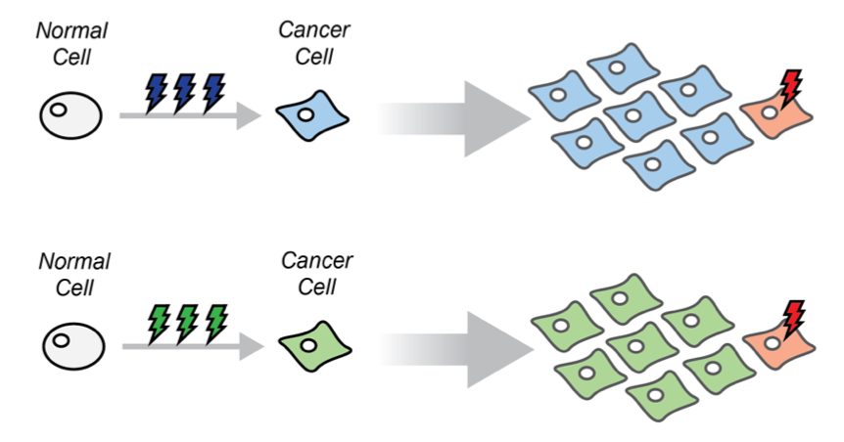
Mutual Exclusivity reflects Selection
PTEN Del
TP53 mut
MDM2 amp
Is MDM2 amplification giving the same advantage in the 2 cases?

Slide 41
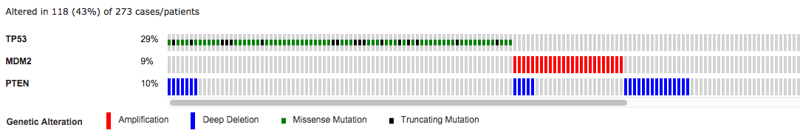
Mutual Exclusivity reflects Selection
TCGA Glioblastoma Dataset (source cBioPortal)

Slide 42
Mutual Exclusivity reflects Selection
PTEN Del
TP53 mut
PIK3CA mut
Is PIK3CA mutation giving the same advantage in the 2 cases?

Slide 43
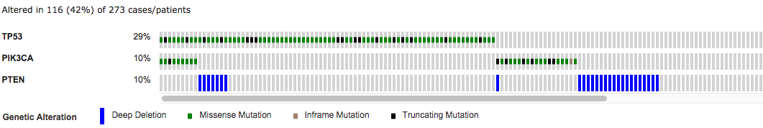
Mutual Exclusivity reflects Selection
TCGA Glioblastoma Dataset (source cBioPortal)

Slide 44
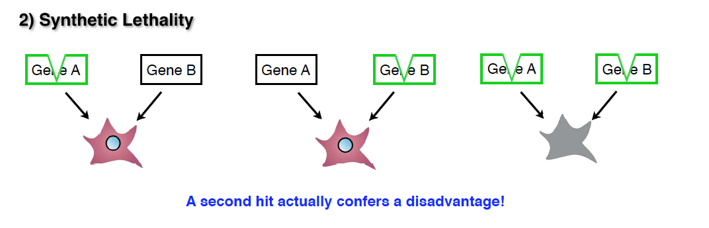
Why mutual exclusivity?

Slide 45
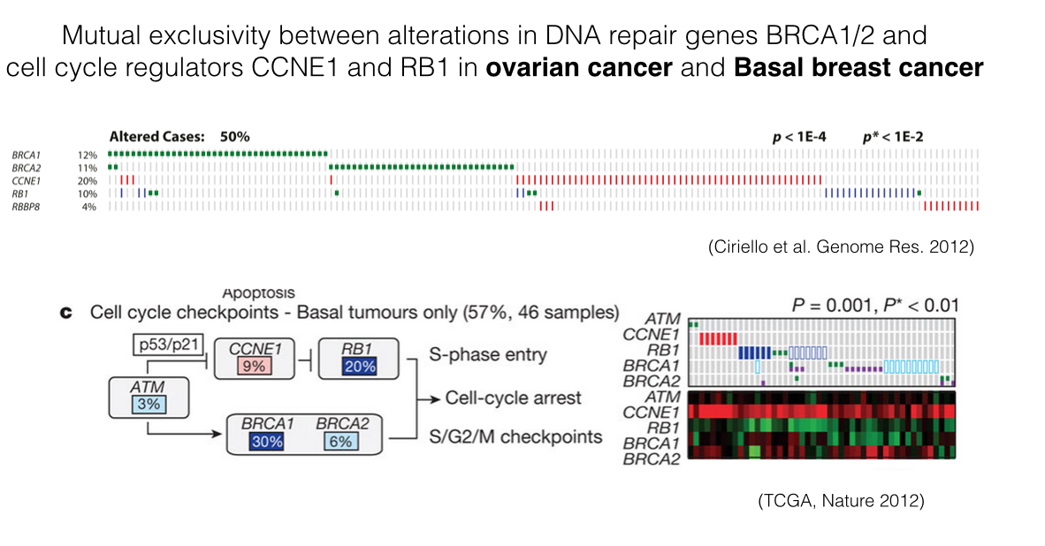
Synthetic Lethal interactions

Slide 46
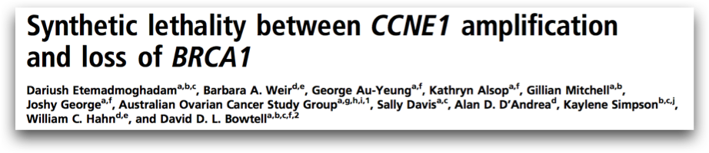
Synthetic Lethal interactions
(PNAS, 2013)

Slide 47
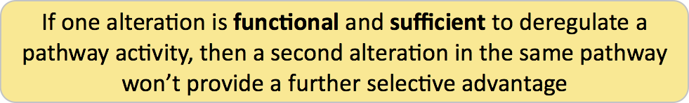
Why it is important?

Slide 48
Why it is important?
Critical players of specific cellular processes
Put alterations in a functional context
Identify most relevant pathways in a tumor

Slide 49
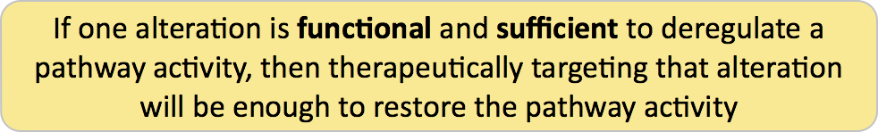
Why it is important?

Slide 50
Why it is important?
How do we identify significantly mutually exclusive patterns of alterations?

Slide 51
Key Steps:
Identify selected alterations
Determine which are functionally related
Statistically evaluate their mutual exclusivity

Slide 52
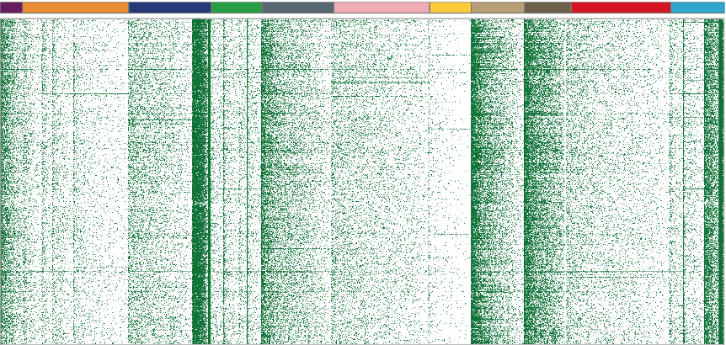
Tumor Molecular Profiles
Somatic mutations across 12 tumor types
Genes
Samples

Slide 53
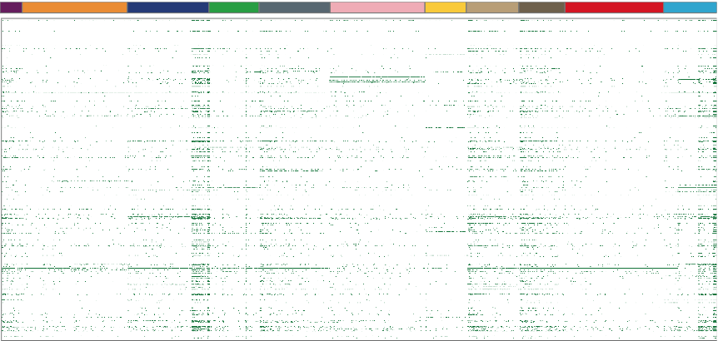
Tumor Molecular Profiles
Candidate driver mutations across 12 tumor types
Genes
Samples

Slide 54
Tumor Molecular Profiles
Candidate driver mutations across 12 tumor types
PIK3CA
VHL
Genes
KRAS
TP53
Samples

Slide 55
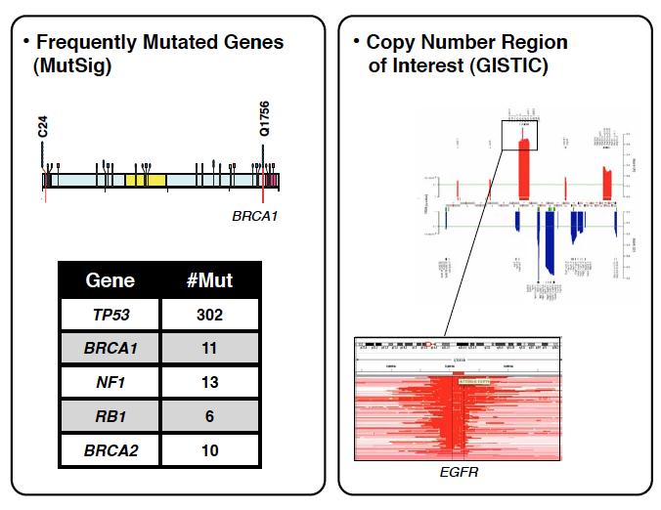
MEMo
Identify selected alterations
MutSig / MuSiC
  Recurrent mutations in cancer
GISTIC
  Recurrent Copy Number Alterations

Slide 56
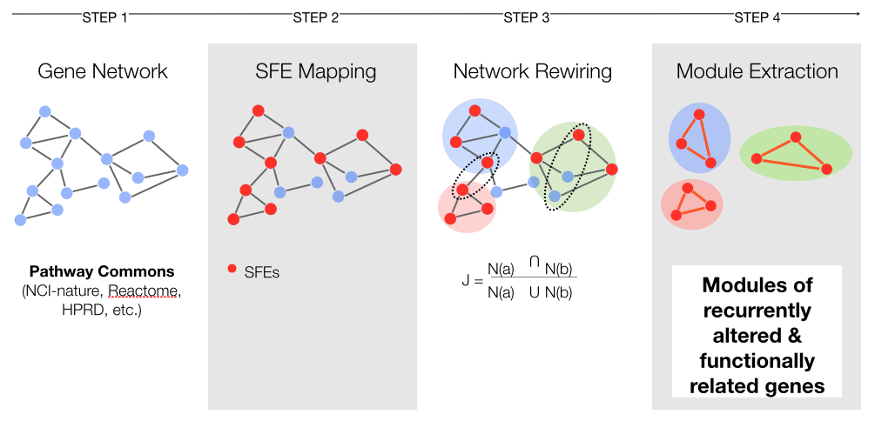
MEMo
2. Determine which are functionally related

Slide 57
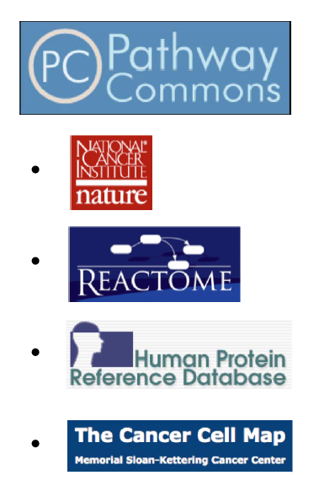
MEMo
2. Determine which are functionally related

Slide 58
MEMo
3. Test the alterations in the module for mutual exclusivity
Alterations are “significantly”
mutually exclusive
if they occur together less frequently
than expected.

Slide 59
What do you expect?

Slide 60
What do you expect?
Your expectations should preserve all the properties of the system
Except the one you’re testing

Slide 61


What do you expect?
Observed
Random 1
Genes
Genes
Samples
Samples
Both matrices have exactly 1882 black cells

Slide 62

What do you expect?
Observed
Random 2
Genes
Genes
Samples
Samples

Slide 63

What do you expect?
Observed
Random 3
Genes
Genes
Samples
Samples

Slide 64


What do you expect?
Sorted Observed
Sorted Random 1
Genes
Genes
Samples
Samples

Slide 65

What do you expect?
Sorted Observed
Sorted Random 2
Genes
Genes
Samples
Samples

Slide 66
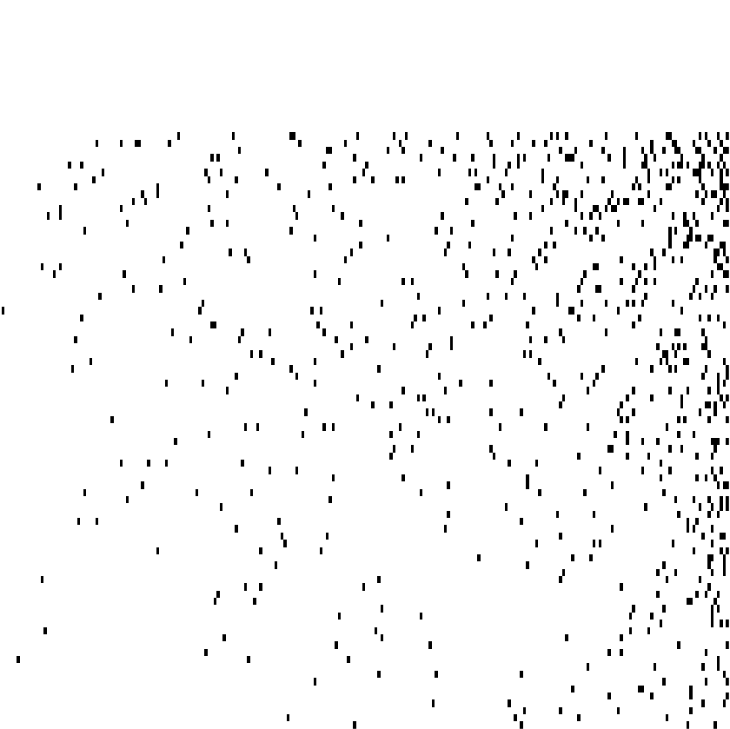
What do you expect?
Sorted Observed
Sorted Random 3
Genes
Genes
Samples
Samples

Slide 67
What do you expect?
3 null models
Randomly shuffle the set of alterations with NO constrains
Randomly shuffle the set of alterations such that the frequency of alteration per gene is identical to the observed
Randomly shuffle the set of alterations such that the frequency of alteration per gene and per sample is identical to the observed

Slide 68
What do you expect?
3 null models
Randomly shuffle the set of alterations with NO constrains
Randomly shuffle the set of alterations such that the frequency of alteration per gene is identical to the observed
Randomly shuffle the set of alterations such that the frequency of alteration per gene and per sample is identical to the observed
Does this matter when we test mutual exclusivity?

Slide 69

Different expectations lead to different results
Observed
10%
10%
100 samples
“The expected overlap should be 1, you observe 0, is that relevant?”

Slide 70
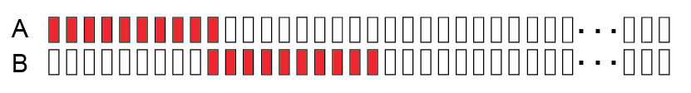
Different expectations lead to different results
Observed
10%
10%
100 samples
p(A) = 0.1
p(B) = 0.1
p(A,B) = 0.1*0.1 = 0.01 = 1%

Slide 71
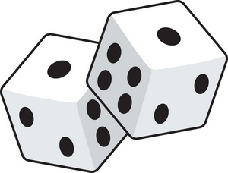
Different expectations lead to different results
Observed
10%
10%
100 samples
p(A) = 0.1
p(B) = 0.1
p(A,B) = 0.1*0.1 = 0.01 = 1%
Is the dice fair?

Slide 72
Different expectations lead to different results
Observed
10%
10%
100 samples
50
50
K mutations
0 mutations

Slide 73
Different expectations lead to different results
Observed
10%
10%
100 samples
50
50
K mutations
0 mutations
p(A) = 0.2
p(B) = 0.2
p(A,B) = 0.2*0.2 = 0.04 = 4%

Slide 74
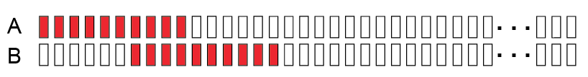
Different expectations lead to different results
Observed
10%
10%
100 samples
50
50
K mutations
0 mutations

Slide 75
MEMo
3. Test the alterations in the module for mutual exclusivity
Samples
1
2
3
4
a
a
1
b
b
2
Genes
Genes
Samples
c
c
3
d
d
4

Slide 76
MEMo
3. Test the alterations in the module for mutual exclusivity
Samples
1
2
3
4
a
a
1
b
b
2
Genes
Genes
Samples
c
c
3
d
d
4
The frequencies of alteration of genes and samples correspond now to the number of edges connected to a node in the network (degree)

Slide 77
MEMo
3. Test the alterations in the module for mutual exclusivity
1. Randomly select two edges
a
1
b
2
Genes
Samples
c
3
d
4

Slide 78
MEMo
3. Test the alterations in the module for mutual exclusivity
2. Switch them
a
1
b
2
Genes
Samples
c
3
d
4
The degree of c, d, 3, and 4 has not changed!
(Switch is valid ONLY if it does not create “double” edges)

Slide 79
Exercise
Dec 14
  Load example of genomic data in R
  Determine the distributions of alterations (genes/samples)
  Compare the distributions against 3 possible null models
  Test for mutual exclusivity specific set of modules (from the paper) using 3 null models
Dec 15
  Select TCGA cancer study (out of 4 proposed)
  Determine alteration distributions
  Based on the paper findings, select modules to test
  Test for mutual exclusivity the modules you select and verify dependence of your results to the null model

